Slide 1
Dollars or Sense:
Economic versus Social Rationality in Residential Energy Consumption
Karen Ehrhardt-Martinez, Ph.D.*
Energy Collaborative Analysis Initiative, Web Forum, August 28, 2008
Based on an earlier report by Ehrhardt-Martinez et al. 2008.

Slide 2
Dollars or Sense: Core Points
The accuracy and adequacy of our conceptual framework is in serious question.
The implications of working with a flawed model are serious.
Time to consider alternative models and approaches that can help accelerate energy efficiency investments and behavior to generate needed energy savings.

Slide 3
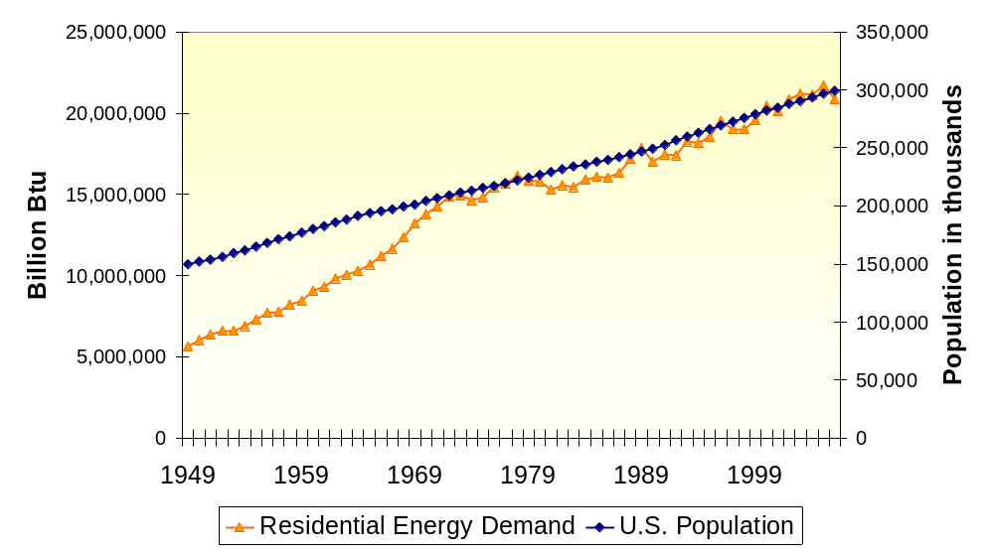
Residential Energy Consumption and Population Growth, 1949-2006

Slide 4
Residential Energy Consumption
More Households
Bigger Houses
New Behaviors
and Lifestyles
Increased Energy Efficiency

Slide 5
Potential Short-Term Residential Energy Savings
Action | Energy Savings
Low cost/ no cost | 8.6%
Low – Med Cost | 9.5%
Efficiency Investments | 8.5%
Total | 25-30%
Source: Gardner and Stern (2008). Forthcoming.

Slide 6
Techno-Economic Approach
Economic Environment
Appropriate Attitudes and Technology
Desired
Energy Consumption
+ Information

Slide 7
Attitudes
People are concerned about the availability and affordability of energy… 77%
People believe that an emphasis on conservation is better than an emphasis on energy production… 64%
People believe that the effects of global warming have already begun to happen… 61%
Americans reporting that energy prices are the most important financial problem facing their families today…30%
Energy costs ranked above all other categories of financial problems.
People want to reduce their impact.
How well are attitudes translating into behaviors?

Slide 8
Human Dimensions
>>
Economic Dimensions
Gaps:
Cost-effective energy savings and actual energy savings
Attitudes and behaviors

Slide 9
Invisibility of Energy and Efficiency
Historically, we have moved from:
Visible to invisible forms of energy
Limited use to ubiquitous demand for energy services.
Paradox: energy is both more integral to our lives and our lifestyles, while it’s less and less visible.
Notes:
Since the turn of the 20th century, we have completely altered our dependence on energy services as well as the means by which we meet our energy service demands. In terms of heating our homes, we’ve gone from chopping wood, to shoveling coal, to purchasing fuel oil, to the almost effortless use of natural gas and electric furnaces.
In the process of this transition, our active involvement in the process of heating our homes and our visual appreciation of the volume of our fuel consumption have been reduced to the point that energy consumption has largely become invisible. The only thing that we’re left with is the monthly utility bill. And to the degree that we can have that automatically debited from our checking account – we don’t even have that.
Of course, at the same time, there has been tremendous growth in the energy services on which we rely, including what we use for air conditioning, computing, television, and the whole assortment of new electronic gadgets that we all rely on.
So the paradox that we’re left with is this: energy is both more integral to our lives and our lifestyles, while it’s less and less visible.

Slide 10
Other Problems with the Standard Model: Rationality and Irrationality
People operate within conditions of bounded rationality,
People behave irrationally in predictable ways,
Behaviors that may not be economically rational in fact may still be entirely rational from other vantage points.

Slide 11
Implications: Needed steps toward a more satisfying framework
A critical need to move away from the “If we build it, they will come” mentality
Move from a purely techno-economic focus to a broader social/human model
Recognize that if we aim for the average person, we’ll miss the vast majority of behaviors

Slide 12
Conclusions
More/better information,
New (social/human) model,
Public health approach
empowers people
recognizes diversity of patterns in human behavior
recognizes diversity of behavioral drivers

Slide 13
Behavior, Energy and
Climate Change Conference (BECC)
November 16-19, 2008
Sacramento, California
www.BECCconference.org
Co-convened by:
American Council for an Energy-Efficient Economy (ACEEE)
Precourt Institute for Energy Efficiency
(Stanford University) and
California Institute for Energy and Environment
(University of California)

Slide 14
Selected Bibliography
Ehrhardt-Martinez, Karen. 2008. “Behavior, Energy and Climate Change: Policy Directions, Program Innovations and Research Paths.” Washington, DC: ACEEE. (forthcoming).
Ehrhardt-Martinez, Karen; Laitner, Skip and Wendy Reed. 2008. “Dollars or Sense: Economic versus Social Rationality in Residential Energy Consumption.” ACEEE Summer Study on Energy Efficiency in Buildings. Asilomar, CA. August 2008.
Gardner, Gerald I. and Paul C. Stern. 2008. “The Short List: The Most Effective Actions US Households can Take to Curb Climate Change.” Environment 50:5.
Laitner, John A. “Skip”; Decanio, Steve J.; and I. Peters. 2001. “Incorporating Behavior, Social and Organizational Phenomena in the Assessment of Climate Change Mitigation Options.” In Society, Behavior and Climate Change Mitigation. E. Jochem, J.A. Sathaye and D. Boulle eds. Netherlands: Kluwer Academic Publishers.
Lutzenhiser, Loren and Sylvia Bender. 2008. “The Average American Unmasked: Social Structure and Difference in Household Energy Use and Carbon Emissions.” ACEEE Summer Study on Energy Efficiency in Buildings. Asilomar, CA. August 2008.
Wilson, Charlie and Hadi Dowlatabadi. 2007. “Models of Decision Making and Residential Energy Use.” Annual Review of Environment and Resources. Volume 32:2.1–2.35.

Slide 15
For Further Information Contact:
Karen Ehrhardt-Martinez, PhD
American Council for an Energy-Efficient Economy (ACEEE)
Washington, DC
o: (202) 507-4016
email: kehrhardt@aceee.org
or visit
http://www.aceee.org

