Slide 1
The Exposure Assessment for Acrylamide
Donna Robie, Ph.D. and Michael DiNovi, Ph.D.
Office of Food Additive Safety
February 24, 2003

Slide 2
History and Background
Sweden – April 2002
  About 100 Food Samples Total
  Used Medians for 8 Food Categories
  Estimated Mean Exposure to Acrylamide
    40 µg/person/day (0.67 µg/kgbw-day, 60 kg bw/person)
    Included “Expected” Value for Food Groups Not Covered in their Sampling

Slide 3
History and Background
FAO/WHO – June 2002
  Used the Same Residue Data as Sweden
  Used food consumption data from U.S., the Netherlands, Norway, Australia, Sweden, and from IARC EPIC Study
  Used Probabilistic Modeling as well as Point Estimate Methods
  Long-Term Exposure Estimates
    0.3 - 0.8 µg/kgbw-day

Slide 4
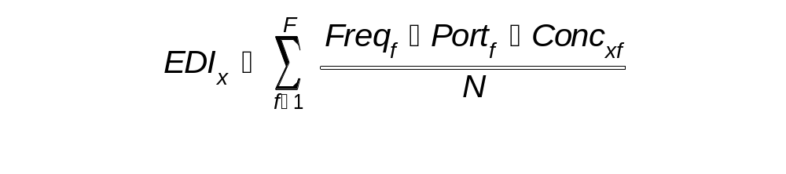
Simplified Exposure Equation
EDI_{x} = The Estimated Daily Intake of Substance x
F = Total no. of foods in which x can be found
Freq_{f} = No. of eating occasions for food f over N survey days
Port_{f} = Average portion size for food f
Conc_{xf} = Concentration of the substance x in the food f
N = No. of survey days
Exposures for Individuals Combined

Slide 5
Food Consumption Surveys
CSFII –Continuing Survey of Food Intakes by Individuals
  Three-day Consumption Records; 1989-1992
  Two-day Consumption Records; 1994-1996, 1998
  Approximately 20,000 participants
  Intakes of Eaters Overestimated and Percent Eaters Underestimated, Relative to Intake Records Obtained During a Longer Survey Period

Slide 6
Food Consumption Surveys
MRCA - Marketing Research Corporation of America
  Fourteen-day Consumption Records;
  1982–1987
  Approximately 26,000 participants
  Census of Frequency of Eating Linked with Portion Size Data from USDA/Nationwide Food Consumption Survey

Slide 7
Future –
Chronic Intake Modeling
CSFII 1994-96, 98, 2-Day Survey Data
Better Estimate of Chronic Exposure with Longer-Term Survey Data
Adjusting 2-Day CSFII Survey Data
  Broadening the Distribution to Include More Eaters
  Reducing the Food Consumption Distribution Mean
  Total Population Food Consumption Kept Constant

Slide 8
Simple Exposure Estimate
Simplest Model
  EDI = Σ [Food Consumption x Conc. of Substance]
  Summed over Foods
  Summed over Individuals
  Point Estimates
Useful for Substances in Only a Few Foods
Used When EDI and ADI/TDI (Acceptable Daily Intake/Tolerable Daily Intake) are Very Different

Slide 9
Probabilistic Modeling
Distributions Used in Place of Point Estimates
Food Consumption
  Typically Lognormal
Concentration Data
  Determined Experimentally
Percentage of Consumers
  Food Surveys

Slide 10
Probabilistic Modeling
Iterative Process
Computer Generated
Each Iteration Contains Values for Food Consumption, AA level, and Percentage of Eaters Chosen from their Underlying Distributions

Slide 11
Monte Carlo Sampling
1
Random Number from Anywhere on
y-axis
Cumulative Probability
Distribution
Generated Value
0
Food Consumption

Slide 12
Acrylamide Intake Modeling
AA Intake = (Eaters_{(yes or no)}) x (Food Amt.) x
(AA Level)
Eaters_{(yes or no)} – Either 0 or 1 in Proportion to Percent
Eaters
Food Amount – Food Consumption Value from Survey
Data
Acrylamide Level – Value from Laboratory Data –
Each Value Equally Likely on Each Iteration
Results are Summed over Foods and Individuals

Slide 13
Acrylamide Intake Modeling
Food | % Eaters | Mean Food Consumption Of Eaters (g/kgbw-d) | AA Conc (µg/kg) | Eater AA Intake (µg/kgbw-d)
Almonds | 0 | 0.1 | 457.0 | 0.00 | AA Intake for Eater (µg/kgbw-d)
Bagels | 0 | 0.2 | 11.8 | 0.00
Baked Beans | 1 | 1.9 | 70.0 | 0.13
Breaded Chicken | 0 | 1.2 | 35.0 | 0.00 | 0.50
Breaded Fish | 0 | 0.6 | 30.0 | 0.00
Breakfast Cereal | 0 | 0.4 | 1056.9 | 0.00
Brewed Coffee | 1 | 0.8 | 184.5 | 0.14
…
…
…
…
…

Slide 14
Acrylamide Intake Modeling
Each Iteration is a Virtual Consumer
25,000 Iterations
No Accounting for Correlations Between Food Choices
Truncation of Distributions Removes Irrationally High Values
  13 L of Coffee Per Day – 100th Percentile
  620g of Cookies per Day – 100th Percentile

Slide 15
Model Limitations
Surveys
  Duration
  Food Classifications
Laboratory Data
  Some Food Types Represented by Fewer than Five Samples
  Variability in AA Levels
    Lot–to-Lot
    Brand-to-Brand
    Product-to-Product
    Foods Prepared at Home

Slide 16
Factors Applied to Food AA Concentration
Ground Coffee/24 = Coffee as Consumed
(Experimentally Derived)
Instant Coffee Crystals/60 = Instant Coffee as Consumed (3g Coffee/6oz Cup)
Dry Soup Mix/12 = Soup as Consumed (15g Soup Mix/6 oz Cup)
Dry Cocoa Powder/10 = Cocoa as Consumed (17g Cocoa Powder/6oz Cup)

Slide 17
All Tested Foods
Food | Mean Population AA intake (ug/kgbw-d) | Cumulative Percentile
French Fries (RF) | 0.056 | 15
French Fries (OB) | 0.049 | 27
Brewed Coffee | 0.047 | 39
Breakfast Cereal | 0.044 | 51
Potato Chips | 0.041 | 61
Cookies | 0.040 | 72
Toast | 0.023 | 78
Soft Bread | 0.020 | 83
Food | Mean Population AA intake (ug/kgbw-d) | Cumulative Percentile
Corn Snacks | 0.011 | 86
Crackers | 0.008 | 88
Pretzels | 0.008 | 90
Popcorn | 0.006 | 92
Baked Beans | 0.006 | 93
Breaded Chicken | 0.005 | 94
Peanut Butter | 0.004 | 96
Soup Mix | 0.003 | 96

Slide 18
All Tested Foods
Food | Mean Population AA intake (ug/kgbw-d) | Cumulative Percentile
Cocoa | 0.002 | 97
Crisp Bread/Matzo | 0.002 | 97
Instant Coffee | 0.002 | 98
Bagels | 0.002 | 98
Chocolate | 0.002 | 99
Tortilla | 0.002 | 99
Breaded Fish | 0.001 | 100
Food | Mean Population AA intake (ug/kgbw-d) | Cumulative Percentile
Doughnuts | 0.001 | 100
Almonds | 0.000 | 100
Nuts & Seeds | 0.000 | 100
Taro | 0.000 | 100
Soy Protein | 0.000 | 100
Pork Rinds | 0.000 | 100
Malted Drinks | 0.000 | 100
Total | 0.37

Slide 19
Acrylamide Intake
MRCA 1982-87; 2+ Population
Food | % eaters | Mean Food Consumption Of Eaters (g/kgbw-d) | AA Conc (µg/kg) | Eaters-only AA intake (µg/kgbw-d) | Mean Population AA intake (µg/kgbw-d)
Breakfast Cereal | 77.4 | 0.84 | 133.3 | 0.11 | 0.09 | Mean AA Intake of Population (µg/kgbw-d)
Potato Chips | 75.8 | 0.17 | 548.0 | 0.09 | 0.07
Toast | 27.0 | 1.14 | 207.8 | 0.24 | 0.06
French Fries (RF) | 48.9 | 0.35 | 321.8 | 0.11 | 0.06 | 0.48
French Fries (OB) | 20.6 | 0.35 | 663.8 | 0.23 | 0.05
Cookies | 66.5 | 0.27 | 221.6 | 0.06 | 0.04
Soft Bread | 73.0 | 1.14 | 44.4 | 0.05 | 0.04
Brewed Coffee | 57.5 | 4.80 | 8.5 | 0.04 | 0.02

Slide 20
Acrylamide Intake
CSFII 1989-92; 2+ Population
Food | % eaters | Mean Food Consumption Of Eaters (g/kgbw-d) | AA Conc (µg/kg) | Eaters-only AA intake (µg/kgbw-d) | Mean Population AA intake (µg/kgbw-d)
Breakfast Cereal | 46.6 | 0.66 | 133.3 | 0.09 | 0.04 | Mean AA Intake of Population (µg/kgbw-d)
Potato Chips | 18.0 | 0.38 | 548.0 | 0.21 | 0.04
French Fries (RF) | 19.4 | 0.60 | 321.8 | 0.19 | 0.04
French Fries (OB) | 8.8 | 0.58 | 663.8 | 0.38 | 0.03 | 0.32
Toast | 35.0 | 0.45 | 207.8 | 0.09 | 0.03
Cookies | 28.6 | 0.48 | 221.6 | 0.11 | 0.03
Brewed Coffee | 47.2 | 7.31 | 8.5 | 0.06 | 0.03
Soft Bread | 68.0 | 0.72 | 44.4 | 0.03 | 0.02

Slide 21
Acrylamide Intake
CSFII 1994-96, 1998; 2+ Population
Food | % eaters | Mean Food Consumption Of Eaters (g/kgbw-d) | AA Conc (µg/kg) | Eaters-only AA intake (µg/kgbw-d) | Mean Population AA intake (µg/kgbw-d)
French Fries (RF) | 19.0 | 0.91 | 321.8 | 0.29 | 0.06 | Mean AA Intake of Population (µg/kgbw-d)
French Fries (OB) | 8.0 | 0.91 | 663.8 | 0.61 | 0.05
Breakfast Cereal | 40.8 | 0.81 | 133.3 | 0.11 | 0.04
Potato Chips | 17.2 | 0.44 | 548.0 | 0.24 | 0.04 | 0.37
Cookies | 30.6 | 0.59 | 221.6 | 0.13 | 0.04
Brewed Coffee | 45.7 | 7.62 | 8.5 | 0.06 | 0.03
Toast | 22.4 | 0.49 | 207.8 | 0.10 | 0.02
Soft Bread | 59.4 | 0.78 | 44.4 | 0.03 | 0.02

Slide 22
Acrylamide Intake
MRCA 1982-87; 2-5 Population
Food | % eaters | Mean Food Consumption Of Eaters (g/kgbw-d) | AA Conc (µg/kg) | Eaters-only AA intake (µg/kgbw-d) | Mean Population AA intake (µg/kgbw-d)
Breakfast Cereal | 97.2 | 2.27 | 133.3 | 0.30 | 0.29 | Mean AA Intake of Population (µg/kgbw-d)
Potato Chips | 82.9 | 0.40 | 548.0 | 0.22 | 0.18
French Fries (OB) | 30.7 | 0.80 | 663.8 | 0.53 | 0.16
Toast | 29.0 | 2.63 | 207.8 | 0.55 | 0.16 | 1.26
French Fries (RF) | 49.9 | 0.80 | 321.8 | 0.26 | 0.13
Cookies | 81.0 | 0.71 | 221.6 | 0.16 | 0.13
Soft Bread | 71.0 | 2.63 | 44.4 | 0.12 | 0.08

Slide 23
Acrylamide Intake
CSFII 1989-92; 2-5 Population
Food | % eaters | Mean Food Consumption Of Eaters (g/kgbw-d) | AA Conc (µg/kg) | Eaters-only AA intake (µg/kgbw-d) | Mean Population AA intake (µg/kgbw-d)
Breakfast Cereal | 77.9 | 1.35 | 133.3 | 0.18 | 0.14 | Mean AA Intake of Population (µg/kgbw-d)
French Fries (OB) | 12.2 | 1.29 | 663.8 | 0.86 | 0.10
Cookies | 41.4 | 1.09 | 221.6 | 0.24 | 0.10
French Fries (RF) | 20.7 | 1.49 | 321.8 | 0.48 | 0.10 | 0.78
Potato Chips | 23.1 | 0.73 | 548.0 | 0.40 | 0.09
Toast | 34.1 | 1.08 | 207.8 | 0.22 | 0.08
Soft Bread | 70.7 | 1.74 | 44.4 | 0.08 | 0.05

Slide 24
Acrylamide Intake
CSFII 1994-96, 1998; 2-5 Population
Food | % eaters | Mean Food Consumption of Eaters (g/kgbw-d) | AA Conc (µg/kg) | Eaters-only AA intake (µg/kgbw-d) | Mean Population AA intake (µg/kgbw-d)
French Fries (OB) | 13.5 | 1.88 | 663.8 | 1.25 | 0.17 | Mean AA Intake of Population (µg/kgbw-d)
Breakfast Cereal | 73.1 | 1.59 | 133.3 | 0.21 | 0.16
French Fries (RF) | 22.0 | 1.88 | 321.8 | 0.61 | 0.13
Cookies | 45.7 | 1.28 | 221.6 | 0.28 | 0.13 | 1.00
Potato Chips | 24.6 | 0.88 | 548.0 | 0.48 | 0.12
Toast | 25.0 | 1.08 | 207.8 | 0.22 | 0.06
Soft Bread | 60.5 | 1.83 | 44.4 | 0.08 | 0.05

Slide 25
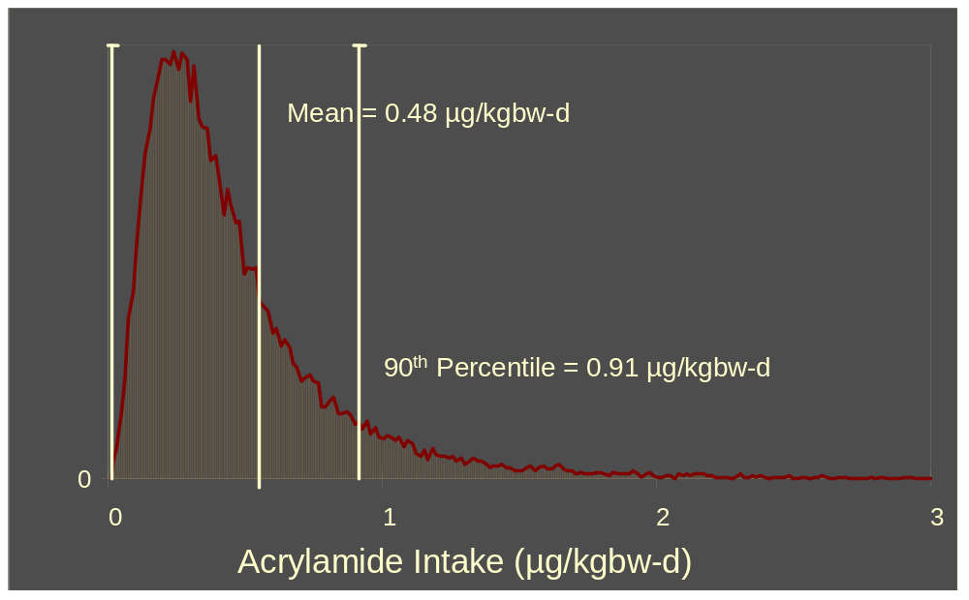
Acrylamide Intake Distribution
MRCA 1982-87; 2+ Population

Slide 26
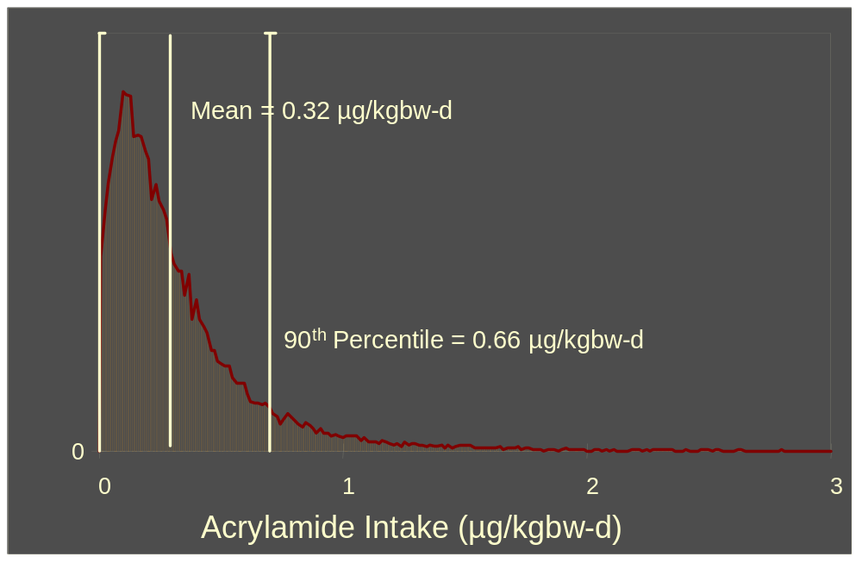
Acrylamide Intake Distribution
CSFII 1989-92; 2+ Population

Slide 27
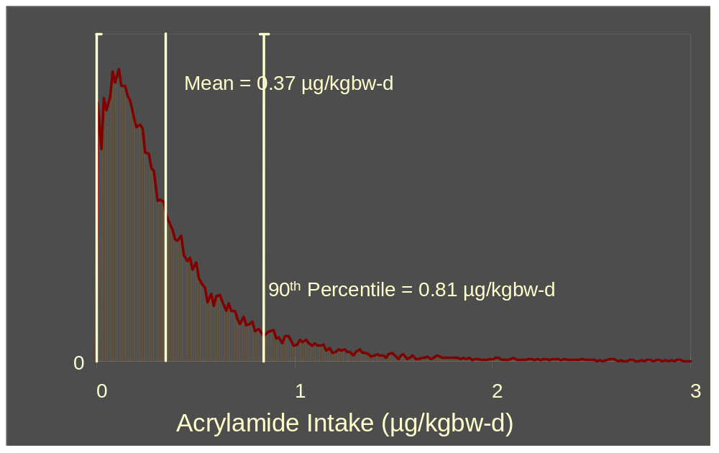
Acrylamide Intake Distribution
CSFII 1994-96, 1998; 2+ Population

Slide 28
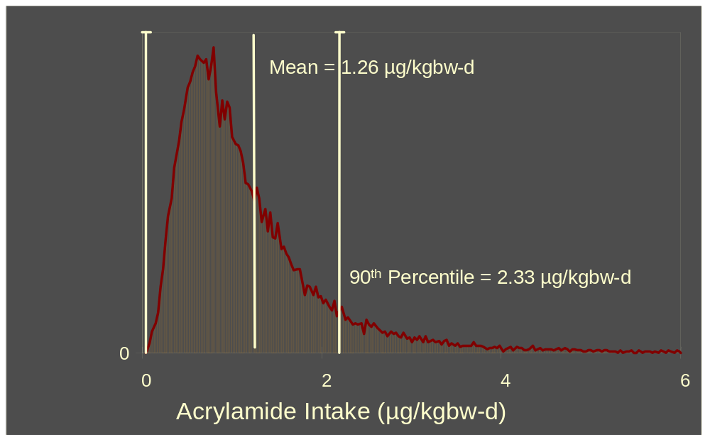
Acrylamide Intake Distribution
MRCA 1982-87; 2-5 Population

Slide 29
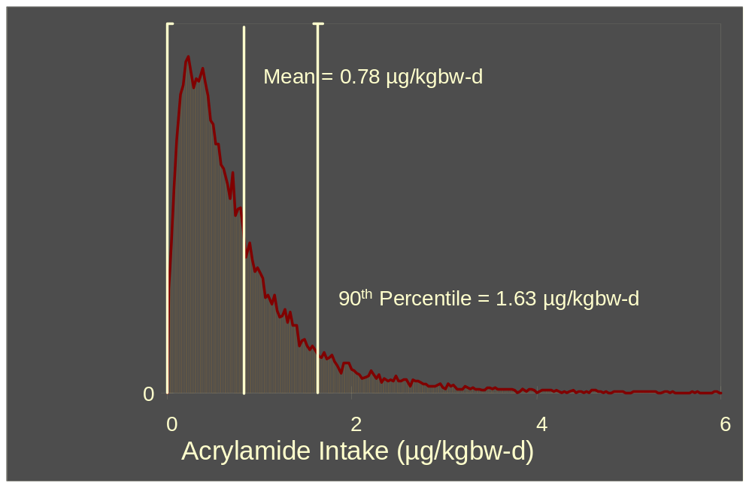
Acrylamide Intake Distribution
CSFII 1989-92; 2-5 Population

Slide 30
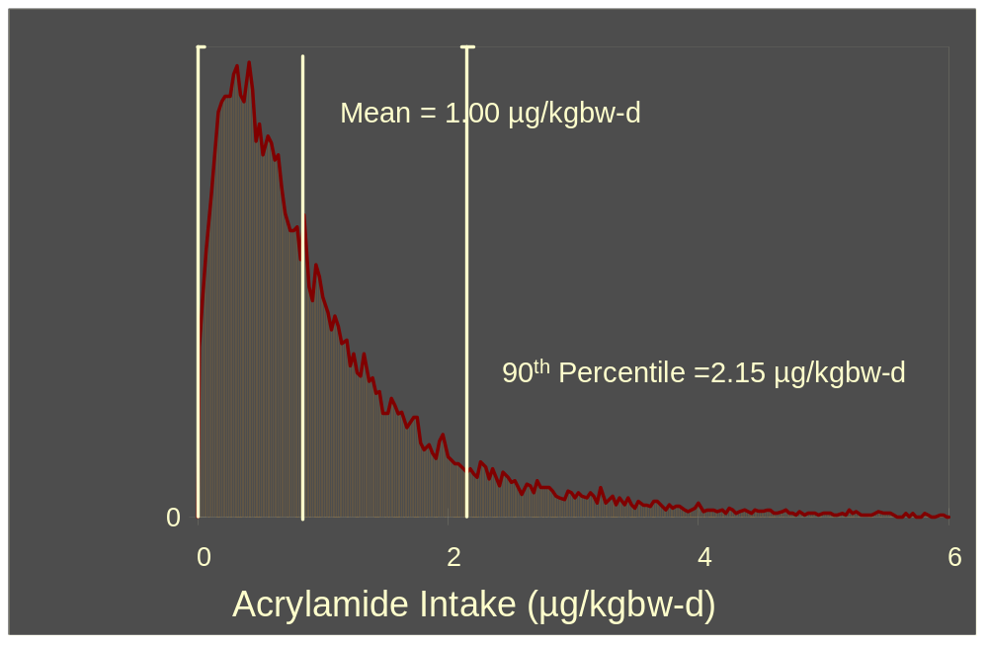
Acrylamide Intake Distribution
CSFII 1994-96, 1998; 2-5 Population

Slide 31
Acrylamide Intake by Single Serving
Food | Mean AA Conc (µg/kg) | Portion Size (g)* | AA (µg)/Portion
Breakfast Cereal | 133.3 | 55 | 7.3
Brewed Coffee | 8.5 | 240 | 3.2
Cookies | 221.6 | 30 | 6.6
French Fries (RF) | 321.8 | 70 | 22.5
French Fries (OB) | 697.8 | 70 | 48.8
Potato Chips | 548.0 | 30 | 16.4
Soft Bread | 44.4 | 50 | 2.2
Toast | 213.0 | 46 | 9.8
* Portion Sizes From 21 CFR 101.12, Table 2

Slide 32
What-If Scenarios
Effect of Mitigation Measure on Population Mean AA Intake
Set AA Levels in Chosen Foods to 0 µg/kg
Rerun the Model
Important to Note that the Foods are Still Included in the Model – they Simply have no Contribution to the Population Mean AA Intake

Slide 33
What-If Scenarios
CSFII, 1994-96, 98, 2+ Population
Population Mean=0.37 µg/kgbw-d
Remove AA from French Fries
  Mean – 0.26 µg/kgbw-d
Remove AA from Snack Foods
  Mean – 0.31 µg/kgbw-d
Remove AA from Breakfast Cereal
  Mean – 0.33 µg/kgbw-d
Remove AA from Coffee
  Mean – 0.34 µg/kgbw-d

Slide 34
Future Work
Modeling of Longer Term Food Consumption
  Expand Consumption Duration for Individuals in 2-Day Survey
  Will More Accurately Model Chronic Intake of Acrylamide
Running What-If Scenarios Based on Technological Capability
Sensitivity Analysis

Slide 35
Summary
Mean Population AA Intakes Consistent with Previous Exposure Estimates
Greatest Contributors to Mean Population AA Intake are the Same for all Surveys
Some Foods with Lower AA Levels Contribute Appreciably to the Overall Mean Population AA Intake because they are Commonly Consumed
No One Food Accounts for the Majority of the Mean Population AA Intake

