Slide 1
Logistics
Block 9
February 2009 FCC & PRC Training

Slide 2
Little Rock FCC Capabilities
12 NDMS Hospitals
Average 300 available beds
30+ Ambulance crews with more available through Mutual Aid
Excellent support from Little Rock National Airport and hangar facilities of Central Flying Service
Manpower and Flight Crew support from Little Rock Air Force Base
Can stand-up for reception activities on short (4 hour) notice
Trained Emergency Medical Response Team at VA Medical Center
Exercise often
Experience with Katrina and Rita
Geography – relatively short flying times from threat zone in Louisiana

Slide 3
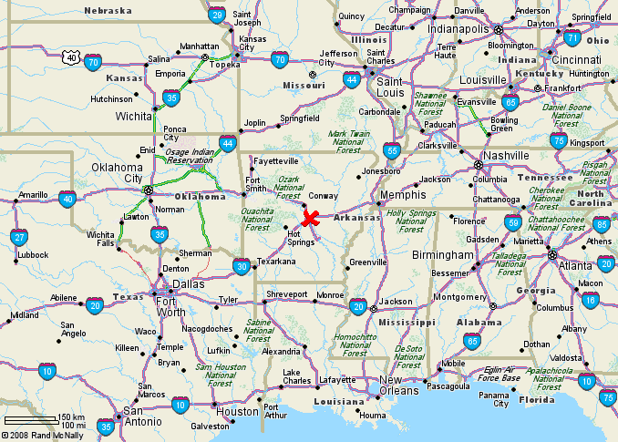

Slide 4
Patient Reception Activities
People
  Incident Commander, Finance/Administration Logistics, Operations, Planning
    Triage Teams
    Medical Teams
    Patient Movement
    Equipment Setup and Removal
    Patient Tracking
    Public Affairs
    Communications (VSAT)
    Food Service

Slide 5
Equipment
Equipment – Medical
  ECG (electrocardiogram)
  Digital thermometers
  Non invasive blood pressure monitoring equipment
  Pulse Oximeters
  Suction and infusion pumps
  Vital signs monitors
  Crash cart
  Spine boards
  Restraints
Patient Support Equipment
  Wheelchairs (including bariatric)
  Litters
  Litter Stands
  Walkers
  Oxygen
  Suction
  Ventilators
  Other

Slide 6
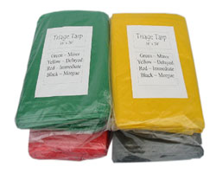
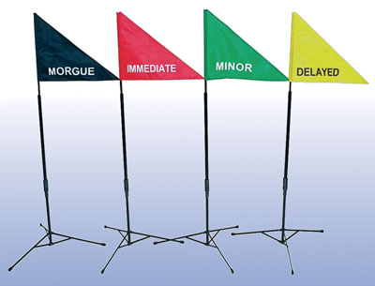
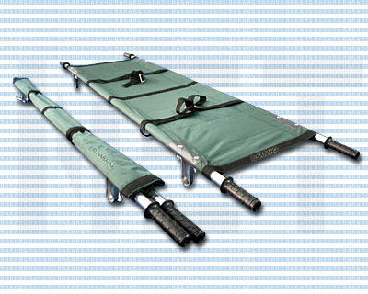
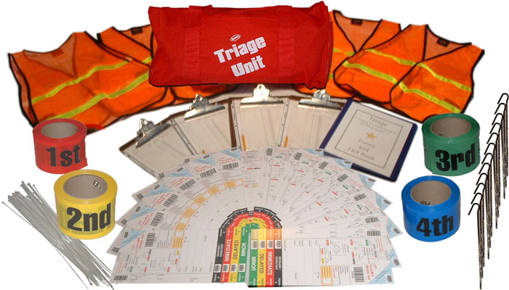
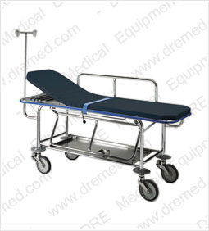
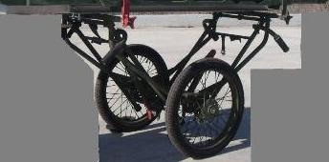

Slide 7
FCC Operations Statistics
Operations stood up at Noon, Saturday, August 30, 2008
First patients arrive 10:57PM, Saturday, August 30, 2008
Last flight received 9:30 PM. Sunday, August 31, 2008
225 Acutely ill patients received, triaged and transported
197 litter, 28 ambulatory
44 non-medical attendants transported
13 Aircraft, 9 C-130 & 4 C-17
12 NDMS hospitals in Little Rock area used
USTRANSCOM manifested less than 100 patients
All patients tracked from airport reception to return home
6 deaths
All patients returned by October 1, 2008.

Slide 8
“Rule of Thumb”
Logistics
FCCs
    Coordinate Logistics for PRAs (NDMS)
    Coordinate Logistics for SCCs (NDMS)
PRCs
    Coordinate Logistics for PRAs (ICMOP)
    Coordinate Logistics for facility (ICMOP)
PRAs
    “Space” (ICMOP/NDMS)
    Logistics coordinated through FCC/PRC
SCCs (NDMS)
    Logistics coordinated through FCC (NDMS)
Notes:
This is meant to help make your logistics requirements clear. If you are an FCC with an NDMS mission your are designated a PRC for the ICMOP mission and need to develop logistics requirements for both scenarios. If you are a PRC not designated as an FCC you only have the ICMOP mission and should tailor your logistics plans accordingly. The most significant difference is: NDMS will most likely generate patients not common to “war time/contingency medicine.” Logistics consideration needs to include possible patient events such as bariatric dementia, elderly, and pediatric patients you might even receive pets. ICMOP patients will almost always be active duty military members. One thing to note is: Some VA/DoD centers organize their own staff to form patient reception teams. However, there are some that have been successful in obtaining community resources to conduct the patient reception process such as the Metropolitan Medical Response System (MMRS), NDMS DMAT or Medical Reserve Corps. Know your customers and know their requirements to prevent a logistics shortage at the time of alert or activation.

Slide 9
Logistics
Is it on a PROGRAM OBJECTIVE MEMORANDUM?
Is it on a DESIGNED OPERATIONAL CAPABILTIY STATEMENT?
Is it on a UNIT TYPE CODE?
Is it WAR RESERVE MATERIEL?
….is it FUNDED?
Pre-Plan to record costs
Pre-Plan to recover costs
Notes:
Logistics can be costly. NDMS logistics requirements can present requirements not normally inherent to the facility whereas ICMOP requirements will most likely be requirements inherent to the facility. The logistics challenge will be identifying proper requirements and stocking the requirements at a level that enables the facility to meet the mission with little notice while remaining fiscally responsible. Time frames to consider are: Initial Notification, to include the PRAs and SCCs, Surge, and Quiescent Operations. Logistics demands could be significantly different during these time frames

Slide 10
Logistics
Customers
FCC Director/FCC Coordinator (NDMS)
    PRAs
      Air Field, Port, Dock, Railhead Managers
      DoD Base/Post Commander
      Community Fire Department
      Community Emergency Management Services (EMS)
      Contracted Transportation
      Community Charity
    Nationwide Network (Non-Federal Acute Care Hospitals)
    Secondary Support Centers
PRC Director/PRC Coordinator (ICMOP)
      DoD Base/Post Commander
      PRAs
      Installation Logistics Functions
      Air Field, Port, Dock, Railhead Managers
      Medical Facility
      DoD/VA Casualty Receiving Hospitals
Notes:
As you can see the FCC and PRC has some similarities and some differences. Take all these into consideration when analyzing the effectiveness of your logistics support plan

Slide 11
Logistics
Logistics Customers
  Team Coordinators
  Medical Triage Officer
  Trauma Physician
  Surgeon
  Nursing Staff
  Respiratory Therapist
  Chaplain
  Public Affairs Officer
Litter Bearers
Patient Tracking
Patient Registration
Laborers
Psychiatrist
Psychologist
Housekeepers
Security Police
Pharmacist
Notes:
Here is a list of others that might come to you for logistics support. It would be wise to plan with all persons involved and make sure all logistics requirements are met for all persons prior to alert or activation.

Slide 12
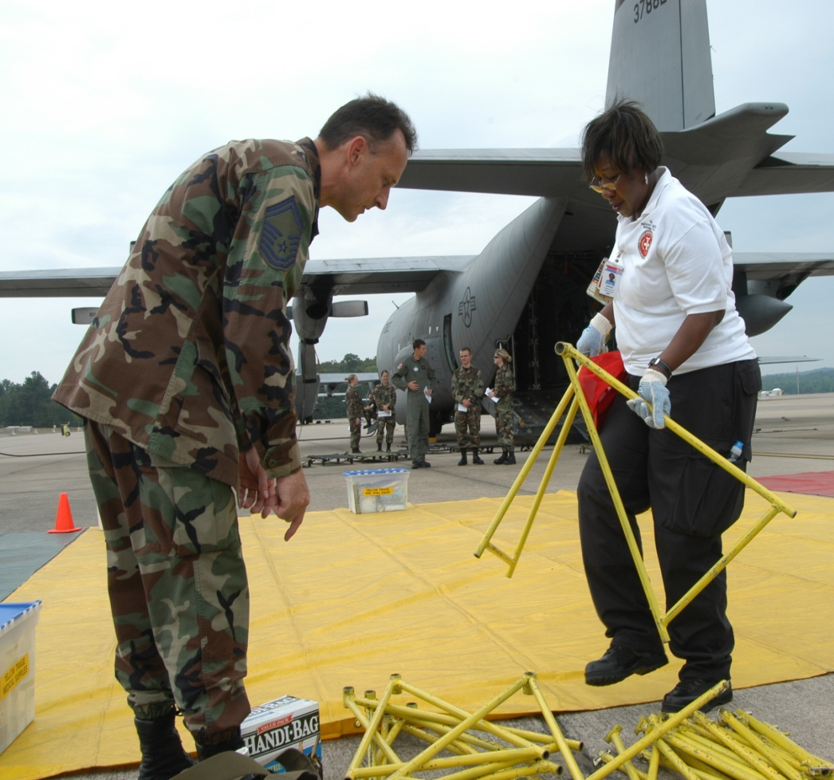
Logistics
Patient Staging Logistics
  Supplies and Equipment Required for Patient Staging
  Patient Support Logistics
    Supplies and Equipment Required for Patient Care
Notes:
There are two general areas of logistics: Patient Staging Logistics and Patient Support Logistics. Patient Staging Logistics are the supplies and equipment needed for staging the patients. Patient Support Logistics refers to the supplies and equipment required for patient care at the patient reception area. Remember to integrate the NDMS/ICMOP planning requirements into the logistics requirements the facilities will experience if activated; especially an ICMOP activation.

Slide 13
Logistics
Patient Staging Logistics
Shelter
Food
Water
Clothing
Sanitation
Waste Management
Storage
Communication
Contracting
Air Field Support
Base/Post Support
Notes:
- Here is an example of Patient Staging Logistics. Some points for SHELTER is making sure to procure through an MOA or a contract, space large enough and environmentally controlled enough. Remember in the MOA or Contract all Power, Lighting, Fuel and other utility costs. Alternates to buildings of opportunity is tents, trailers, portable shelters etc. Remember to plan in all the space and BOS procurement requirements associated with this option. FOOD AND WATER: Remember ICE! If possible plan to cater to the culture of patients; especially with NDMS missions (elderly, children, religious, etc) Explore Volunteer Groups, Donated Supplies, Charities, etc especially for NDMS scenarios. CLOTHING: Be cognizant of the climate the patients are being transported from. This might drive a requirement for coats, blankets, or the reverse: a heavy clothing swap-out for lighter clothes and clothing storage requirement. Remember all possible Patient Gown requirements. Another part of clothing is team work attire and uniforms such as foul weather gear, Personnel Protection Equipment, and ICS vests. SANITATION: First consider the logistics requirements for personnel hygiene and toilets. Second, consider waste management, - medical waste, sharps, pathologicals and radiological as well as regular waste to include HAZMAT. STORAGE: Plan logistically for Blood and Blood Products. Litters and Litter Straps, Wheelchairs, Patient Valuables (will differ significantly from NDMS and ICMOP) Weapons, Narcotics, and Controlled Substances.

Slide 14
Logistics
Patient Support Logistics
Medical Materiel
Medical Equipment
Medical Supplies
Pharmaceuticals
Blood
PMI

Slide 15
Logistics
Patient Support Logistics:
Non-Medical Supplies
Administrative and General
Clipboards Paper Clips
Printers Paper and Cartridges Pencils/Pens
Felt Tip Pens Rubber Bands
File Boxes Staplers/Staples
File Folders Tape
Forms Writing Pads
Maps Guidelines
Checklists Plans
Regulations
**DO NOT OVER LOOK IT, COMM, POWER GENERATION and SIGNAGE
*Example from David Grant USAF Medical Center, FCC, Travis AFB CA
Notes:
There are also Non-Medial Supplies. Here is an example from David Grant Medical Center

Slide 16
Logistics
Patient Support Logistics: Medical Supplies
2x2s - 4 boxes IV Trays
Airways, Disposable - 10 medium KCL 20 Megs - 4 Ampoules
Alcohol swabs - 2 boxes Life pack - 1
Ammonia inhalants - 4 boxes Masks 02 - 20
Bacitracin ointment - 1 box Nylon tape - 1 box ea. (½", 1", 2")
Band-Aids - 4 boxes Otoscopes/Ophthalmoscopes w/3 batteries
Betadine swabs - 4 boxes Penlights - 6
Blood pressure cuffs - 6 Portable 02 - 20
Cold packs - 6 boxes Portable suction - 5
Cotton tip applicators - 4 pkgs Reflex hammers - 3
Dressings Restraints - 5
ABDs - 50 Scissors - 6
Ace bandages - 3"x12" Splints
Ace bandages - 4"x12" Arm - Air - 1
Cravats - 50 Baalsa Wood - 6
Kling 3" - 20 Hand traction - 1
Kling 4" - 20 Leg - Air - 1
*Drug Kit Stethoscopes - 6
Emergency Crash Cart - 1 Tongue Blades - 4 boxes
Eye dressing/Eye pads - 2 boxes Tourniquets - 4
Intercaths - 10 ea. (18, 20, and 22 ga.) Volutrol - 20 ea.
IV fluids - 2 boxes
1000cc RL - 10
1000cc D5W - 10
1000cc D5NS - 10
1000cc D5RL – 10
* Drug kits will be assembled by the Pharmacy Team upon activation.
*Example from David Grant USAF Medical Center, FCC, Travis AFB CA
Notes:
Here is an example of medical supplies planned for patient support logistics.

Slide 17
Logistics
Patient Support Logistics: Medical Equipment
  IV Trays
  Life pack – 1
  Otoscopes/Ophthalmoscopes w/3 batteries
  Blood pressure cuffs - 6
  Portable 02 – 20
  Portable suction – 5
  Stethoscopes – 6
  Emergency Crash Cart - 1
*Example from David Grant USAF Medical Center, FCC, Travis AFB CA
Notes:
And a continuation of the patient support logistics.

Slide 18
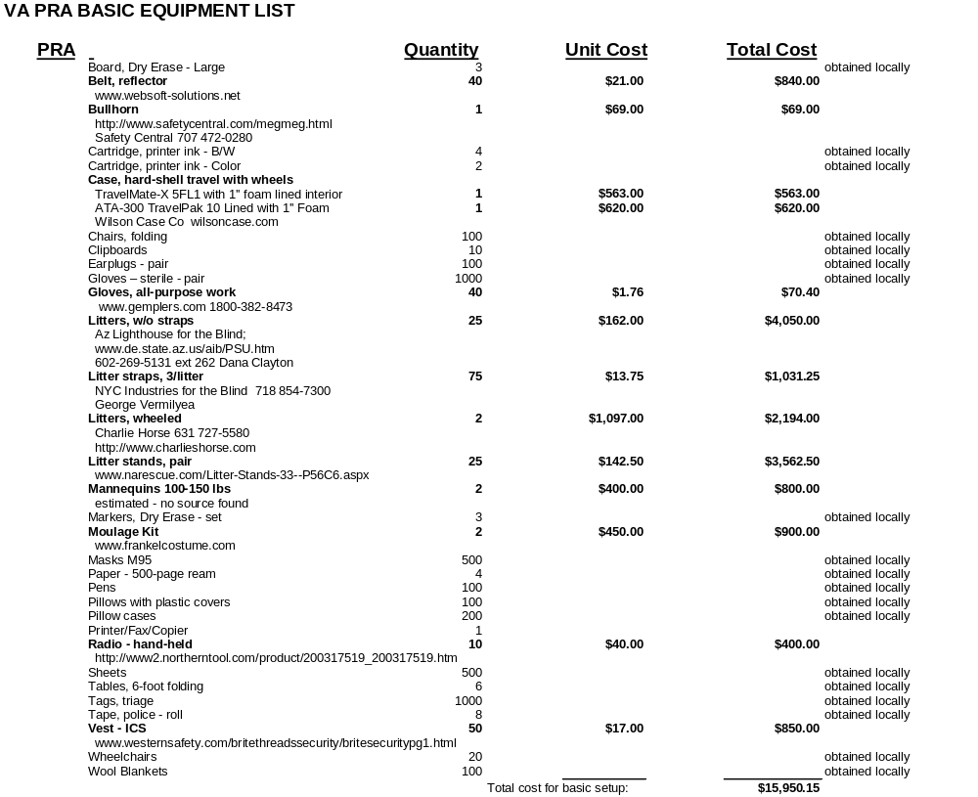
Logistics
Notes:
Here is an example of the patient support logistics for PRA activities provided by the Army. Note: They have captured unit and total costs.

Slide 19
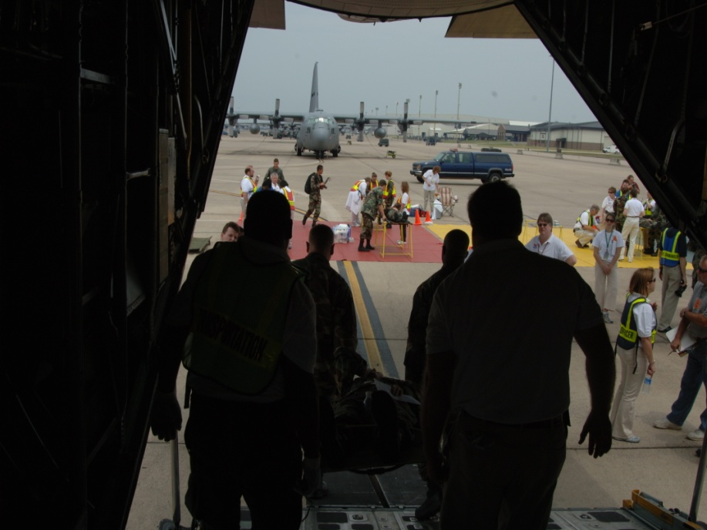
Logistics
Contracted Services
Security
EMS/Ambulances/Air Ambulance/Ambus (civilian or military)
Contracted Transport
  Buses
  Shuttles
  Passenger Vans
Comm
Pest Control
Fuel
Food/Billeting
Notes:
Here are some examples of items that could be contracted out in the event of the actual need. It is important to effectively integrate contracting into your logistics plans and requirements. One big consideration is FLIGHTLINE ACCESS and SECURITY CLEARNACES. Consider your mission and contract accordingly.

Slide 20
Logistics
REMEMBER!
Body Tags and Bags
Patient Movement Item Management
Communications
Signage
Lighting
Adverse Weather
  Ice, Snow Removal
  Wind, Rain, Dust, Pest Mitigation
Heating and Cooling
Pets
Your Team!!

Slide 21
Logistics
PLANNING FACTOR
Base your Logistics Plans on:
  Activation
  Patients per 24 Hour Period (Quiescent)
  Maximum Surge from Planned Patients

Slide 22
Logistics
IMPORTANT DOD NOTES
AFI 41-209
AR 40-61
Navy Operational Medical Logistics
Navy Health Services Strategies
Ft Dietrich

Slide 23
Questions?
J. Rex Oxner
Area Emergency Manager
Central Arkansas Veterans Healthcare System
j.oxner@med.va.gov
501-257-1015
Major Gregory J. Ready
Chief, Homeland Security Operations
Headquarters Air Force, SG3XO
DSN: 222-7683 COMM: 703-692-7683
gregory.ready@pentagon.af.mil
703-692-7683

