Slide 1
Varieties of Impulsivity: Evidence from Animal Studies
John Evenden
Dept of Neurosciences
AstraZeneca R & D Wilmington
Wilmington, DE, USA

Slide 2
What’s in this talk
Four Questions
What is Meant by Different Varieties of Impulsivity?
Do Biologically Important Factors Influence the Different Varieties of Impulsivity in Different Ways?
How does “personality” (or trait impulsivity) interact with state impulsivity?
Does it make a difference whether impulsive behaviour leads to loss of rewards or punishment?

Slide 3
Question 1
What is Meant by Different Varieties of Impulsivity?

Slide 4
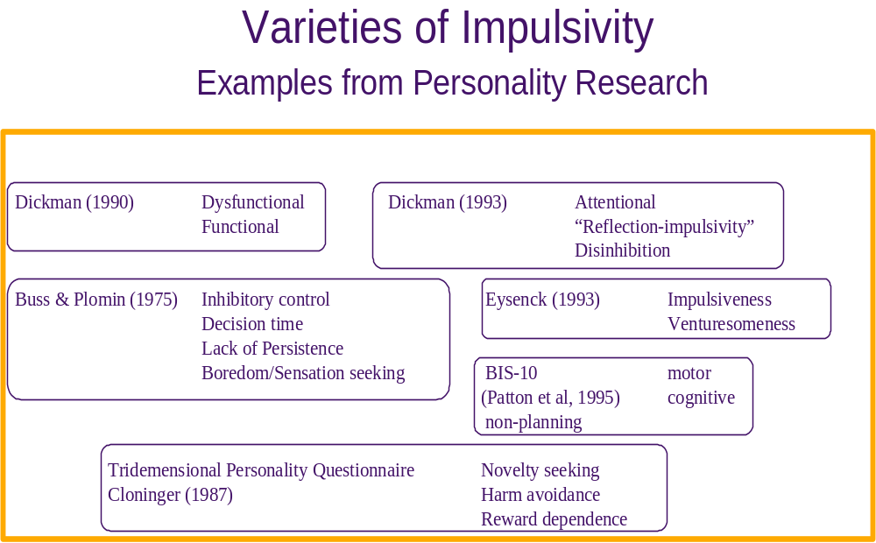

Slide 5
Impulsive Decision Making and the 3-term Contingency
What are the CONSEQUENCES of different contingencies?
Stimulus
UCS/Reinforcer
Classical Conditioning
Instrumental
Conditioning
What do I need to know in PREPARATION to act?
How should I EXECUTE my act to ensure predicted outcome?
Response

Slide 6
Three types of impulsive decision making
PREPARATION Not all relevant information Uncertain
is taken into account before Discrimination
making a decision
EXECUTION The necessary behaviour is Fixed Consecutive
ended before the goal is Number Test
attained
CONSEQUENCES A quick, but less valuable Delayed
outcome is chosen rather Reinforcement Test
than a later but more valuable

Slide 7
Three tests of impulsive decision making
PREPARATION Not all relevant information Uncertain
is taken into account before Discrimination
making a decision
EXECUTION The necessary behaviour is Fixed Consecutive
ended before the goal is Number Test
attained
CONSEQUENCES A quick, but less valuable Delayed
outcome is chosen rather Reinforcement Test
than a later but more valuable

Slide 8
Question 2
Do Biologically Important Factors Influence the Different Varieties of Impulsivity in Different Ways?

Slide 9
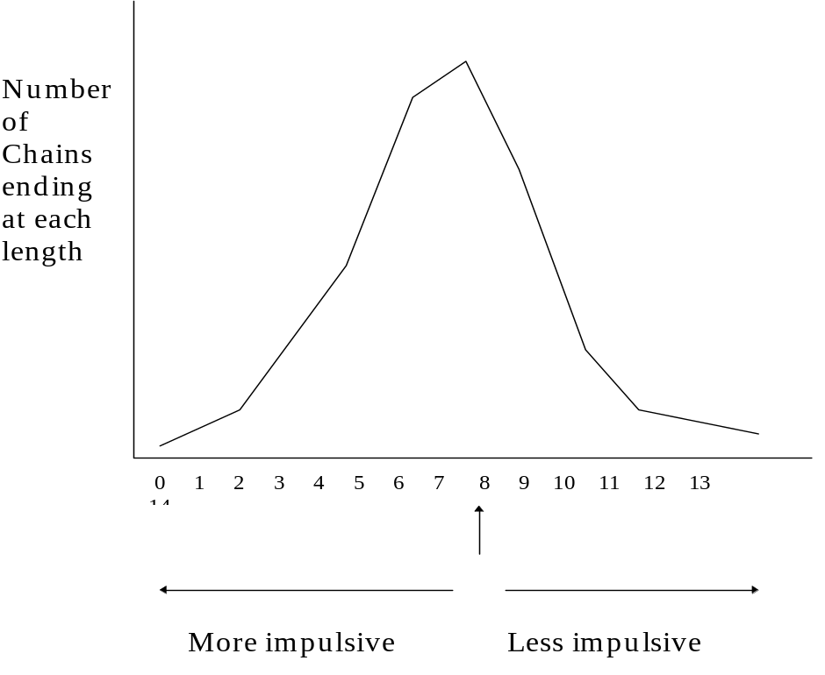
Fixed Consecutive Number Schedule
L.L.L.R = 3 No Food
L.L.L.L.L.L.L.R = 7 No Food
L.L.L.L.L.L.L.L.R = 8 Food
L.L.L.L.L.L.L.L.L.L.R = 10 Food
Count up how many times
each length occurs and plot it
in a histogram (distribution
analysis)

Slide 10
Paced Fixed Consecutive Number Test
Trained to press left and right lever to obtain small food pellets
After this the levers are retracted for either 2 or 5 seconds
every time the rats presses
Trained press first the left lever then the right lever to get
food
Trained to press the left lever several times before pressing
the right lever to get food.
This way the experimenter has control over how fast the
rat can press the lever and the minimum time to complete a chain of responses
Food
Lever
Lever

Slide 11
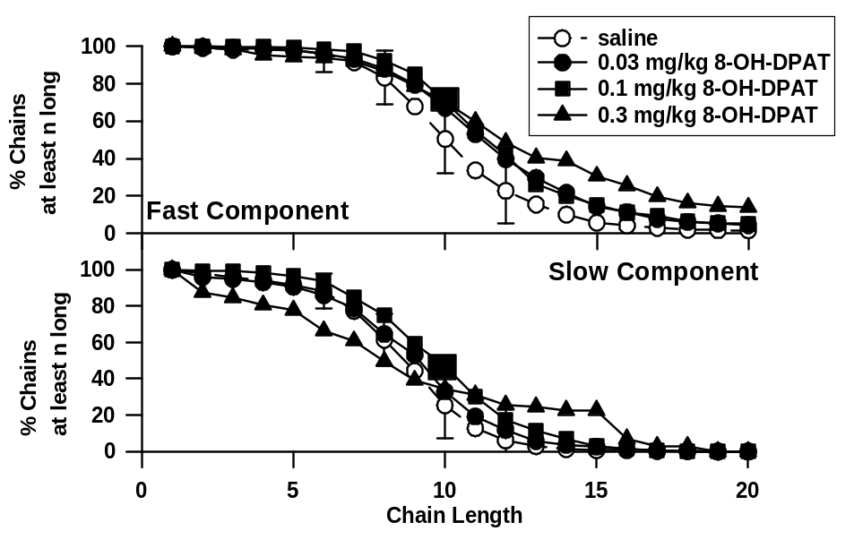
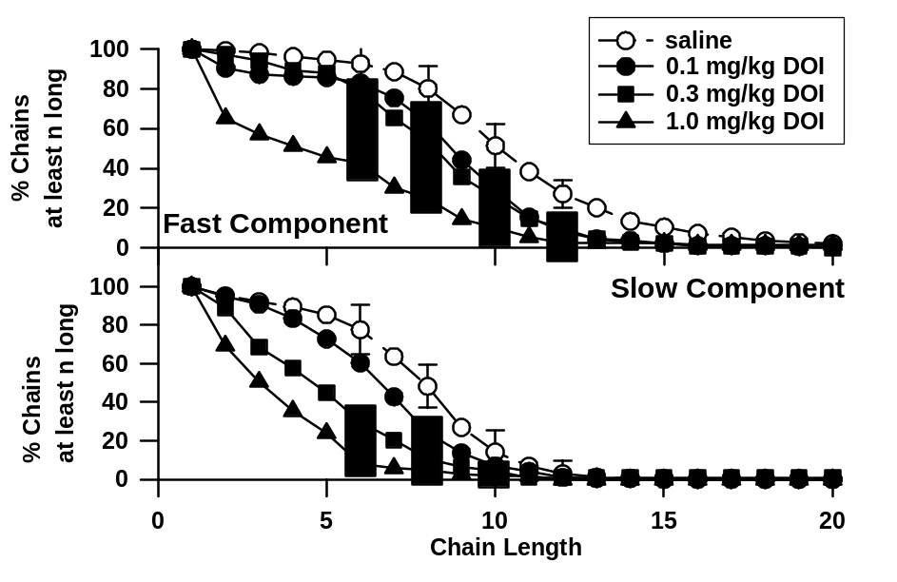
Paced Fixed Consecutive Number Schedule
- 8-OH-DPAT, DOI - survival plot
8-OH-DPAT reduces impulsivity, DOI increases impulsivity

Slide 12
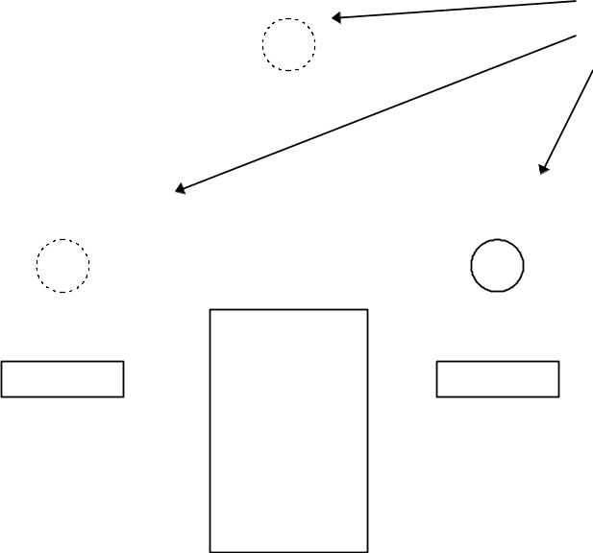
Uncertain Discrimination
Rats are first trained that a lit lamp
signals lever which gives food
When they have been trained to 95 - 100% correct
the test procedure is started in which the signal
is made uncertain.
First one of the levers is chosen as “correct”.
Then one of the three lights is turned on at random.
After 0.1 s that light is turned of, and again one of the
lights is turned on at random
...and so on...
Each time one of the lights is chosen, the probability that it is the one over the correct lever
increases by a small amount until after about 5 s it is on nearly all the time.
Lamps

Slide 13
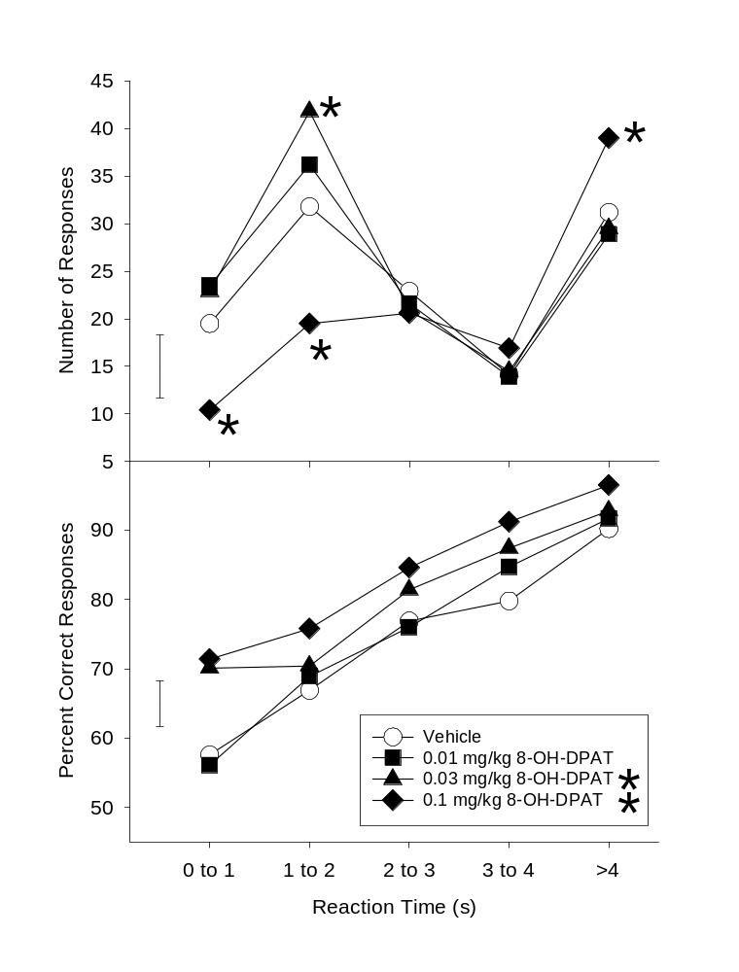
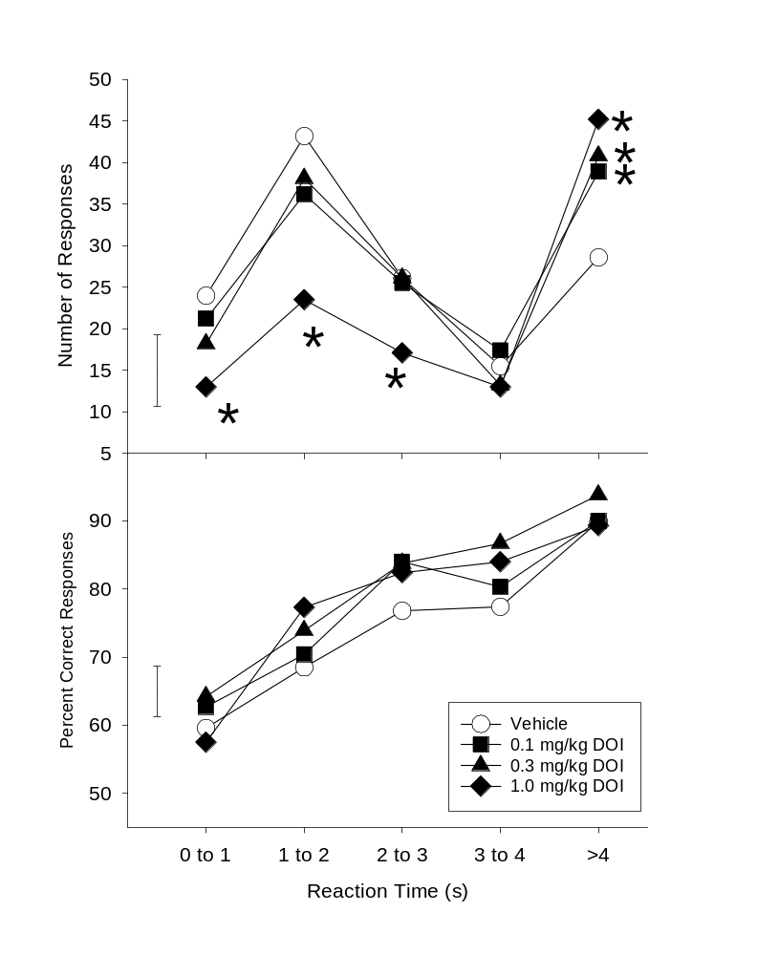
Uncertain Discrimination - 8-OH-DPAT, DOI

Slide 14
Impulsivity - Trait and State
We usually think of impulsivity as an aspect of personality
DSM personality disorders are essentially lifelong
Most personality questionnaires are designed to look for the personality trait of impulsivity
But
Drugs change the state of the subject, not his/her underlying personality

Slide 15
Question 3
How does “personality” (or trait impulsivity) interact with state impulsivity?

Slide 16
State and Trait interactions
Acutely administered drugs are a model of “state”
Different strains of rats are models of different patterns of “traits”
Question
Do the drugs have the same effects in different rat strains with different levels of “trait impulsivity”?

Slide 17
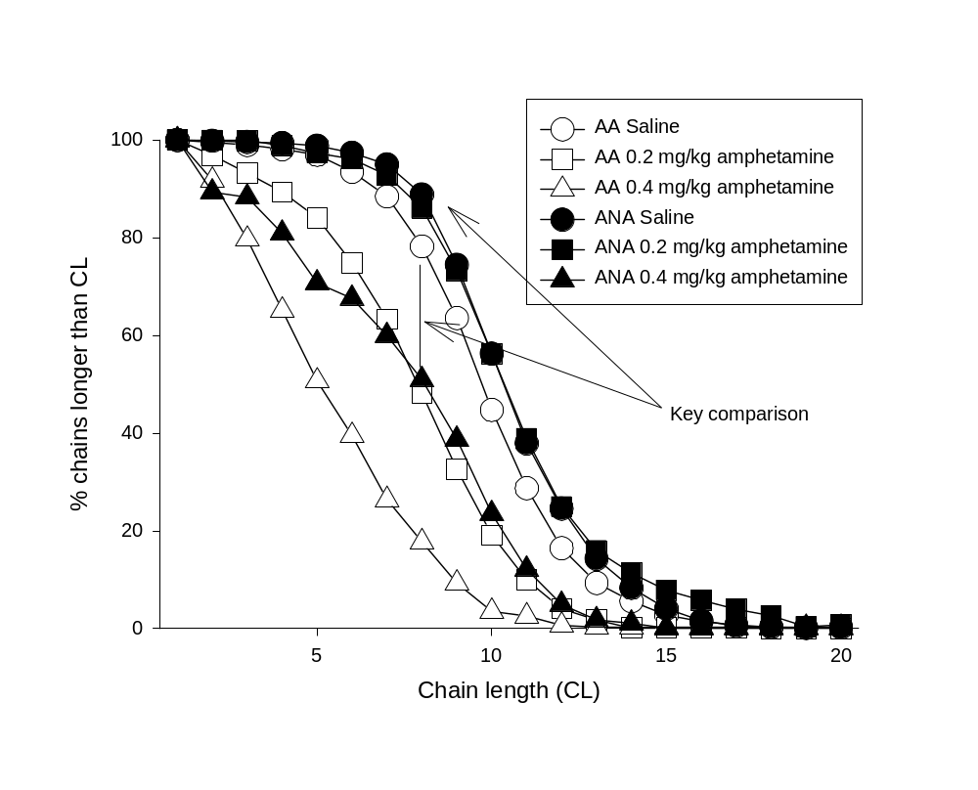
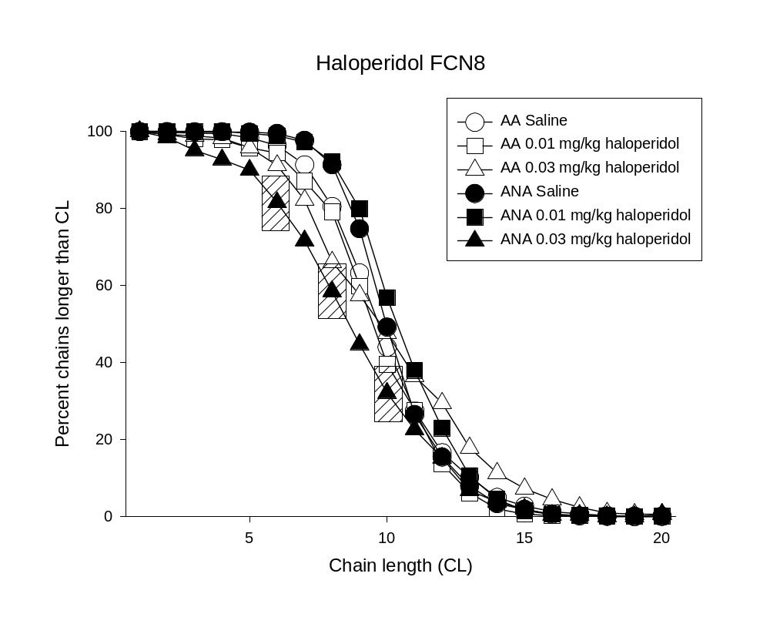
Paced Fixed Consecutive Number Schedule
- amphetamine, haloperidol - AA/ANA rats

Slide 18
Question 4
Does it make a difference whether impulsive behaviour leads to loss of rewards or threat of punishment?

Slide 19
Motivation and impulsivity
Most non-human impulsive behaviour results in loss of positive reinforcers
Much human impulsive behaviour results in delivery of punishers
Question
Is it possible to model self control using avoidance of punishment in rats?

Slide 20
Fixed Consecutive Number Shock Avoidance
Basic schedule is two-lever paced fixed consecutive number (FCN6)
Option 1: make 6 or more consecutive responses on left lever and then press right lever for delivery of one food pellet
Option 2: make less than 6 consecutive responses on left lever and then press right lever for delivery of one food pellet + 0.5s footshock (0.45 - 0.9 mA)

Slide 21
Paced FCN Shock Avoidance
100
80
60
Percent Chains longer than CL
Rat 1 (Shock Avoidance)
40
Rat 3 (Shock Avoidance)
Rat 10 (Positive Reinforcer)
Rat 17 (Positive Reinforcer)
20
0
1
3
5
7
9
11
13
15
17
19
Chain Length (CL)
Amphetamine increases impulsivity if the outcome is loss of reward, but reduces impulsivity is the outcome is punishment

Slide 22
Summary
Different aspects of impulsivity are differentially sensitive to the various drugs
    dopaminergic drugs primarily seem to affect EXECUTION of behaviour
    “traditional” serotonergic deficit may fit best with a deficit in PREPARATION
Effects of the drugs don’t always fit with expectations
The effects of the drugs depend (in part) on the strain of rat used. Impulsive behaviour is modulated by trait factors (genetics, “personality”), and state factors (in this case, drug treatment). These factors interact with one another. This interaction is complex and not obvious
Positive reinforcement schedule and punishment schedule can maintain the same pattern of self control/impulsivity
The effects of drugs can be dramatically different if self-control is brought about by negative reinforcement (loss of reward) or punishment.

