Slide 1
Second Multi-IC Symposium on the Application of Genomic Technologies to Population-Based Studies: Facilitating Collaboration in Genome-Wide Association Studies
Challenges in analysis: computing platforms, spurious associations
Joan E. Bailey-Wilson, Ph.D.
Head, Statistical Genetics Section
Co-Chief, Inherited Disease Research Branch
NHGRI, NIH

Slide 2
A “significant” Population Association may be due to:
a causal allele - the associated allele IS the disease/trait allele
an associated allele at a marker locus which is in linkage disequilibrium with the disease/trait allele at the tightly linked disease locus
association without linkage as a result of other causes such as population stratification or confounding (uninformative about disease causality)
Type I error (false positive)

Slide 3
Association Due to Linkage Disequilibrium
In small isolated populations with only a small number of founders, linkage disequilibrium may extend for a long distance around the disease locus.
In most populations, linkage disequilibrium can only be detected for extremely tightly linked loci or when the “marker” locus is in fact the disease locus.
This is what we hope for when we observe a significant association in a GWAS study.
But – what about spurious associations – what causes them?? To understand that we need to talk about Hypotheses, hypothesis testing and statistical error rates

Slide 4
Hypotheses in GWAS Studies
GWAS studies are often said to be “fishing expeditions” without hypotheses.
This is NOT true!!!
All statistical tests have a null hypothesis called “H₀:” (that we try to reject) and an alternate hypothesis called “H_{a}” that is a reasonable alternative if the null hypothesis is rejected.

Slide 5
Hypotheses in GWAS Studies
The null hypothesis for a GWAS is “None of the SNP loci genotyped in these data are associated with the disease of interest.”
The alternate hypothesis is “At least 1 of the genotyped SNPs is associated with the disease of interest in these data”.
We calculate statistics to measure the strength of the association of each SNP (or haplotypes of SNPS) with the disease of interest and significance levels (p-values).
What do these p-values MEAN????

Slide 6
Significance Levels
P-value – The probability of observing a test statistic as large or larger than the one that was observed in your data if the null hypothesis is true.
As the p-value becomes small, then we feel more comfortable saying that the null hypothesis of “no association” is not true.
We pick a threshold and when the observed p-value is lower than this threshold, we say the test is significant at that p-value and that we have rejected the null hypothesis.

Slide 7
Error Rates
Significant association – We generally want there to be only a 5% chance of making an error if we reject the null hypothesis of no association – so we pick a p-value threshold of 5%. This means that if we repeat the same test 100 times, we would say there was a significant association 5 times, even though it was not true
Type I error – Saying that the null hypothesis of NO ASSOCIATION is rejected when in fact it is true and there are not any associations of the SNPS with the disease.

Slide 8
Error Rates
Type I error rate – the probability of falsely rejecting the null hypothesis of no association
Should be 5% if you set a p-value threshold of 5%
Type II error – the probability of FAILING to reject the null hypothesis when it is false – i.e. the probability of NOT saying that a SNP is associated with disease in your sample when in fact it really is associated in the population.
Power = 1-Type II Error

Slide 9
Error Rates
You want to MINIMIZE Type I error rate and MAXIMIZE Power so that you don’t say a SNP is associated when it is not (spurious association) and you also don’t MISS true associations.
Making the threshold for a significant test very small will make Type I error small but this will reduce power.
We usually pick a threshold of 5% (p=0.05) so we only have a 5% risk of a spurious association.

Slide 10
Error Rates
BUT there are many things that can increase your Type I error rate and cause spurious associations!

Slide 11
Types of Association Study Designs Can Affect Rate of Spurious Associations
Case-Control association tests
  Powerful but susceptible to increased Type I errors due to population stratification
  Can use genomic control methods to detect and adjust for stratification [e.g. Pritchard & Donnelly, Theoretical Population Biology 60, 227–237,2001]
  Match cases and controls by ethnicity
Family based association tests such as the Transmission Disequilibrium Test (TDT), Haplotype Relative Risk (HRR) method, Pedigree Disequilibrium Test (PDT), and Family-Based Association Test (FBAT)
  Requires more genotyping for equivalent power but not susceptible increased rates of spurious association due to population stratification

Slide 12
Other Causes of Spurious Associations
Genotyping errors
  Systematic genotyping errors that preferentially classify heterozygotes as homozygotes or that cause heterozygote genotypes to fail more frequently can increase the rate of spurious associations
  Test for Hardy-Weinberg equilibrium to detect this and drop markers where the H-W p-value <0.01
  Drop markers that have genotyping call rates less than 95% (or 99%) since they are more likely to have systematic errors!
  Repeat genotyping of highly significant SNPs to obtain complete and accurate genotypes

Slide 13
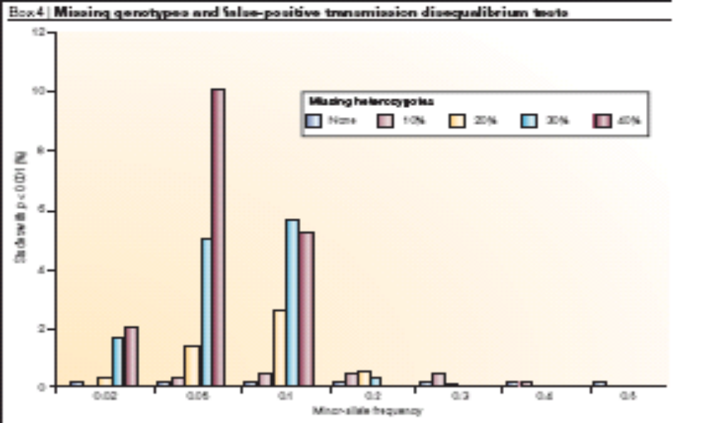
Percentage of spurious associations at varying rates of missing heterozygote data in 1000 parent-child trios, AFTER removing SNPs with call rates < 90% and SNPs with H-W p-value <0.01
Hirschhorn & Daly, Nat Rev Genet 6:95-108, 2005

Slide 14
Genome Wide Association Studies
Multiple Testing and Error Rates
Genotype from 100K to 550K (or more) SNP markers
Perform association test for each marker with the disease or trait
For each test, 5% chance of a spurious association if you use a p-value threshold of 5%
5% X 550,000 = 27,500 spurious associations in a GWAS if you use p=0.05 as the threshold
Multiple testing is a BIG problem!!!

Slide 15
Adjusting for Multiple Testing
Use a smaller p-value for the significance threshold to control the family wide error rate – i.e. the probability of ANY false positive in your whole study.
p=1 x 10⁻⁵ results in 5 false positives in one GWAS of 550,000 tests
p=1 x 10⁻⁷ results in a 5.5% chance of a Type I error when performing 550,000 tests
P-value needs to be smaller if performing more tests (haplotypes, GXG or GXE interactions)

Slide 16
Adjusting for Multiple Testing
But setting a lower p-value threshold means that larger sample sizes are needed to have enough power to detect SNPs with real associations, particularly if the size of the effect of the SNP on risk for disease is small.
Most studies will be underpowered, making it very likely that many significant associations will be Type I errors or spurious associations.

Slide 17
Ioannidis JPA (2005) Why most published research findings are false. PLoS Med 2(8): e124.
It can be proven that most claimed research findings are false.
The probability that a research finding is indeed true depends on the prior probability of it being true (before doing the study), the statistical power of the study, and the level of statistical significance (p-value)
Bias can further reduce the probability that a research finding is true. It can entail manipulation in the analysis or reporting of findings. Selective or distorted reporting is a typical form of such bias.
The post-study probability that a significant research finding is true is the positive predictive value, PPV.

Slide 18
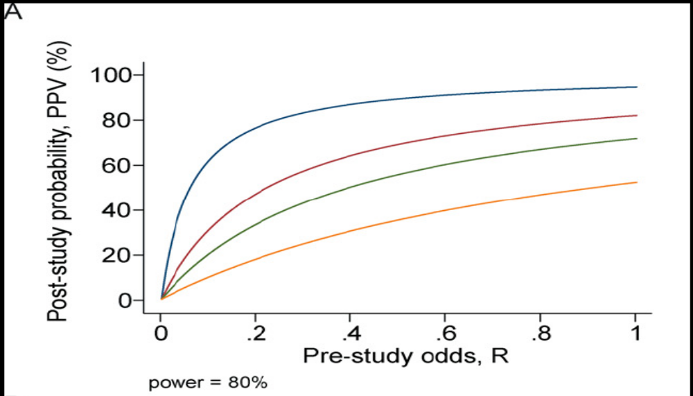
PPV for any one study decreases if many studies are performed
Blue=1, Red=5, Green=10, Orange=50 studies
Ioannidis JPA (2005). PLoS Med 2(8): e124.

Slide 19
Corollaries
The smaller the studies conducted in a scientific field, the less likely the research findings are to be true.
The smaller the effect sizes in a scientific field, the less likely the research findings are to be true.
The greater the number and the lesser the selection of tested relationships in a scientific field, the less likely the research findings are to be true.
The greater the flexibility in designs, definitions, outcomes, and analytical modes in a scientific field, the less likely the research findings are to be true.
Too large and too highly significant effects may actually be more likely to be signs of large bias in most fields of modern research.
Ioannidis JPA (2005). PLoS Med 2(8): e124.

Slide 20
Moonesinghe R, Khoury MJ, Janssens ACJW (2007) Most published research findings are false—But a little replication goes a long way. PLoS Med 4(2): e28. doi:10.1371/journal.pmed.0040028
Replication—the performance of another study statistically confirming the same hypothesis—is the cornerstone of science and replication of findings is very important before any causal inference can be drawn.
PPVs of research findings increase when more studies have statistically significant results.

Slide 21
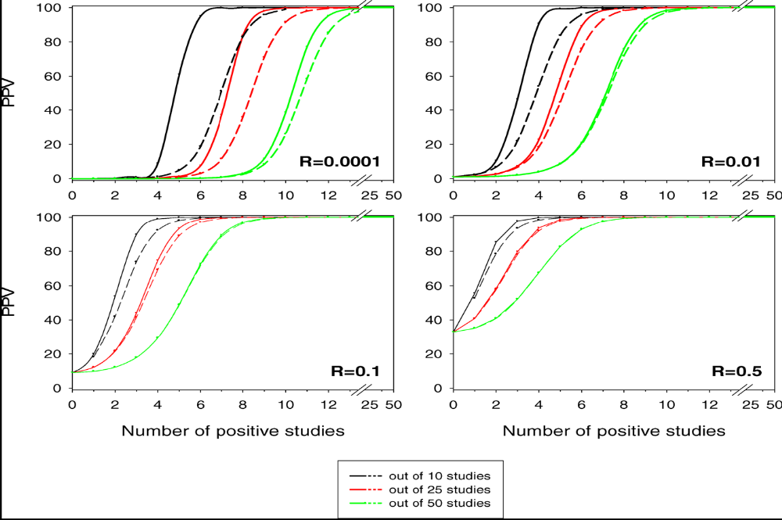
Figure 2. Positive Predictive Value for Research Findings Being True for At Least r Positive Studies Out of Ten, 25, and 50 Studies for Pre-Study Odds R of 0.0001, 0.01, 0.1, and 0.5 (α =0.05) Dashed lines refer to power of 0.2 and solid lines to power of 0.8.
Moonesinghe R, Khoury MJ, Janssens ACJW (2007). PLoS Med 4(2): e28. doi:10.1371/journal.pmed.0040028

Slide 22
Replication to control spurious associations
True replication requires that the exact same finding is reexamined in the same way.
Original and replication studies should be adequately powered
Bias against reporting negative studies will seriously decrease the chance that a finding is true

Slide 23
How to ensure replication studies are adequately powered?
Zollner S, Pritchard JK Overcoming the Winner’s Curse: Estimating Penetrance Parameters from Case-Control Data AJHG 80:605-615, 2007
Difficulties of replication occur because most genuine associations have small to moderate effects on risk of disease
Therefore, there is generally incomplete power to detect associations in any given study

Slide 24
Zollner S, Pritchard JK Overcoming the Winner’s Curse: Estimating Penetrance Parameters from Case-Control Data AJHG 80:605-615, 2007
The odds ratio (a measure of risk of disease due to the associated risk allele) is almost always overestimated in the initial association study
Using these overestimates to plan the sample size needed for the replication study results in lower power than expected
Zollner & Pritchard developed a method for estimating frequency and genotypic penetrances at the associated locus that do not overestimate the effect of the risk allele on disease risk

Slide 25
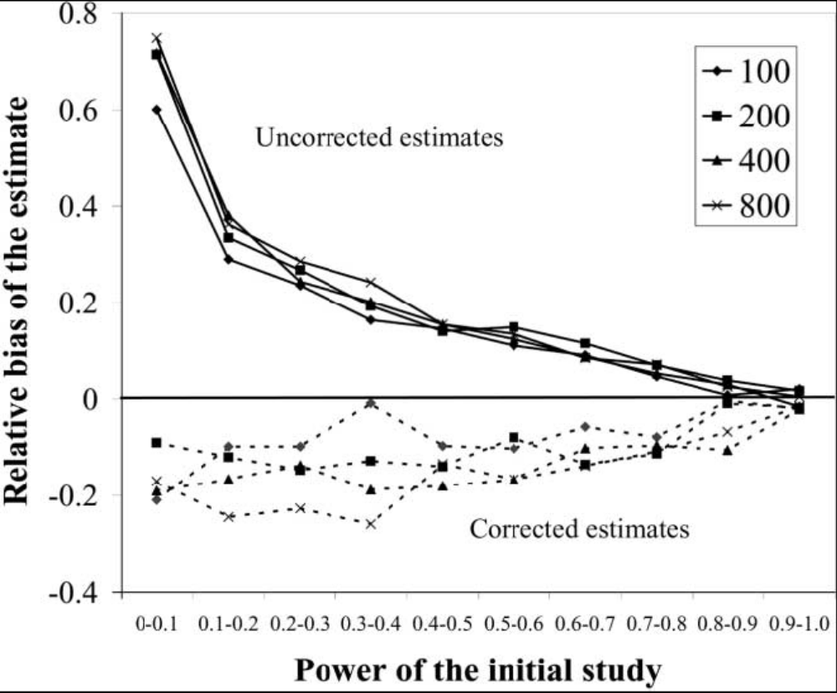
Figure 2. Bias of the uncorrected and corrected estimates of the additive genetic effect. The vertical axis indicates the average relative bias observed in each power category. The solid lines show the bias of estimates of penetrance parameters that were generated without correction for ascertainment, whereas the dashed lines show the bias of estimates generated while correcting for ascertainment.
Zollner S, Pritchard JK AJHG 80:605-615, 2007

Slide 26
Replication Studies
Should be adequately powered
Should test the same phenotype
Should test the same associated SNP, even if other nearby SNPs are also tested
At least some replication studies should be in the same population
Should use the same methods as the original report

Slide 27
Computing Issues
HUGE amount of data
Can take DAYS just to download these datasets
Large amounts of disk space and fast processors with fast I/O speeds are necessary to manipulate these data
Thousands of files of genotypes for one project!!
Merging phenotypes with genotypes is a BIG job!

Slide 28
Computing Issues
Some programs available to help manipulate these files
PLINK (free)
BC/SNPmax
HelixTree

Slide 29
Computing Issues
Computations for 550,000 tests take much longer than for 1 or even 100 tests as in most candidate gene studies. (5500 times longer than 100 tests)
Doing a GWAS on one PC will take an unacceptably long time!!
Need a cluster of fast computers to enable GWAS analyses to finish in a reasonable time.

