Slide 1
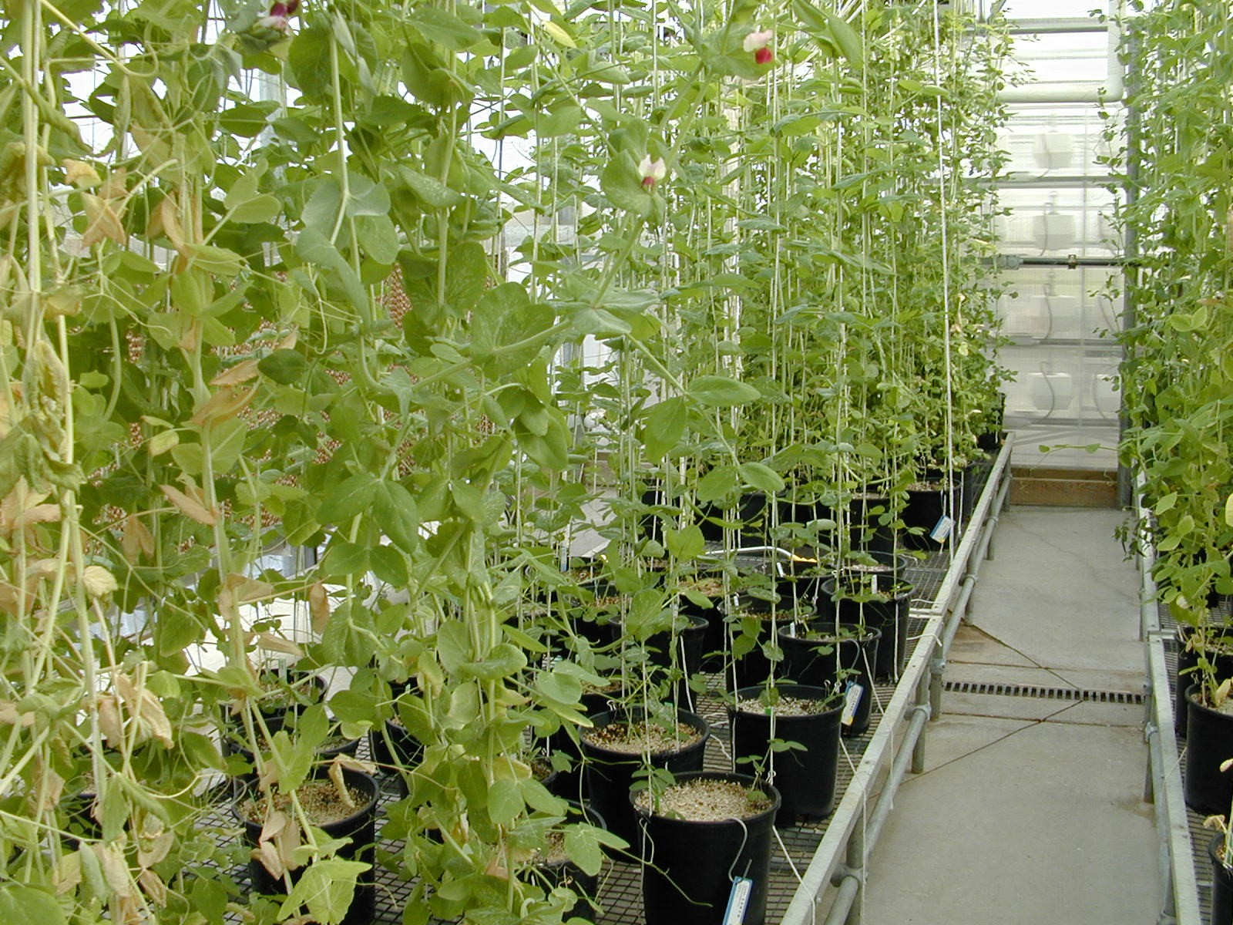
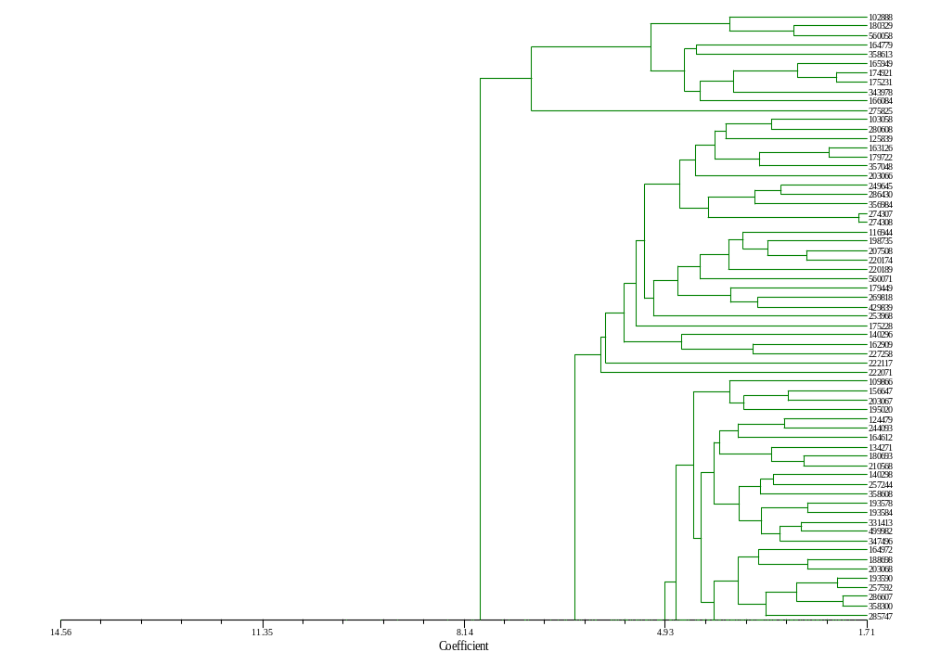



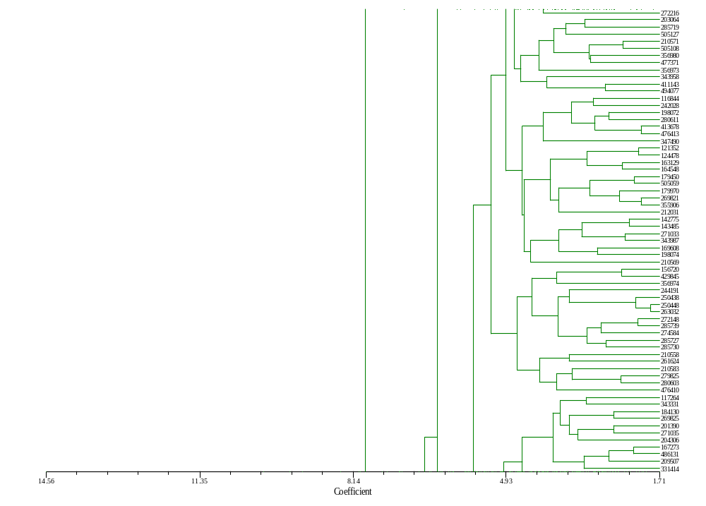
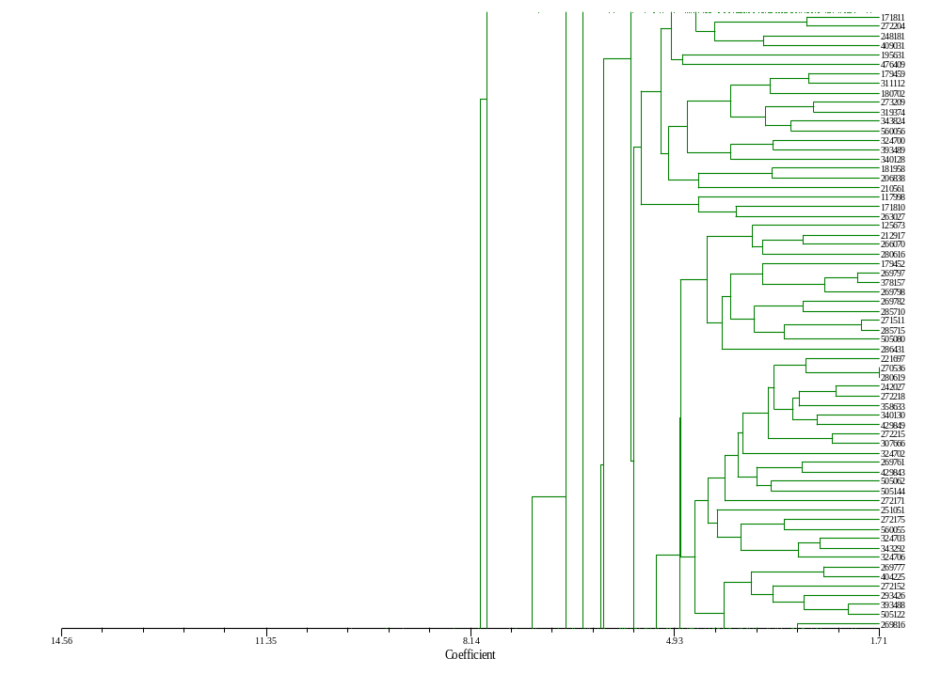
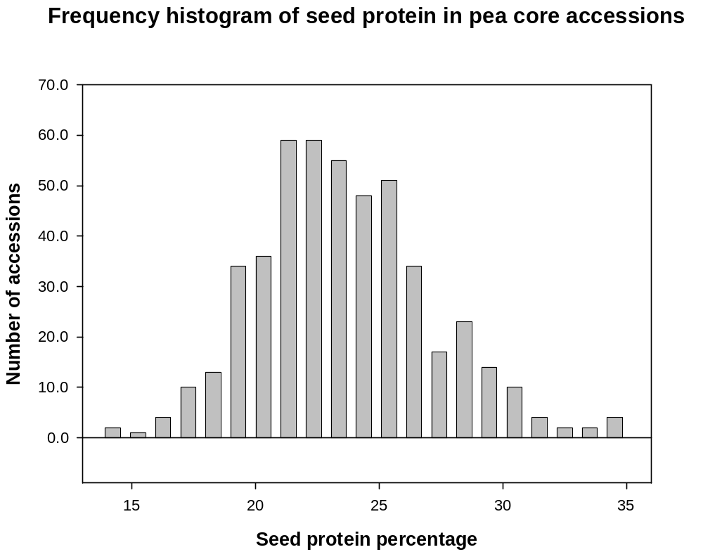
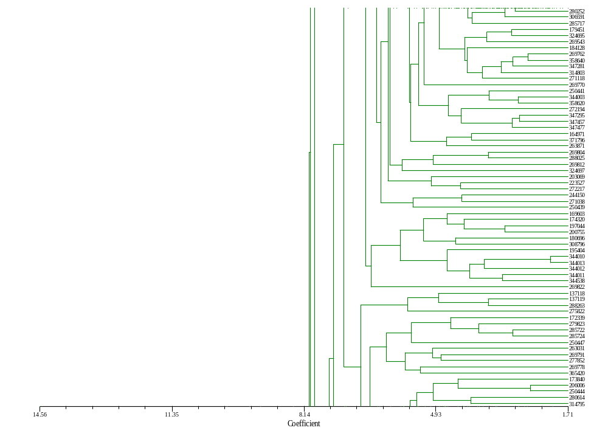
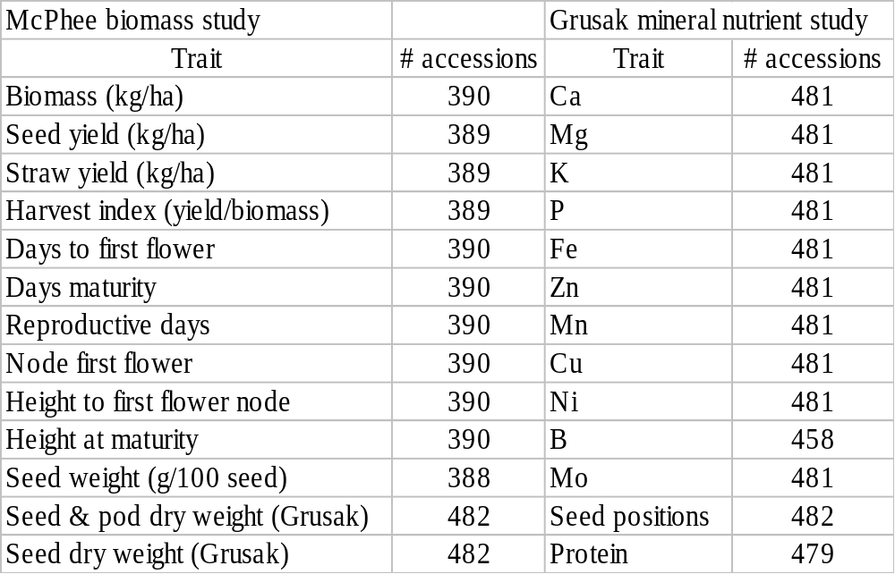
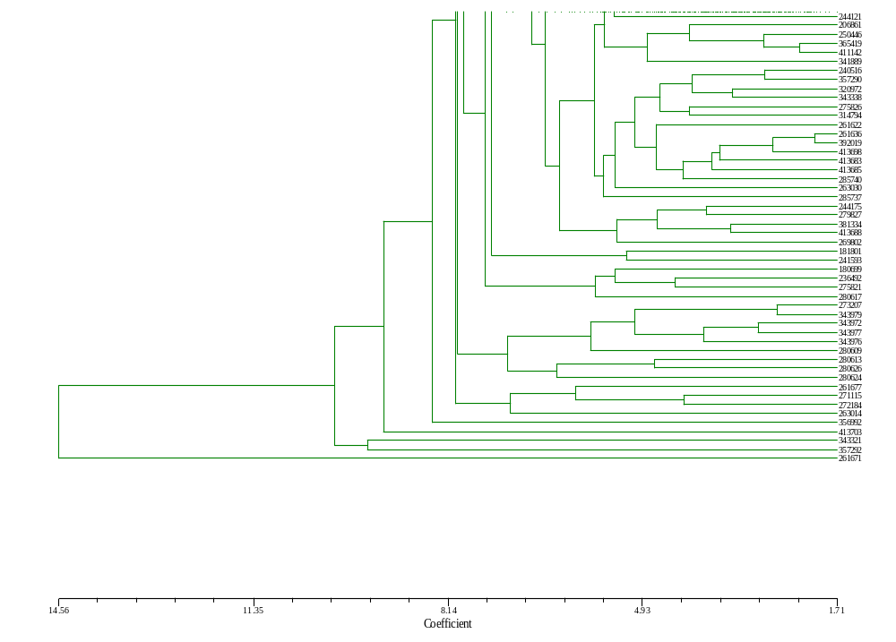
Poster 537. ASA-CSSA-SSSA Annual Meeting Denver, CO. November 1-6, 2003.
Figure 2. Refined pea core collection of 310
Accessions based on 26 quantitative trait data.
Refined pea core collection based on qualitative and quantitative characteristics
Clarice J. Coyne, USDA-ARS Western Regional Plant Introduction, Washington State University, Pullman, WA
The Pisum germplasm collection contains 3918 accessions. The first Pisum core collection created contained 504 accessions. This core was selected based on geographical origin and flower color (Simon and Hannan). Extensive phenotypic data has since been entered into the National Plant Germplasm System Germplasm Resources Information Network (GRIN) database by cooperators and 26 quantitative traits was used to select two new core collections. The new pea core collection consists of 310 accessions, a subset of the original 504. The new core and a mini-pea core collection of 50 accessions was created using yield component data published by McPhee (390 accessions), mineral nutrient data (481 accessions) collected by Grusak and seed protein content (481 accessions) from Coyne. A comparison of means, minimum and maximum values indicates no loss of genetic variation in the trait values used in this analysis. Next, the complete data set from GRIN (http://www.ars-grin.gov/npgs/)will be analyzed to further refine the new core collection. Approximately 550 pea accessions are genetic stocks (http://www.ars-grin.gov/ars/PacWest/Pullman/GenStock/pea/MyHome.html) so a core of 10% would be 336 accessions.
Materials and methods
The STAND module (NTSYSpc) was used to standardize the variables.
STAND performs a variety of linear transformations of the variables in a data matrix. The default options correspond to the usual standardization of a matrix used in numerical taxonomy. This module was used prior to SIMINT so as to reduce the effects of different scales of measurement in different characters. The linear transformation used is of the form:
y’= (y-a/b)-c
where several optional values for a, b, and c are provided. Note that by using the proper codes for a and b several different standardizations are possible. Dissimilarity coefficients for interval measure (quantitative) data were generated using the SIMINT module (NTSYSpc). The input was in the form of a rectangular data matrix after standardization and the output was a symmetric matrix. The default parameter DIST average taxonomic distance (NTSYSpc) was used to generate the matrix. A dendrogram was generated from the Sequential, Agglomerative, Hierarchical, and Nested (SAHN) clustering method using the unweighted pair-group method, arithmetic average (UPGMA) (Sneath and Sokal, 1973; Rohlf, 2000) using NTSYSpc SAHN module. The EUCLID coefficient was used to generate the dissimilarity matrix in Euclidean distances for the new core selected. Random numbers were assigned to accessions in similar clusters and used to select the accessions for the refined core (Figure 2).
Figure 1. The frequency histogram graphically represents the variation of total seed protein found in the first USDA Pisum core collection and indicates a two-fold difference between the lowest and highest protein concentration (Coyne et al 2003). A normal distribution for the trait is also indicated.
Table 1. Trait data used to refine the pea core collection.
References
Coyne, Razai, Baik, Gruzak. 2003. Variation for protein in the USDA pea core collection. NAPIA Biannual Meeting Abstracts.
Grusak, Knewtson, Ibrikci, Muehlbauer. 2003. Potential for Improving Micronutrient Nutrition in Cool Season Legumes. International Plant & Animal Genomes XI Conference, www.intl- pag.org/11/abstracts/W17_W110_XI.html.
McPhee and Muehlbauer. 2001. Biomass production and related characters in the core collection of Pisum germplasm. Genetic Resources and Crop Evolution 48:195-203.
Rohlf. 2000. NTSYSpc: Numerical Taxonomy and Multivariate Analysis System, version 2.1. Exeter Software, NY.
Simon and Hannan. 1995. Development and use of core subsets of cool-season food legume germplasm collections. HortScience 30:907.
Sneath and Sokal. 1973. Numerical Taxonomy. W.H. Freeman and Company. San Francisco.

