Slide 1

Development of markers associated with traits of agronomic importance in winter oats
Catherine Howarth, Alexander Cowan,
Irene Griffiths and Tim Langdon

Slide 2
Development and analysis of a UK mapping population and contrasting bulk segregants.
Buffalo × 96-41Cn3 (N.B. now named Tardis)
    Winter mapping family
    Key traits: Height, disease resistance, kernel content, lodging
Hendon × N327-6
    Key traits: Grain oil and protein, naked grain, height, disease resistance, flowering time
96-21Cn19 × SA99572
    Key trait: β-glucan
(Ac Assiniboia × 94-14Cn5/1) × 95-27Cn5/1/1
    Key trait: low lignin husk
Participants in this Defra and RERAD sponsored Sustainable Arable LINK project include IGER, the Roslin Institute, Senova Ltd, British Oat and Barley Millers Association, HGCA, Bernard Matthews Foods Ltd, British United Turkeys Ltd, British Poultry Council, Oat Services, GB Seeds Ltd, Svalof-Weibull AB, ADAS and Elm Farm Research Centre

Slide 3
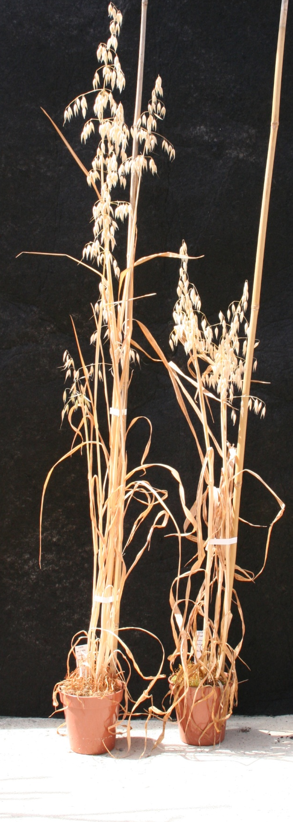
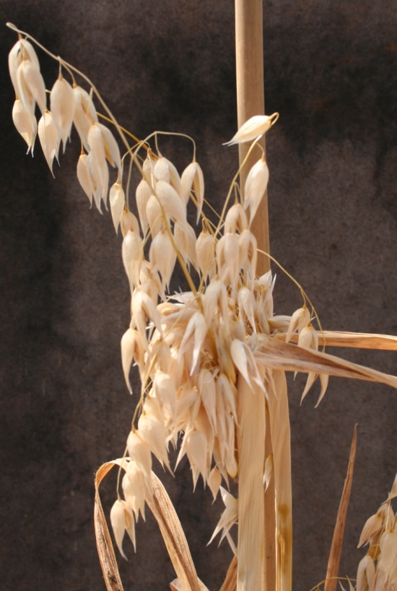
Winter oat mapping family
96-41Cn3 (Tardis)
conventional height
Good kernel content
large grains
high resistance to mildew from PC54.
Buffalo
husked dwarf variety
low kernel content
small grains
poor resistance to mildew

Slide 4
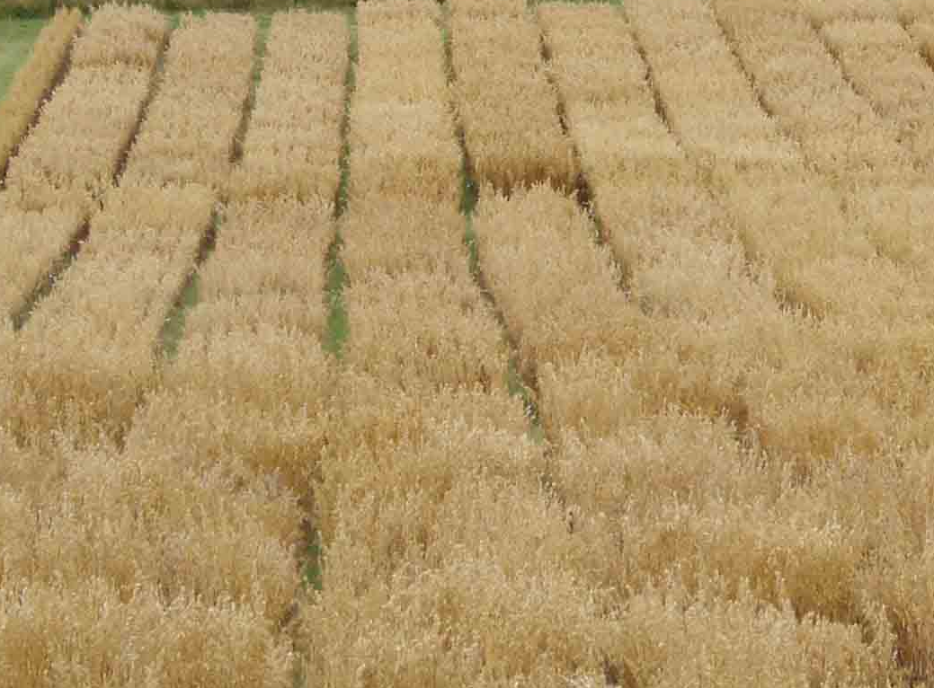
Buffalo × Tardis
F₂ grown in glasshouse 2005
F₃ grown unreplicated in field 2006
F₄ grown in field as a 3 rep 6 row trial; harvest complete August 2007. Winter hardiness, flowering, height, extrusion, yield components and disease resistance scored.
F₅ sown in field autumn 2007 in a 3 rep, 6 row trial for further phenotyping. Winter hardiness, Flag leaf emergence and flowering time scores completed.
157 loci currently mapped in 21 linkage groups; data from 300 DArT markers known to be polymorphic awaited. 89 loci unlinked.

Slide 5
Segregation of flowering time in Buffalo x Tardis population 2007

Slide 6
Genetic linkage map of Buffalo x Tardis mapping population June 2008 indicating position of dw6
dw6

Slide 7
wh06
wh07
wh08
Leaf length Apr 05
Leaf width Apr 05
Growth habit Apr 07
Co-location of QTL for winter hardiness and early season growth on Buffalo x Tardis linkage group 1
Tardis allele increases winter hardiness
Buffalo allele increases growth

Slide 8
EE 05
EE07
B
EE 05
EE06
T
EE 05
EE07
Flag leaf 08
T
Co-location of flowering time QTL on LG1 and 2

Slide 9
EU ERANET-PG proposal
  UK, Germany, Austria, Finland
  Association genetics in oats
    Field phenotyping in 6 locations over 2 years
    SSR/ AFLP/ DArT genotyping
  Development of SNP markers in oats via 454 sequencing
    Map in DH population
    Use with association panel

