Slide 1
Sickle Cell Anemia
Jeffrey Keefer MD, PhD

Slide 2
“Peculiar elongated and sickle-shaped red corpuscles in a case of severe anemia”
  JB Herrick describing disease in a West Indian student
  Archives of Internal Medicine in 1910

Slide 3
Sickle cell anemia is one of the most prevalent genetic disorders world-wide
Results from a variant of the Beta Globin gene on chromosome 11
  a glutamic acid at the 6th position is replaced by a valine resulting in formation of Hemoglobin S

Slide 4
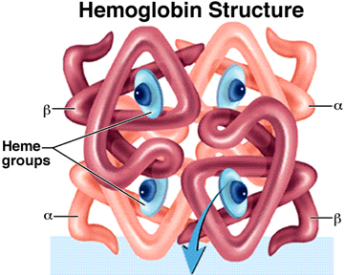
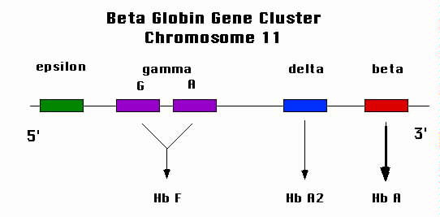

Slide 5
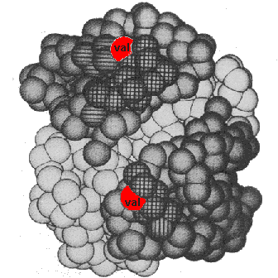
Hemoglobin S

Slide 6
Sickle cell disease genotypes
Hemoglobin SS disease (homozygous sickle cell disease)
  Both Beta Globin alleles with the S mutation
  Most common and most severe form
Hemoglobin SC disease
  One Beta Globin with the S mutation
  One Beta Globin with the C mutation (lysine at position 6)
  Patients sickle and have disease-typically milder than SS

Slide 7
Sickle cell disease genotypes
Hemoglobin S Beta 0 (null) Thalassemia
  One Beta Globin gene with the S mutation
  One Beta Globin Gene with a severe thalassemia mutation (No production of normal beta globin)
  Similar to SS disease
Hemoglobin S Beta Plus Thalassemia
  One Beta Globin with the S mutation
  One Beta Globin Gene with a mild thalassemia mutation (decreased but finite production of normal beta globin)
  Typically milder than SS disease

Slide 8
Non-sickling HbS genotypes
Sickle cell trait
  One normal Beta globin allele
  One beta globin allele with the S mutation
HbS HPFH
  One beta globin cluster with HPFH mutation
  One beta globin allele with the S mutation

Slide 9
Frequency of beta globin gene variants in California
Ethnicity | Hb SS^{b} | Hb AS | Hb S/beta⁺thal | Hb SC
Asian | 0/207551 | 1/1336 | 0/207551 | 0/207551
Asian Indian | 0/15843 | 1/725 | 1/15843 | 0/15843
Black | 1/700 | 1/14 | 1/4056 | 1/1297
Hispanic | 1/45622 | 1/183 | 1/729953 | 1/364976
Middle Eastern | 0/21677 | 1/360 | 0/21677 | 0/21677
Native American | 1/16529 | 1/176 | 0/16529 | 0/16529
White | 1/158127 | 1/625 | 1/553447 | 0/1106895
ªSource: Lorey et al (1996)
^{b}HbSS includes HbS/beta⁰-thalassemia

Slide 10
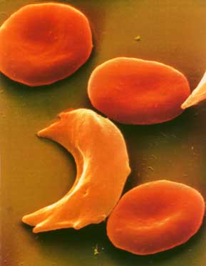
Hemoglobin S: What’s the big deal?
1927 Hahn and Gillespie showed sickling with deoxygenation of red cells in a patient

Slide 11
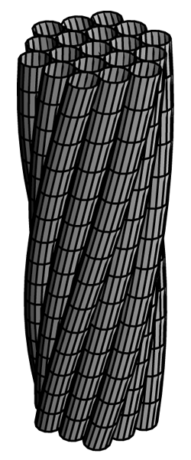
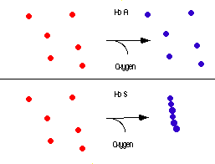
Hemoglobin S polymer formation
The hydrophobic valine is exposed in the deoxy conformation and burrows within a hydrophobic pocket of neighboring Beta chains

Slide 12
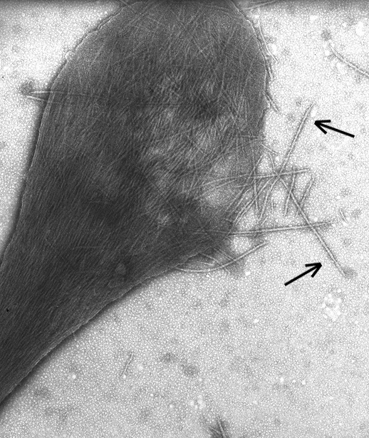
Hemoglobin
polymers

Slide 13
Simple pathology-complex disease
Presence of HbS leads to a variety of clinical manifestations- Cool pathophysiology at work!
  Infection painful crises
  chest crises priapism
  strokes pulmonary htn
  splenic sequestration avascular necrosis
  renal failure

Slide 14
Simple pathology-complex disease
Disease severity variable and difficult to predict
  Genotype (SS vs SC vs Sthal)
  Beta globin gene cluster haplotype
    Senegal most benign, central african republic most severe
  Fetal hemoglobin levels-Higher is better
  BAD as infant: dactylitis, severe anemia, leukocytosis
Steinberg MH. Predicting clinical severity in sickle cell anaemia.Br J Haematol. 2005 May;129(4):465-81.

Slide 15
Incidence of sickle cell complications in the US, based on genotype
Complication | HbSS (per 100 pt-years) | HbSC (per 100 pt-years) | HbS/beta⁰-thalassemia (per 100 pt-years) | HbS/beta⁺-thalassemia (per 100 pt-years)
Acute Chest Syndrome | 12.8 | 5.2 | 9.4 | 3.9
Bacteremia | 6.5 | 5.8
Stroke | 0.61 | 0.17 | 0.10 | 0.11
Pain crisis | 24.0 | 8.5
A.J. Epidemiology May 2000

Slide 16
Survival by genotype in 1980s
Sex and Genotype | Median Survival
Males with Hb SS | 42 years
Females with Hb SS | 48 years
Males with Hb SC | 60 years
Females with Hb SC | 68 years
In 1973 mean survival with SS disease was 14 years!
Care for sickle cell patients has begun to focus on screening and prevention in addition to symptom management

Slide 17
Early Diagnosis
Maryland has universal newborn hemoglobin screening
  Big step in decreasing mortality in sickle cell disease
  Identify babies to prophylax against infection
Isoelectric focusing
  Electrophoresis in a pH gradient
HPLC column chromatography to quantify
Molecular diagnostics-sequencing the beta globin gene

Slide 18
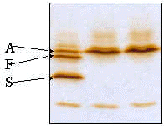
IEF Gel
1 2 3
Reported by intensity: SFA
Hemoglobin S beta plus thalassemia

Slide 19
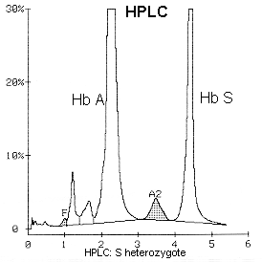
TRAIT on HPLC
Report is ASFA2
Sickle cell trait

Slide 20
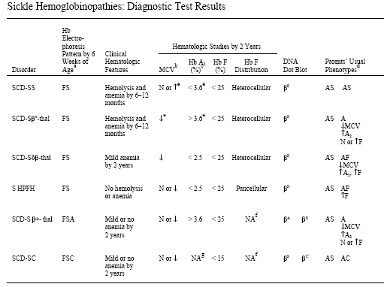
SICKLE CELL DISEASE IN CHILDREN AND ADOLESCENTS: DIAGNOSIS, GUIDELINES FOR COMPREHENSIVE CARE,AND PROTOCOLS FOR MANAGEMENT OF ACUTEAND CHRONIC COMPLICATIONS©
Mid-Atlantic Sickle Cell Disease Consortium (MASCC) Practice Guidelines Workgroup
sponsored by the Mid-Atlantic Regional Human Genetics Network (MARHGN)

Slide 21
Preventative Medicine
All patients need a medical home
  Primary pediatrician + hematology care
  Q3month visits here in the first year then q6month-yearly depending
Patient/family education
  State educator meets with each family at home or in the clinic for detailed teaching
    Assess fever, respiratory distress, splenomegaly and jaundice at a minimum
    Management of febrile events

Slide 22
Prevention
Prophylactic Penicillin (PROPS study, NEJM1986)
Shown to reduce mortality from pneumococcal sepsis (84% decrease in bacteremia)
Start by 2 months of age (or at first visit)
125mg BID until age 3
250mg BID until ???

Slide 23
Penicillin—When to stop?
We historically have stopped 1 year after 2nd 23 valent pneumococcal vaccine (age 6)
PROPS II showed no advantage of continuing after 5yo but many centers do
Immunology division does lifelong PCN for asplenic patients-why don’t we?
Recent death from pneumococcal sepsis 1 week after stopping PCN at age 7
Our management strategy is in flux
  considering longer term therapy

Slide 24
Prevention
Immunizations
Routine immunizations including H. flu and Prevnar, the 7 valent pneumococcal conjugate
23 valent polysaccharide conjugated pneumococcal vaccine at age 2 and 5
  Booster schedule unclear and no formal recs
  Immunology does q5-10 years
Influenza vaccine yearly
Meningococcal vaccine
  Have not been giving to kids routinely
  Definitely for college

Slide 25
Prevention
Health screening
Transcranial Doppler Ultrasound for stroke risk
At age 2, for SS patients, begin TCD ultrasound screening on a yearly basis
  Measures flow velocity in CNS vasculature
    “garden hose analogy”
    <170cm/sec is normal
    170-200-repeat frequently to assure no progression to abnormal
    >200 abnormal-repeat to confirm and begin chronic transfusions if abnormal

Slide 26
STOP: Stroke prevention in Sickle Cell Anemia Trial (NEJM 1998)
Trial showed that stroke risk is elevated (10% per year) in patients with abnormal TCD
Chronic transfusions in kids with abnormal TCDs decreases stroke risk by 6 months on therapy
  Recent California data show study suggest 5-6 fold decrease in stroke pre versus post TCD (Fullerton,Blood 2004)
When to stop???

Slide 27
STOP II trial
Randomized kids after 3 years of transfusion to
  Continue transfusion
  Stop transfusion
Monitor TCD and clinical parameters
Study halted secondary to high rate of conversion to abnormal TCD and stroke in several patients
For now abnormal TCD = prolonged transfusional therapy

Slide 28
Other preventative measures
CNS
  Neurocognative testing and education intervention
  MRI for silent stroke-unsure of treatment plan-needs study!!
Lungs
  Pulmonary function testing-especially with RAD or post ACS
  Sleep study for snoring/sleep apnea
  Pulmonary Hypertension screening late adolescents/adults
Renal
  Screening for proteinuria—microalbumin
    Use of ACE inhibitors to prevent renal disease-some data
Eyes
  Yearly optho exams especially in SC patients
General
  Prophylactic use of Hydroxyurea to prevent organ damage
  BABY HUG STUDY

Slide 29

  “My baby has a fever”
  “I am in pain all over”
  “My hand is numb”
  “I can’t catch my breath”
  “My baby has a huge spleen”
  “My privates are swollen”

Slide 30
Fever
Infection is the most immediate risk for infants with SCA
All sickle cell patients with t>38.5 or recurrent low grade temps should be seen immediately
  PE, CBC with retic, blood culture, chest x-ray, UA and urine culture
Admit for antibiotics (48 hr rule-out) and observation
  Young Kids (under 3?, no right answer)
  Sick kids (temp>40, low BP etc, petechiae etc)
  Indwelling catheters
  Elevated white counts or low platelet counts
  Alarming Urinalysis
  Infiltrates
  Toxic smears
  Social concerns-no phone, transportation etc

Slide 31
Outpatient fever management
DISCUSS WITH YOUR FRIENDLY ATTENDING PLEASE
  Older kids
  Not ill
  Good family for follow-up
Get blood cultures
GIVE ceftriaxone
Observe after antibiotics in ED (4 hours recommended)
Follow-up next day for evaluation and 2nd ceftriaxone dose pending culture results

Slide 32
Pain
Dactylitis in infants—usually ok with NSAIDs
Mild pain
  NSAIDs and/or oral narcotics-many families have a “home regimen” for early pain
  Rest and fluids
  Local measures-warm compresses, massage, distraction
Failing home meds: ED VISIT
  Aggressive upfront pain management is key
    Morphine sulfate IV large doses repeating as needed
    Tordol IV
    Hydration (not hyperhydration)

Slide 33
Inpatient Pain Management
Hematology manages pain of sickle cell patients on our service
PCA is typical starting point (some exceptions)
  Morphine versus Dilaudid
  Orders are on D drive on public workstations-PCA folder
    Residents will write these from Excel spread sheet-requires 2 signatures-Dosing ranges are included in orders
    Orders include Tordol dosing and other prn meds such as senekot, benedryl etc
  Both basal and bolus are given-Bolus use is an indicator of pain control
  Remember typical pain crisis is 5-7 days

Slide 34
Pain
Transition to oral
  Add daily IV dose from basal and bolus together and convert this to a daily oral dose
    IV to Oral conversions vary-usually 3X for MSO4-see the Lane or other reference for conversion
  Leave bolus on while initially transitioning
  Don’t need to be pain-free to leave
  Be sure patients can fill their narcotics before leaving the hospital

Slide 35
Pain
For atypical pain think of other causes
  Myalgias-Influenza
  Point tenderness with fevers-osteomyelitis
  Joint pain-rheumatologic issues
Consult pain service
  Prolonged/chronic pain
  Multiple pain meds
  Use of Epidurals
  Don’t work outside your own comfort zone with these drugs!!!

Slide 36
Acute Chest Syndrome
Definition:
  New infiltrate + (fever or chest pain or hypoxia)
Causes (Vichinsky,NEJM 2000)
  Fat emboli from necrotic marrow
  Chlamydia pneumoniae, Mycoplasma
  S.pneumo, Staph aureus
  Parvo

Slide 37
ACS Management
Antibiotics
  Ceftriaxone + Biaxin
Incentive spirometry/pulmonary toilet
Albuterol if needed
Transfusion therapy
  Simple transfusion for low hemoglobin (maybe)
    BE CAREFUL —Stroke assoication with simple transfusion especially with hct over 30% (Strouse in progress)
  Exchange transfusion
    Some would argue this is best in almost all cases
    Certainly indicated for ill children or for clinical deterioration

Slide 38
ACS Management
Steriods anyone? (Buchanan Blood 1998)
  0.3mg/kg of dexamethasone q12hrX 4 doses
  Lots of improvement but 27% readmitted within 72 hours vs 4% no steriods
  Our experience is even worse with “rebound effects” primarily prolonged hospitalization for pain
Conclusion: No steroids for ACS
Treat asthma however if necessary

Slide 39
Stroke
10-12% of children with SCA will have a symptomatic stroke (large vessel disease)
  Additional 20% have asymptomatic infarcts by MRI scanning
RAPID action can reverse deficits associated with acute stroke
For any suspicious CNS event
  EXHANGE TRANSFUSION (Don’t delay for imaging)
    Goal is HbS < 30%
    Manual exchange in PICU
    Erythrocytopheresis team (Need large lines for this)
      Page on call aphoresis attending for help setting this up
Long term management with chronic transfusion

Slide 40
Stroke
Exchange transfusion ASAP for CNS symptoms
  Don’t wait 2 days for MRI slot
  Don’t wait until morning so everyone can sleep
  Don’t wait to discuss with your team on rounds with a full notebook of articles to impress the attending
Of course nothing is every easy or straight forward!!

Slide 41
Splenic Sequestration
Occurs in infants and young kids with SS dz
  Rapid onset of fatigue, listlessness and pallor
  Can progress quickly to shock
  SC patients sequester as older kids/adolescents and tend to be less severe
Admit and closely monitor spleen size and hemoglobin-q2-4 hours in some cases
Therapy is red cell transfusion/fluid management or emergent splenectomy in extreme cases
Recurrent episodes may be indication for elective splenectomy

Slide 42
Aplastic Crisis
Low reticulocyte counts with no hemoglobin drop deserve close outpatient follow-up
Patients with Hemoglobin 1.5-2g less than baseline with low reticulocyte count need admission with observation
  PRBCs for symptomatic/exaggerated anemia
  Slow infusion
Isolation and send Parvovirus studies

Slide 43
Priapism
Painful persistent erection due to vaso-occlusive obstruction of the venous drainage
  89% of males will have at least one episode by adulthood
Episodes classified as
  Stuttering: frequent intermittent episodes with mild tenderness that resolves spontaneously
    Often in younger prepubertal kids
  Persistent: severe/painful often seen in pubescent or older teens
Both stuttering and persistent episodes can lead to impotence but persistent painful erection is a medical emergency

Slide 44
Priapism management
Stuttering
  Typically resolves on its own
  Ensure adequate hydration
  Oral analgesia if necessary
  Attempt to urinate
  Gentle exercise: walking stairs etc
  Treat any underlying UTI if present

Slide 45
Priapism management
Persistent
  All of the therapies for stuttering are appropriate as initial therapy (can be started at home)
    Analgesia, hydration, exercise, urination
  If these don’t work patients need to be seen ASAP
  Next steps are really not well defined:
  “There is no evidence for the benefits or risks of the different treatments for both stuttering and fulminant priapism in sickle cell disease. This systematic review has clearly identified the need for well-designed, adequately-powered, multicentre randomised controlled trials assessing the effectiveness of specific interventions for priapism in sickle cell disease” Chinegwundoh F, Anie KA Cochrane Database Syst Rev. 2004 Oct 18;(4):CD004198.

Slide 46
Priapism management
Many therapies have been utilized
  IV narcotics and hydration is standard
  Transfusion-exchange and simple
    No good data, simple exchanges have been reported to worsen in some situations
  Vasoactive agents-oral or injected into corpora cavernosa
    Terbutaline
    Hydralazine
    Epinephrine

Slide 47
Priapism management
Penile aspiration (Buchanan Blood 2000)
  Aspiration with epinephrine irrigation in ED within 6 hours of onset
  Successful in 37/39 cases
  Our urologists have much less faith in this procedure
    Often want “maximal medical therapy” (exchange) before attempting this
Our approach : dialogue with urology early
  Typically kids ultimately get exchange and/or aspiration but order is variable-I push for aspiration up front
Prevention
  Antiandrogen therapy has been successful
  Oral pseudoephrine

Slide 48
Therapy for Sickle Cell Anemia
Chronic Transfusion
Hydroxyurea
Bone Marrow Transplant

Slide 49
Chronic Transfusion
Monthly transfusion to suppress reticulocytosis with HbS < 25%
Indications
  Prevention of recurrent stroke
  Prevention of first stroke (abnormal TCD)
  Recurrent ACS
  Recurrent severe pain crises
  Renal failure and heart failure
    Not studied in children

Slide 50
Transfusion Complications
Iron overload
  No specific data in kids on effects of this
    In adult SS disease overload+ increased mortality and organ failure (Ballas 2001)
  Defining iron status is important
    Liver biopsy
    Where iron is deposited: RES versus organs
  Desferal therapy is standard therapy
  Erythrocytopheresis as a transfusion method may decrease need for chelation
Allo-immunization: Anti K, E, C most common
Transfusion reactions
Potential transfusion mediated infections

Slide 51
Hydroxyurea
Causes increase in fetal hemoglobin production
  HbF inhibits polymerization of HbS
Myelosuppressive effects may also be important
In adults HU decreases
  Pain crises
  ACS events
  Need for Red cell transfusions
  Mortality*** (Steinberg,JAMA 2003)
    40% reduction in mortality in patients on HU
  Initial publication NEJM 1995 Multicenter Study of HU (MSH) Drs. Charache and Dover

Slide 52
HU in Children
Now several studies published: as young as 6 months of age
To summarize
  HU increases HbF levels (and F cells) in kids
    Higher baseline=better effect
    Higher dose+better effect
  Toxicity
    Myelosuppression, N/V, rashes,
    No severe effects reported-no obvious malignancy link
    No effect on growth or development noted
  Clinical efficacy
    Decrease in pain, ACS and transfusions
    Use in stroke prevention still not definative

Slide 53
Hydroxyurea
Indications are bad disease
  Frequent pain or ACS are most common
Start low and escalate every 2-3 months
  15mg/kg to start
  Close followup for counts (myelosuppression)
  Follow HbF response
  Follow clinical course
    May have response at less than MTD that is sufficient

Slide 54
Bone Marrow Transplant
It is curative
Standard matched sib versus non-myeloablative (mini-transplant)
Our non-myeloablative protocol
  Initial trials failed to induce stable engraftment in 3 patients
  Now adding cytoxan post infusion to help prevent graft failure

Slide 55
Nice reference on line
http://www.pitt.edu/~marhgn/guide.pdf
SICKLE CELL DISEASE IN CHILDREN AND ADOLESCENTS: DIAGNOSIS, GUIDELINES FOR COMPREHENSIVE CARE, AND PROTOCOLS FOR MANAGEMENT OF ACUTE AND CHRONIC COMPLICATIONS©
Mid-Atlantic Sickle Cell Disease Consortium (MASCC) Practice Guidelines Workgroup
sponsored by the Mid-Atlantic Regional Human Genetics Network (MARHGN)

Slide 56
THE END

