Slide 1
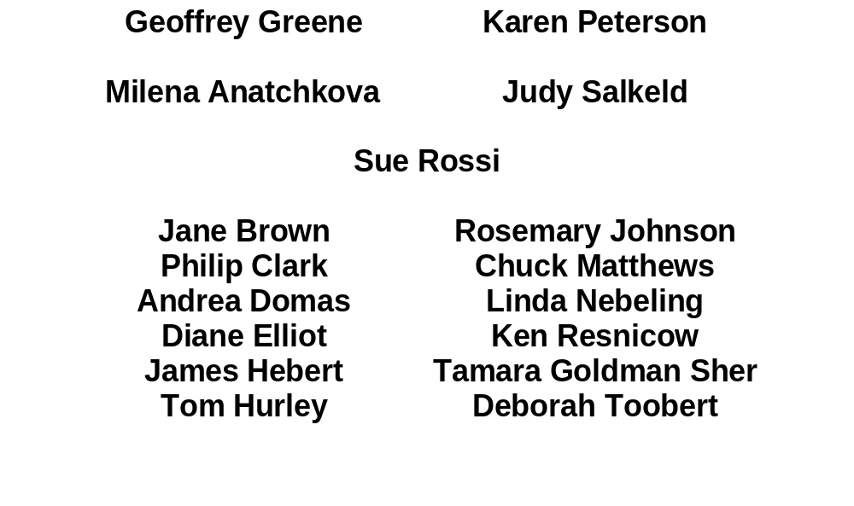
BEHAVIORAL CHANGE CONSORTIUM (BCC) DIETARY VALIDATION STUDIES
Supported by NIH OBSSR RFA OD-98-002

Slide 2
OVERVIEW
BCC provides a unique opportunity to validate brief, self-report measures of fruit and vegetable servings and fat intake among diverse samples participating in intervention trials to reduce risk of chronic diseases.
COMMON MEASURES:
1) NIH revised fruit and vegetable screener
2) NIH fat screener
FUNDING MECHANISM (NCI) 1) Supplement augments original scope of work 2) 6 of 15 BCC projects
    3) Cost-effective validation study

Slide 3
PARTICIPATING SITES
The SENIOR Project (Stage-based Health Promotion with the Elderly)
P.I.: Phillip G. Clark, URI: NIA R01AG16588-02
Reducing Disease Risk in Low-income Postpartum Women
P.l.: Karen Peterson, HSPH: NICHD R01HD37368-02
Promoting Healthy Lifestyles: Alternative Models’ Effect
P.I.: Diane L. Elliot, OHSU: NIAMS R01AR45901-02
Health Promotion Through Black Churches
P.I.: Ken A. Resnicow, Emory U.: NHLBI R01HL64959-02
A Couples Intervention for Cardiac Risk Reduction
P.I.: Tamara Goldman Sher, ORI: NHLBI R01HL62158-02
Enhancing Support for Women at Risk for Heart Disease
P.I.: Deborah J. Toobert, ORI: NHLBI R01HL62156-02

Slide 4
RATIONALE
BCC common measures are feasible to administer and yield collection of comparable data across a range of behavioral interventions in different study groups.
Original 5-A-Day screener and brief measures of fat intake are widely used, but underestimate dietary intake compared with
in-depth self-report measures.
NIH revised Fruit and Vegetable Scan (FVS) and NIH Fat Screener (FS) are promising options for both surveillance and outcome measures for population-based interventions.

Slide 5
Prior validation studies had limited access to diverse populations, and did not evaluate changes in self-report estimates over time or in response to intervention.
Absorption of phytochemicals and micronutrients is a necessary step for chronic disease risk reduction through increased fruit and vegetable intake. Thus, dietary calibration must be complemented by biochemical measures of validity.

Slide 6
PURPOSE AND DESIGN
Compare the relative validity of NIH screeners across samples that vary by age, gender, educational level, race/ethnicity and health and reproductive status.
Subjects will be randomized into treatment and control conditions, lasting at least 12 months.
Relative validity evaluated at baseline and at later points to assess sensitivity to detect intervention-related change.

Slide 7
Criterion measures include:
- Serum assays (5 projects)
- 24-hour dietary recalls (4 projects)
- Anthropometry (4 projects)
Assessing social desirability trait (4 projects) permits quantification of systematic bias in self-reports based on screeners.

Slide 8
SPECIFIC AIMS
Evaluate the correlation and limits of agreement between servings of fruit and vegetables estimated from the FVS and servings calculated from the mean intake on three 24-hour recalls.
Analyze the correlation and limits of agreement between fat intake estimated from the FS and fat intake calculated from the mean intake on three 24-hr recalls.
Evaluate the sensitivity of these instruments to measure dietary change after behavioral interventions designed to increase fruit and vegetable consumption and/or decrease fat consumption.

Slide 9
Compare FVS baseline estimates of fruit and vegetable intake as well as change in intake over time with serum carotenoids, retinol, tocopherol, and folate.
Compare FS baseline estimates of fat intake as well as change in intake over time with serum cholesterol, HDL, triglycerides and LDL.
Pool the analyses from each participating BCC site to allow for subgroup analyses.
Calculate the amount of bias in screener estimates of dietary intake of fruit and vegetables and total fat due to social desirability trait.

Slide 10
METHODS
Common procedures and protocols reduce variation, provide basis to compare self-report estimates in different populations and intervention settings.
Existing protocols for intervention trials unchanged by additional research questions. BCC supplemental activities affect informed consent only for participants in validition subsamples.
Validation subjects selected randomly from subjects recruited for intervention trials at the six sites.

Slide 11
BIOCHEMICAL MEASURES
Fasting venous sample collected in 5-7 ml separator tube, clotted for 30 min and centrifuged.
Carotenoids, retinol, tocpherol (UIC, Bowen)
Folate (Tufts University, Selhub)
Lipids
Total cholesterol and triglycerides
HDL cholesterol
LDL cholesterol

Slide 12
DIETARY ASSESSMENTS
Three 24-hour recall interviews at each assessment timepoint over a 2-week period, including one weekend day.
Interviewers follow NDS protocol.
Interviewers blinded to treatment group, and indicate if the recall appeared reliable.
A list of NDSR food codes for fruits and vegetables will be created to calculate number of USDA Food Guide Pyramid servings.

Slide 13
ANTHROPOMETRY
Weight will be measured by trained project staff on a balance-beam scale, and reported to the nearest 0.1 kg.
Height will be measured using a wall mounted stadiometer, to the nearest 0.1 cm.
Triceps and other skinfold thicknesses will be assessed using a Lange caliper, and recorded to nearest 0.5 mm.
Waist and hip circumferences will be measured with non-stretchable tape to 0.1 cm.

Slide 14
DATA ANALYSIS
Servings of fruit and vegetables will be calculated from the FVS and dietary fat from FS using NIH procedures.
Daily servings of fruits and vegetables in Food Guide Pyramid portion sizes will be calculated from the average of the three 24-hour recalls.
Examine means and distributions. Transform fruit and vegetable servings, biochemical measures as indicated.

Slide 15
PRIMARY ANALYSES
Correlation coefficients between the estimates based on screeners and criterion measures (recalls, biochemical assays)
Sensitivity, specificity, NPV, PPV of screeners in classifying Healthy People 2010 Objectives
    > 5 fruit and vegetables, > 2 fruit, > 3 veg
    < 30 % fat

Slide 16
SECONDARY ANALYSES
Restrict sample to subjects with 3 recalls
Multiple regression analyses to define the relationship between dietary and biochemical measures adjusting for age, gender, race/ethnicity, cigarette smoking, BMI, supplement use
Calculate correlation coefficient within measurement error model
Estimate the bias in the test method relative to the comparison method. The regression coefficient obtained for “social desirability trait” will be the bias associated with that variable (Hebert et al., 1997)

Slide 17
STATUS AND LOGISTICS
Baseline data being collected, cleaning and analysis 2001-2 (URI); Follow up data and analysis 2002-3 (HSPH)
Factors supporting cross-site cooperation and collaboration:
  NCI supplemental funding, Dr. Nebeling-Project Officer
  Common measures and analyses
  Coordinating sites (HSPH, URI)
    Dedicated time of project managers x 2
    Meet every 1-2 months to discuss logistics and analyses, share resources
Nutrition workgroup and subgroups convene by conference call every 1-2 months to discuss, resolve specific issues

