Slide 1
Use of breeding populations to detect and use QTL
Jean-Luc Jannink
Iowa State University
2006 American Oat Workers Conference
Fargo, ND 24 July 2006

Slide 2
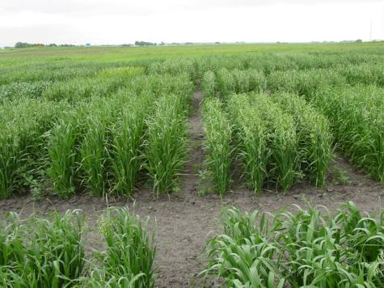

Translation
Experimental
Populations
Breeding
Populations

Slide 3
Bi-parental cross
From Schön et al., yield, plant height, and grain moisture all over here

Slide 4
Community Effort Needed
The number of “effective factors” influencing a “highly quantitative” trait (e.g., grain yield): probably >50.
Number of individuals needed to identify such small-effect QTL: probably ~ 1000.

Slide 5
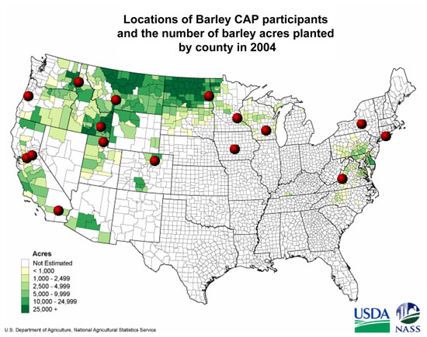
http://www.barleycap.org
96 Lines
96 Lines
96 Lines
96 Lines
96 Lines
96 Lines
96 Lines
Total:
960 Lines / Year
96 Lines
3000 SNP / Line
Objective: Capitalize on phenotyping in breeding programs

Slide 6
Barley CAP

Slide 7
QTL Detection in Breeding Populations
P = E + G
P = E + M + u
•
•
•

Slide 8
Requirement of Linkage Disequilibrium
A specific typed marker allele always comes together with the same causal QTL allele
This is Linkage Disequilibrium
Under what conditions does this occur?
•
usually

Slide 9
Mutation
Original Population State
AB
aB_x0003_
A mutation arises
AB
AB
aB_x0003_
aB_x0003_
aB_x0003_
aB_x0003_
AB
AB
AB
AB
aB_x0003_
aB_x0003_
aB_x0003_
Ab
The b allele now always occurs in the presence of the A allele

Slide 10
Subpopulation structure / admixture
Population 1
Population 2
B
A
a
B_x0003_
A
b
A
b_x0003_
b
A
B
A
A B
a
B
B
a
b
A
A
b
a
B
b
A
A
b
b
A
A
B
If the populations come together, the b allele again always occurs in the presence of the A allele

Slide 11
Structure
Spring barley &
2 vs. 6 row
Winter barley

Slide 12
Analysis Given Structure
Each individual has a probability of belonging to each subpopulation: Q
Each subpopulation has its own mean, v_{k}
But only one effect is associated with each allele, α
•
•

Slide 13
QTL x E?
Dry
Wet
QTL x E x Structure?

Slide 14
Barley CAP

Slide 15
Possible Use
Make
Crosses
Make
Crosses
Contribute
phenotype
genotype
data to THT
ALT
F₁→F₂
F₁→F₂
Yr5
Yr1
Yr1
F₂→F₃
F₃→F₄
F₂→F₃
F₃→F₄
Yr4
Yr3
Yr2
Yr2
PLT
ALT
F₄ Spc Plt
F₄ Spc Plt
Yr3
Genotype
Select on m
Increase in NZ
Head Row

Slide 16
Key Question
What level of LD exists in the “American Oat Population?”
To detect causal polymorphisms, they need to be in high LD (r² > 0.5) with typed polymorphisms.
If (r² > 0.5) extends over several cM, we will need fewer markers

Slide 17
LD in European barley
“There were in total 53 marker pairs with distance < 1 cM, of which 32 had a significant correlation (P < 0.01), while 19 pairs were not significantly correlated (P > 0.01) and thus in LE.”
N.B. r²>0.06 => P < 0.01, whereas r²>0.50 needed…

Slide 18
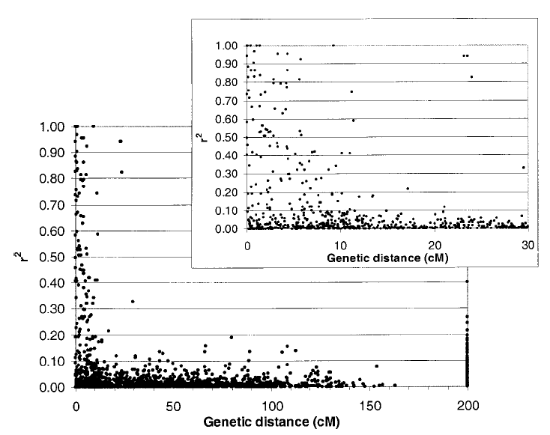
Linkage Disequilibrium

Slide 19
LD in North American Oat
O’Donoughue et al. 1994 “Relationships among North American Oat Cultivars Based on Restriction Fragment Length Polymorphisms”
83 cultivars (both spring and winter)
48 probes
205 polymorphic bands

Slide 20
Extended data from Sorrells
56 Probes
239 Polymorphic bands (alleles)
28441 allele pairs

Slide 21
Distribution of r²

Slide 22
Linkage Disequilibrium

Slide 23
Extended data from Sorrells
56 Probes
40 Probes with position on KxO (Wight 2003)
21 Probes with a single position on KxO
8 Probe pairs with single location on same linkage group

Slide 24
LD in North American Oat

Slide 25
Questions for DArT markers
Likely to be biased toward transcribed / untranscribed genomic regions?
What minor allele frequencies does the discovery process allow?
Will they mark only a single location in the hexaploid genome?
We should probably be able to use the discovery / diversity panel for an LD study

Slide 26
Conclusion
I think LD-based MAS has promise
  integrated discovery and use of QTL
  capitalizes on phenotyping by breeders
I think we are already setting up the DArT marker discovery process so as to get a first estimate of feasibility in oat.

Slide 27
LD decay over time

