Slide 1


Cognitive Behavioral Therapy for Medically Ill Patients
Jeffrey A. Cully, PhD
Michael E. DeBakey VAMC
Baylor College of Medicine
Houston Center for Quality of Care and Utilization Studies

Slide 2
Outline
Background – Depression/Anxiety in Medical Illness
ACCESS Project (CBT for Medically Ill)
Summary / Opportunities for Rural MH Applications

Slide 3
Medical Illness, Depression, Anxiety
Depression and anxiety are highly prevalent
  Primary care settings = 15%-20%
  Chronic illness (e.g. COPD, CHF) = 25%-50%
Depression and anxiety associated with increased morbidity, mortality, health service use and cost (Katon, 2003)
Few medically ill patients with depression and/or anxiety are recognized and adequately treated

Slide 4
Why are so many going without mental health care?
Patient barriers
  Negative MH attitudes, beliefs, and treatment expectations
  Often present with physical rather than psychological concerns
  Mismatch between preferences and availability of care. Patients prefer psychotherapy to medications

Slide 5
SC MIRECC Pilot Grant
(funded Oct 2007)
Purpose/Goals
  1)To develop a manual-driven psychosocial intervention to meet the unique needs of medically ill patients with depression and/or anxiety.
  2) To conduct an open trial to assess feasibility and preliminary outcomes for depression, anxiety, and quality of life

Slide 6
Aim 1: Treatment Development
Modular skill-based approach
  Physical Health / Self-Management Skills
  Traditional CBT Skills (thoughts, behaviors)
Brief / Time Limited Treatment
  45 minute sessions
  Active treatment = 6 sessions
  Booster sessions at weeks 8,10,12
  Sessions offered in-person and by telephone
Therapist Manual and Patient Workbook

Slide 7
Intervention Components
Adjusting to Chronic Conditions using Education, Support, and Skills (ACCESS)
Core Modules (weeks 1 and 2)
  Chronic Cardiopulmonary Disease and Stress
  Understanding Personal Impact and Increasing Control
Elective Modules (sessions 3 through 6)
  Disease Management (exercise, diet, sleep, etc)
  The Power of Thoughts
  Increasing Pleasant Activities
  Learning How to Relax
  Problem Solving

Slide 8
Aim 2: ACCESS Open Trial
To examine feasibility, acceptability, and outcomes
  Outcome Measures:
    Beck Depression Inventory – Second Edition
    State Trait Anxiety Inventory
    Disease Specific Quality of Life
    General Quality of Life
  Assessments
    Baseline
    Post-treatment (8 weeks)
    Follow-up (20 weeks)

Slide 9
ACCESS
Participants
VA patients with Congestive Heart Failure (CHF) or Chronic Obstructive Pulmonary Disease (COPD)
Must have CHF/COPD functional impairment and clinically significant symptoms of depression (BDI-II) or anxiety (STAI-T)

Slide 10
ACCESS
Participants
(data from April 2008)
VA Recruitment recently ended
  23 patients enrolled
  Average age 71.4 (SD 8.23)
  22 men and 1 woman
  18 Caucasian and 5 African American
  CHF only (n=8), COPD only (n=5) both (n=10)
  Depression only (n=6), anxiety only (n=5) both (n=12)

Slide 11
ACCESS
Results - Acceptability
Low attrition
  83% attended first session
  Average number of sessions 5.5 (out of 6)

Slide 12
Satisfaction
CSQ-8
Response | 8 Week (N=16) | 3 Month (N=8)
Received desired services | 100% | 100%
Program met needs | 87.5% | 87.5%
Would recommend program | 100% | 100%
Satisfied with the amount of help received | 100% | 75%
Helped to deal more effectively with problems | 93.8% | 100%
Overall satisfaction | 100% | 100%

Slide 13
ACCESS Modules / Modalities
What modules did patients and clinicians select?
What modalities (in-person or telephone) did patients most frequently utilize?

Slide 14
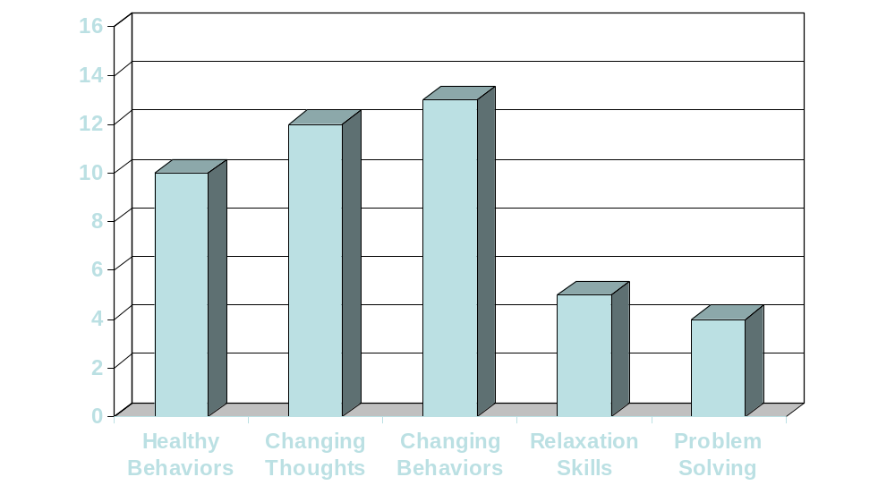
Frequency of Module by Patient
75%
88%
63%
31%
25%
% = percentage of patients receiving this module during treatment

Slide 15
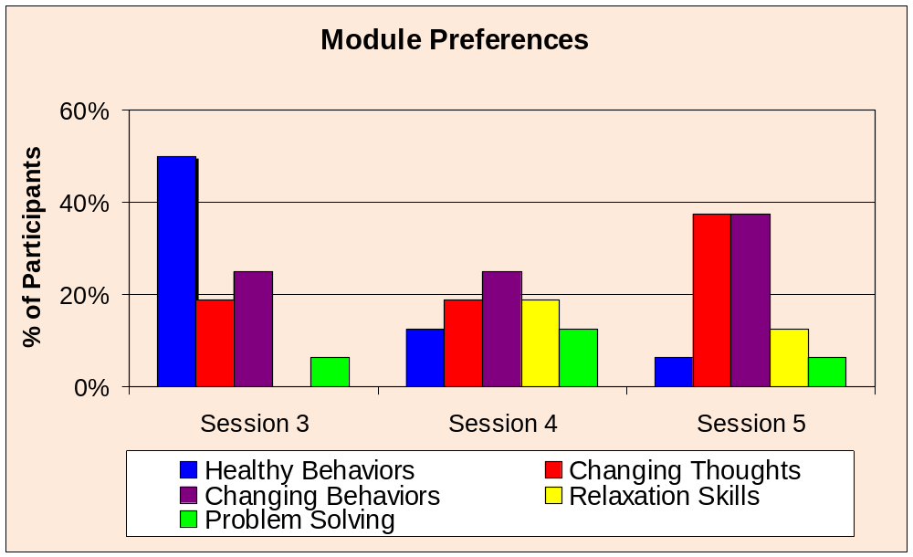
Module Usage

Slide 16
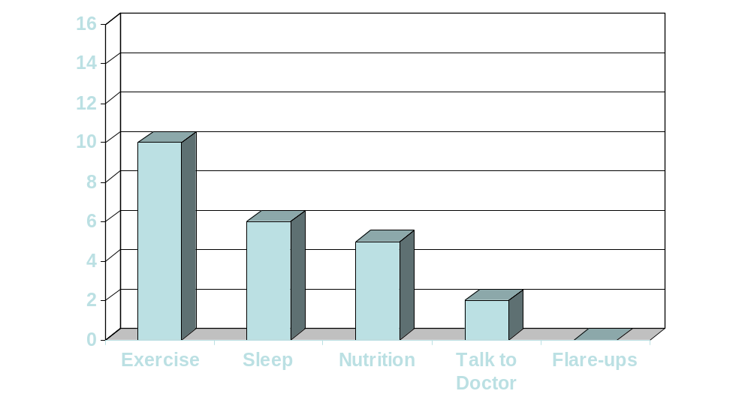
Healthy Behavior Module
63%
38%
31%
13%
0%
% = percentage of patients receiving this module during treatment

Slide 17
Telephone vs. Person
Out of 64 potential sessions (3 through 6)
  42 sessions occurred in-person (66%)
  22 sessions occurred by telephone (34%)
Preferences by patient
  7 participants in-person sessions only
  9 participants used telephone sessions

Slide 18
Post-Treatment (8 week) Outcomes:
Depression & Anxiety
 | Baseline | Post Tx | Effect Size
Depression (BDI-II) | 16.94 | 9.44 | 1.07
State Anxiety (STAI) | 35.69 | 32.38 | 0.28
Trait Anxiety (STAI) | 40.63 | 33.38 | 0.66
N = 16

Slide 19
Post-Treatment (8 week) Outcomes:
SF-36
 | Baseline | Post Tx | Effect Size
General Health | 31.56 | 36.88 | 0.31
Phys Functioning | 20.00 | 25.94 | 0.42
Role Limit Physical | 6.25 | 26.56 | 1.11
Role Limit Emotion | 31.25 | 56.25 | 0.60
Energy/Fatigue | 34.06 | 45.31 | 0.64
Emotion Wellbeing | 59.00 | 74.75 | 1.11
Social Functioning | 52.34 | 73.44 | 0.92
Pain | 42.34 | 53.91 | 0.49
N = 16; Mean = 50, Higher scores indicate better health

Slide 20
Post-Treatment (8-week) Outcomes:
Disease Specific Quality of Life
 | Baseline | Post Tx | Effect Size
CHF QoL | 38.31 | 55.44 | 1.19
COPD QoL
Dyspnea | 46.39 | 47.78 | 0.07
Fatigue | 36.46 | 54.17 | 1.04
Emotion | 60.12 | 75.99 | 1.06
Mastery | 58.68 | 71.18 | 0.66
Total N = 16; KCCQ n =10; CRQ =12

Slide 21
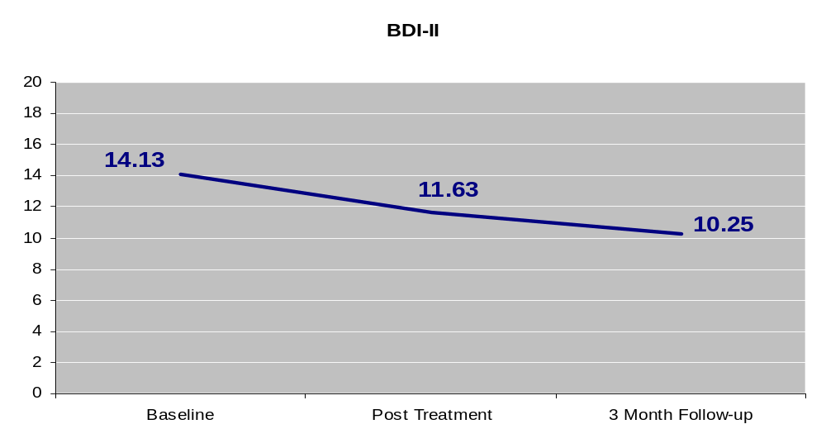
3-Month Follow-up Outcomes:
Depression (n=8)
BDI-II Effect Size =0.81

Slide 22
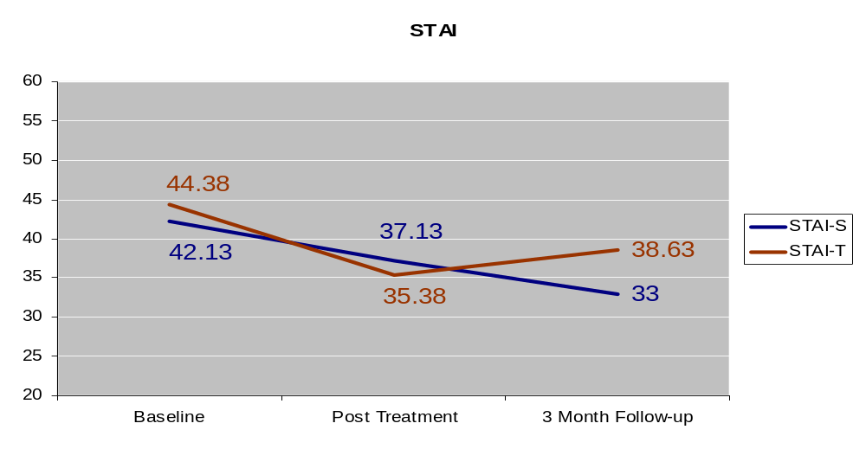
3-Month Follow-up Outcomes:
Anxiety (n=8)
STAI-S Effect Size =0.99
STAI-T Effect Size =0.51

Slide 23
Baseline to 3-month Outcomes:
SF-36
 | Baseline | 3 month | Effect Size
General Health | 28.13 | 28.75 | 0.05
Phys Functioning | 18.13 | 19.38 | 0.09
Role Limit Physical | 6.25 | 15.63 | 0.61
Role Limit Emotion | 41.67 | 45.83 | 0.11
Energy/Fatigue | 33.13 | 36.25 | 0.22
Emotion Wellbeing | 56.00 | 65.00 | 0.54
Social Function | 45.31 | 65.63 | 1.16
Pain | 31.56 | 46.25 | 0.61
N = 8 Mean = 50, Higher scores indicate better health

Slide 24
Summary
Preliminary results suggest ACCESS may be a highly effective treatment for depression and anxiety in the medically ill
Unlike other psychosocial interventions ACCESS shows the potential to improve physical quality of life outcomes

Slide 25
Summary (2)
Physical changes appear to be diminishing over time
  Intervention improvements?
    Longer follow-up duration
    Consolidation of modules
    More therapist attention to physical health in later sessions
Need additional trials (e.g. comparison to usual care with larger sample of patients)

Slide 26
Avenues for Rural MH Applications
Telephone-based psychotherapy
Internet-based platform for psychotherapy
  My Healthe Vet?
CBT training for rural MH providers
Patient Workbook critical for telephone / internet CBT applications

Slide 27
Challenges for Rural MH Applications
Many patients prefer face to face therapy (interaction with therapist)
Patient factors – hearing, reading level, education, internet access
Crisis management
Availability of rural MH providers
Others ….

Slide 28
Acknowledgements
Research Team
  Mark Kunik MD MPH
  Melinda Stanley PhD
  Anita Deswal, MD FACC
  Nicola Hanania, MD
  Jessica Skinner (project coordinator)
  VA and BCM Interns and Fellows (study clinicians)
Funding
  VA HSR&D – Career Development Award
  VA South Central MIRECC – Pilot Study Program
  Houston Center for Quality of Care and Utilization Studies

