Slide 1
Time-Marching Numerical Methods

Slide 2
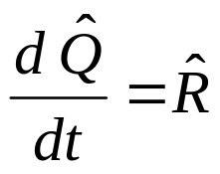



Basics of Time-Marching Methods
The finite-volume formulation yielded the ordinary differential equation
This equation is non-linear in that
and
The variable t is time and indicates that the solution may be time-varying
(unsteady). The time variable gives the equation a mathematically hyperbolic
character. That is, the solution is dependant on the solutions at previous times.
We can use this trait to develop time-marching numerical methods in which we
start with an initial solution (guess) and march the equations in time while
applying boundary conditions. The time-varying solution will evolve or the
solution will asymptotically approach the steady-state solution.

Slide 3

Methods for Steady Problems
If we assume the solution is steady, and so, time is not a variable, then the
equation takes the form
we have at least a few other options for numerical methods:
Iterative Methods. These methods assume the equation is mathematically elliptic and start with an initial solution and iterate to converge to a solution.
Direct Methods. These methods also assume the equation is elliptic, but solve the system of equations in a single process.
Space-Marching Methods. These methods assume that equation can be cast as a mathematically parabolic equation in one of the coordinate directions and marched along that coordinate. (i.e. Supersonic flows in x-direction).

Slide 4

Time Discretization
We will first consider time-marching numerical methods. We first need to
consider a finite time step δt
where n is the index for time. The δ indicates a finite step (not differential).
A couple of concepts:
The marching of the equation over a time step can occur over one or more stages and one or more iterations.
The marching can be done explicitly or implicitly. An explicit method uses known information to march the solution. An implicit method uses known and unknown information and requires solving a local system of equations.

Slide 5
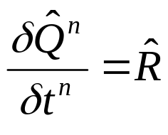





Euler Methods
To demonstrate these concepts, consider the Euler methods, both explicit and
implict. The methods are single-stage and first-order accurate in time. The
the left-hand side of the equation is discretized as
where
and so,
But how to discretize in in time?
Explicit: Implicit:
( Unstable! )

Slide 6
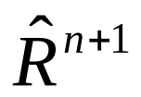
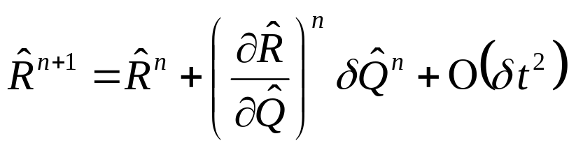
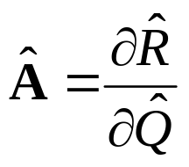

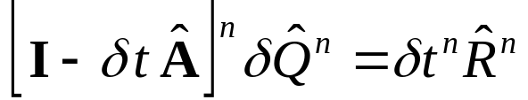
Linearization of
The Euler Implicit Method introduced an implicit right-hand-side term. This
term is approximated using a local linearization of the form
The flux Jacobian can be defined as
such that the Euler implicit method can be expressed as
or
where I is the identity matrix.

Slide 7
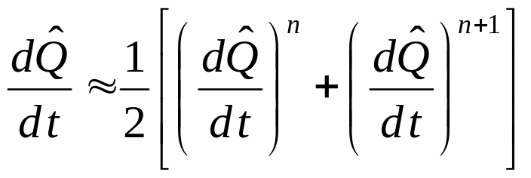
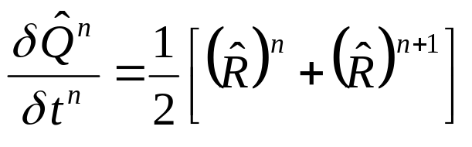
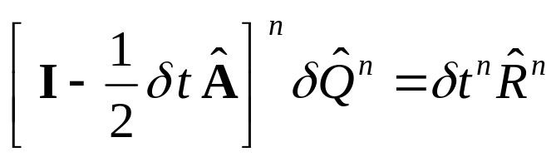
Trapezoidal Time Difference
Trapezoidal (mid-point) differencing for second-order accuracy in time:
Make substitution of equation,
Use linearization to form

Slide 8
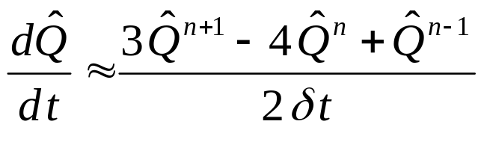
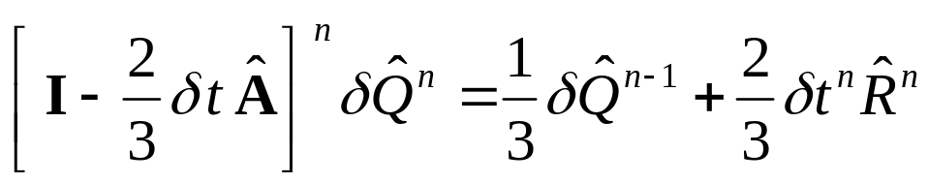
Three-Point Backward Time Difference
Three-point backward differencing for second-order accuracy in time:
This results in the form

Slide 9


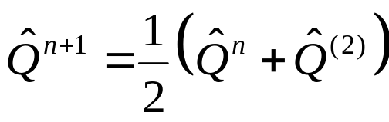
MacCormack Method
An example of a multi-stage, explicit method is the MacCormack Method,
Stage 1:
Stage 2:
and then

Slide 10


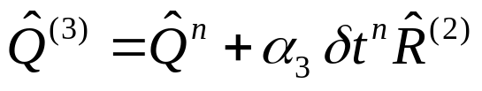


Runge-Kutta Method
Another example of a multi-stage, explicit method is the Runge-Kutta Method.
The four stage method has the form:
Stage 1:
Stage 2:
Stage 3:
Stage 4:
and then
Typical coefficients are: α₁ = 1/4, α₂ = 1/3, α₃ = 1/2, α₄ =1.

Slide 11
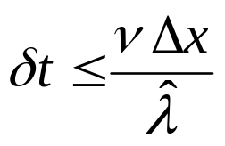

Time Step Size Control
The size of the time step δ t used in the time-marching methods requires
several considerations:
Resolution of time variation (time scale of a fluid particle).
Stability of the numerical method.
CFL stability condition:
  ν , Courant-Friedrichs-Lewy (CFL) number (explicit methods generally require ν < 1, but implicit methods allow larger numbers).
  Δx, Resolution of the finite-volume cell.
  , Eigenvalues (wave speeds).

Slide 12
Time Steps, Iterations, and Cycles
The numerical method marches the solution over a time step δ t. An iteration
is the numerical process of taking a single time step. A cycle is one or more
iterations.
Numerical errors exist in most methods that may not result in a second-order
solution in time over one iteration. Multiple sub-iterations of the numerical
method may be needed to remove these errors.
One such method for performing these sub-iterations is the Newton Iterative
Method.

Slide 13

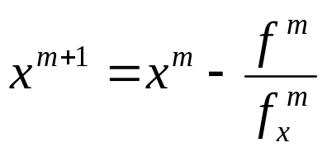

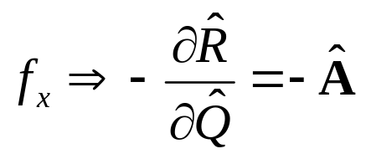

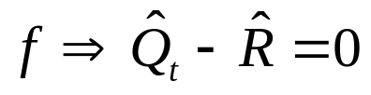
Newton Iterative Method
Consider the “standard” Newton iterative method for finding a root f(x) = 0,
which can be re-written as
or
where m is the iteration index. Now consider the equations we wish to solve
and substitute them into the above form

Slide 14
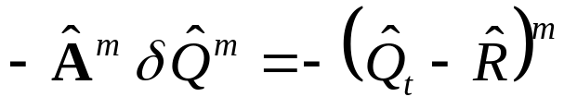
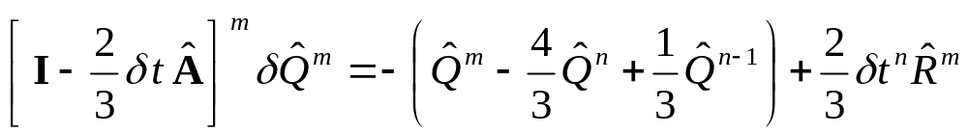
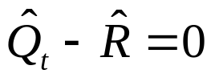
Newton Iterative Method (continued)
Substituting these into the Newton iteration equation yields
Substituting a three-point, backward time difference for the time derivative,
applying some other small approximations, yields.
The right-hand-side of this equation is simply the discretized form of the
equation
which is the equation we wish to solve. Iterating the previous equation until the
right-hand side becomes zero will assure that the equation is solved with the
errors reduced.

Slide 15

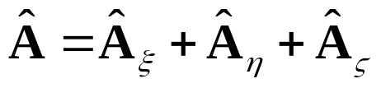
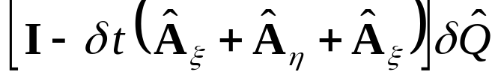
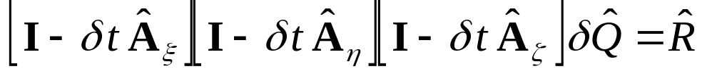
ADI / Approximate Factoring
The Jacobian matrix is three-dimensional. We must now approximate the
Jacobian for the finite-volume cell. We consider a hexahedral cell with
generalized coordinates (ξ, η, ζ). We can write the Jacobian as the sum
Substituting this into the left-hand side of the Euler Implicit Method results in
This can be “factored” to allow a series a 3 one-dimensional numerical solutions.
The factoring neglects third-order terms and higher and results in the form
This approach can be applied to the other implicit methods discussed.

Slide 16
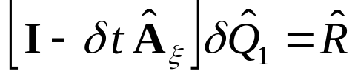
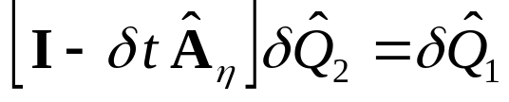
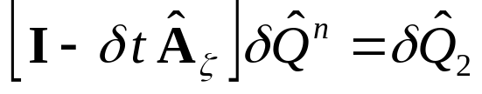
ADI / AF (continued)
The equations can then be solved in a series of one-dimensional solutions of the
form:
The inviscid part of the Jacobian matrices can undergo further diagonalization to
form a scalar penta-diagonal system that is numerically easier to invert, and
which reduces computational effort. However, this reduces the implicit method
to first-order accuracy in time.

Slide 17
Solution Convergence Acceleration
There exists several methods for accelerating the convergence of the solution
to a steady-state solution:
Use a uniform global CFL number which results in varying local time steps. Thus larger time steps are used in regions of larger cells.
Use an incrementing CFL number that starts with a small CFL number to get past initial transients then increases the CFL number to converge.
Limit the allowable change in the solution, δQ, over an iteration.
Locally fix bad solution points by replacing the bad solution point with an average of local points.

Slide 18
Other Methods Not Discussed
Several other solution algorithms are available in WIND that have not been
discussed:
Jacobi Method
Gauss-Seidel Method
MacCormack’s First-order Modified Approximate Factorization (MAFk)
ARC3D 3-factor Diagonal Scheme
Next ⇒

