Slide 1
FASD Prevention:
Implementing Project Choices
Building FASD State Systems (BFSS)
San Antonio, Texas
June, 2005
Kirk von Sternberg, Ph.D.
Department of Family and Community Medicine
The University of Texas Health Science Center at Houston
School of Medicine

Slide 2
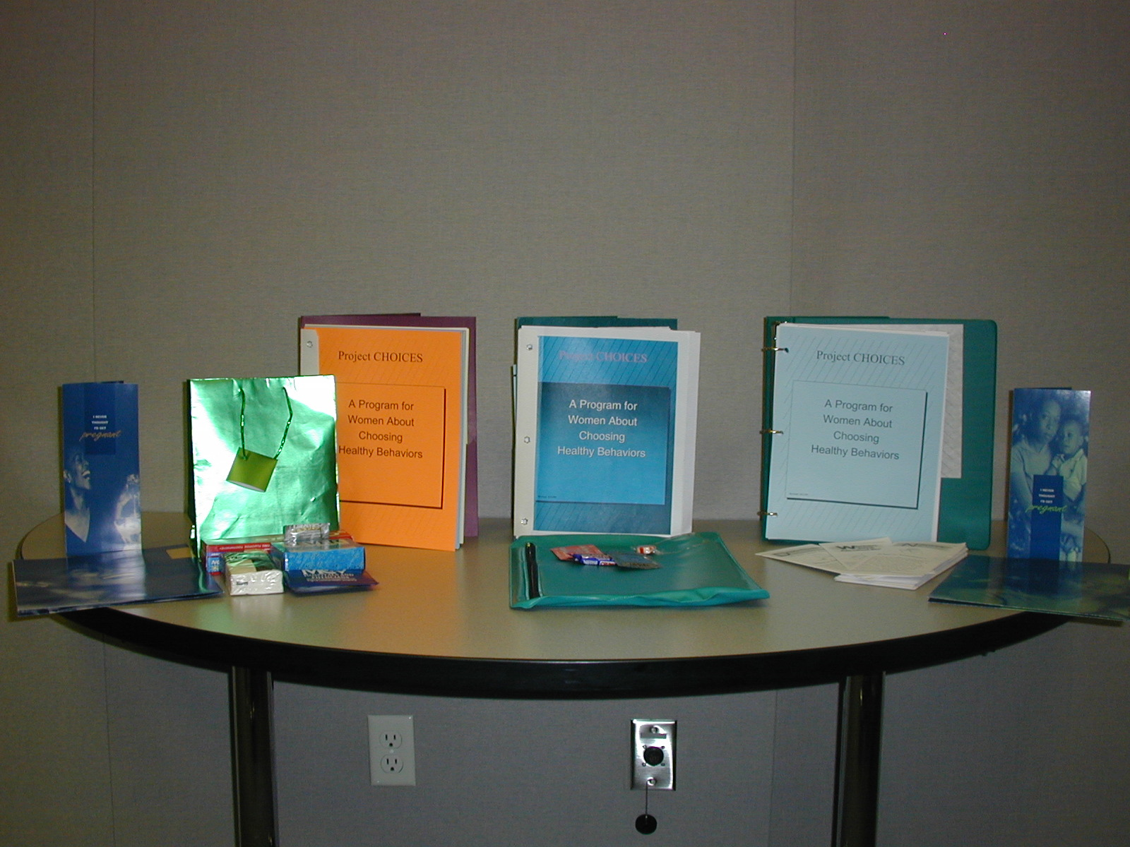
PROJECT CHOICES
A PRECONCEPTIONAL APPROACH

Slide 3
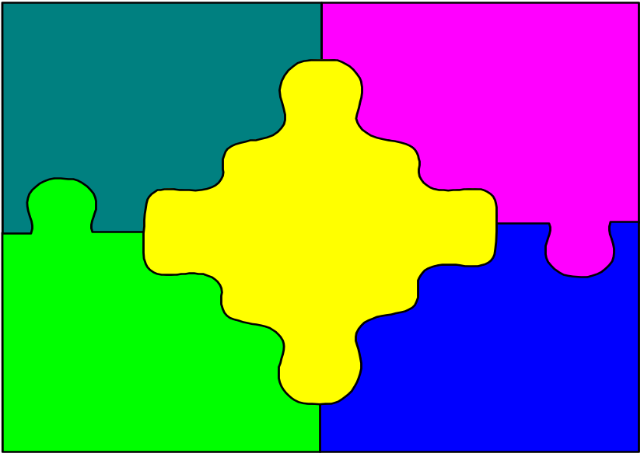
EPIDEMIOLOGIC SURVEY
Project CHOICES Research Group. Alcohol-exposed pregnancy: characteristics associated with risk. American Journal of Preventive Medicine. 2002 23(3):166-173.
Writing Team: Mary Nettleman (chair), Joseph Carbonai, R.Louise Floyd,
Patricia Dolan Mullen, Jasjeet Sidhu
Analytic Team: J. Carbonari (chair), K. vonSternberg, J. Baio, J. Sidhu

Slide 4
Centers for Disease Control and Prevention
R. Louise Floyd, DSN
University of Texas Health Science Center at Houston
Mary Marden Velasquez, PhD
Patricia Dolan Mullen, DrPH
Virginia Commonwealth University
Mary Nettleman, MD
Karen Ingersoll, PhD
NOVA Southeastern-Florida
Mark Sobell, PhD
Linda Sobell, PhD

Slide 5
EPIDEMIOLOGIC SURVEY
Characterize the population including level of risk for AEP
Identify variables correlated with risk
Identify independent predictors of risk

Slide 6

SETTINGS
Jail
Treatment Center
University of Texas Health Science Center
Inner City Primary Care
Inner City GYN
Virginia Commonwealth University
Primary Care Clinics in an HMO
Media Recruits
NOVA Southeastern-Florida

Slide 7
OVERVIEW
Women, aged 18-44 years
Survey designed by Study Team
Administered by trained interviewer on site with each survey taking about 30 minutes
Over 18 months

Slide 8

DEFINITION OF “AT RISK”
LAST 90 DAYS
FERTILE
UNPROTECTED SEX
8 OR MORE DRINKS PER WEEK OR
> 5 DRINKS IN ONE DAY MORE THAN ONCE IN LAST 6 MONTHS

Slide 9
2672 RESPONDENTS
62% African American
21% White
8% Hispanic
6% Native American
3% Other

Slide 10
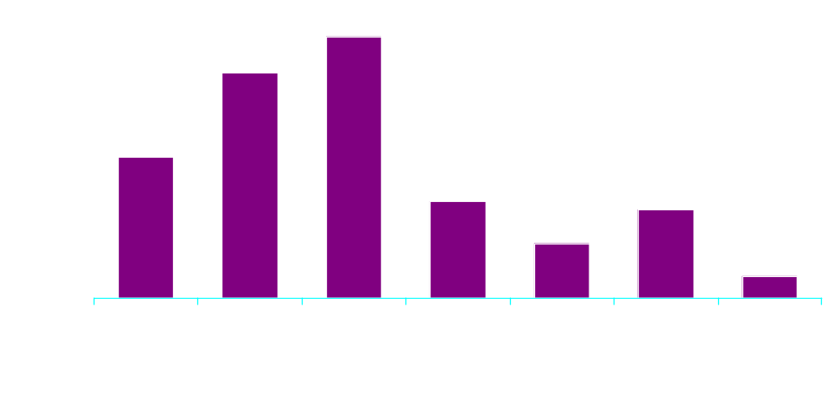
Community-based Settings with High Proportion Of Women at-Risk for an Alcohol Exposed Pregnancy
Notes:
Risk for alcohol-exposed pregnancy was defined by:
Fertile and had unprotected intercourse in past 6 months
Risk-level alcohol consumption (average 8 or more drinks per week or binged twice or more n past 6 months)
Risk was higher in settings where women were expected to engage in higher risk-taking behavior
All settings showed higher proportion of risk than we estimated from national population estimates
Jail & recovery sites categorized as higher risk, health clinic and media samples categorized as lower risk

Slide 11
DEMOGRAPHICS
17 % were legally married
51% were employed
68% were high school grads or equivalent

Slide 12

DEMOGRAPHICS: AGE

Slide 13

INCOME

Slide 14

FERTILITY
32% infertile, 9% abstain
13% pregnant or trying
25% contracepting correctly
12% not contracepting correctly
8% not using contraception

Slide 15
ALCOHOL USE
71% of respondents drank
31% were binge drinkers
  (5 or more drinks on a day)
25% were frequent drinkers
  (8 or more drinks per week)

Slide 16
AT RISK FOR AEP
333 Respondents (12.5%)
National estimates for the general population suggest a 1% to 2% risk
Respondents were 6.9 times more likely to be at risk for AEP (95% CL 5.2-9.3, p=0.0001) than general population
All sites were at increased risk (p<0.05)

Slide 17
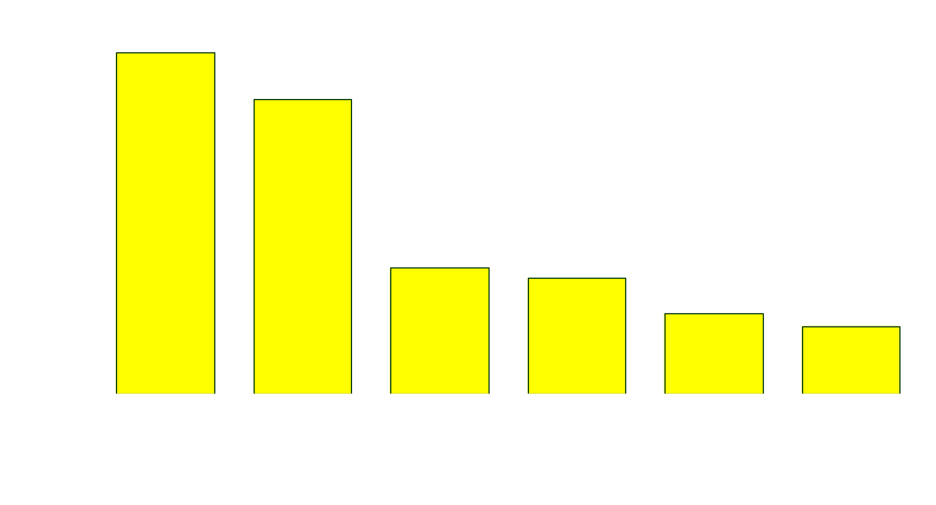
% AT RISK FOR AEP

Slide 18
At-Risk Women vs Not At Risk
Univariate
 | Odds Ratio | C.I.
Ever used drugs | 8.3 | 5.1-13.6
Current drug use | 7.2 | 5.3-9.8
Hx of Tx for Et/drugs | 5.1 | 3.9-6.6
Ever smoked | 5.1 | 3.5-7.6
Ever homeless | 3.9 | 3.0-5.1
Hx of Mental Tx | 3.1 | 2.3-4.3

Slide 19
At-Risk Women vs Not At Risk
Other significant univariate correlates (p<0.001) included:
  Age > 30
  White race
  Less Education
  Started Drinking <age 16
  Hx of Inpt Tx for Drug/Et/Mental
  Hx of Physical Abuse
  Unemployed
  Current Smoker
  No Health Ins
  Perceived Poor Health

Slide 20
AT-RISK WOMEN: FACTORS ASSOCIATED WITH RISK
Comparison group was women who were not at risk but who were sexually active and fertile
Univariate and Multivariate Analysis

Slide 21
MULTIVARIATE ANALYSIS
CURRENT BEHAVIORS (p<0.0001)
 | Odds Ratio | C.I.
Current Drug Use | 5.1 | 3.6-7.1
Current Smoker | 2.3 | 1.7-3.1

Slide 22
MULTIVARIATE ANALYSIS
HISTORICAL VARIABLES (p<0.0001)
 | Odds Ratio | C.I.
Ever Used Drugs | 3.1 | 1.8-5.4
Inpt Tx for Drug/Et | 2.3 | 1.8-3.1
Physical Abuse | 1.9 | 1.4-2.5
Ever smoke 100 cigs | 1.9 | 1.3-2.7
Inpt Tx for Mental Health | 1.6 | 1.1-2.3

Slide 23
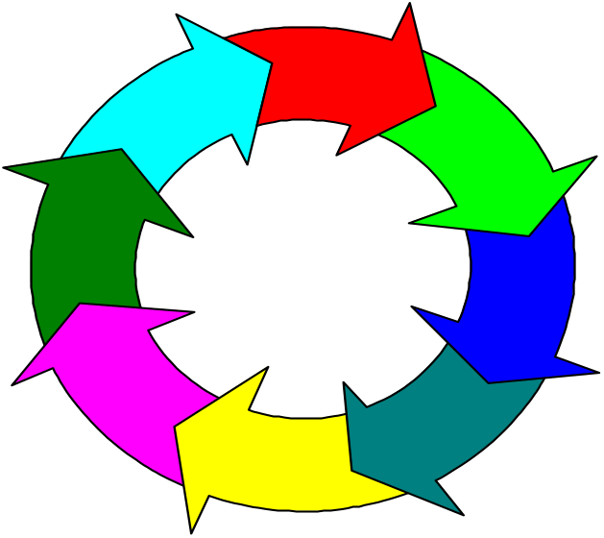
SUMMARY
12.5% of women were at risk for an alcohol-exposed pregnancy
Risk for AEP was associated with a history of multiple problems, many of which persisted into the present

Slide 24
CONCLUSIONS TO DATE
  ALL Project CHOICES SETTINGS HAVE HIGHER PROPORTIONS OF WOMEN AT RISK FOR AN AEP THAN THE ESTIMATED RATE FOR WOMEN AGED 18-45 YRS. OVERALL (<2%)
  SETTINGS REPRESENT IDEAL LOCALES FOR DESIGNING AND TESTING INTERVENTIONS TO REDUCE THE RATE OF AEP

Slide 25
Project CHOICES Feasibility Study
Reducing the Risk of Alcohol-Exposed Pregnancies: A Study of a Motivational Intervention in Community Settings
Project CHOICES Intervention Research Group, Pediatrics, 2003;111
Writing Team, M. Velasquez (chair), K. Ingersoll, L. Floyd, M. Sobell
Analytic Team, J. Carbonari (chair), K. von Sternberg, J. Baio, J. Sidhu

Slide 26


Slide 27
Objective: Prevent Alcohol-Exposed Pregnancies
Reduce Drinking
or
Contracept Effectively
or
Both

Slide 28
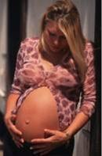


Can we develop and implement an intervention to target BOTH behaviors that place women at risk for alcohol-exposed pregnancy?
The first study to address improving contraception and reducing drinking in a single intervention
Notes:
One of the most interesting but also a challenging aspect of the pilot intervention study of Project CHOICES was its uniqueness in addressing dual issues in a single intervention.

Slide 29
Definition of “Not at Risk”
Drinks ≤ 7 drinks/week & no days ≥ 5 drinks
or
Contracepts Effectively
or
Both

Slide 30
TimeLine Follow-Back
Sunday | Monday | Tuesday | Wednesday | Thursday | Friday |  | Saturday
1 | 2 | 3 | 4 | 5 | 6 |  | 7
A: VI: Y N BC: Y N T: | A: VI: Y N BC: Y N T: | A: VI: Y N BC: Y N T: | A: VI: Y N BC: Y N T: | A: VI: Y N BC: Y N T: | A: VI: Y N BC: Y N T: |  | A: VI: Y N BC: Y N T:
8 | 9 | 10 | 11 | 12 | 13 |  | 14
A: VI: Y N BC: Y N T: | A: VI: Y N BC: Y N T: | A: VI: Y N BC: Y N T: | A: VI: Y N BC: Y N T: | A: VI: Y N BC: Y N T: | A: VI: Y N BC: Y N T: |  | A: VI: Y N BC: Y N T:
CODES:
A: Alcohol Use VI: Vaginal Intercourse BC: Birth Control T: Type of birth control |  |  |  | C: Condom P: Birth Control Pill D: Diaphragm I: IUD |  | S: Spermicide N: Norplant E: Depo-Provera Other: (write in)

Slide 31
Eligibility Criteria for Intervention
18-44 years old
Fertile
Not contracepting effectively in past 3 months
Drinking 8 drinks per week on average or 5 per occasion
Available for 9 months
Signed informed consent
Notes:
Now that you have a good understanding of the content of the Project CHOICES intervention, let me turn to some of the other aspects of the study design. Women were eligible for the study if they were:…

Slide 32
Intervention Study
Conducted in same 6 settings
Targeted same population groups as CHOICES Epidemiology survey
  2,384 women screened
  230 eligible
  190 consented and enrolled
Conceptualized as a “feasibility study” or pilot study

Slide 33
Intervention Design Considerations
Women would be drawn from a range of settings with different reasons for risk
Many women would NOT be presenting for treatment but were recruited for study
  Readiness for change would vary
  Intervention must address readiness for change and motivation
Intervention should have evidence of efficacy
Notes:
As a multisite team, we considered several important factors in designing the intervention.

Slide 34
Effectiveness of Brief Interventions
Three major factors contribute to a patient’s long-term compliance with treatment:
The patient feels that behavior change is a personal choice
The encounter between the patient and the provider is positive
The patient has adequate self-confidence about his or her ability to make recommended behavior changes

Slide 35
Motivational Interviewing
Motivational Interviewing is an empathic, client-centered, yet directive counseling style. Its goal is to explore and resolve ambivalence about changing behaviors
Notes:
I’ve mentioned Motivational Interviewing, so let me be more specific. MI was developed by Miller and Rollnick in the early 90’s, building on 20 years of social and clinical psychology research that emphasized certain factors related to successfully making a planned change. MI is a counseling style….

Slide 36
Readiness: Stages of Change
ACTION
MAINTENANCE
PREPARATION
RELAPSE
&
RECYCLE
CONTEMPLATION
PRECONTEMPLATION
Notes:
I’ve mentioned readiness several times, and I’m referring to the stages of change from the well known Transtheoretical Model of Change of Prochaska and Diclemente. Here you see a diagram depicting the stages, from precontemplation at the bottom, where the woman is not yet considering change, to contemplation, when she is considering change but is equally motivated to remain the same, to preparation, in which she plans to make changes within a month, on to action, in which change is occurring currently, and then possibly to maintenance, in which changes that were made in the action stage are maintained and solidified. Lastly, at any point beyond preparation, the woman may relapse and recycle through the stages, with 85% re-entering the circle at contemplation or higher.

Slide 37
Why Motivational Interviewing?
Those in earlier stages of change (precontemplation, contemplation) require motivation
We anticipated that many study participants would be in early stages of readiness given they were not presenting for treatment
Good evidence of efficacy, at least to reduce drinking
Notes:
We selected a motivational intervention for several reasons, as alluded to before.

Slide 38
Motivational Interventions
Motivation is a state of readiness to change,
which may fluctuate from one time or situation
to another. This state can be influenced.
Motivation for change does not reside
solely within the client.
The counselor’s style is a powerful determinant
of client resistance and change. An empathic
style is more likely to bring out self-motivational
responses and less resistance from the client

Slide 39
Motivational Interventions
People struggling with behavioral problems
often have fluctuating and conflicting motivations
for change, also known as ambivalence.
Ambivalence is a normal part of considering and
making change and is NOT pathological
Each person has powerful potential for change.
The task of the counselor is to release that potential
and facilitate the natural change process that is
already inherent in the individual.

Slide 40
Considerations in training practitioners in brief interventions
Highlight differences between motivational interventions and educational or advice-giving approaches
Interventions must be brief and ‘do-able’
Beware of the “I already do this” belief
Providers need to have high levels of confidence in the effectiveness of the strategies AND their ability to use them

Slide 41
Considerations in training practitioners in brief interventions
Encourage the practitioner to use each of the strategies whenever possible, but not to feel as though they have to stick to a ‘script.’ It is much more important to establish rapport and listen to the woman
Encourage the practitioner to integrate the strategies into the session in a natural manner rather than moving from one exercise to the next
Discuss differences between the ‘trait’ and ‘state’ models

Slide 42
Assumptions of a Trait Model
Defense mechanisms (e.g. denial) are stable personality characteristics
Unless a client is motivated, there is little one can do
Treatment failure, refusal, & drop-out are due to denial
People are inherently motivated to resist change
Accepting/admitting one’s disease (diagnosis) is essential
Denial can be dealt with only through direct confrontation

Slide 43
Problems with the Trait Model
Attributional handicapping: Internal locus of failures
Self-fulfilling prophecy with people judged unmotivated
Encourages counter-therapeutic behaviors in counselors (suspiciousness, hostility, moralizing, power struggles)

Slide 44
Problems with the Trait Model
Substance abusers show no unique personality
Show no higher level of denial than normal population
Measures of denial are not clearly related to treatment, outcome

Slide 45
Problems with the Trait Model
Client drop-out, compliance, and outcome are powerfully influenced by counselor characteristics and environment
Direct confrontation yields poorer compliance, outcomes

Slide 46
Counselors Influence Client Motivation
Expectations influence outcomes
Differences in drop-out rates
Differences in outcome rates
Simple actions decrease drop-out
Empathic counselors have better outcomes

Slide 47
Qualities of a Good Motivational Counselor
Respect for individual differences
Tolerance for disagreement and ambivalence
Patience with gradual approximations
Genuine caring and interest in
clients served

Slide 48
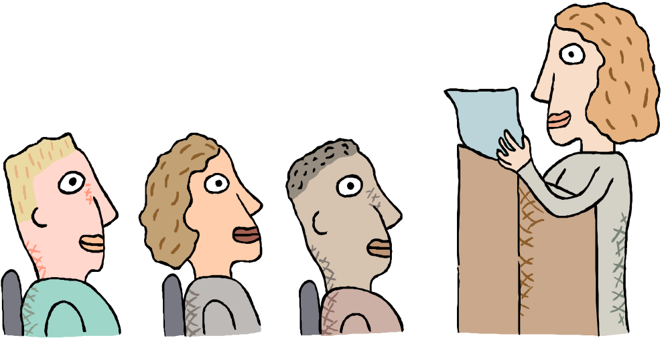
Motivation and Counseling
Persuasion and education alone don’t create behavior change
Empathic interpersonal counseling styles increase willingness to consider change and avoid resistance
Notes:
We also know from social psychology that persuasion as a tactic, and education alone, are not enough to help people change habitual behavior. Rather, we use a counseling style in motivational interviewing that increases a woman’s readiness to consider change.

Slide 49
Underlying the Spirit of Motivational Interviewing is:
Collaboration - In motivational interviewing, the counselor does not assume an authoritarian role. The interviewer seeks to create a positive atmosphere that is conducive to change.
Evocation – Consistent with a collaborative role, the counselor’s tone is not one of imparting things, such as wisdom or insight, but rather eliciting – finding these things within and drawing them out from the person.

Slide 50

Motivational Interviewing Principles
Express Empathy
Develop Discrepancy
Roll with Resistance
Support Self-efficacy
Notes:
MI techniques stem from these 5 basic principles. First, express an empathic understanding and interest in the woman. Second, help her perceive a discrepancy between where she is and where she wants to be. Third, be approachable, flexible, and avoid arguing or persuading tactics. Fourth, if you perceive resistance, use this as a cue to change strategies and move in a more productive direction. Fifth, encourage optimism for change and support her when she makes statements of confidence in her ability to change.

Slide 51
Motivational Interviewing:
Client-centered techniques
Ask Open-ended questions
Listen reflectively
Affirm her participation and honesty
Summarize frequently
Emphasize her personal choice and control
Notes:
Here are some of the counseling techniques used in MI and in Project CHOICES that are fundamental, client-centered techniques.

Slide 52
Motivational Interviewing:
Directive Techniques
Selectively reflect “change talk”
Explore discrepancies between goals and behavior
Elicit reasons for change from the woman
Assist in goal setting
Notes:
These are the techniques that make MI a directive approach. For example,….

Slide 53
A Person Is Likely to Change When:
She believes change is important
She is confident in her ability to make recommended changes
Change
Notes:
MI counselors know that in order to a woman to be motivated or ready for change, she must both believe that change is important, and feel confident that she can make the needed change.

Slide 54
Project CHOICES Intervention
Gyn/ family
planning
visit
Counseling Session 1
Counseling Session 2
Counseling Session 3
Counseling Session 4
3 month follow up
6 month follow up
Notes:
Now I’ll review the flow of the Project CHOICES intervention.

Slide 55
Counseling Session 1
Orientation to study
Informed consent
Rapport building
Assessment
Provide fact sheets
Make gyn appointment
HW: Decisional balance for alcohol and contraception and self monitoring
Notes:
In her first session,

Slide 56
Thinking About Drinking
Good things about my drinking:
Good things about changing my drinking:
More relaxed
Will not have to think about my
problems for a while
More comfortable with drinking friends
More control over my life
Support from family and friends
Less legal trouble & Better health
Not so good things about my drinking:
Not so good things about changing my drinking:
Disapproval from family and friends
Increased chance of legal and job
trouble
Costs too much money
More stress or anxiety
Feel more depressed
Increased boredom
Notes:
This is a sample of a decisional balance completed by a woman in Project CHOICES. You can see that she identified…..

Slide 57

Counseling Session 2
Personalized Risk Feedback
Debriefing of feedback
Review self-monitoring log and
decisional balance homework
Initial goal setting
Notes:
In session 2, the woman receives feedback on a variety of measures she completed during the first session. She hears about how her drinking compares to national averages, how many calories she drank, and how much she spent on alcohol in the past year. She also learns about risks related to drinking at her level, and the risk of pregnancy and why she is at risk.

Slide 58
Your Personalized Feedback - I
+
At your last session you said that you drink ________ drinks/week.
You also said that on occasions you may drink ______ drinks in a single day.
Moderate Drinking:
Drinking Level: No more than 7 drinks per week AND
no more than 3 drinks in any one day.
Risks:
Risky Drinking:
Drinking Level: More than 7 drinks per week or
more than 3 drinks in any one day.
Risks:

Slide 59
Your Personalized Feedback - II
+
How does your drinking compare with other women? Your current drinking level falls into the __________ risk group. You are drinking more than _______________ % of women aged 18-44.
Moderate Drinking
(3 out of 10)
No Drinking
(5 out of 10)
30
50
20
Risky Drinking
(2 out of 10)

Slide 60
Your Personalized Feedback - III
+
How much money did you spend on alcohol last year?
Based on what you told us, you drank around __________ drinks in the past
3 months.
If you usually drink at home, and an average drink at home costs $1.25, then
you spent about $___________ on alcohol last year.
If you usually drink at a bar or restaurant, and an average drink there costs
$3.50, then you spent about $__________________ on alcohol last year.
How many calories did you consume from alcohol per drinking day?
Alcohol has calories which have no nutritional value. Sometimes women gain
weight because of the extra calories they get from alcohol.
Based on what you told us, you drank around ___________ drinks per
drinking day.
If an average drink has 100 calories, you consumed about ____________
calories per drinking day from alcohol.

Slide 61
Your Personalized Feedback - IV
+
Pregnancy Risk
[ ] Low -- You use birth control correctly every
time you have vaginal intercourse .
[ ] Risky -- You never use birth control or you
sometimes have vaginal intercourse
without using birth control correctly.
You are at risk because ___________________________
________________________________________________
_________________________________________________

Slide 62
Self-Evaluation Ruler - Alcohol
On the following scale, which point best reflects how ready you are at the present time to change your drinking?
Not at all ready to change my
drinking
Thinking
about changing my drinking
Planning and
making a
commitment to change my drinking
Actively
changing
my drinking
Notes:
Here’s an example of a readiness ruler we use several times over the course of the sessions on which she can indicate her readiness to change one of the target behaviors.

Slide 63

Gyn Visit
History
Contraception education and counseling
Physical exam (if desired by woman)
Provision of contraception
Notes:
After the second visit, she visits the gyn clinic practitioner associated with Project CHOICES.

Slide 64

Counseling Session 3
Review self monitoring homework
Debrief gyn visit
Readiness rulers
Decisional balance update
Goal statement update: how well is it fitting?
Notes:
In session 3, she …..

Slide 65
Goal Statement & Change Plan
for Birth Control - I
[ ] Choice 1: I plan not to have vaginal intercourse at all.
[ ] Choice 2: I plan to have vaginal intercourse and
not to use any birth control.
[ ] Choice 3: I plan to use birth control every time
I have vaginal intercourse; (specify method(s)) _____________________________
[ ] Choice 4: I plan to use birth control sometimes, but not with every vaginal intercourse;
(specify method(s))_______________________________

Slide 66

Counseling Session 4
Review prior sessions
Develop final goal statement and change plan for alcohol and or contraception
Discuss current decisional balance
Discuss self-efficacy
Schedule follow-up
Certificate of completion
Notes:
In the last session, we…..

Slide 67
Intervention Summary
Used a motivational interviewing intervention to help women examine their risky drinking and ineffective contraceptive behaviors (dual focus).
Women attended 4 counseling sessions, a session with a gynecologist, and follow-up.
Changing either behavior (or both) results in no risk for an alcohol-exposed pregnancy.
Notes:
We’re eagerly anticipating the results of the intervention. Since we’ve recently completed our 6 month followups, we have anecdotal evidence (not yet analyzed) that we should expect a positive impact from the study. So to summarize, we…..

Slide 68
Counselor Training
+
M.A. and Ph.D. Level with Counseling or Clinical Psychology Background
On-site training in Motivational Interviewing
Centralized training in Study Protocol
Weekly Supervision
“Pilot” clients

Slide 69
Intervention Quality Control
+
Audiotaped Sessions
Session Checklists
MI Rating Scale
Supervisor Rating Scale
Weekly Supervision

Slide 70


What Happened?

Slide 71
Completion Rates
Counseling Session 1 100.0%
Counseling Session 2 92.0%
Counseling Session 3 67.2%
Counseling Session 4 58.7%
Ob/Gyn Session 62.2%
3-Month Follow-Up 74.6%
6-Month Follow-Up 75.3%

Slide 72
Pre-Intervention
100% At Risk
6 Months Post-Intervention
68.2% Not At Risk
31.8% At Risk

Slide 73
Routes to “Not At Risk”
18.4% Reduced Drinking
34.0% Contracepted Effectively
47.6% Did Both

Slide 74
Completion And Success
Mean (SD) No. Sessions Completed
Not At Risk 4.33 (1.17)
Still At Risk 3.96 (1.37)
n.s.

Slide 75
“Not At Risk” X Setting
Setting % Not At Risk
Jail 66.7%
Treatment Center 57.1%
Inner City Primary Care 57.1%
Inner City Gyn 66.7%
Media Recruits 79.5%
Broward Co. Prim. Care 60.0%

Slide 76
Conclusions
Findings suggested the intervention was effective
More women chose to effectively contracept than chose to reduce drinking
Problem severity may predict outcome
Shows enough promise to move on to a randomized control trial (Efficacy Study)

Slide 77




Project CHOICES
Efficacy Study
†
A multi-site collaborative project between the Centers for Disease Control and Prevention, Nova Southeastern University, the University of Texas Health Science Center-Houston, and the Virginia Commonwealth University.
BATTELLE

Slide 78
Demographics n = 827
Education
Less than 12 years 28%
High school or equivalent 38%
Some college 26%
4 year degree or beyond 8%

Slide 79
Demographics
Total Family Income
< $20,000/yr 57.5%
> $20,000/yr 42.5%
Mean A.U.D.I.T. Score: 17.61

Slide 80
Demographics
Marital Status
Single/never married 51%
Legally married 11%
Living w/ partner 17%
Separated 9.5%
Divorced 9.5%
Widowed 2%

Slide 81
Demographics
Race
American Indian/Alaska Native 4%
Asian 1%
African-American 52%
Native Hawaiian/Pacific Islander 1%
White 42%
Other 7%
Ethnicity
Hispanic 11%

Slide 82
Demographics
Employment Status
Employed full time 40%
Self-employed 11%
Out of work for >1 year 17%
Out of work for <1 year 24%
Homemaker 18%
Student 17%
Retired <1%
Unable to work 7%

Slide 83
Demographics
Received previous outpatient alcohol/ drug treatment 28%
Median number of times treated: 2
Received previous inpatient alcohol/
drug treatment 34%
Median number of times treated: 1

Slide 84
Demographics
Received previous outpatient treatment
for psychological problems: 37%
Median number of times: 1
Received previous inpatient treatment
for psychological problems: 20%
Median number of times: 1

Slide 85
Retention Rates: Assessments
 |  | Baseline | 3 Month | 6 Month | 9 Month
Florida | NOVA – Broward Co. Media | 149 | 107 71.8% | 106 71.1% | 112 75.2%
 | NOVA – Primary Care | 99 | 66 66.6% | 63 63.6% | 66 66.6%
 |  | 248 | 172 69.4% | 169 68.1% | 178 71.8%
Texas | UT - Jails | 223 | 139 62.3% | 148 66.6% | 149 66.8%
 | UT – Treatment Centers | 121 | 91 75.2% | 99 81.8% | 103 85.1%
 |  | 344 | 230 66.9% | 247 71.8% | 252 73.3%
Virginia | VCU - Gyn Clinic | 114 | 81 71.1% | 68 59.6% | 72 63.2%
 | VCU – Medicaid HMO | 126 | 103 81.7% | 91 72.2% | 95 75.4%
 |  | 240 | 184 76.7% | 159 66.3% | 167 69.6%

Slide 86
Outcome Variables
Ineffective Contraception
Risky Drinking:
  > 4 drinks on any one day or
  > 7 drinks per week

Slide 87
Ineffective Contraception
In the past 3 months, how many different men did you have intercourse with?
When you had intercourse during the past 3 months, what were you and your partner(s) using to keep you from getting pregnant?
During the past 3 months, did you have intercourse and not use (method) as described in this card?

Slide 88
Effective Contraceptive Methods
Condoms
Diaphram, Cervical Cap
Pill
Lunelle
Patch
Morning-After Pill
Depo-Provera
IUD
Norplant
Sponge
1 partner only and partner had Vasectomy
Had no partners

Slide 89
Risky Drinking
(Frequency)
During the past 3 months, how many alcoholic drinks, if any, would you estimate that you consumed per week?
(Binge)
Considering all types of alcoholic beverages, how many times during the past 3 months did you have five or more drinks in one day?

Slide 90
Risk of Alcohol Exposed Pregnancy
  Yes = ≥1 occurrence
  of > 4 drinks in a day
  or >7 drinks per week
Risk Drinking
Yes
No
At Risk | Not at Risk
Not at Risk | Not at Risk
Yes
Unsafe Sex
No
  Yes = ≥1 occurrence of vaginal sex without effective birth control

Slide 91
Conclusions

