Slide 1

Public Hearing on Direct-to-Consumer Promotion of Medical Products
Gail H. Javitt, JD, MPH
Genetics and Public Policy Center
Johns Hopkins University
November 1, 2005
Notes:
Thanks for inviting me
Our mission is to create the environment and tools needed by key decision makers in both the private and public sectors to carefully consider and respond to the challenges and opportunities that arise from scientific advances in genetics
Our first project looks at reproductive genetics, which include reproductive genetic testing, genetic modification and reproductive cloning
We do not take positions – we are a resource for all side of the growing debate how to guide the development and use of these technologies. But for today, I thought it would be useful and interesting to present what you need to know about Preimplantation Genetic Diagnosis, genetic testing of embryos created through IVF, which is rapidly becoming a part of IVF for thousands of patients and is growing rapidly in use.

Slide 2

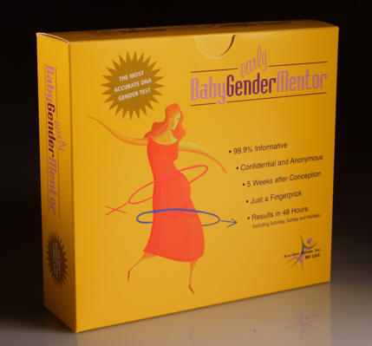
“No prescription required”
“More than 99.9% accurate”
“Completely safe”

Slide 3



IMAGENE™
GENETIC TESTING FOR THE MILLENNIUM
Introducing a ground breaking addiction treatment tool.
Are you compulsive? Have you ever wondered why you crave certain things and/or act in an irrational manner? Would you like to know if you have the genetic predisposition to abuse drugs and alcohol? Are you concerned about your children's future? Does your child have the genetic trait that leads to disruptive and addictive personalities? DNA testing can help you understand and manage a child's behavior before it gets out of control.
Imagene will test a panel of dopaminergic related Reward Deficiency Syndrome(RDS) genes. This will allow you to know if there is a genetic predisposition towards any of the associated addictions. The Reward product line is then available to treat the genetic predisposition towards RDS.
Notes:
New Hope for Understanding DNA Predispositions
Under normal conditions in the "Reward System" the neurotransmitter Dopamine works to maintain our normal drives. When dopamine is released into the synapse it stimulates certain dopamine receptors. These stimulated dopamine receptors signal feelings of well-being and stress reduction occurs as the main result. When there is a dysfunction in the "brain reward cascade" which could be caused by certain genetic variants, the brain requires a dopamine fix to feel good. People are born with this genetic trait that leads to substance seeking behavior.
New Hope for Understanding DNA Predispositions
Under normal conditions in the "Reward System" the neurotransmitter Dopamine works to maintain our normal drives. When dopamine is released into the synapse it stimulates certain dopamine receptors. These stimulated dopamine receptors signal feelings of well-being and stress reduction occurs as the main result. When there is a dysfunction in the "brain reward cascade" which could be caused by certain genetic variants, the brain requires a dopamine fix to feel good. People are born with this genetic trait that leads to substance seeking behavior.
New Hope for Understanding DNA Predispositions
Under normal conditions in the "Reward System" the neurotransmitter Dopamine works to maintain our normal drives. When dopamine is released into the synapse it stimulates certain dopamine receptors. These stimulated dopamine receptors signal feelings of well-being and stress reduction occurs as the main result. When there is a dysfunction in the "brain reward cascade" which could be caused by certain genetic variants, the brain requires a dopamine fix to feel good. People are born with this genetic trait that leads to substance seeking behavior.

Slide 4
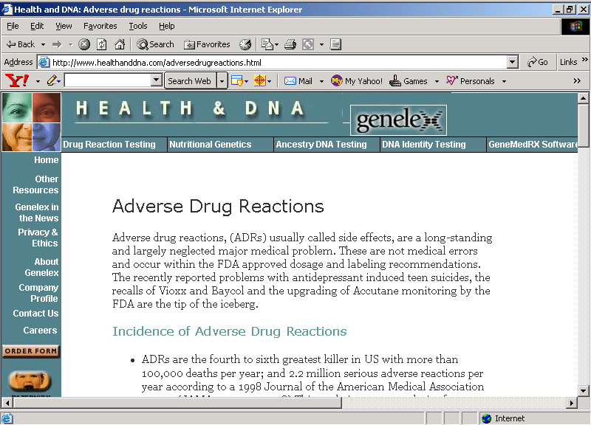

Slide 5
Genetic Testing Quality Initiative
Goals:
validity of tests is supported by the science before they are offered to patients and uses of outcomes of tests
all laboratories must demonstrate their ability to get the right answer reliably
health care providers are educated about these tests and able to provide them to patients with adequate context and counseling
patients have confidence in the claims made about tests and in the tests themselves.

Slide 6


