Slide 1
Genetics for Epidemiologists
Study Designs: Family-based Studies
Thomas A. Pearson, MD, PhD
University of Rochester
School of Medicine
Visiting Scientist, NHGRI

Slide 2
Genetics for Epidemiologists:
Study Designs: Family-based Studies
Learning Objectives
Introduce study designs to generate or test genomic hypotheses.
Describe the major study designs which involve genetically related individuals.
Provide examples of family-based designs from the literature.
Consider the advantages and disadvantages of family-based designs in the study of gene-disease associations.

Slide 3
Identical Twins, 51 Year Old Males, with Myocardial Infarction*
Characteristic EB AB
Cigarette smoking 1 ppd 1 ppd
LDL Cholesterol (mg/dl) 151 151
Blood pressure Normal Normal
Diabetes None None
Coronary Arteriography JHH HFH
Coronary Dominance Left Left
Right Coronary Lesions None None
Left Ant. Descending Lesions None None
Left Circumflex Lesions >90% stenosis >90% stenosis
[Single lesion in OM branch]
* Herrington DM, Pearson TA. Am J Cardiol 1987; 59: 366-7.

Slide 4
The Genetic Etiology of Disease
Gene Variant
Gene Expression
Gene Product
Altered Physiology
Phenotype (Disease)

Slide 5
Hierarchy of Questions Regarding a Genetic Etiology of a Disease
Does it aggregate in families?
Is it inherited from parent to offspring?
Which chromosomes carry the gene(s)?
Which gene(s) are associated with it?
Which gene variant(s) are associated with it?
What gene products are altered as a potential direct or indirect cause of it?

Slide 6
Candidate Gene Approaches
(Hypothesis-driven)
Twin Linkage Other Family-
Studies Analysis based Designs
Candidate Genes
Disease vs. No Disease
Replication

Slide 7
Genome-wide Association
(Agnostic)
Entire Genome
Disease vs. No Disease
Replication

Slide 8
Familial Aggregation?
Family History as an Independent Risk Factor
Definition of a positive family history
  Self-reported vs. verified
  Specific definitional elements
    Age of onset of disease
    Degree of relatedness of affected relatives
    (1st, 2nd, 3rd degrees)
    Number of relatives affected
Family information bias: The flow of family information about exposures or illnesses may be stimulated by, or directed to, a new case in its midst .
(Sackett D. J Chron. Dis. 1979; 32: 51-63)
Relative risk ratio: A measure of the strength of familial aggregation:
Prevalence of disease in
Relative Risk Ratio (λ) = relatives of affected persons
Prevalence of disease in
the general population

Slide 9
Risk Ratios for Siblings of Probands with Complex Diseases with Familial Aggregation*
Disease λ
Schizophrenia 12
Autism 150
Bipolar Disorder 7
Type 1 Diabetes Mellitus 35
Crohn Disease 25
Multiple Sclerosis 24
* Nussbaum et al: Thompson and Thompson’s Genetics in Medicine, 2007, p 153.

Slide 10

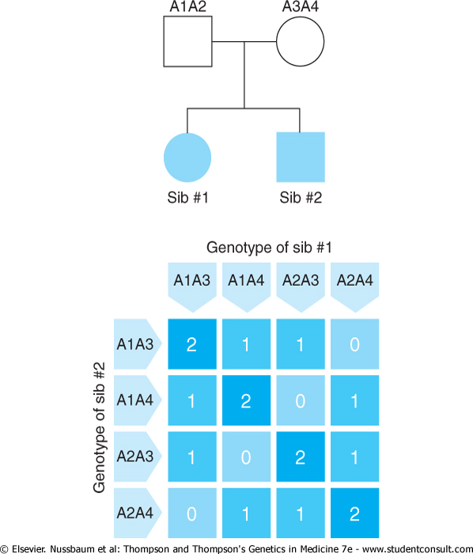
Downloaded from: StudentConsult (on 10 May 2008 05:05 PM)
© 2005 Elsevier

Slide 11
Studies of Familial Aggregation of Disease in Siblings
Twins
  Monozygous (MZ) twins (0.3% of births)
  Dizygous (DZ) twins (0.2-1.0% of births)
  Twins reared apart
  Twins adopted and raised by unrelated foster parents
Siblings

Slide 12
Measures of Degree of Genetic Contribution to Disease in
Family Studies
Qualitative traits or diseases
  Concordance
Quantitative traits
  Correlation
  Heritability

Slide 13
Concordance
Calculated as the number of twin-pairs with disease amongst those twin-pairs with at least one affected twin (Gordis):
#twins with both affected
# twins with both affected + # twins with only one affected
Concordance < 100% in MZ twins is evidence for nongenetic etiological factors.
Concordance in MZ twins > DZ twins is evidence for genetic etiological factors.

Slide 14
Concordance Rates for Parkinson’s Disease in Twin Pairs *
Number Concordant Pairs Types of Pairs of Pairs Number %
All twin pairs
Monozygous 71 11 15.5
Dizygous 90 10 11.1
Onset <50 years
Monozygous 4 4 100.0
Dizygous 12 2 16.7
Onset >50 years
Monozygous 65 7 10.8
Dizygous 76 8 10.5
*Tanner CH et al. JAMA 1999; 281: 341-346 as cited in Gordis, 2004

Slide 15
Concordance Rates in MZ and DZ Twins*
Concordance (%)
Disorder MZ DZ
Nontraumatic epilepsy 70.0 6
Multiple sclerosis 17.8 2
Schizophrenia 40 4.8
Bipolar disorder 62 8
Osteoarthritis 32 16
Rheumatoid arthritis 12.3 3.5
Psoriasis 72 15
Cleft lip 30 2
Systemic lupus erythematosus 22 0
Nussbaum et al. Thompson and Thompson’s Genetics in Medicine, 2007

Slide 16
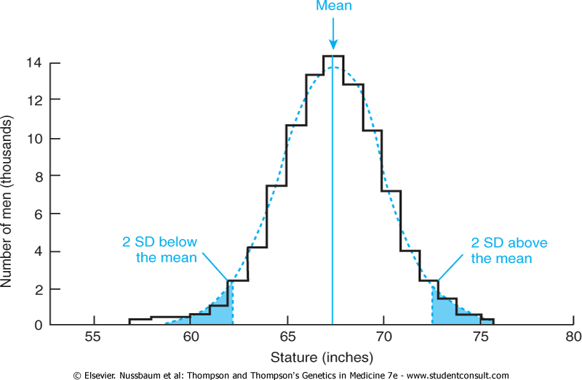
Downloaded from: StudentConsult (on 10 May 2008 05:05 PM)
© 2005 Elsevier

Slide 17
Measures of Degree of Genetic Contribution to Disease in
Family Studies
Qualitative traits or diseases
  Concordance
Quantitative traits
  Correlation
  Heritability

Slide 18
Correlation Among Relatives for Systolic Blood Pressure*
Relatives Compared Correlation (r)
Monozygotic twins 0.55
Dizygotic twins 0.25
Siblings 0.18
Parents and offspring 0.34
Spouses 0.07
* Feinlieb M et al as cited in Gordis, 2007

Slide 19
Heritability (h²)
Defined as the fraction of total phenotypic variance of a quantitative trait that is caused by genes.
Calculated from twin studies:
h² = Variance in DZ pairs-Variance in MZ pairs
Variance in DZ pairs
Varies from 0.0 (no heritability) to
1.0 (strong heritability); >.7 or .8 suggest strong influence of heredity on trait.

Slide 20
Limitations of Twin Studies
Environmental exposures may not be identical even in MZ twins.
MZ twins can have different gene expressions.
The risk of the genotype may be heterogeneous between twin pairs.
Ascertainment bias: Co-twin with disease is more likely to participate in twin studies as compared to unaffected co-twin.

Slide 21
Linkage Analysis: Family-based Approach to Identification of Susceptibility Genes
Linkage: the tendency for alleles at loci that are close together to be transmitted together as an intact unit (haplotype).
Recombinant fraction (Θ) varies 0.0-0.5:
0.0 = tightly linked, no recombination
0.5 = unlinked, independently assorting
Map distance in centimorgans: genetic length over which one recombinant cross-over will occur in 1% of meioses.

Slide 22
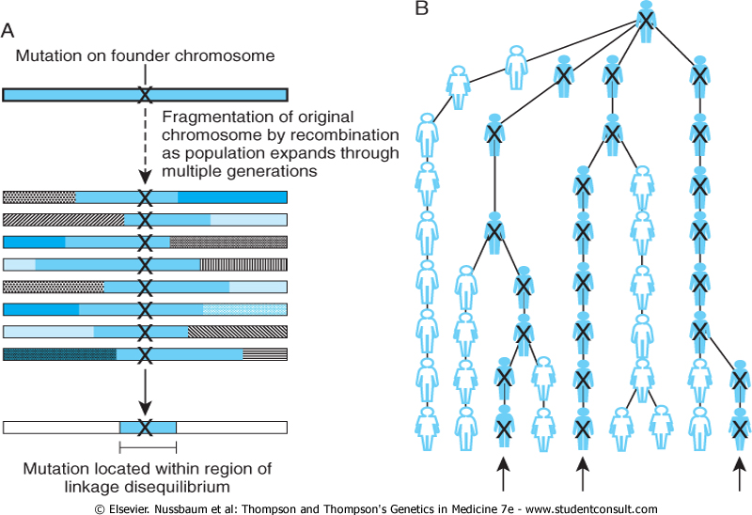
Downloaded from: StudentConsult (on 11 May 2008 06:40 PM)
© 2005 Elsevier

Slide 23
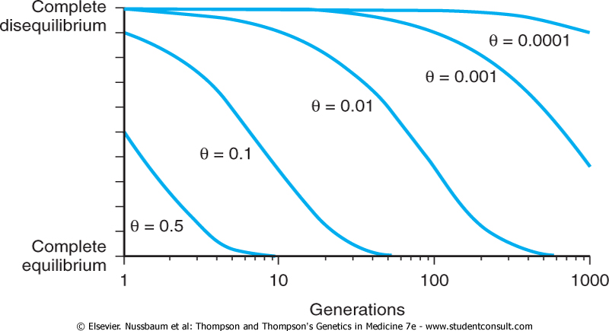
Downloaded from: StudentConsult (on 11 May 2008 06:40 PM)
© 2005 Elsevier

Slide 24
Determination of Linkage in Family Studies
Assume a mode of Mendelian inheritance.
Identify markers with known positions to serve as references.
In families, determine the number of 1st degree relatives who show recombination assuming various values of θ (0.0 to 0.5).
Calculate ratio of liklihood of observing the family data for values of θ to the likelihood of observing the family data if the loci were unlinked (θ = 0.5).

Slide 25
LOD Score (Z= Logarithm of Odds)
Z = Likelihood of the data if loci linked at a particular θ
Likelihood of the data if loci are unlinked (θ = 0.5)
Best estimate of θ, the recombinant frequency between a marker locus and the disease locus.
Magnitude of Z assesses strength of likelihood of linkage (LOD>3 is 1000/1 odds that loci are linked).
LOD scores can be added across families.

Slide 26
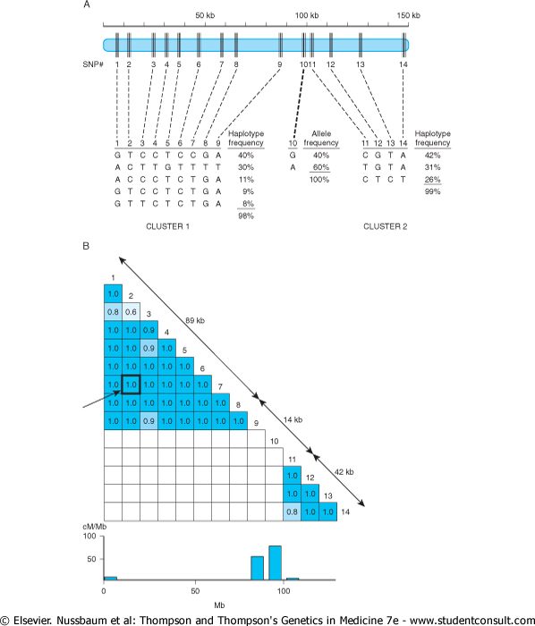
Downloaded from: StudentConsult (on 11 May 2008 06:40 PM)
© 2005 Elsevier

Slide 27
Trios: Study Design of Affected Offspring and Both Parents
Phenotypic assessment only in affected offspring.
Genotyping in both parents and affected offspring.
Used in both discovery and replication GWAS.
Advantage: Not susceptible to population stratification due to sampling of cases and controls from populations of different ancestries.

Slide 28
Parents and Offspring: Transmission Disequilibrium Testing (TDT)
Tests whether an allele at given locus (linked to disease or trait) transmitted to affected offspring by parents more frequently than expected by chance.
Heterozygous parents transmit alleles m₁ and m₂ at given locus with equal frequency (50%); affected offspring should receive disease-associated allele more frequently.
Obviates need for control group.

Slide 29
TDT in Type I Diabetes: Excess Transmission of D18s487 Allele 4
(Merriman T et al. Hum. Molec. Genet 1997; 6;1003-1010)
Families | Trans-mitted | Not Trans-mitted | % T | P-value
Affected | 348 | 276 | 55.8 | 0.004
Not affected | 101 | 98 | 50.8 | NS

Slide 30
Comparison of GWAS Studies Using Case-Control and Trio Designs to Identify Associations Between Three SNP’s and Type 1 Diabetes Mellitus*
 | rs2476601 | ra10255021 | rs2903652
Case-Control
Allele | A | A | A
Minor Allele Frequency
Cases (N=561) | .1471 | .0667 | .2834
Controls (N=1143) | .0876 | .1095 | .3782
OR | 1.8 | .58 | .65
P Value | 1.3 x 10⁻⁷ | 1.2 x 10⁻⁴ | 4.8 x 10⁻⁸
Trio
Alleles | A:G | A:G | A:G
Trans : Untrans | 137:64 | 18:57 | 160:228
TDT P Value | 2.6 x 10⁻⁷ | 6.7 x 10⁻⁶ | 7.9 x 10⁻⁵
*Hakonarson H, et al. Nature 2007; July 15

Slide 31
Limitations of Trios
Difficult to assemble trios if late onset of disease in affected child.
Sensitive to small degrees of genotyping errors which can distort transmission proportions between parents and offspring (Mitchell AA et al. J Hum Genet 2003; 72: 598-610)
  Example in GWAS of schizophrenia (Kirov G et al: Molec Psych 2008; 1-8).

Slide 32
Other Issues in Family-based Designs
GWAS of Affected/Unaffected sibling comparisons
(Maraganore DM et al. Am J Hum Genet 2005; 77:685-693)
Attribution of heritability or genetic risk.
  1.Multivariate adjustment of disease association for susceptibility SNPs to determine if risk can be accounted for:
  Y = β₀ + β₁(+FH) + β₂(SNP₁) + β₃(SNP₂) + etc.
  2. Multiple adjustment for intermediary risk factors to identify excess risk in first degree relatives (Framingham Heart Study).

Slide 33
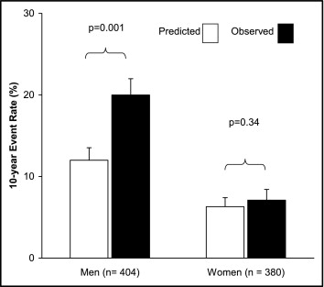
Does the Framingham Risk Score Predict Risk in Siblings of Early Premature Coronary Patients?
784 sibs (30-59 yrs.) of 449 pts. With CAD with onset <60yrs.
Ten year follow-up for incident CAD events.
Ten year risk from FRS calculated at baseline.
Excess risk in men (66.6%) and in women (12.7%).
Vaidya D et al, AJC 2007; 100: 1410-1415

Slide 34
Conclusions
Family-based studies have been the cornerstone of identification and quantification of the familial risk and heritability of human diseases.
Linkage analysis identifies the location of genes relative to known markers and the alleles within a haplotype in linkage disequilibrium.
Trios provide a family-based design for candidate genes or for discovery or replication GWAS.

