Slide 1
HR Competencies:
Challenges and Opportunities
The Future is NOW
Timothy M. Dirks
Director of Human Resources Management
U.S. Department of Energy

Slide 2
Dave Ulrich, Author
HR Champions
“ To be more significant,
HR must become more
professional.”

Slide 3
Drivers of Change for HR Profession
Impacts of downsizing
Demographic makeup of HR profession
New and emerging roles
Alternative methods of service delivery
Increasing customer demands
Technology impacts
New skills and competencies
President’s memo aligning HR with mission

Slide 4
Competencies: What are they?
OPM defines as . . . “An underlying characteristic of an employee (i.e., motive, trait, skill, aspect of one’s self-image, social role or a body of knowledge) which results in effective and/or superior performance” (Boyatzis, 1982)

Slide 5
Why Competencies?
(1) Maintain focus
(2) Measure and align performance
(3) Facilitate change

Slide 6
HR COMPETENCY MODEL
IPMA, OPM and NAPA
Addresses 5 roles
Use as a tool for change
Redefines role of HR organization and professionals

Slide 7
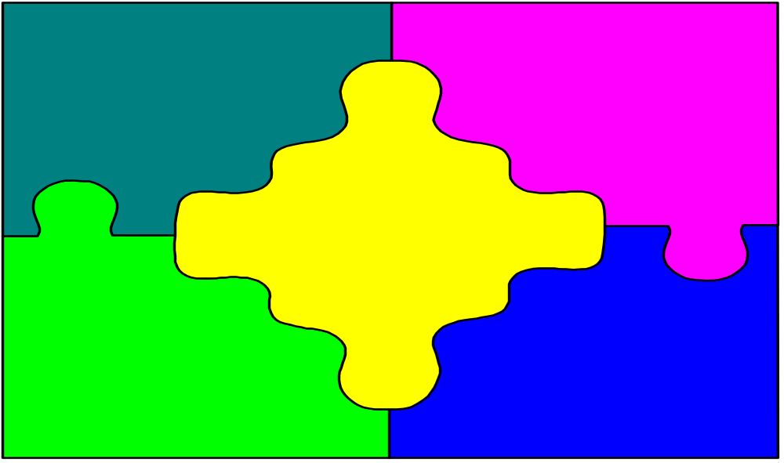
HR Competency Model
Strategic Partner
- understands culture
- knows mission
Leader
analytical, strategic,
creative thinking, and
knows business
systems
Change
Consultant
O.D., marketing
& teaming
Technical Expert
- Knowledge HR law
& policies, work-life,
info. technology
Employee
Champion
- develop relationships
- promotes diversity

Slide 8
Impacts on Current
Technical Expertise
Brain Drain
Future exodus
Lack of training and development opportunities
Lack of attention to or focus on “the basics”

Slide 9
Addressing Technical Competency Challenge
Training / re-training
Job Rotations
Customer focus
Develop competency-based systems for selection, training, and performance management

Slide 10
HR Imperatives - Delivering on the New Roles and Competencies
HR must become more customer-focused and results-oriented.
HR must be creative and drivers of positive change.
HR needs to be mission driven and aligned with key organizational goals.

Slide 11
HR Imperatives - Delivering on the New Roles and Competencies
HR must embrace new automated technologies to aid in service delivery and workforce analysis.
HR must be managed like a business regarding return on investment and cost-benefits analysis.
HR organizations must invest in the continual development of their people.

Slide 12
Gandhi
“We must become the change
we want to see.”

Slide 13

One Size Fits All?
No - there is no one size fits all solution.
Factors:
- Agency size/scope
- Customer needs
- Budget status
- Leadership commitment
- Culture and the like

Slide 14
What’s Next?
Analysis and assessment
needs to be done to determine
which competencies are appropriate
for your agency’s culture, strategic mission and environment.

Slide 15
What’s next?
After identifying critical competencies -
align and integrate HR systems to
support those competencies.

Slide 16
What’s next?
Align to agency mission and vision:
HR programs and policies
HR service commitments and delivery systems
HR position descriptions and performance plans
HR individual development plans
HR training and development
HR awards and recognition
HR measures/metrics

Slide 17
What’s next?
Competency Training and Certification/
Credential programs
  enhance image
  sense of pride and stature
  new skills
  provide a foundation
  consistent service delivery expectations

Slide 18
Albert Einstein
“In the middle of difficulty
lies opportunity.”

