Slide 1
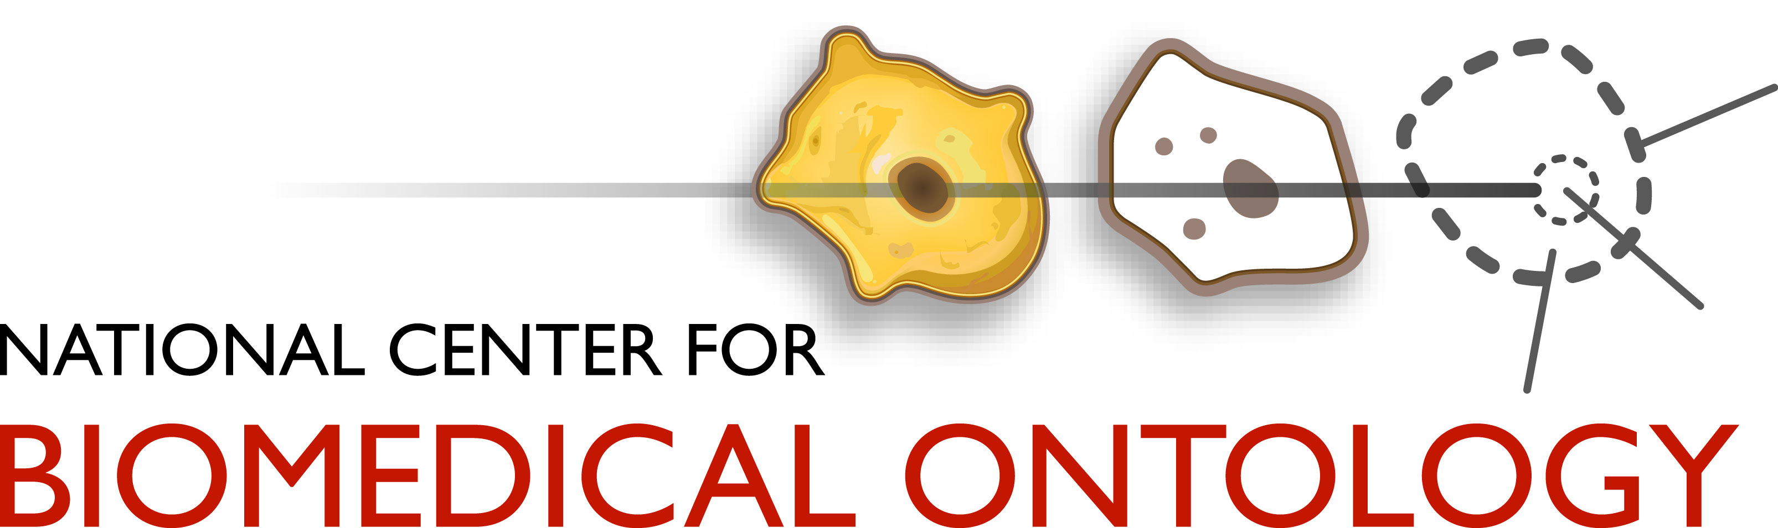
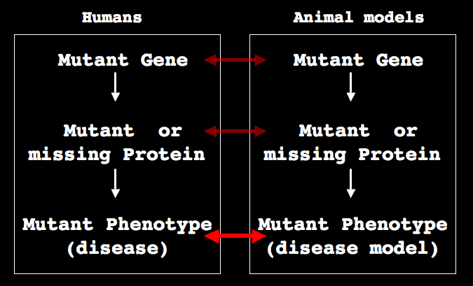
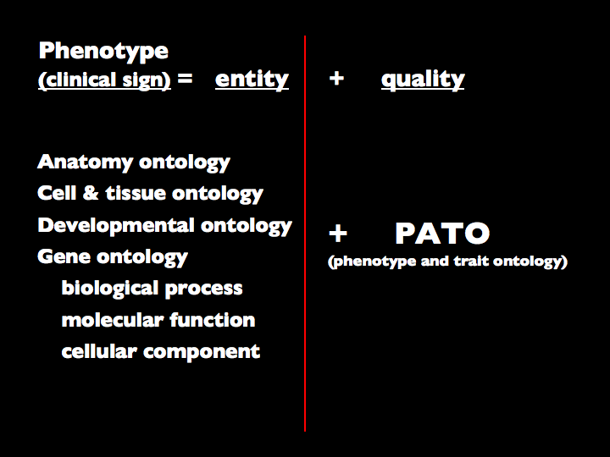
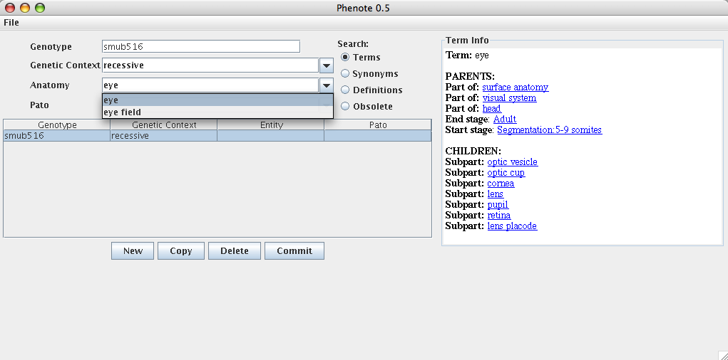
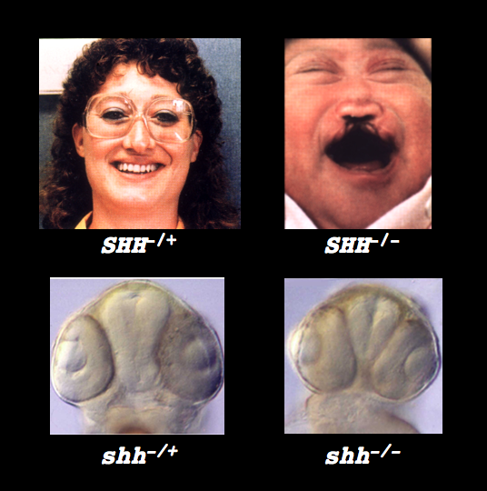
ONTOLOGIES LINK HUMAN DISEASES TO ANIMAL MODELS
Michael Ashburner¹, Mark Gibson², Suzanna Lewis², Chris Mungall², Erik Segerdell³ and Monte Westerfield³
¹Cambridge University, ²Lawrence Berkeley National Laboratory and ³University of Oregon
OVERVIEW
One of the major challenges facing biomedical researchers is to develop methods to link information obtained from studies of model organisms to the diagnosis and treatment of human diseases.
Model organisms provide a rich and deep understanding of gene functions particularly from studies of expression patterns and mutant phenotypes. Databases often store phenotypic information as text. Text alone, however, limits the ability to organize and search for specific information. It is much more preferable to use ontologies (structured vocabularies) because they define relationships between terms. Several existing ontologies provide terms and relationships useful for annotating phenotypes, including the Gene Ontology (GO) that classifies gene products, various model organism and human anatomical ontologies, and the Phenotype and Trait Ontology (PATO) that provides vocabulary and syntax for describing phenotypes.
We are using and further developing these resources and the syntax of PATO to design a set of orthogonal ontologies to describe mutant phenotypes and diseases. We are developing a curator interface and using it to annotate fruitfly and zebrafish mutant phenotypes and associated human diseases. Shared ontologies allow us to make links among different species.
We propose that this general strategy can be extended to phenotypes in all species, thus providing a means to link human diseases to model organisms.
STRATEGY
ONTOLOGIES
BLAST
BLAST
ONTOLOGIES
Ontologies can be used to describe phenotypes, thus providing a means to link human diseases with animals models, when the genes are unknown.
CURATION TOOL
ANIMAL MODELS OF HUMAN DISEASE
SYNTAX
Clinical signs:
• hypotelorism
• cleft palate
• cyclopia
SPECIFIC AIMS
1. We will use PATO to annotate mutations of fruitfly (Drosophila) and zebrafish, with priority to those in genes whose human ‘homologs’ are associated with disease.
2. We will use PATO to annotate the human homologs of annotated Drosophila and zebrafish genes.
3. We will develop ontologies necessary for these annotations and we will contribute both the ontologies and the annotations to the NCBO.
Human holoprosencephaly can result from mutations in the SHH gene. Allelelic differences produce more or less severe phenotypes ranging from narrowed eyes (hypotelorism), to cleft palate to cyclopia. Mutations in the orthologous zebrafish gene produce very similar phenotypes.

