Slide 1



Patient-Reported Outcomes Measurement Information System

Slide 2
Why the need for improved PRO measures?
Can we easily use our outcomes data for:
  clinical trial outcome evaluation?
  clinical decision-making?
  administrative and management purposes?
  health policy decision making?
  regulatory and market purposes?
Notes:
NOTE: SLIDES #8 - #11 ARE FOR PRESENTING PROMIS TO OTHER AUDIENCES. PLEASE MODIFY ACCORDINGLY.

Slide 3
Why the need for improved PRO measures in Clinical Trials?
Planned benefits of the PROMIS measures
  Responsiveness to differences should they exist across treatment groups.
  Improved performance where floor and ceiling effects are expected.
  Potential to reduce respondent burden
  Potential to reduce research cost
Notes:
NOTE: SLIDES #5 - #7 ARE FOR PRESENTING PROMIS TO CLINICAL TRIALISTS.

Slide 4
What's wrong with today's measurements ?
3
2
2
Questionnaire
with a high
precision -
but small range
1
1
Questionnaire
with a wide
range -
but low precision
0
- 1
- 2
- 3
Notes:
Static questionnaire are either not precise enough or their measurement range is to narrow … ceiling and floor effects …

Slide 5
Computer Adaptive Tests
2. Question
3. Question
3
high
depression
2
2
2
1
1
1
Questionnaire
with a high
precision -
AND a
wide range
0
0
- 1
- 2
low
depression
- 3
Notes:
Purpose of this slide is to walk the audience through the CAT process using an example …and thereby transmit the message of narrower measurement range and higher precision with each question …
I typically ese e.g. an example for depression, or any other topic I want to focus on … like first question “do you feel depressed”, answer “some of the time” … than we would like to know how depressed and the CAT might choose a question asking about self worth, and if the patient indicates that this is diminished also, a third question asking about thoughts of suicide might be appropriate … in this case the answer would be no, never …
And maybe compare it with another scenario like the participant would have answered the first question, no I am not at all depressed, asking about suicide would not make sense, instead the CAT might have chosen a question asking about happiness … bla bla
The conclusion is, we can make precise test over the entire range …

Slide 6
Themes of the NIH Roadmap
New Pathways to Discovery
Research Teams of the Future
Re-engineering the Clinical Research Enterprise

Slide 7
Re-engineering the Clinical Research Enterprise
To continue NIH’s mission of successful medical research, it will need to recast its entire clinical research system
  Requires the development of new partnerships of research with organized patient communities, community-based health care providers, industry, and academic researchers.
  Need new paradigms in how clinical research information is collected, used, and reported.
  Includes the advances in information technology, psychometrics, and qualitative, cognitive, and health survey research.

Slide 8
The PROMIS of a better future…
A publicly available, adaptable and sustainable Internet-based system that will:
  Administer individually “tailored” questionnaires (using Computer Adaptive Testing (CAT) technology) to measure health status outcomes
  Collect and analyze responses
  Provide instant health status reports to users to:
    Enhance research
    Improve clinical decision-making
    Facilitate policy-making by health plan and systems and public programs

Slide 9
PROMIS:
Long-term Objectives
Create a publicly available, adaptable and sustainable Internet-based system, the Patient-Reported Outcomes Measurement Information System (PROMIS) -- that will:
  Administer “tailored” questionnaires (using CAT technology) that measure a patient’s health status.
  Collect the patients’ responses for research and for upgrading the system.
  Provide instant health status reports to patients and health care providers to improve treatment decision making.
Lay groundwork for public-private partnership to extend the PROMIS beyond its five-year development stage.

Slide 10
PROMIS integrates the fields of…
Information
Technologies
Cognitive
Aspects of
Survey
Methods
Psycho-
metrics
PROMIS
Qualitative
Research
Methods
Survey
Research
Notes:
This project will utilize the advances in information technologies, the strengths of modern measurement theory, and the contributions from the fields of psychometrics, cognitive psychology, and health survey methods to develop a new and dynamic PRO measurement and reporting.

Slide 11



PROMIS Network Structure
PRS
PROMIS Network
PRS
S
C
C
SC
PRS
SAB
NIH
Science
Officers
Notes:
$25+ Million, 5-Year cooperative agreement between NIH and extramural investigators (using a U01 Grant Mechanism) including six Primary Research and Data Collection Sites (PRS) and a Statistical Coordinating Center (SCC). The PROMIS Steering Committee (SC) holds conversations among PIs on a monthly basis and meets face-to-face about every 3-4 months. The Scientific Advisory Board (SAB) advises the NIH. The SAB consists of Drs. Mick Couper (U. of Michigan), Jacqueline Dunbar-Jacob (U. of Pittsburgh), Ronald Kessler (Harvard), Colleen McHorney (Merck), Dick Moxley (Strong Memorial Hospital), Donald Patrick (U. of Washington), Ruth Stein (Albert Einstein College of Medicine), Laurie Burke (FDA), Lisa Hines (CMS), Don Detmer (U. of Virginia), and Margaret Rothman (Johnson and Johnson).

Slide 12
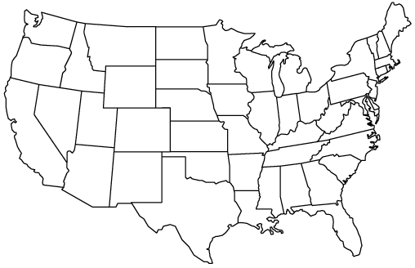
The PROMIS Network
●
University of Washington
Stony Brook University
Evanston
Northwestern Healthcare
●
●
●
●
●
♦
●
●
●
▲
NIH
●
●
Stanford University
University of Pittsburgh
●
UNC –Chapel Hill
●
Duke University
●
Notes:
Note: This map identifies the Statistical Coordinating Center (Evanston Northwestern – David Cella, PI) and 6 Primary Research and Data Collection Sites (Duke, Kevin Weinfurt, PI; Stanford, James Fries, PI; SUNY, Arthur Stone, PI; UNC, Harry Guess, PI; Pittsburgh, Paul Pilkonis, PI; Washington, Dagmar Amtmann, PI). Non-labeled dots represent sub-contractors. Deborah Ader is the NIH Program Director.

Slide 13
PROMIS Domain Hierarchy
Upper Extremities (ADL): walking, arising, etc.
Function/Disability
Lower Extremities (ADL): grip, buttons, etc
Central (ADL): neck & back (twisting, bending)
Activities: IADL (e.g. errands)
Physical Health
Pain
Symptoms
Fatigue
Other
Satisfaction
Anxiety
Depression
Health
PRO
Emotional Distress
Anger/Aggression
Mental Health
Alcohol & Substance Use
Cognitive Function
Negative Impacts of illness
Subjective Well-Being (positive effect)
Satisfaction
Positive Psychological Functioning
Meaning and Coherence (spirituality)
Mastery and Control (self-efficacy)
Positive Impacts of Illness
Role Participation
Performance
Social Health
Satisfaction
Social Support
Satisfaction
Notes:
One possible way to focus on one sub domain … (with animation)
Note: Yellow Highlighted Domains are the PRO domains that will be covered in PROMIS first round of testing to begin in April 2006. The “General Health” Domain is an overall evaluation by patient of the condition of their health. Each measured domain will also include a global item assessing their level on the construct.

Slide 14
Advantages of adding IRT to Classical Test Theory
Item Response Theory focuses on the mathematical relationship of items, not scales, to the latent trait
Advantages:
  Scale reduction – potentially more precision with less items
  Scale flexibility – different items to measure the same trait
  Equate scores of different scales (crosswalking)
  Test item equivalence across groups (DIF)
  Tailored administration (CAT)

Slide 15
Leveraging Advances in Computer and Internet Technology
Continuous access to PRO measurement
Automated administration, validation checks, and data recording, storing, and scoring
Enhanced graphic interface to improve format and presentation for patients (e.g. increased accessibility)
Immediate feedback of a patient’s health status both to the patient and provider

Slide 16
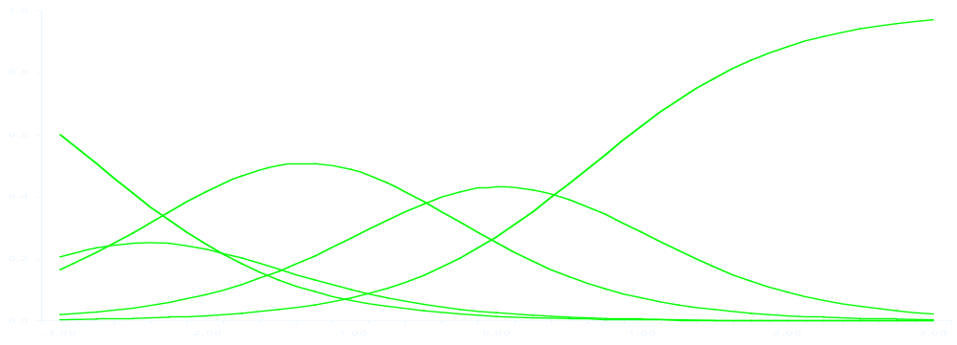
How often did you feel nervous?
All of the time
Most of the time
Some of the time
Little of the time
None of the time
-3
-2
-1
0
1
2
3
Severe
high
moderate
low
very low
Emotional Distress
Item Bank
(Validated & IRT-Calibrated Emotional Distress Items)

Slide 17
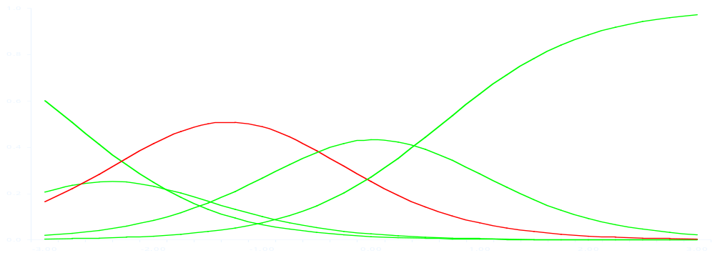
How often did you feel nervous?
Some of the time
-3
-2
-1
0
1
2
3
Severe
high
moderate
low
very low
Emotional Distress
Item Bank
(Validated & IRT-Calibrated Emotional Distress Items)

Slide 18
How often did you feel nervous?
Some of the time
-3
-2
-1
0
1
2
3
Severe
high
moderate
low
very low
Emotional Distress
Item Bank
(Validated & IRT-Calibrated Emotional Distress Items)

Slide 19

How often did you feel hopeless?
All of the time
Most of the time
Some of the time
Little of the time
None of the time
-3
-2
-1
0
1
2
3
Severe
high
moderate
low
very low
Emotional Distress
Item Bank
(Validated & IRT-Calibrated Emotional Distress Items)

Slide 20
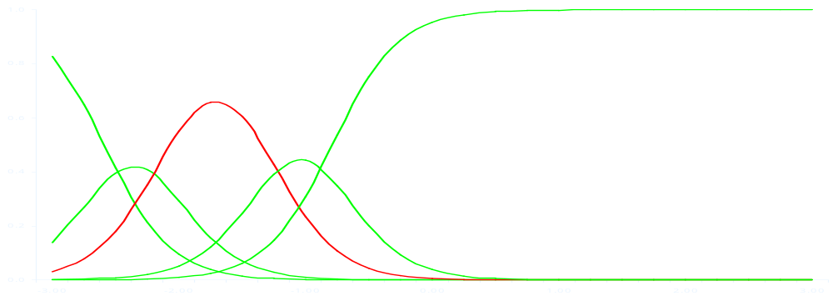
How often did you feel hopeless?
Some of the time
-3
-2
-1
0
1
2
3
Severe
high
moderate
low
very low
Emotional Distress
Item Bank
(Validated & IRT-Calibrated Emotional Distress Items)

Slide 21

How often did you feel worthless?
All of the time
Most of the time
Some of the time
Little of the time
None of the time
-3
-2
-1
0
1
2
3
Severe
high
moderate
low
very low
Emotional Distress
Item Bank
(Validated & IRT-Calibrated Emotional Distress Items)

Slide 22
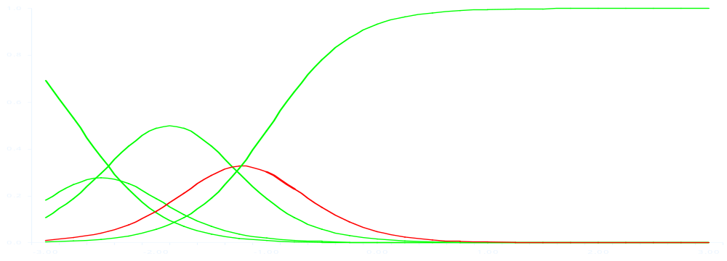
How often did you feel worthless?
Little of the time
-3
-2
-1
0
1
2
3
Severe
high
moderate
low
very low
Emotional Distress
Item Bank
(Validated & IRT-Calibrated Emotional Distress Items)

Slide 23
How often did you feel worthless?
Little of the time
-3
-2
-1
0
1
2
3
Severe
Target in on
emotional
distress score
high
moderate
low
very low
Item Bank
(Validated & IRT-Calibrated Emotional Distress Items)

Slide 24
PROMIS Item Bank Development
Comprehensive collection and review of existing items (legacy items)
Development of new and modified items (approx. 8000 total items)
Binning and winnowing of items (1064 items)
Readability analysis and revisions
Focus groups
Cognitive interviews (784 items)

Slide 25
How Clinical Researchers would use PROMIS
Set up assessment protocol, including selecting domains and modes of administration
Patients complete at office or anywhere
Researchers provided with tracking on completion and results
Downloadable dataset
Documentation of the PROMIS system for use in publications, FDA submissions, etc.

Slide 26
What PROMIS Is Not
PROMIS measures patient reports –
  It is not a laboratory or performance measure
PROMIS currently measures a limited set of clinically relevant domains
  It does not measure all clinically relevant patient reported outcomes (at least not yet)
PROMIS measures outcomes –
  It is not adequate alone to use for most screening or diagnostic needs

Slide 27
PROMIS: More than the Network Project
Independent Projects
  Patient Reported Sleep Domains (Pittsburgh)
  Pain and Fatigue in Children with Disabilities (Washington)
  PROMIS for Pediatric Samples (UNC)
  Outcomes in Arthritis and Aging Populations (Stanford)
  IRT in Multi-Site Clinical Trials (Duke)
  Ecological Validity in Patient Reported Outcomes (Stony Brook)
Spin-Off Projects
  Patient Reported Outcomes in Cancer Treatment Trials
  Quality of Life Outcomes in Neurological Disorders

Slide 28
Information
PROMIS: www.nihPROMIS.org
Roadmap: www.nihroadmap.nih.gov
NIH Science Officers:
  William Riley, NIMH
  Bryce Reeve, NCI
  Larry Fine, NHLBI
  Lou Quatrano, NICHD
  Susan Czajkowski, NHLBI
  Suzana Serrate-Sztein, NIAMS
NIH representatives from numerous other institutes

Slide 29
What is Computerized Adaptive Testing (CAT)?
A technique for administering a PRO instrument that
  selects questions on the basis of a person’s response to previously administered questions
    each question, stored in an “item bank” has been psychometrically and qualitatively reviewed as informative for measuring the health construct
  determines a person’s score with the minimal number of questions and no loss of measurement precision

Slide 30
Advantages of CAT Assessments
Provide an accurate estimate of a person’s score with the minimal number of questions
  Questions are selected to match the health status of the respondent
Minimize floor and ceiling effects
  People near the top or bottom of a scale will receive items that are designed to assess their health status

Slide 31
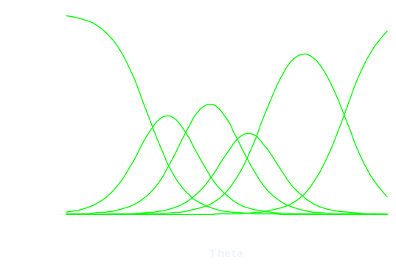
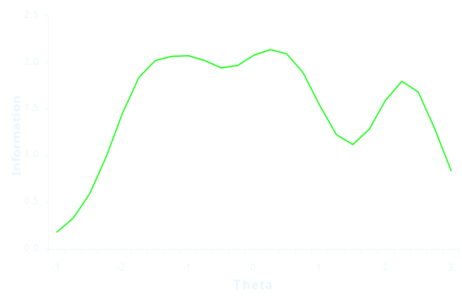
Items from
Instrument
A
Items from
Instrument
B
Items from
Instrument
C
New
Items
Item Library (>8,000)
Content Expert
Review
Focus
Groups
Cognitive
Testing
Secondary
Data Analysis





Questionnaire
administered to large
representative sample








Item
Response
Theory
(IRT)
Item Bank
(IRT-calibrated items reviewed for
reliability, validity, and sensitivity)
CAT
Short Form
Instruments

Slide 32
Item Response Theory
(IRT) Modeling
A family of models that describe, in probabilistic terms, the relationship between people’s responses to questions and their position on the continuum of what is being measured (e.g., pain)

Slide 33
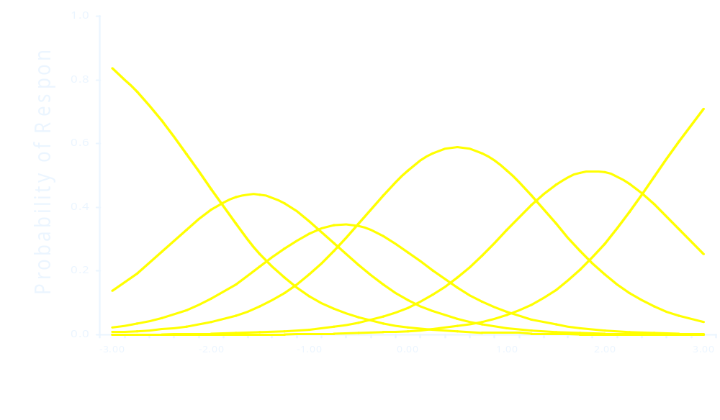
Item Response Theory
(IRT) Modeling
How much bodily pain have you had during the past 4 weeks?
None
Moderate
Very Severe
Very Mild
Severe
Mild
no pain
extreme pain
IRT assigns properties to each question that provide information on which people a given question is best suited for

Slide 34
What is the PROMIS Potential?
Enhance national capacity to
  evaluate effectiveness of all health interventions, prevention, diagnosis, treatment, rehabilitation, palliation
  monitor progress against burdens of disease
  support a wide range of studies on the determinants of health care utilization and outcomes

Slide 35
What is the PROMIS Time Line?
2004-05: Choose specific domains
Identify, review instruments and items
2006-07: Build item pools in 5 domains
Collect response data
Create alpha version of CAT
Build collaborative alliances
2008-09: Conduct final calibration process
Put CAT into final form
Conduct second major network project
Feasibility tests and User Group meetings Build sustaining partnerships

Slide 36
PROMIS Website http://www.nihPROMIS.org/
Contact Information:
Shani Rolle, M.S.
NIH Coordinator
RolleS@mail.nih.gov

