Slide 1
Interspecific Testing of Gender-associated SCAR Markers in Salix
Oak Ridge National Laboratory
State University of New York-Syracuse
BFDP Subcontractor’s Workshop
November 8, 2001

Slide 2
Background
Discovery of RAPD markers associated with femaleness in certain families of S. viminalis
Modification of quantitative genetics model of sex determination in S. viminalis
  Two loci, each with 4 alleles
  Epistatic interaction
  RAPD markers associated with one allele of hypostatic locus
Notes:
Cilla proposed a working model of sex determination, suggesting a 2 locus, 4 allele epistatic interaction. Predicted 3/13 families should segregate at a single locus for an allele determining gender.
Identification of a RAPD marker linked to femaleness in certain genetic backgrounds. Most known markers linked to males (except kiwi). Marker is biparentally inherited and linked to a nuclear gene, but subject to expression of at least one alternative, unknown locus.

Slide 3
4.4 + 2.1 cM
354₅₂₀
SDL- II
AE08₇₈₀
2.7 cM
3.3 cM
Putative sex-determination locus in S. viminalis
Notes:
RAPD marker sequenced and converted to SCAR; additional, marker developed.
Estimates of crossing over used to calculate mapping distance from putative sex determination locus.

Slide 4
Objectives
Task 1: Test small segregating F1 populations of S. eriocephala progeny for the presence of the SCAR markers developed for S. viminalis
Task 2: Determine significance of association of markers to gender in S. eriocephala

Slide 5
Methods
Survey parental genotypes of S. eriocephala F1 families
Select families for marker analysis
Perform segregation analysis of markers within and among families

Slide 6
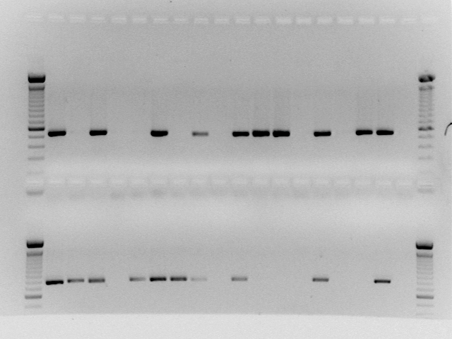
Survey of S. eriocephala P1
Identify alternate allelic combination of both markers
SCAR 354₅₂₀
♀♀♀♀♀♀♀ + - ♂♂♂ ♂♂♂♂♂ -
SCAR AE08₇₈₀
Notes:
Gender phenotype vs. marker phenotype
Because SCAR markers dominant, no a priori knowledge of marker presence signifying homozygous or heterozygous allelic state.
Look at specific parents to identify 1) families representing alternate allelic combination for both markers; that is one parent has both markers and the other parent lacks both.

Slide 7
S. eriocephala Family Selection
P1 | ♂
♀ | 646 | 95061 | 95316 | 95019 | 95024 | 95022 | 95054 | 287
96305 | 98-1 |  | 98-3 | 98-4 | 98-5
S652 | 98-106 | 98-6 | 98-7 | 98-8 | 98-9 | 98-10
S25 |  |  | 98-11 | 98-12 | 98-13 | 98-14 | 98-15 | 98-42
95331 |  |  |  | 98-16 | 98-17 | 98-18 | 98-19 | 98-43
95064 | 98-26 | 98-27 |  |  |  | 98-28 | 98-29 | 98-44
95306 | 98-31 | 98-32 |  |  |  |  | 98-34 | 98-45
95311 |  | 98-37 | 98-38 | 98-39 |  |  |  | 98-46

Slide 8
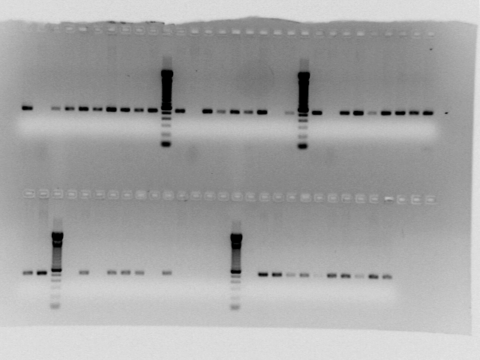
Segregation Analysis:
SCAR 354₅₂₀
98-4 98-12 98-14
41 F1 genotypes in 5 S. eriocephala families
19 females, 20 males, 2 unknown gender
No association with gender
♀ ♂♀♂♂♀♀♀♀♂ ♀♂♀♀♂♂♂ - + ♀♂♂♀♂♀♀♂♀
♀? ♀♂♀♂♀♂♀♂? ♂♂♂ ♀♂♀♂♂♀♂♀♂♂♀
98-17 98-43
Notes:
Family ID above and below section of gel associated with family.
Female parent green, male parent
For 354-520, none of the families satisfy both criteria of alternate homozygous allelic form and expression of hypostatic locus

Slide 9
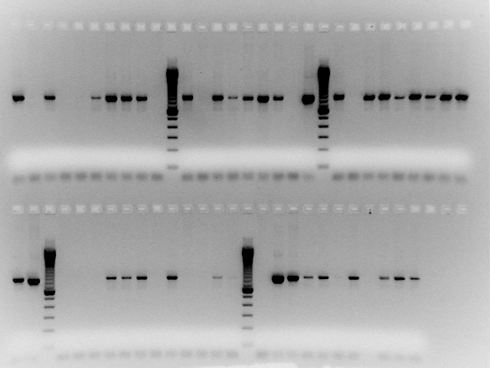
Segregation Analysis:
SCAR AE08₇₈₀
In Family 984, marker associated 100% with female progeny
Test other families sharing mother 96305:
    981
    983
    985
98-4 98-12 98-14
♀♂♀♂♂ ♀♀♀♀♂ ♀♂♀♀♂♂ ♂ - + ♀♂ ♂♀♂♀♀ ♂♀
♀? ♀♂♀ ♂♀♂♀♂? ♂♂♂ ♀♂♀♂ ♂♀♂♀♂♂♀
98-17 98-43
Notes:
Other families represent an additional 26 genotypes.

Slide 10
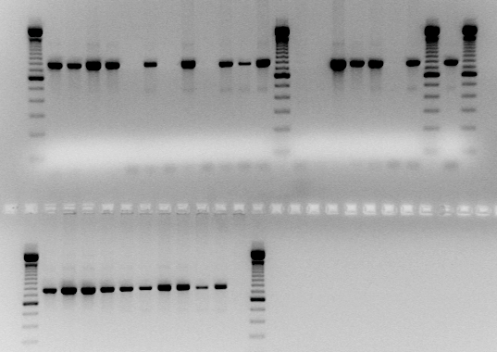
Segregation Analysis:
SCAR AE08₇₈₀
98-1 98-3 +
Goodness-of-fit: progeny of 96305 families 98-1, 98-3,98-4
  15/15 females
    Χ²=15.0, p<0.005, df=1
  1/9 males
    χ² =5.4, p<0.025, df=1
♀♂♀♀ ♂ ♀♂♀♂♀♂ ♀ ♂♂♀♀♀ ♂♀
♂♀♂ ♂♂♀♀♀ ♂♀♂
98-5
Notes:
Know mother is het for marker based on 98-4 segregation of marker with gender
Father in 98-1 is also het; marker not associated with gender
Father in 98-3 doesn’t have marker
Father in 98-5 hom +
Due to recombination, not unexpected that some male progeny exhibit marker

Slide 11
Results
Collected gender and marker data on additional 43 (31 female and 12 male) progeny in S. eriocephala family 99-4
No association of marker with gender for 354₅₂₀
Goodness-of-fit for AEO8₇₈₀ showed a significant association of marker with gender for female progeny of 994 and 984 families combined (n = 36 X² = 13.4 p < 0.005 d.f. =1) as well as for males of these families (n = 15 X² = 15 p < 0.005 d.f. =1)

Slide 12
Results
Recombination based on single crossover estimates SCAR AEO8₇₈₀ marker at 13.7 + 3.4 cM from locus involved in gender determination
If mapping distance in Salix is similar to Populus (~220 kb/cM), then distance from marker to locus is ~3.0 Mb + 750 kb.

Slide 13
Conclusions
Marker developed for S. viminalis is associated with femaleness in S. eriocephala, suggests:
    Genetic basis for gender
    Multilocus system common in family
Putative epistatic interaction allows us to observe association of marker with femaleness in other families
Additional work needed to enable use of markers to predict gender in broader genetic backgrounds
Notes:
Suggests multilocus sex determination system common in family
No relation not unexpected given recombination

Slide 14
A RAPD Marker Associated With Twisted Stem Form in Corkscrew Willow F1 Hybrids
Oak Ridge National Laboratory
State University of New York-Syracuse
BFDP Subcontractor’s Workshop
November 8, 2001

Slide 15
Background
Corkscrew willow (S. matsudana ‘Tortuosa’) exhibits an unusual phenomenon–tortuosity, or spiral growth along the branches and petioles—that is common to only a few species of woody plants.
Is the phenotype exhibited is due to a single gene trait?
Could finding a gene controlling this trait help us understand one of the mechanisms involved in secondary growth?

Slide 16
Objectives
Task 1: Obtain interspecific F1 hybrid progeny segregating for tortuosity and collect phenotypic data associated with growth and development.
Task 2: Develop and analyze molecular marker associations between the phenotype of the progeny and genetic loci associated with tortuosity.

Slide 17
Methods
S. matsudana ‘Tortuosa’ female crossed to male S. alba clone 99010 at SUNY
85 family 99270 F1 hybrids assessed for degree of stem twisting in field
Bulked segregant analysis of straight-stemmed vs. corkscrew-stemmed full sibs used to look for RAPD makers

Slide 18
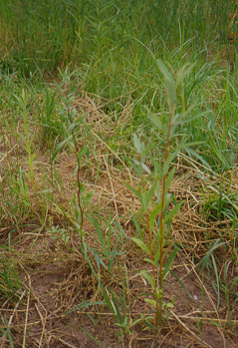
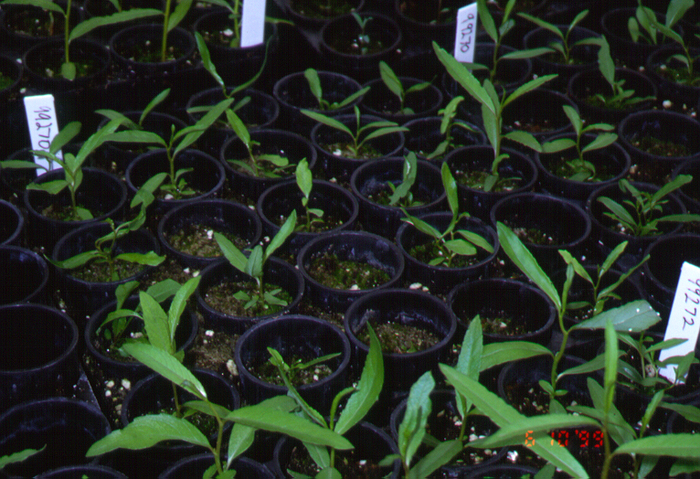
Results
85 F1 hybrids
  41 straight-stemmed
  40 twisted-stemmed
  4 uncertain

Slide 19
Results
DNA extracted and bulked for 10 corkscrew and 10 straight-stemmed progeny of family 99270
640 RAPD primers screened
530 RAPD primers amplified
32 primers polymorphic between bulks

Slide 20
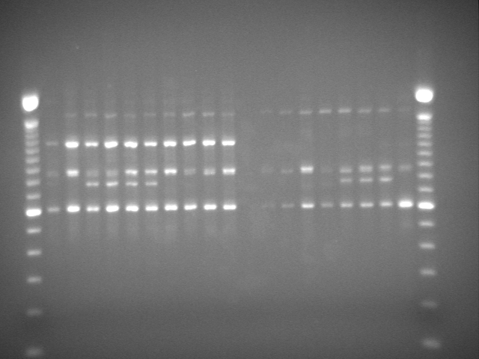
Results
Primer OPQ-07 amplified 1.2 kb band with 100% fidelity in corkscrew F1 phenotypes
Marker absent from straight-stemmed F1 phenotypes

Slide 21
Conclusions
Stem phenotype and marker exhibit 1:1 segregation in F1 hybrids
Need to test additional F1 to determine strength of relationship
Sequence marker to seek possible functional role of DNA
Need to develop additional markers

Slide 22
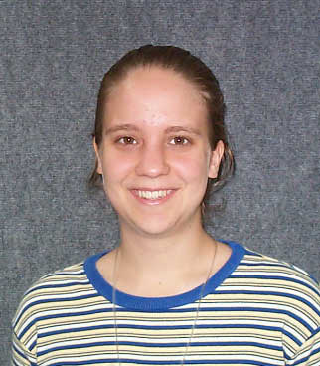
Acknowledgments
Office of Transportation Technology BioPower Program, DOE
Bioenergy Feedstock Development Program, ORNL
Salix Consortium, SUNY
Rachel McCord, Davidson College

