Slide 1
Differential Item Functioning of the English- and Spanish-Administered
HINTS Psychological Distress Scale
Chih-Hung Chang, Ph.D.
Feinberg School of Medicine
Northwestern University
HINTS DATA USER CONFERENCE
January 20-21, 2005, St. Pete Beach, FL

Slide 2
Objective
To examine the extent to which the psychological distress items exhibiting differential item functioning (DIF) contribute to observed between-group differences in reporting depression
  English- vs. Spanish-Administered CATI

Slide 3
Participants
A total of 6,369 respondents (18 years and older) from a national probability sample of general adult population were surveyed
All 362 Spanish-administered participants included
362 English-administered participants randomly selected

Slide 4
Sample Characteristics
 |  | Spanish (n=362) | English (n=362)
Gender | Male | 155 | 177
 | Female | 207 | 185
Age | M ± s.d. | 40.2±16.1 | 49.4±18.2
Race | Hispanic | 334 | 40
 | Other | 28 | 322

Slide 5
Measure
Self-reported depression was measured by the 6-item Psychological Distress Scale (PDS; 0-12 not-depressed; 13-24 depressed)

Slide 6
Psychological Distress Scale
HS-2. During the past 30 days, how often did you feel [FEELING]?
  a. so sad that nothing could cheer you up
  b. nervous
  c. restless or fidgety
  d. hopeless
  e. that everything was an effort
  f. worthless
1=All of the time; 2=Most of the time; 3=Some of the time; 4=A little of the time; 5=None of the time

Slide 7
Method
Differential Item Functioning (DIF) analysis based on multiple-group partial credit model was conducted
  DIF is said to occur when individuals with the same level of latent trait (e.g., depression) being measured but who come from different identifiable subgroups (e.g., English vs. Spanish) do not have the same probability of category endorsement

Slide 8
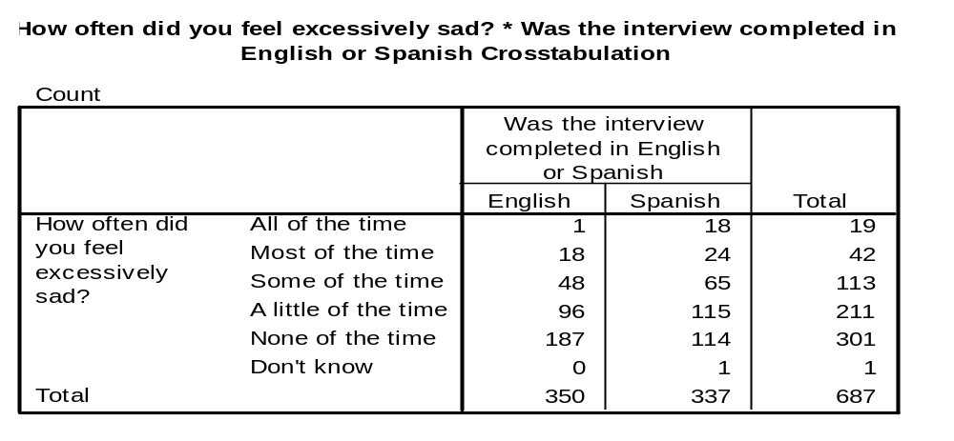
Results
Sample Item Endorsement

Slide 9
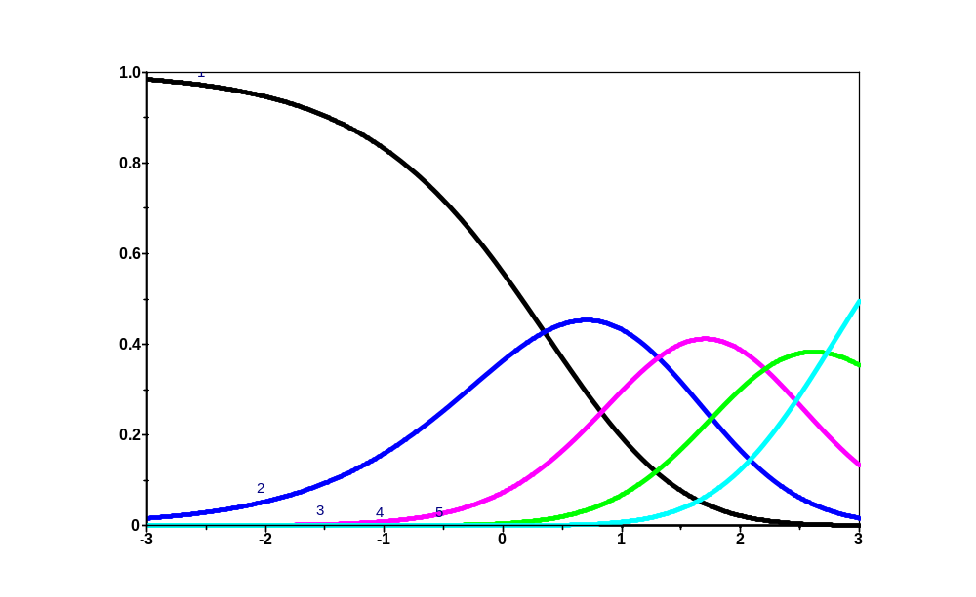
Results
Item Characteristic Curve

Slide 10
Results
Differential Item Functioning
 | Slope | Location (Spanish) | Location (English) | p
Excessively sad | 0.72 | 1.33 | 1.65 | 0.01
Nervous | 0.61 | 1.40 | 1.23 | 0.21
Restless | 0.74 | 1.22 | 0.97 | 0.03
Hopeless | 1.58 | 1.40 | 1.62 | 0.04
Everything is an effort | 0.42 | 1.06 | 1.01 | 0.75
Worthless | 0.86 | 1.77 | 1.69 | 0.59

Slide 11
Results
Serious Psychological Distress
 | Spanish (n=362) | English (n=362)
No (PDS score 0-12) | 284 (87.1%) | 324 (93.6%
Yes (PDS score 13-24) | 42 (12.9%) | 22 (6.4%)

Slide 12
Results
General Health Status
 | Spanish (n=362) | English (n=362)
Excellent | 31 (9.2%) | 38 (10.9%)
Very Good | 35 (10.4%) | 107 (30.6%)
Good | 86 (25.5%) | 133 (38.0%)
Fair | 164 (48.7%) | 59 (16.9%)
Poor | 19 (5.6%) | 13 (3.7%)

Slide 13
Summary
The response characteristic curves indicated that the five ordered response categories (ranging from “all of the time” to “none of the time”) worked as expected
3 items (“so sad that nothing could cheer you up”; “restless or fidgety”; “hopeless”) displayed DIF
12.9% Spanish-administered adults reported depressed (PDS score 13-24) and only 6.4% for those English-administered adults

Slide 14
Conclusions
Although Spanish-administered adults reported more depression, our findings suggest that the between-group comparison may be biased by DIF
More research is needed to investigate the impact of different language version of other health-related measures, particularly those that use Likert-type response options

Slide 15
Contact Information
Chih-Hung Chang, Ph.D.
Buehler Center on Aging
Feinberg School of Medicine
Northwestern University
750 N. Lake Shore Drive, Suite 601
Chicago, IL 60611
Tel: (312) 503-4354
Fax: (312) 503-5868
E-mail: chchang@northwestern.edu

