Slide 1
Understanding(?)
Object Networks
P. Calafiura
L.Vacavant(next talk)

Slide 2
Introduction to Object Networks
(highlights from R.D. Schaffer talk)
Overview:
  Architectural design: the how and the what
  Canonical example: EM calorimeter cluster finding
  Some Background to the Object Network design
  Object Networks: an Overview
  Some basic assumptions of the design
  Architecture overview
  The Component Model
  RD talk URL http://arc.nersc.gov/control

Slide 3
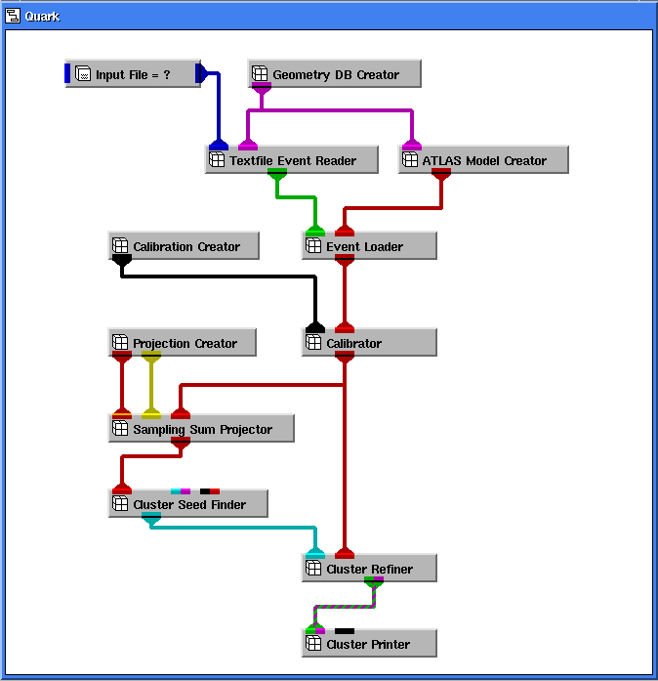

Slide 4
  A Module may hold an object and make it visible as output to other Modules
  The other Modules may observe one of these objects via their input
  The observers of an object are notified whenever the object has changed
Legend:
Inputs
Module
G3EventReader
DetectorModelCreator
Connection
Outputs
Event
Detector model
EventLoader
Detector model filled
Calibrator

Slide 5
Design features
Data and algorithms should be separated
The framework assures that methods execute as necessary
  takes care of execution scheduling logic and the networking infrastructure
Perhaps the most important point of this design is that of reducing information flow
  What this means is that, within reasonable limits(?), each stage should clearly specify its “interface” as a minimal set of parameters.
  This is to be contrasted with the design where all data, transient and persistent, is hung onto one large hierarchical structure,
Data Objects stable, algorithms change all the time
Use dynamic linking
Interacting mainly via a GUI

Slide 6
The Component Model
communication
component
facets
Storage
management
trait
parameter
client
Any valid C++ type may be a component: i.e. both intrinsic and user-defined types
No assumption about the structure of behavior of a component is made by the network infrastructure:
  traits describe components and provide facets which serve as handles to components, e.g. for transient, persistent, or CORBA implementations.

Slide 7
We (generally) liked
Design based on components implementing well-defined interfaces and the extensive use of notification
  maximize re-usability
Separation between data and algorithms
  not traditional OO, but we are used to it

Slide 8
We are worried about...
Self-executing networks
  Lack of experience with complex networks
    largest example 12 components
  Are the end-users going to like it?
    Not many users right now
  Can we control them?
    Need predictable, repeatable execution

Slide 9
We are worried about…(2)
No “Event” (manager)
  increased complexity of transient/persistent mapping
  ownership of DataObjects (collections!)?
Pure Data-Flow based control
  how to broadcast an “error” or “reset” condition to each component?

Slide 10
The backdoor...
HitFinder
HistoHits
Hits
Hits
Hits
Hits
TrackFinder
Tracks
Vector<Hit*> myHits
T0Refiner
myHits[j] = newT0;
Tracks
Also Hits has changed!!!

