Slide 1
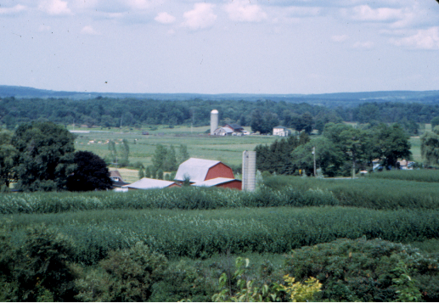
Willow Biomass Demonstration Program Developments and
Research Progress
T.A. Volk, P. Tharakan, L.P Abrahamson
State University of New York College of Environmental Science and Forestry, Syracuse, NY

Slide 2
Overview
Demonstration Program Developments
  Harvesting
  Conversion testing
  CRP program
Research Developments
  Genetic selection trial
  Clone site trials

Slide 3
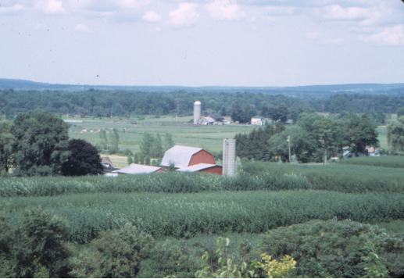
Demonstration Program Developments

Slide 4
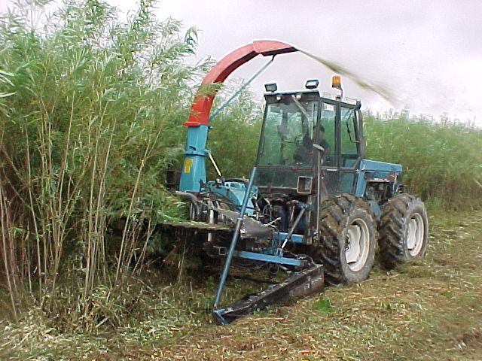
Harvesting
The first 40 ha (100 acres) of willow biomass crops is scheduled for harvest in the winter of 2000-2001.
Chip wagon will be equipped with load cells and a GPS unit for continuous measurements of yield across fields.
Bender harvester being tested in Sweden in the summer of 2001 prior to shipment.

Slide 5
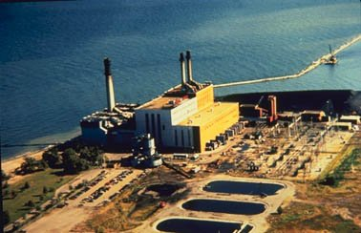
Co-firing Progress
Co-firing system operation test completed in the middle of October.
Co-firing trials with complete set of emissions tests being planned for November.
NRG Dunkirk power plant on Lake Erie

Slide 6
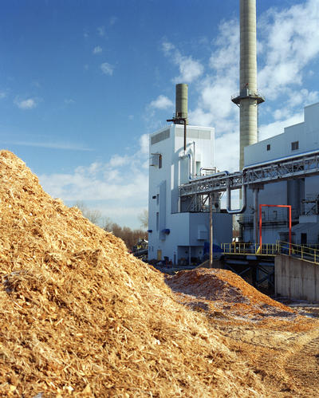
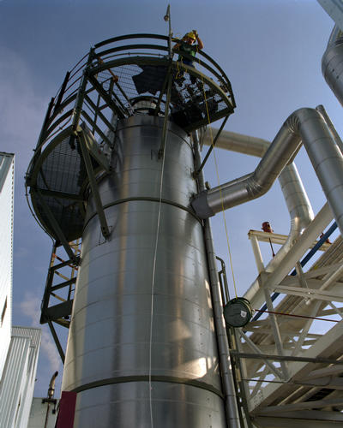
Gasification
Gasification tests with 20+ tons of willow biomass conducted in September 2001 in Burlington, VT.
McNeil Generating Station & Wood Chip Gasifier of Burlington Electric Department.

Slide 7
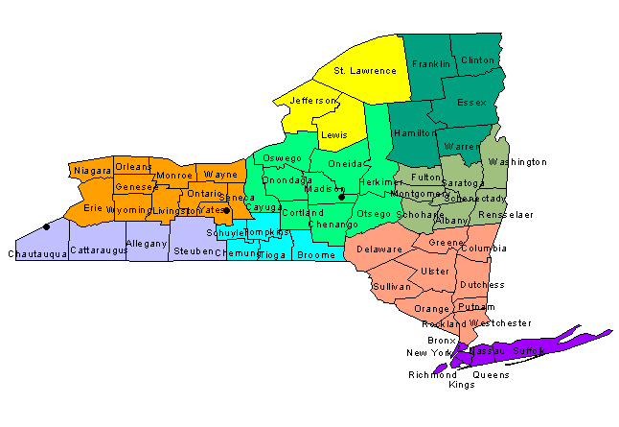
Willow Biomass CRP Program
Colgate University
N
(1,173 acres)
Greenidge Power Plant
Dunkirk Power Plant
(7,171 acres)
(6,656 acres)

Slide 8
Research Developments

Slide 9
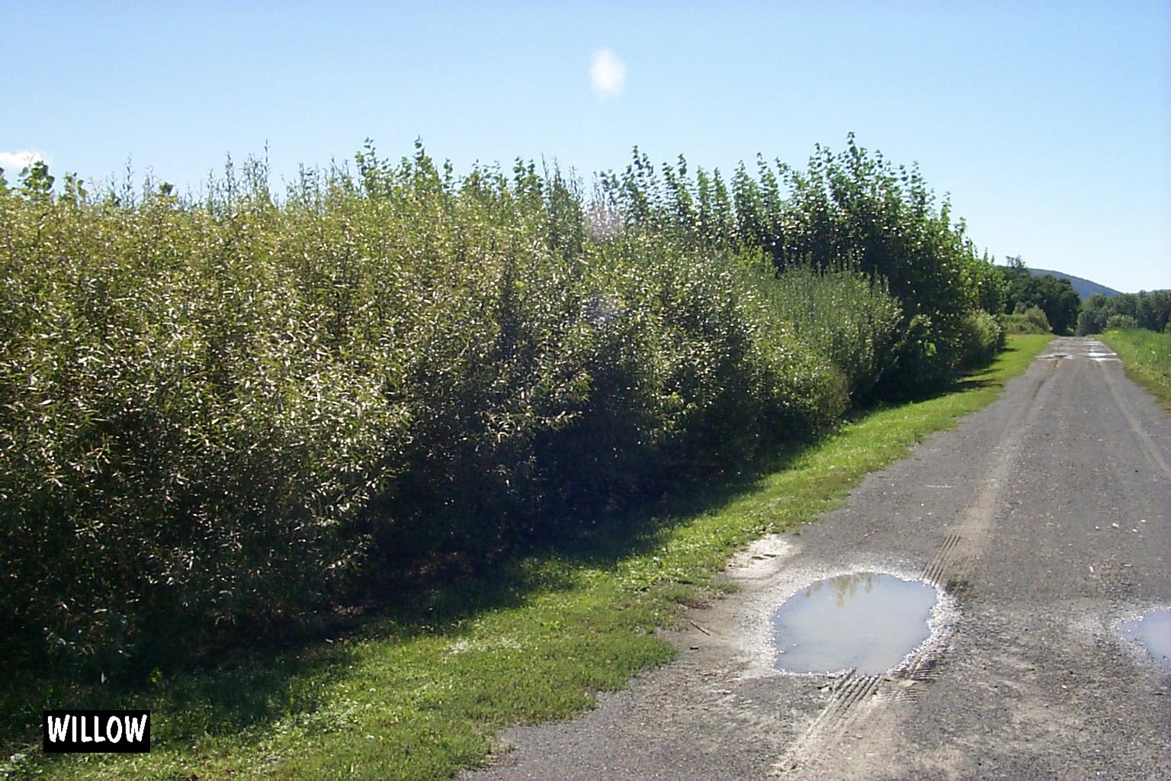
Objectives
Evaluate aboveground biomass production of the clones
Assess a suite of traits that may effect aboveground biomass production.
Identify traits that relate to higher biomass production and group the clones into performance potential classes.
Three-year old material in the trial at Tully, NY.

Slide 10
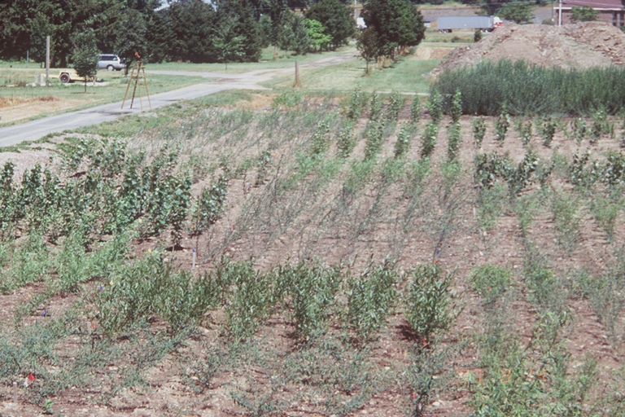
Genetic Selection Trial
Established in spring 1997 with 31 willow and 7 hybrid poplar clones
15,180 plants ha⁻¹ (6,300 plants acre⁻¹⁾
Coppiced in fall 1997
Harvested in 2000
Companion trial located in Rhinelander, WI
Establishment year (1997) in Tully, NY.

Slide 11
Measurements
Growth and development – stool height, stem diameter, number of stems per stool, biomass production, specific leaf area, leaf area index, stem angle.
Nutrient characteristics – foliar nitrogen (N), wood N and nitrogen use efficiency (NUE).
Wood quality – specific gravity and bark to wood ratio.

Slide 12
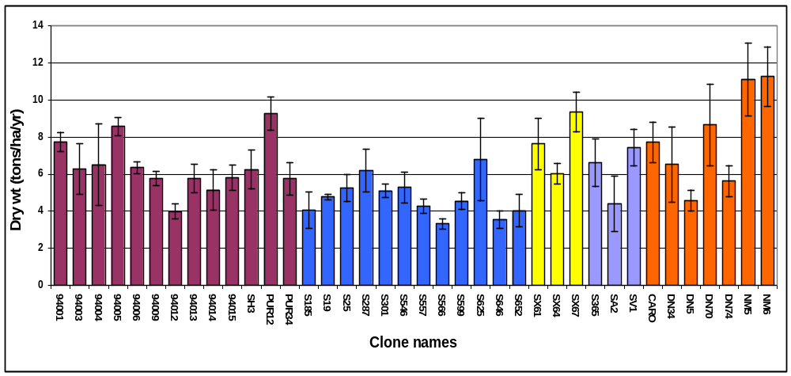
First Rotation Yields
First rotation biomass production was 3.6 - 11.3 odt/ha/yr.

Slide 13
Results
For the willow clones, there were significant but weak to moderate correlations between the different traits and aboveground biomass production.
Trait (p < 0.05) Pearson’s Correlation Coefficient
Stem height 0.54
Wood nitrogen concentration -0.46
Nitrogen use efficiency 0.45
Bark to wood ratio -0.45
Number of stems per stool 0.44
Leaf area index 0.35
Specific leaf area -0.30
Foliar nitrogen concentration 0.19

Slide 14
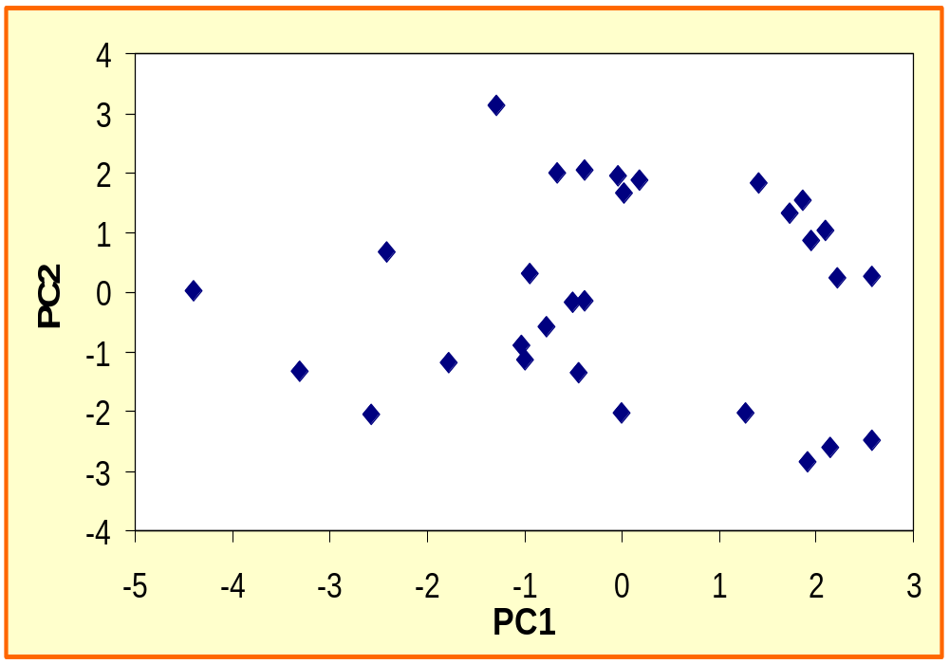
Principal Component Analysis
Correlations with
Traits PC1 PC2
Height 0.90
Wood N -0.87
NUE 0.83
Bark-wood ratio -0.67
Leaf area index 0.42
Diameter 0.42 -0.83
Specific leaf area -0.36
No. of stems 0.88
Stem angle -0.58
Foliar N 0.58
Specific gravity 0.56

Slide 15
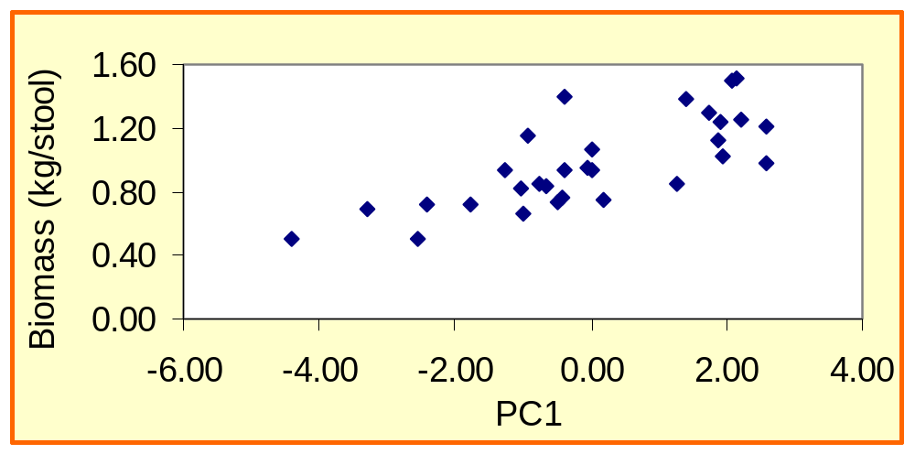
Results
Strong correlation between PC1 and biomass production (r = .80)
No significant relationship between PC2 and biomass production.

Slide 16

Results
Two separate strategies for high biomass production
Group 1
  small number of large stems
  low bark to wood ratio
  high LAI
  low SLA
  high NUE

Slide 17
Results
Group 2
  large number of small stems
  high wood specific gravity
  high foliar N concentration

Slide 18
Conclusions
Several clones produce as much or more above ground biomass as the reference clone
Two different growth strategies resulting in high biomass production
Implications for selecting clones for different applications (e.g. NUE) and traits for the breeding program

Slide 19
Ongoing Work
Complete clonal characterization and analysis from first rotation.
Assess potential for early selection and indirect selection using data collected during the first rotation.
Continue monitoring of clones during second rotation.
Examine patterns of resource use efficiency (light, N, water) and relationships with leaf level photosynthesis for select clones during second rotation.

