Slide 1
Automated Scoring of Essays:
Evaluating Score Validity
P. Adam Kelly
Florida State University
April 13, 2001

Slide 2
Purpose
To establish whether the computer is capable of scoring essays similar to how experts rate essays.

Slide 3
Purpose
To establish whether the computer is capable of scoring essays similar to how experts rate essays.
While computer-generated essay scores correlate highly with human expert scores, no empirical linkage of electronic processing to cognitive processing currently exists.

Slide 4
Purpose
To establish whether the computer is capable of scoring essays similar to how experts rate essays.
While computer-generated essay scores correlate highly with human expert scores, no empirical linkage of electronic processing to cognitive processing currently exists.
The essence this proposed linkage: construct validation of computer-generated scores, following the Messick (1995) procedure.

Slide 5
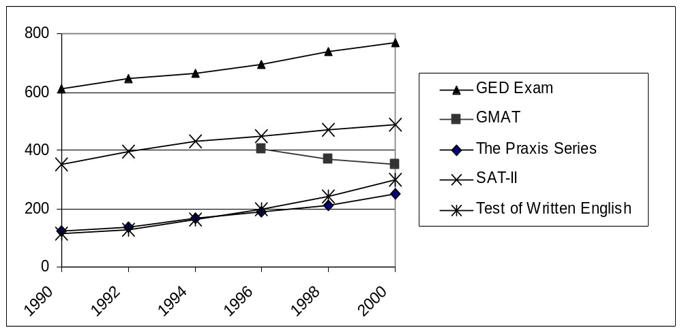
Essay Use on Large-Scale Tests:
Large and Getting Larger
{Figure 1}

Slide 6
Why not even more growth?
ESSAYS ARE TOO EXPENSIVE!
(Cost of hiring and training raters;
time involved in scoring thousands
of essays;
difficulty in finding qualified raters)

Slide 7
A Solution: Computerized Scoring of Essays
Inexpensive
Reliable
Accessible

Slide 8
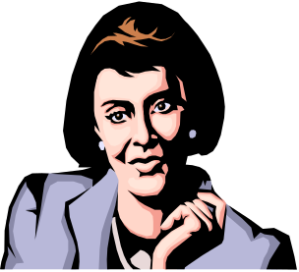


essay
human rater score
(S1)
human reader score
(S2)
YES
NO
Is |S₁ - S₂| > 1 ?
Final Score
=
mean
Final Score
=
mode, or mean
of closest
expert human rater score (S3)

Slide 9

essay
human rater score
(S1)
Computer-generated score
(S2)
YES
NO
Is |S₁ - S₂| > 1 ?
Final Score
=
mean
Final Score
=
mode, or mean
of closest
expert human rater score (S3)

Slide 10
A Big Question
Are the scores generated by computers valid?

Slide 11
Review of Previous Work
The Four Leaders in the Field (and their models):
Burstein/ETS® (e-rater™, regression)
Page/Tru-Judge, Inc. (PEG™, regression)
Landauer/Colorado - KAT (IEA™, LSA)
Elliott/Vantage Learning (IntelliMetric™)

Slide 12
Review of Previous Work
(validity-related studies)
Burstein/ETS® (e-rater™):
  Computer-to-human rater correlation studies (≥3)
  Computer-to-other criterion correlation studies (≥2)
  Factor analysis
  Tree-based regression

Slide 13
Review of Previous Work
(validity-related studies)
Page/Tru-Judge, Inc. (PEG™):
  Computer-to-human rater correlation studies (≥2)
  Factor analysis / factor correlation (“trait-scoring”)
  (≥2)

Slide 14
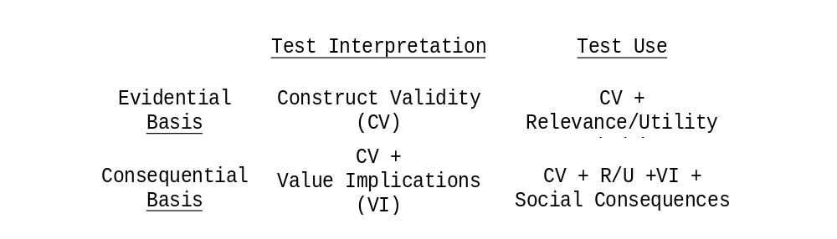
Review of Previous Work
(validity-related studies)
Construct validation of essay scores: Messick’s (1987) 2-by-2 matrix, elaborated in Messick (1995) as a
six-point “road map”
{Figure 2}

Slide 15
Messick’s (1995)
Six Aspects of Construct Validity
“Intrinsic”
Content
Structural
Substantive
“Extrinsic”
Generalizability
External
Consequential

Slide 16
The Sample
~1,800 GRE Writing Assessment essays:
  “Issue” prompt type: ~600 essays on 3 prompts
  model-building & cross-validation
  “Argument” prompt type: ~1,200 essays on 3 prompts
  model-building & cross-validation

Slide 17
Phase I: Content
(Relevance and Representativeness)
Factor analyzed the 59 e-rater “features” from three linguistic classes: discourse (rhetorical), syntactic (structural), and topical (content)
Rank-ordered the factors, or “underlying characteristics” of writing; discussed this list with essay test development experts

Slide 18
Factor Analysis
Principal Component/Principal Factor Method
(Muraki, Lee, & Kim, 2000)
Two models: “Issue” and “Argument” generic
PCA: “Issue”: 5 components, 25 features, PVE = 51%
“Argument”: 5 comp. , 21 features, PVE = 48%
FA: “Issue”: 25 features fitted to 6 factors
“Argument”: 21 features fitted to 6 factors
Rotated by Promax (oblique) method
{Tables 1 - 4}

Slide 19
Factor Analysis
Fits of the six-factor models:
  Exploratory:
  “Issue” model: PVE = 68% of 25 features
  “Argument” model: PVE = 76% of 21 features
  Confirmatory:
  “Issue” model: PVE = ≤38% of 25 features
  “Argument” model: PVE = ≤34% of 21 features
{Table 5}

Slide 20
Factor Analysis
Indication of a “dynamic” relationship between syntactic features and discourse features in an essay (Muraki, et al., 2000):
    Redundancy of feature loadings > .50 across factors,
    Loadings highest for discourse features on one factor, for syntactic features on the other, and
    The same features and factors are involved in
    both models ...

Slide 21
The “Characteristics of Writing”
(in ranked order of explanatory importance)
Issue-1: 4 discourse*
Issue-2: 1 discourse
Issue-3: 3 syntactic*
Issue-4: 2 discourse
Issue-5: 3 content
(one excluded)
Argument-1: 4 discourse*
Argument-2: 2 discourse
Argument-3: 1 discourse
Argument-4: 3 content
Argument-5: 3 syntactic*
Argument-6: 3 discourse
{Table 6}

Slide 22
Phase II: Structural
(Reflexivity of the Task and Domain Structure)
Built:
  Detailed scoring criteria
  “Feature-based” (focused holistic) rubrics,
  one per scoring criterion
Had test development experts review these, looking for evidence of engaging thought processes and judgments, not just rote counting tasks

Slide 23
e-rater & Rubric Criteria
e-rater Criteria
Discourse structure
Types of sentence
structure
Content analysis
Rubric Criteria
“Organization of
ideas”
“Syntactic variety”
“Vocabulary usage”

Slide 24
What the test development experts said:
Several of the characteristics (i.e., Issue-2 /Argument-3 and Issue-4/Argument-6) would not be seen as valid by expert raters.
It would be unusual for expert raters to think of some of the characteristics in isolation from the rest of the essay.
Both of these statements proved true ...

Slide 25
Phase III: Substantive
(Theories and Process Models)
Introduced expert raters to “feature-based” scoring rubrics
Used “talk-aloud” protocols to prompt and audio recording to capture evidence that raters’ thought processes reflect the scoring rubrics and e-rater scoring processes

Slide 26
Who the expert raters were:
Four “scoring leaders,” recognized for their rating expertise and prior participation in studies
Faculty in English programs at Delaware Valley-area colleges
Two “issue” raters, and two “argument” raters
(as designated by the researcher in advance)

Slide 27
What each expert rater did:
At home, a week in advance:
    Rated a sample of 110 essays using the usual holistic scoring guide for the GRE W. A.
At ETS:
    Participated in an initial group interview, an individual “talk-aloud” rating exercise, an interactive rating verbalization, and a debriefing.

Slide 28
What the expert raters said:
In the initial group interviews:
    “Issue” raters disliked Issue-2 and Issue-4
    “Argument” raters disliked Arg.-3 and Arg.-6
      Why? Characteristics not legitimate for rating
    All four raters had difficulty parsing Issue-1/Arg.-1 and Issue-5/Arg.-4 from the rest of the essay
    Why? Odd to think of content as separate from
    the discourse approach used

Slide 29
What the expert raters said:
In the “talk-alouds”:
    More “off-task” than “on-task” utterances -- a rater
    was prompted to “keep talking” when silent
    Indicators of “slippage” back into holistic rating
    paradigms: “oh, well, I’ll just give this a four”
In the interactive rating verbalization:
    Expressions of understanding, some exasperation:
    “Oh, so that’s how we’re supposed to rate that.”

Slide 30
What the expert raters said:
In the debriefing:
    All four raters agreed with the hypothesis of a “dynamic interplay” between syntax and some forms of discourse -- the “right” use of syntactic variety can “make or break” certain discourse strategies.
    All four raters asked to go home!

Slide 31
Phase III: Substantive
(continued)
Analyzed and reported all proportions of agreement and pairwise correlations of human rater and e-rater scores:
  cross-validation GRE essay samples
  interrater subsamples
  adjudicated essay subsamples
Assessed convergent/discriminant evidence
{Table 7}

Slide 32
e-rater vs. expert raters:
The Good:
  Issue-1/Arg.-1, the most “important” of the characteristics, also shows the best agreement, both e-rater-to-expert and expert-to-expert.
  4 of 5 “issue” characteristics and 4 of 6 “argument” characteristics show agreement near the holistic proportion, and the ones far off were viewed a priori as invalid characteristics.

Slide 33
e-rater vs. expert raters:
The (sort of) Bad:
  The e-rater-to-expert correlations are lower, across both models, for all characteristics than they are for the holistic scoring.
  Bright spot: The e-rater-to-expert correlation for Issue-1/Arg.-1, the most important characteristic, isn’t too far off the holistic ...

Slide 34
e-rater vs. expert raters:
The (pretty) Ugly:
  Cohen’s kappa, a “chance-corrected measure of agreement” between raters (Fleiss, 1981, p.217), indicates poor agreement beyond chance for all 11 characteristics (i.e, randomly assigned scores might agree as well or better than these) ...
  And it isn’t the raters’ fault: their interrater agreement and correlations are high for both models, including on previously adjudicated essays.

Slide 35
Implications of the Findings
Content representativeness evidence of “intrinsic” construct validity of e-rater scores:
  The features that “drive” e-rater are identifiable and constant, group into factors (“characteristics”), forming reasonably interpretable, parsimonious factor models (although the model fits aren’t spectacular).

Slide 36
Implications of the Findings
(continued)
Structural evidence:
  (Most of) the factors (“characteristics”) that emerge from the factor analysis resemble targeted writing qualities in the GRE W. A. Scoring Guides -- as ETS Technologies has claimed.

Slide 37
Implications of the Findings
(continued)
Substantive evidence: the most compelling, both for and against the validity of e-rater scores:
  All four expert raters agreed: the “syntactic” and “content” characteristics are relevant, identifiable, and reflective of what a rater should look for
  To a lesser extent, they agreed on Issue-1/Arg.-1.

Slide 38
Implications of the Findings
(continued)
However, they also agreed strongly : Issue-2/Arg.-3 and Issue-4/Arg.-6 inappropriate under any circumstances
Conclusion:
Simpler scoring models that leave out certain features likely more acceptable to raters
Explanatory ability of such models even less than that of current models

Slide 39
Limitations of the Study
Low factor model-to-data fits:
  isolating characteristics takes them out of context, produces a “reverse synergy” in interpretation
Lack of rater familiarity with characteristic-specific rubrics, scoring tasks:
  but expertise, adaptability of raters probably helped mitigate the lack of training, practice

Slide 40
Limitations of the Study
(continued)
Characteristic-specific rubrics not pre-tested:
  although ETS test development experts helped, still noticeable problems with interpreting the rubrics, likely leading to scoring inconsistencies

Slide 41
Future Directions
A comprehensive follow-up, addressing the limitations cited, with larger samples
Extend the study to GMAT W. A., Test of Written English, NAEP W. A.

