Slide 1
MTAC Work Group Report Service Assessment
For
Destination Delivery Unit (DDU) Drop Shipped Packages

Slide 2
Issue
Today for Packages
  Point to point service measurement
  Tracking system
    Passive machine scanners
    Active hand-held devices

Slide 3
Issue
Until
  More elements are linked
  More packages are coded
Need to Assess Service for DDU Dropship
  First and last steps in the process
  USPS total responsibility for service

Slide 4
Desired Results
Work:
  Jointly with parcel shippers, consolidators to assess performance to goal of 100% next day delivery
To:
  Achieve through understanding of mutual operations
  Determine most effective information interface
  Investigate alternate methods for assessing “age” of mail
  Methodology should maximize “passivity”
  Minimize attributable costs

Slide 5
System Objectives
Good measurement system for Fall shipping season
Refine through FY2003
Basis for performance assessment in FY2004

Slide 6
Parcel Select Service Performance
System started June 8, 2002
Reports
  USPS reports through WebEIS
  External access through Internet
Focus on Quality
  Ensure accurate 8125 scans
  Validating the quality of mailer files and process

Slide 7
Parcel Select Service Performance
Shared Service Performance Reports
  Common Web reports that will be used by customers and postal managers for service analysis and discussions
  Approach is used for Confirm and now for Parcel Select
    Parcel Select includes parcels dropshipped to BMCs, SCFs, and delivery units

Slide 8
Parcel Select Service Performance
Two Ways of Measuring Performance
  By service commitment
    BMC – 3 delivery days
    SCF – 2 delivery days
    DDU – 1 delivery day
  Percent delivered by day
    Data views by cumulative percent or percent by day

Slide 9
Parcel Select Service Performance
Service Calculations Based On:
  Mail entry documentation (8125) scan
  Delivery point scan
    Delivered
    Attempted
    Undeliverable as addressed
    Forward
    Return to sender
    Dead mail

Slide 10
Parcel Select Service Performance
Data Available by Organizational Level:
  National
  Area
  Cluster
  BMC service area
  3-digit
  5-digit

Slide 11
Parcel Select Service Performance
Data Views:
  Week
  Accounting period
  Quarter
  Year
Service metrics are reported based on the week of the first delivery point scan
  Reports produced the following week

Slide 12
Obstacles (which can be hurdled)
Only three participants at this time
Package count matching 8125 manifested volumes
Break out by consolidator's customer

Slide 13
Sample Reports – Step 1
Customer
first selects
Report Type

Slide 14
Sample Reports – Step 1
Consecutive choices based on previous selections

Slide 15
Sample Reports – Step 1
3 - 5 sub-steps possible in report selection
process depending upon report

Slide 16
Sample Reports – Step 1
Only the
“active” selection is bulleted and bolded

Slide 17
Sample Reports – Step 1
Report type and data selection now complete

Slide 18
Sample Reports – Step 2
Report period in Postal terms followed by
date range selection

Slide 19
Sample Reports – Step 2
Final
selection is
data display

Slide 20
Sample Reports – Service Report Download
Easy download into Excel allows customer to customize report

Slide 21
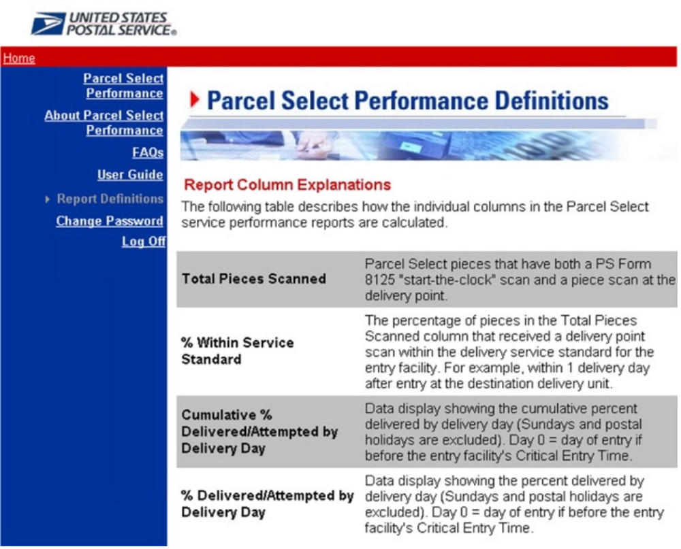
Sample Reports – Report Definitions
Explanations for customer same as those for
internal use

Slide 22
Planned Enhancements
Identifying 8125’s with mismatched volumes
Allowing for specific customer mailing assessment
Assess time between attempted delivery and actual delivery

