Slide 1
Maximizing
Science
Congressman Vernon J. Ehlers, Ph.D
U.S. House of Representatives

Slide 2
Types of Science
Basic
Applied
Product Development
Technical

Slide 3
VIEWS OF RESEARCH
The Public’s View:
Basic Research
Applied Research
Vannevar Bush’s View:
Basic
Applied
Notes:
Same comments as the last slide

Slide 4
DON STOKES VIEW (MODIFIED):
Bohr
Pasteur
Understanding-
Driven Research
(Basic)
Data
Acquisition
Edison
Use-Inspired Research
(Applied)
Notes:
Needs a source. The point of this slide is unclear—need a focusing statement for the audience

Slide 5
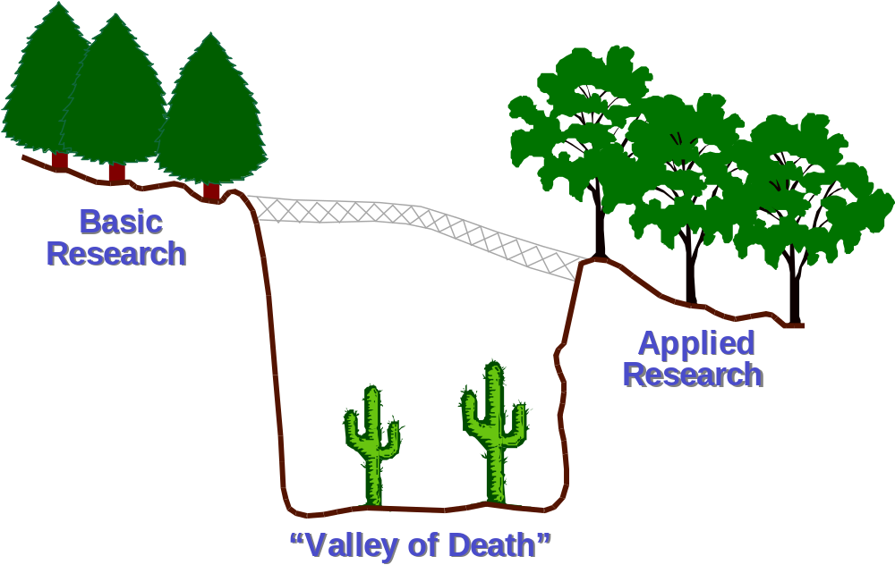
The Valley Of Death
Notes:
Same comments as the last slide

Slide 6
Key Ideas
Disciplinary or Interdisciplinary Science

Slide 7
Disciplines of Science
Chemistry
Biology
Physics

Slide 8
Key Ideas
Disciplinary or Interdisciplinary Science
Size and Complexity of Science

Slide 9
Size & Complexity in Science
Size
Complexity

Slide 10
Size & Complexity in Science
Size
Complexity

Slide 11
Size & Complexity in Science
Size
Complexity

Slide 12
Key Ideas
Disciplinary or Interdisciplinary Science
Size and Complexity of Science
Management of Science and Scientists

Slide 13
Management of Science and Scientists
The type of management used must match the type of science being done
The task of management is, above all, to facilitate and encourage science, not impede it.

Slide 14
Management of Science and Scientists
Basic research : manage by inspiring
Product development: manage by directing

Slide 15
Management of Science and Scientists
We must maximize returns on scientific research by minimizing individual scientist’s involvement in management

Slide 16
Managing Science
7
5
Management
(tons of paper)
3
1
1
3
5
7
9
11
13
Scientific Results
(published papers)

Slide 17
Managing Science
7
5
Management
(tons of paper)
3
1
1
3
5
7
9
11
13
Scientific Results
(published papers)

Slide 18
Managing Science
7
5
Management
(tons of paper)
3
1
1
3
5
7
9
11
13
Scientific Results
(published papers)

Slide 19
Management of Science and Scientists
Managers must recognize scientific research hasn’t changed greatly, but its complexity and subject areas have.

Slide 20
Management of Science and Scientists
Good science managers encourage risk-taking, new ideas, and interdisciplinary research.
Problems:
Does peer review still work?
Interdisciplinary reviewers?
Best reviewers available?
Encourage new scientists?

Slide 21
Maximizing Scientific Capital
(Getting More and Better Scientists!)
Jobs of the future will require a basic
understanding of math and science

Slide 22
K-12 Math and Science Education
Teacher Training
Hands-on, inquiry-centered, concept-based
curricula
Interested and involved parent(s)
Helpful scientists, mathematicians,
& engineers

Slide 23
Undergraduate Education
Recruitment
Special assistance for students
Internships
Part-time Employment

Slide 24
Graduate Education
Research Support
Teacher Training
Shortened degree programs
Faculty & Post-docs
Research support
Mentoring

Slide 25
Who Should Be Involved?
Federal Government
Private Sector
Universities
State Governments
Scientists
Let’s all do it together!

