Slide 1

Clinical Practice Improvement
Susan D. Horn, PhD
Institute for Clinical Outcomes Research
699 E. South Temple, Suite 100
Salt Lake City, Utah 84102-1282
801-466-5595 (T) 801-466-6685 (F)
shorn@isisicor.com
www.isisicor.com

Slide 2
AHRQ Transforming Healthcare Quality through Information Technology
NURSING HOME IT: OPTIMAL MEDICATION and CARE DELIVERY

Slide 3
NURSING HOME IT: OPTIMAL MEDICATION and CARE DELIVERY
Objectives
Build on ICOR experience
NPULS study
AHRQ Partnership for Quality: ‘Real-time Optimal Care Plans for Nursing Home QI’
Implement HIT solutions in long term care:
Electronic CNA documentation
Clinical decision support focused on incontinence care, nutrition management, skin assessment, behavior management, and restorative care best practices
Electronic medication documentation and administration.
Identify HIT implementation best practices:
Collaborative, multi-disciplinary partnerships
Workflow analysis and clinical process redesign efforts throughout each stage of implementation
Ongoing assessment of implementation processes and refinement based on evaluation results

Slide 4
ICOR Experience: Research
National Pressure Ulcer Long-term care Study (NPULS)
  6 long-term care provider organizations
  109 facilities
  2,490 residents studied
  1,343 residents with pressure ulcer; 1,147 at risk
  70% female, 30% male
  Average age = 79.8 years
Funded by Ross Products Division, Abbott Laboratories, 1996-97

Slide 5
NPULS Results: General Care
Outcome: Develop Pressure Ulcer
General
Assessment
Incontinence
Interventions
Pressure Relief
Interventions
Staffing
Interventions
+ Age ≥ 85
+ Male
+ Severity of Illness
+ History of PU
+ Dependency in ≥ 7
ADLs
+ Diabetes
+ History of tobacco use
+ Mechanical devices for the containment of urine (catheters) (treatment time ≥ 14 days)
- Disposable briefs (treatment time ≥ 14 days)
- Toileting Program (treatment time ≥ 21days)
+ Static pressure reduction: protective device (treatment time ≥ 14 days)
+ Positioning: protective device (treatment time ≥ 14 days) (p=.07)
- RN hours per resident per day ≥ 0 .25
- CNA hours per resident per day ≥ 2
- LPN hours per resident per day ≥ 0.75
Medications
- Antidepressant

Slide 6
NPULS Results: Nutritional Care
Outcome: Develop Pressure Ulcer
Nutritional
Assessment
Nutritional
Interventions
+ Dehydration signs and symptoms: low systolic blood pressure, high temperature, dysphagia, high BUN, diarrhea, dehydration
+ Weight Loss: ≥ 5% in last 30 days or ≥ 10% in last 180 days
- Fluid Order
- Nutritional Supplements
  standard medical
- Enteral Supplements
  disease-specific
  high calorie/high
  protein

Slide 7
NPULS Psychiatric Medications
Dementia & Agitation n = 803
No Psych Meds 32.5%
Anti-psychotics 31.5%
Anti-depressants 34.6%
Anti-anxiety 34.9%
Combinations in 42% of treated residents

Slide 8
Long-Term Care Residents with Agitation in Dementia
Recommended Practice
Use fewest number of medications possible (Omnibus Reconciliation Act 1987)
Minimize use of benzodiazepines
Use atypical over typical antipsychotics
Use SSRIs over tertiary amine antidepressants
Avoid combination therapy

Slide 9
NPULS Results: Medication Use with Dementia with Agitation
Outcome: Develop Pressure Ulcer
Medication
% Hospital + ER
% Restraints
% Pressure Ulcers
No Psych Medications
20.0
19.9
37.2
Monotherapy
17.2
24.0
24.0**
SSRI +
9.9**
12.3*
12.6**
Monotherapy includes antipsychotic only, antidepressant only, or antianxiety only
SSRI + includes SSRI and antipsychotic or antianxiety medications concurrently
*p<.05 **p<.01

Slide 10
AHRQ Partnership for Quality
Real-time Optimal Care Plans for Nursing Home QI
Integrate sustainable quality improvement into daily operations
    Incorporate evidence-based practices for pressure ulcer prevention
    Integrate into daily work versus ‘add-on’ project
Focus on critical data elements and information flow
    Eliminate redundant documentation
    Reduce paperwork and streamline documentation
    Improve accuracy of information
    Improve communication among multi-disciplinary care teams
Translate documentation into data & data into multi-disciplinary clinical reports
Establish pre-IT foundation

Slide 11
Workflow Redesign Target Areas
CNA Daily Workflow
  Documentation flow sheets
  Communication with clinical team
Nursing Daily Workflow
  Wound Nurse documentation and reporting
  Care Plan documentation and communication
Care Planning Processes
  Identify residents at risk for pressure ulcer development
  Reports used in clinical decision-making
  Response between identification of resident need and intervention
  Monitoring of resident outcomes

Slide 12
Results to Date
Workflow inefficiencies reduced:
    # documentation forms for CNAs
    CNA time looking for documentation book
    Time to compile reports for State Regulators and MDS
    Time for Wound RN to summarize and report data
Communication among care team improved
Pressure ulcer development reduced
    Decreased approximately 25% in one year
    Average of $1,885 per pressure ulcer event in FY 04
Front-line satisfaction improved

Slide 13
Medication Findings Replicated in Practice
Benefits of Combination Psychiatric Medication Therapy
  23 residents in one facility with weight loss
  (5-10% in <=30 days, >10% in <=180 days)
      3 (13%)residents treated with combination therapy
      12 (52%) residents treated with mono-therapy
      8 (35%) residents received no psych meds

Slide 14
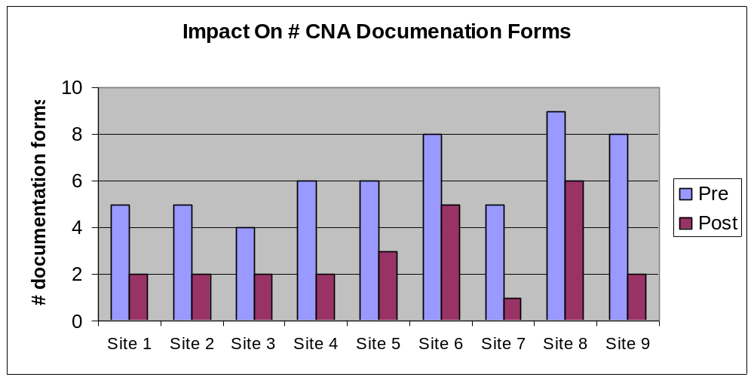
Impact Workflow Efficiency: CNA Documentation
Standardization of CNA documentation streamlined documentation processes for staff and resulted in consolidation of forms.

Slide 15
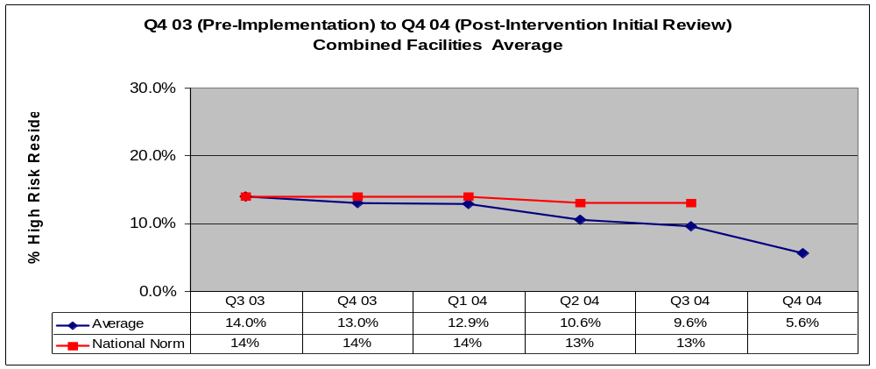
Impact On Pressure Ulcer QMs
The combined facilities’ average (includes 7 facilities that implemented in Apr ’04) shows an overall reduction in the QM % of high risk residents with pressure ulcer from pre-implementation to initial post-implementation time periods.
Note that 4 of the 11 participating facilities are not reported: 2 implemented in Q1 05, 1 does not report QM data, 1 was not reported in Nursing Home Compare database.
National Norm
Combined Facilities
Q4 03 – Q3 04 % Change = -26.4%
Q4 03 – Q4 04: % Change = - 56.9%
CMS data through Q3 04
3 Sites provided data Q4 04
Source: CMS Nursing Home Compare; Facility QM data reports

Slide 16
AHRQ Transforming Healthcare Quality through Information Technology
NURSING HOME IT: OPTIMAL MEDICATION and CARE DELIVERY
Implement HIT solutions in long term care:
Electronic CNA documentation
Clinical decision support
Electronic medication documentation and administration
Identify HIT implementation best practices:
Collaborative, multi-disciplinary partnerships
Workflow analysis and clinical process redesign
Ongoing assessment and refinement of implementation processes

Slide 17
Workflow Redesign Target Areas:
Clinical Documentation
Clinical documentation and reporting:
  CNA - daily flow sheets
  Care team documentation
    Resident care plan
    Diet orders
    Restorative care
    Skin assessments
    Pressure ulcer documentation
  Feedback reporting to improve resident care
    MDS information
    Federal and State survey information
    Care plan information

Slide 18
Workflow Redesign Target Areas: Medication Administration Process
Entering MD orders
  RN enters into MD order module
Communicating with pharmacy
  Order verification
MedPass
  Eliminate time wasters: new medication look-up
  Bar code scanning of medications
  Verify that the “five rights” have been met – right patient, medication, dose, time, route.

Slide 19
Factors for Successful HIT
Effective Project Management Team Approach
  Facility Implementation Team
    representatives of all clinical staff
  Regular conference calls
    Forum for sharing perspectives and learning across facilities
    Identify next steps
    Written minutes
  Staged Approach with Clear Incremental Objectives
    Each phase has defined scope
    Facilities make investments incrementally
    Identify incremental milestones

Slide 20
Factors for Successful HIT
Focus on Workflow Redesign as Initial Step
  Redesign daily workflow versus add-on project work
  Emphasize CNA involvement and feedback
Streamline Documentation and Information Flow
  Focus on critical data elements
  Reduce redundant documentation
  Improve accuracy of documentation
  Improve communication among multi-disciplinary care teams

Slide 21
Factors for Successful HIT
Translate Documentation into Data
  Migrate from paper environment toward a data culture environment
Translate Data into Multi-disciplinary Reports
  Migrate from a culture of using quarterly reports for retrospective analysis
  TO
  Culture that uses weekly reports for timely resident care planning

Slide 22
Unanticipated Changes to Project Plans in Year 1
Additional HIT vendors
  eMAR offerings for long term care are new and untested
  HIT vendor product development schedule is not predictable
Time associated with evaluating and selecting HIT
  Vendors reluctant to acknowledge product limitations
  Product demonstrations do not always reflect system capabilities
  Vendors reluctant to interface with other systems
Expanded number of participating facilities

Slide 23
Learning
Long term care facilities are eager to proceed with HIT implementation
Assistance is needed to:
  Standardize data elements that incorporate requirements for best practices and quality
  Share information and learning across facilities
  Redesign daily processes
  Educate staff to use timely feedback reports

Slide 24
Opportunities to Improve Medication Delivery
Accuracy of MAR
  Transcription of initial medication order to MAR
  Monthly ‘change over’ process: transcribing medications for all residents each month
Efficiency
  Time to enter new orders
  Time to complete monthly ‘change over’
  Time from MD order to RN verification to pharmacy
MedPass
  Time to complete
  # delays due to searching for information

Slide 25
Impact On Outcomes & Safety
Decrease Pressure Ulcer Development
  Optimize nutrition and incontinence treatments
Decrease Medication Errors
  Wrong resident, wrong drug, wrong dose, wrong timing, or omission
Increase Adherence to Best Practices
  Right interventions for Right resident at Right time
Increase Staff Accountability and Satisfaction
  Inclusion of front-line workers in QI efforts
  Comprehensive documentation at point of care

