Slide 1
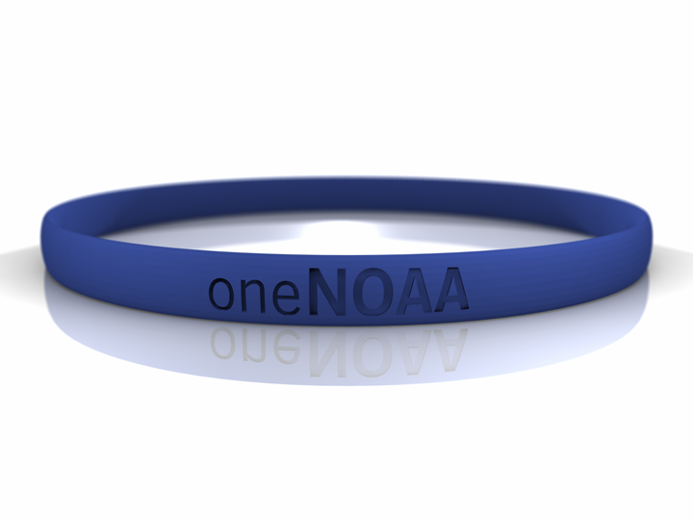


Right Person, Right Place,
Right Time
What’s the Opportunity?
Charles Challstrom
NOAA Assistant Administrator
for Oceans & Coasts
Greg Withee
NOAA Assistant Administrator
for Satellite & Information Service
December 1, 2005

Slide 2


What’s the Challenge?
Need to ensure NOAA has the appropriate suite of knowledge, skills, and abilities to continue to meet its mission.
  Recruiting – Eddie Ribas
  Retention – Louisa Koch
  Training and Education – Percy Thomas
  Workforce Planning – Dave Kennedy
Notes:
These issues are not new. If you go to the Program Review Team report from 2001, you’ll find that recommendations 57-68 were dedicated to developing and sustaining the NOAA workforce.
Challenges present difficulties and opportunities and planning to meet staffing, is no different. The Agency may have difficulty recruiting the people we need but will also have the opportunity to think, work, and organize in new ways. The Agency can use this opportunity for creative problem solving and innovation. The main point is to get the right people in the right jobs at the right time.

Slide 3
What’s the Opportunity
– Recruiting
NOAA is “employer of choice”, attracting and efficiently hiring an inter-disciplinary workforce
  Strengths
    Reach broader audience, especially Universities
    Build off existing programs
    More streamlined, efficient process that has a Subject Matter Expert (SME) involved in every step
    Better quality candidates
    More inter-disciplinary expertise in NOAA workforce
  Concerns
    Individual NOAA entities are pursuing independently
    Resource constraints
    Will it work for disciplines other than science, e.g., PPBES, IT

Slide 4
What’s the Opportunity – Retention
One NOAA /Goal-oriented employees
Possible opportunities:
  Cross pollination (e.g., NRAP, PCO)
  Structured career progression
  Incentives for enhancing needed skill sets (e.g., PPBES)

Slide 5
What’s the Opportunity – Retention
Effectively manage turnover
Possible opportunities:
  Use turnover to YOUR advantage
  Make it easier to return to NOAA
  Improve workplace quality
    Expand use of traditional retention tools (e.g., pay, bonus)
    Introduce new tools (e.g., electronic processes)

Slide 6
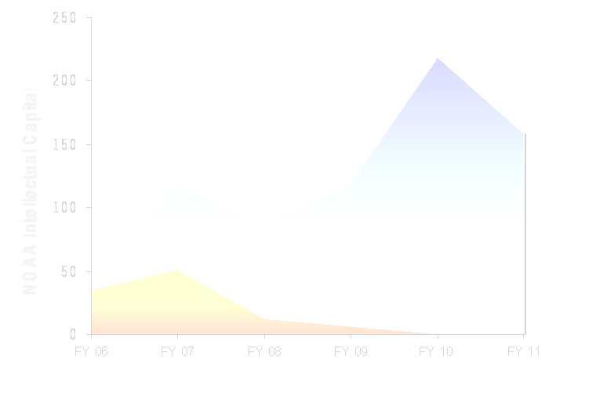
What’s the Opportunity Training & Education
Future: Corporate Intellectual Recapitalization process in place
Outcome
  Minimal intellectual gap
Strengths
  Quantify performance improvements
  Enhance succession planning
  Coherent corporate action plan
  Build finances into programs
  training becomes part of CORE PROCESS
Concerns
  “Whole place falls apart, planes fall from the sky, and ships sink”

Slide 7
What’s the Opportunity
– Workforce Planning
NOAA “Workforce Planning” policy & process implemented
  Gain
    Workforce matches NOAA’s needs
  Strengths:
    Strategic vision of NOAA’s workforce needs
    oneNOAA “Workforce Planning” approach
    Proactive, iterative process to identify skills, resources, future needs
    Builds on demonstrated successes
  Concerns
    Continuing investment
    Urgency/timing
    Commitment
    Workforce education
Notes:
Existing and needed skills
Internal / external resourcing
Changes in technology and demographics
Future education needs
Links to strategic plan
Mission evolution

Slide 8
What’s the Opportunity
– Summary
NOAA is “employer of choice”, attracting and efficiently hiring an inter-disciplinary workforce
One NOAA/Goal-oriented employees
Effectively manage turnover
Corporate Intellectual Recapitalization process in place
NOAA “Workforce Planning” policy & process implemented

