Slide 1
Inpatient HIT
Adoption Experiences
James M. Walker, MD, FACP
CMIO, Geisinger Health System
Director, EHR Safety Institute

Slide 2
Geisinger Overview
40 counties, 5 helicopters
4 hospitals; 30,000 discharges per year
41 clinic sites, 70 specialties
670 physicians
HMO
2.4 million prescriptions per year

Slide 3
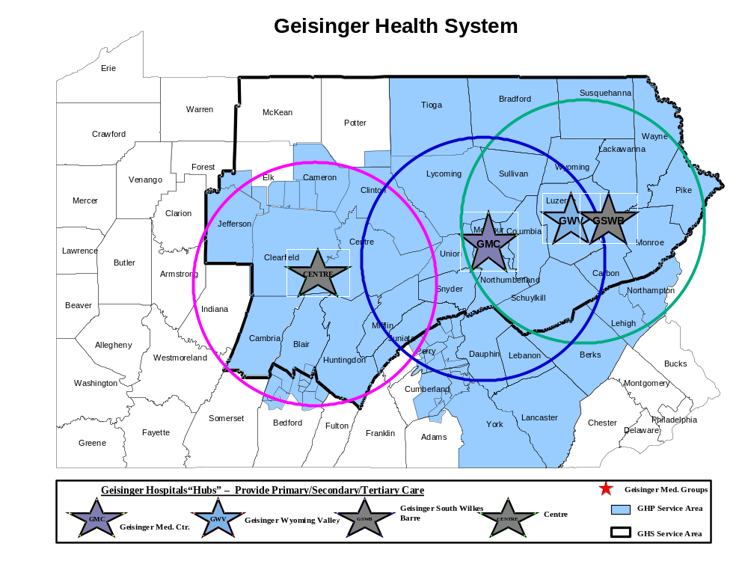
TYLER MEMORIAL HOSPITAL
MOSES TAYLOR HOSPTAIL
MERCY HOSPITAL SCRANTON
COMMUNITY MEDICAL CTR.
LOCK HAVEN HOSP.
CLEARFIELD HOSPITAL
PHILLIP[SBURG AREA HOSP.
BLOOMSBURG HOSP.
SUNBURY COMM. HOSP.
CENTRE COMMUNITY HOSP.
SHAMOKIN AREA HOSP.
POTTSVILLE HOSPITAL
LEWISTOWN HOSP.
GOOD SAMARITAN HOSP.
Non-Geisinger Physicians with EHR access

Slide 4
Clinical Information Systems
Outpatient EHR – all clinicians, all activities
Inpatient EHR
  Results, ADT, Nursing Documentation, ED, OR
  10/07 - Order Management, Physician Documentation

Slide 5
Clinical Information Systems
Outpatient EHR
Inpatient EHR
Patient EHR – 82,000 users
Outreach EHR – 250,000 notes/year
Regional Information Exchange
Research – EHR benefits, information-optimized care processes

Slide 6
Agenda
A Goal worthy of the cost (ROI)
Organizational capabilities
Organization & user readiness
The Operations/IT team
Software matters
Knowledge Management
EHR Safety

Slide 7
A Goal Worthy of the Cost
Transform the way the organization provides care:
Reimbursable performance
High-touch patient experience
Safe, effective processes
Decreased unit-cost of care
Employee satisfaction

Slide 8
Organizational Capabilities
Care-process transformation (continuous)
Patient safety
Incentives for clinicians and managers to use the EHR effectively
Human-factors engineering
Project management
Experienced information-systems staff

Slide 9
Organization & User Readiness
Organizational strategy
  Organization-wide strategy teams
  Executive leadership
Notes:
Remember small hospitals and practices.

Slide 10
Organization & User Readiness
Organizational strategy
Physician champions
Notes:
Remember small hospitals and practices.

Slide 11
Physician Champions
“Founding champion”
CEO
CMO
Project champions
Local champions (Domain Experts)

Slide 12
Non-Physician Champions
COO
CFO
Quality Improvement
Patient Safety
Managers
Nursing

Slide 13
Organization & User Readiness
Organizational strategy
Champions
Inter-Disciplinary Implementation
  Implementation-strategy teams
  Control teams
  Inter-disciplinary feedback teams
  Optimization teams
  Scope-of-practice team
Notes:
Remember small hospitals and practices.

Slide 14
EHR Scope-of-Practice Team
Operations
Clinicians
Medical Records
Education
Legal
Risk Management
Information Security
EHR Teams
CMIO

Slide 15
Organization & User Readiness
Organizational Strategy
Champions
Inter-Disciplinary Implementation
Positive experience of HIT
  Phased implementation
  Fit the EHR to the work.
  EHR use
Notes:
Remember small hospitals and practices.

Slide 16
Fit the EHR to the work.
Workflow analysis and re-design
Specialized EHR tools (70 Specialties)
  Order sets
  Note templates
  Preference lists
  Alerts and reminders
  Pick lists

Slide 17
Organization & User Readiness
Organizational strategy
Champions
Inter-disciplinary implementation
Positive experience of HIT
Incentives
Notes:
Remember small hospitals and practices.

Slide 18
Incentives
Performance Assessment
Financial (internal & external)
Transformation Opportunities
Recipients
  Care teams
  Individual clinicians
  Managers
  HIT teams

Slide 19
Clinically Astute IT
CIO
Process engineering
Business analysis
Network management
Uptime team
Help Desk
Notes:
Kaiser, Mass General

Slide 20
Operations-Led HIT
Control teams (implementation)
EHR-optimization teams
Needs assessment
Project prioritization
Downtime plans
Shared responsibilities with IT

Slide 21
Software Matters
Commercial Software
Market discipline
Community of users
Vendor partnership
HIT integration

Slide 22
Software Matters
HIT Integration
Inpatient EHR (ED)
Outpatient EHR
Operating Rooms
Patient Health Record (PHR)
Outreach EHR

Slide 23
Knowledge Management
Scores of projects (groupware)
Hundreds of team members
Thousands of rules and tools (curation)
Sub-optimal knowledge products
Laborious input methodologies

Slide 24
EHR Safety
Focus on System-Safety Flaws
  (any characteristic of an EHR or its interactions with other healthcare systems that creates the potential for system malfunction and patient harm)

Slide 25
EHR Safety Pyramid
Adverse Events
(failed flaw
mitigation)
System
Malfunctions
(incidents, near
misses)
System-Safety Flaws

Slide 26
EHR Safety
Focus on System-Safety Flaws
Flaw Management
  Fix software (vendor or provider).
  Change the process.
  Omit the “feature”.
  Train users.
  Replace the software.
  Track flaws.

Slide 27
EHR Safety
Focus on System-Safety Flaws
Flaw Management
Look beyond CPOE (to integrated processes)
  Order Entry <–> Pharmacy <–> eMAR
  Inpatient <–> Outpatient

Slide 28
EHR Safety
Focus on System-Safety Flaws
Flaw Management
Look beyond CPOE (integrated processes)
Implement safe, HIT-supported care processes
  Prospective Risk Analysis
  Usability Testing

Slide 29
Summary
A Goal worthy of the cost (ROI)
Organizational capabilities
Organization & user readiness
The Operations/IT team
Software matters
Knowledge Management
EHR Safety

Slide 30
Discussion
jmwalker@geisinger.edu

