Slide 1

A Distributed Component Framework for Science Data Product Interoperability
17th International CODATA Conference
October 15-19, 2000
Dan Crichton/JPL Dan.Crichton@jpl.nasa.gov
Steve Hughes/JPL Steve.Hughes@jpl.nasa.gov
Sean Kelly/UTA Sean.Kelly@jpl.nasa.gov
Sean Hardman/JPL Sean.Hardman@jpl.nasa.gov
Jet Propulsion Laboratory, California Institute of Technology
National Aeronautics and Space Administration

Slide 2
Problem Statement
Problem: Science data is highly distributed across geographically heterogeneous data systems. It is difficult to access, and the systems do not interoperate well. There is no common interchange mechanism, nor is there a common architecture. Correlation of data across these systems is problematic.
Solution: Design an enterprise data architecture that supports cross disciplinary solutions for data management and archiving including interoperability among science data systems.

Slide 3
What is an Enterprise Data Architecture?
An enterprise data architecture provides the infrastructure necessary to enable development of interoperable, enterprise-wide applications
Focus on providing the key data management infrastructure
  Data Archiving
    Managing Local Data
  Search and Retrieval
    Data Location
    Managing Profiles
  Data Access
    Data sharing between data systems
    Data Interoperability

Slide 4
Why is an EDA Critical?
Interoperability is an important key to unlock knowledge discovery
  Allows scientists the ability to locate critical information
  Enables knowledge management across an agency
  A key to scientific discovery
State of data systems across agency
  Difficult to access (no standard interfaces)
  Geographically distributed
  Have no standard language or protocol for interchange (no EDI) agency wide
  No common metadata language agency wide
  Have no system for registration of data products
  Have little or no interoperability
  Have few common terms for describing data

Slide 5
Object Oriented Data Technology Task
Research task funded by the Office of Space Science (OSS) at NASA
Provides a framework for managing data access and interoperability
  Archive Service: For managing data sets
  Profile Service: For managing metadata profiles about data systems, data sets, and data products
  Product Service: To tie individual data systems into a larger enterprise data system
Build data system solutions that are cross disciplinary
Presented a paper at CODATA in March 2000 called “Science Search and Retrieval using XML”

Slide 6
OODT Goals
Encapsulate individual data systems to hide uniqueness
Provide data system location independence
Require that communication between distributed systems use metadata
Use a standard data dictionary for describing systems and resources
Provide a scaleable and extensible solution
Provide a mechanism for data product exchange
Allow systems using different data dictionaries to be integrated

Slide 7
OODT Focus
Focus on building middleware components for an enterprise data architecture
Focus on building “profiles” for managing metadata information about cross-disciplinary resources
Provide sufficient layers of abstraction in the architecture to isolate technologies choices from the architecture choices
  XML for the data content
  CORBA for the data transport
Research technologies for implementing a distributed data architecture
  Distributed Object Computing (CORBA, DCOM, etc)
  Database Technology (RDBMS, ODBMS)
  Data Access Technologies (O/JDBC, STEP, XML, etc)
  Directory Implementations (LDAP)
  Data Interchange (XML)
  Communication Technologies (Web/HTTP, MOM, RPC, etc)

Slide 8
Focus on Middleware
In the computer industry, middleware is a general term for any programming that serves to “glue together” or mediate between two separate and usually already existing programs. A common application of middleware is to allow programs written for access to a particular database to access other databases.
Messaging is a common service provided by middleware programs so that different applications can communicate. The systematic tying together of disparate applications is known as enterprise application integration.
http://www.whatis.com

Slide 9
Role of Middleware
Applications
User Interface
Middleware
Data
Middleware can tie application, data, and user interfaces together and hide the unique interfaces

Slide 10
Middleware (Cont)
Middleware allows for the encapsulation of individual data systems
  Hide uniqueness by introducing the data architecture layer
Ties distributed applications together an often works with a Electronic Data Interchange (EDI) type mechanism
Enables reuse and promotes standards

Slide 11
Focus on Metadata
Metadata is data about data
Provides descriptive information about the data
  Classification, identification, etc
  Metadata Example
    Data Value: 55 (not descriptive)
    Metadata Values:
      Data Element Name:Vehicle_Speed
      Unit: Miles per Hour
      Description: The average velocity of a vehicle.
Use standards where appropriate
  ISO/IEC 11179 – A framework for the Specification and Standardization of Data Elements
  Dublin Core – A metadata element set intended to facilitate discovery of electronic resources.

Slide 12
Data Search and Retrieval
Space scientists can not easily locate or use data across the hundreds if not thousands of autonomous, heterogeneous, and distributed data systems currently in the Space Science community.
Heterogeneous Systems
  Data Management - RDBMS, ODBMS, HomeGrownDBMS, BinaryFiles
  Platforms - UNIX, LINUX, WIN3.x/9x/NT, Mac, VMS, …
  Interfaces - Web, Windows, Command Line
  Data Formats - HDF, CDF, NetCDF, PDS, FITS, VICR, ASCII, ...
  Data Volume - KiloBytes to TeraBytes
Heterogeneous Disciplines
  Moving targets and stationary targets
  Multiple coordinate systems
  Multiple data object types (images, cubes, time series, spectrum, tables,
    binary, document)
  Multiple interpretations of single object types
  Multiple software solutions to same problem.
  Incompatible and/or missing metadata

Slide 13
Solutions to Data Search
Build metadata “profiles” that describe data system resources
  Encapsulate individual data systems resources. (Hide uniqueness.)
  Communicate using metadata. (Provide metadata with data)
  Enable interoperability based on metadata compatibility.
  Refocus problem on metadata development.
  Provide a core framework of software components to interconnect distributed data systems

Slide 14
Profile DTD
<!ELEMENT profiles
(profile+)>
<!ELEMENT profile
(profAttributes,
resAttributes,
profElement*)>
<!ELEMENT profAttributes
(profId, profVersion*, profTitle*, profDesc*, profType*,
profStatusId*, profSecurityType*, profParentId*, profChildId*,
profRegAuthority*, profRevisionNote*, profDataDictId*)>
<!ELEMENT resAttributes
(Identifier, Title*, Format*, Description*, Creator*, Subject*,
Publisher*, Contributor*, Date*, Type*, Source*,
Language*, Relation*, Coverage*, Rights*,
resContext*, resAggregation*, resClass*, resLocation*)>
<!ELEMENT profElement
(elemId*, elemName, elemDesc*, elemType*, elemUnit*,
elemEnumFlag*, (elemValue | (elemMinValue, elemMaxValue))*,
elemSynonym*,
elemObligation*, elemMaxOccurrence*, elemComment*)>

Slide 15
XML Profile Example (1 of 2)
<profile>
<profAttributes>
<profId>OODT_PDS_DATA_SET_INV_82</profId>
<profDataDictId>OODT_PDS_DATA_SET_DD_V1.0</profDataDictId>
</profAttributes>
<resAttributes>
<Identifier>VO1/VO2-M-VIS-5-DIM-V1.0</Identifier>
<Title>VO1/VO2 MARS VISUAL IMAGING SUBSYSTEM DIGITAL …</Title>
<Format>text/html</Format>
<Language>en</Language>
<resContext>PDS</resContext>
<resAggregation>dataSet</resAggregation>
<resClass>data.dataSet</resClass>
<resLocation>http://pds.jpl.nasa.gov/cgi-bin/pdsserv.pl?…</resLocation>
</resAttributes>

Slide 16
XML Profile Example (2 of 2)
<profElement>
<elemId>ARCHIVE_STATUS</elemId>
<elemName>ARCHIVE_STATUS</elemName>
<elemType>ENUMERATION</elemType>
<elemEnumFlag>T</elemEnumFlag>
<elemValue>ARCHIVED</elemValue>
</profElement>
<profElement>
<elemId>TARGET_NAME</elemId>
<elemName>TARGET_NAME</elemName>
<elemType>ENUMERATION</elemType>
<elemEnumFlag>T</elemEnumFlag>
<elemValue>MARS</elemValue>
</profElement>
</profile>

Slide 17
Data Access
Access to distributed data systems and databases is difficult
  Vendor database products
  Data model implementations
  Representations of data
  Platforms
  O/S
  etc
…are all different

Slide 18
Solutions to Data Access
Provide a framework to support common access to distributed data systems
Plug into an overall data architecture solution
  Consistent metadata
  Consistent data interchange
  Build “product servers” which negotiate the interface between the infrastructure and the data system implementation
Provide a middleware framework to tie the data architecture together
Provide data abstraction
  Data and information hiding
  Location hiding and independence
Provide a standard language for communication
  Use XML Query language for data interchange
  Use rich metadata to describe queries and results

Slide 19
XML Query Example (1 of 2)
<query>
<queryAttributes>
<queryId>OODT_XML_QUERY_V0.1</queryId>
<queryTitle>OODT_XML_QUERY - PDS DIS Query Example</queryTitle>
<queryDesc>PDS DIS Query for TARGET_NAME = MARS</queryDesc>
<queryType>QUERY</queryType>
<queryStatusId>ACTIVE</queryStatusId>
<querySecurityType>UNKNOWN</querySecurityType>
<queryRevisionNote>2000-05-12 JSH V1.2 Updated for new
prof.dtd</queryRevisionNote>
<queryDataDictId>OODT_PDS_DATA_SET_DD_V1.0</queryDataDictId>
</queryAttributes>
<queryResultModeId>ATTRIBUTE</queryResultModeId>
<queryPropogationType>BROADCAST</queryPropogationType>
<queryPropogationLevels>N/A</queryPropogationLevels>
<queryMaxResults>100</queryMaxResults><queryResults>0</queryResults>
<queryKWQString>TARGET_NAME = MARS</queryKWQString>

Slide 20
XML Query Example (2 of 2)
<querySelectSet></querySelectSet>
<queryFromSet></queryFromSet>
<queryWhereSet>
<queryElement>
<tokenRole>elemName</tokenRole>
<tokenValue>TARGET_NAME</tokenValue>
</queryElement>
<queryElement>
<tokenRole>LITERAL</tokenRole>
<tokenValue>MARS</tokenValue>
</queryElement>
<queryElement>
<tokenRole>RELOP</tokenRole>
<tokenValue>EQ</tokenValue>
</queryElement>
</queryWhereSet>
<queryResultSet></queryResultSet>
</query>

Slide 21
Data Archiving
Promote data archiving best practices at the data system level.
  Support short-term requirements
    Support convenient and efficient data retrieval.
    Reduce data redundancy.
    Support multiple users.
    Provide data security.
    Improve consistency.
  Long Term Requirements
    Ensure data remains viable.
    Ensure data remains useable.
    Ensure data remains understandable.

Slide 22
OODT Query Flow
Search Web Page
User
query
XMLQuery
(no results)
XMLQuery
(no results)
Query Server
Profile Server
jpl
Web server
search.jsp
QueryClient
XMLQuery
(profiles of resources to handle query)
Profile DB
XSL
(profiles or
data products
formatted)
XMLQuery
(profiles or
data results
as requested)
Product Server
jpl.pti
PTI Repository
XMLQuery (product search)
Product Server
jpl.pds
XMLQuery (data results)
PDS DVD Jukebox
Product Server
jpl.pds.mola
PDS MOLA Oracle DB

Slide 23

OODT Product Server
The Product Server plugs into the OODT framework and manages the “handshake” between the data system and the OODT system.
Extensible by dynamically loading objects at runtime which are specific to the data system model
Queries and results are passed using an OODT XML Query structure
Encapsulates one or more data sources for standardized access
Generic Server
Implementation Class
Query
File
Sys
Flat file accessor
Result
Other accessor
Database
Product Server

Slide 24
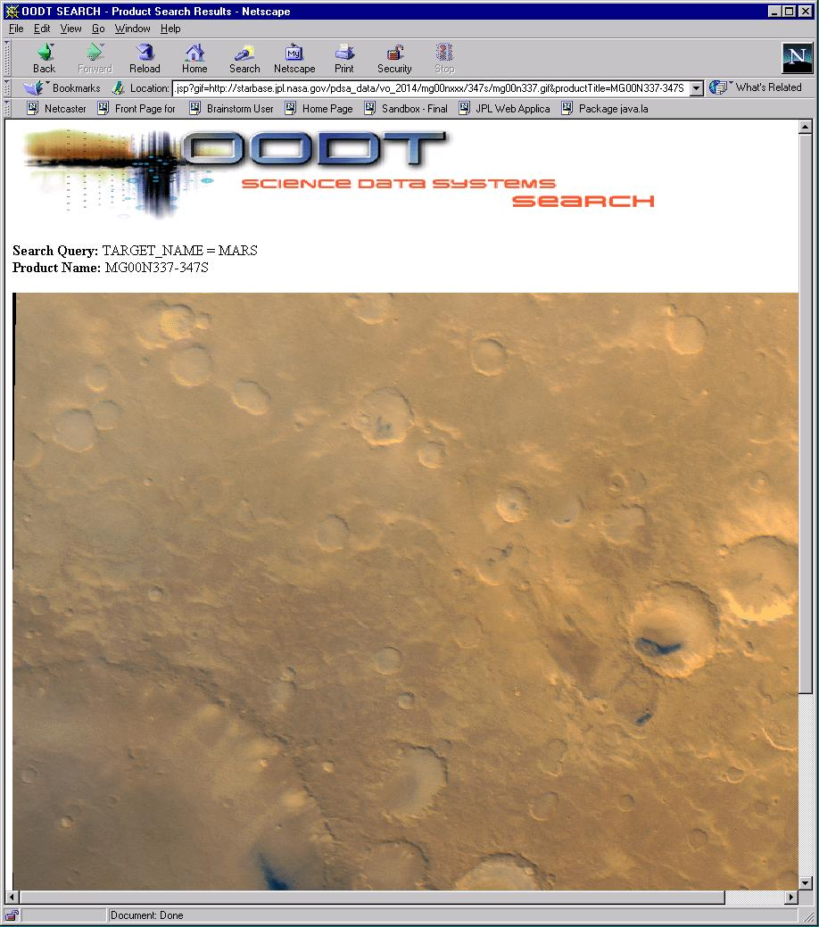
Results Slide

Slide 25
OODT Insertion in the PDS
Focused research activity on information technology in support of space science data systems
  Providing a long term architecture to improve the ability for scientists to retrieve data within the PDS
    Refocus the problem away from technology solutions
    Provide and leverage a metadata infrastructure
  Providing new solutions for data management in order to access and correlate heterogeneous data products archived in distributed heterogeneous data systems
  Reusing a metadata infrastructure that exists
  Supporting the PDS distributed node architecture

Slide 26
What is the PDS?
PDS is the official planetary science data archive for NASA.
PDS is chartered to ensure that planetary data are archived and available to the scientific community.
  Publish and disseminate documented data sets for use in scientific analysis.
  Work with projects to help design, generate, and validate data products for placement in archive
  Develop and maintain archive data standards to ensure future usability.
  Provide expert scientific help to the user community.
PDS is a distributed system designed to optimize scientific oversight in the archiving process.

Slide 27
What has the PDS Accomplished?
Produced a high-quality peer-reviewed archive of Solar System Exploration Data
  Stored for long-term viability
  Described by metadata
  Distributed either online or on CD media
Developed a robust standards architecture
  Planetary Science Data Dictionary - Provides the “domain of discourse” for the planetary science community.
  Planetary Community Model - Provides formalized descriptions of the entities and their relationships within the planetary science community.
Developed science driven management structure
  Responsive to changing mission project environment through distributed, science discipline oriented nodes.

Slide 28
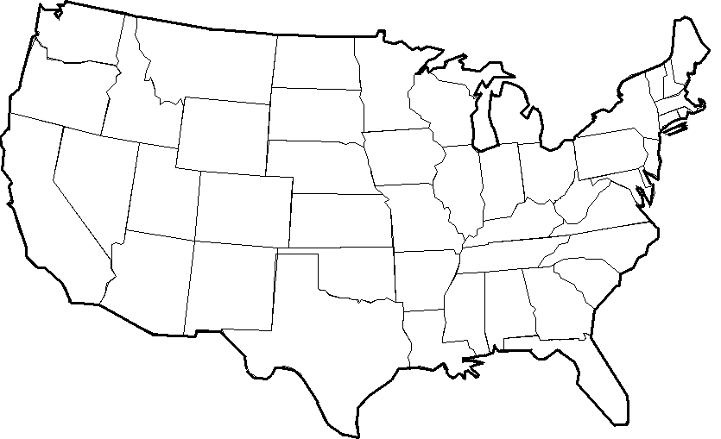
PDS Nodes and Institutions (Silos)
Geosciences/Washington University
Rings/Ames
Radio Science/Stanford
Small Bodies/UMD
Planetary Plasma/UCLA
Imaging/JPL
Central Node/JPL
NAIF/JPL
Imaging/USGS
Atmospheres/New Mexico State

Slide 29
OODT Outside Opportunities
Early Detection Research Network from the National Cancer Institute (NCI)
  Interested in reusing the OODT technology to link data from distributed data centers in support Biomarkers Research
Children’s Hospital, Los Angeles and Johns Hopkins Medical Institute
  Interested in reusing the OODT technology to link pediatric physiological data between the hospitals

Slide 30
More Information
“Science Search and Retrieval using XML” by OODT Team. Presented at Second National Conference on Scientific and Technical Data, National Academy of Sciences, Washington D.C.
  http://oodt.jpl.nasa.gov/doc/papers/codata/paper.pdf
Planetary Data System
  http://pds.jpl.nasa.gov
Dublin Core
  http://purl.oclc.org/dc
Extensible Markup Language
  http://www.w3c.org/XML
ISO/IEC 11179: Specification and Standardization of Data Elements
Object Management Group (CORBA and UML standards)
  http://www.omg.org
Federal CIO Statement on Metadata
  http://www.cio.gov/docs/metadata.htm
National Information Standards Organization Z39.50 Information Retrieval Protocol
http://www.niso.org/z3950.html

Slide 31
Backup Slides
Backup Slides

Slide 32
OODT Metadata Development
Metadata Registry – Develop a data management system for managing the semantics of data that is shared within and between domains.
  Terminology Base – Domain specific name space.
  Data Dictionary – Inventory of domain terms with definitions and other distinguishing attributes.
  Ontology – A set of concepts, their relationships and constraints, all within the scope of a domain.
  XML for metadata registry and communication
Several I.T. efforts have shown the criticality of metadata in enabling data sharing and system interoperability.

Slide 33
Data Archiving
Archiving is a time-consuming and sometimes expensive task that culminates in giving one's data away. So why do it? *
  Provide basic infrastructure for managing data long term
  Reinforces open scientific inquiry
  Encourages diversity of analysis and opinions
  Promotes new research and allows for the testing of new or alternative methods.
  Improves methods of data collection and measurement through the scrutiny of others
  Reduces costs by avoiding duplicate data collection efforts.
  Provides an important resource for training in research
*ICPSR Guide 1997

Slide 34
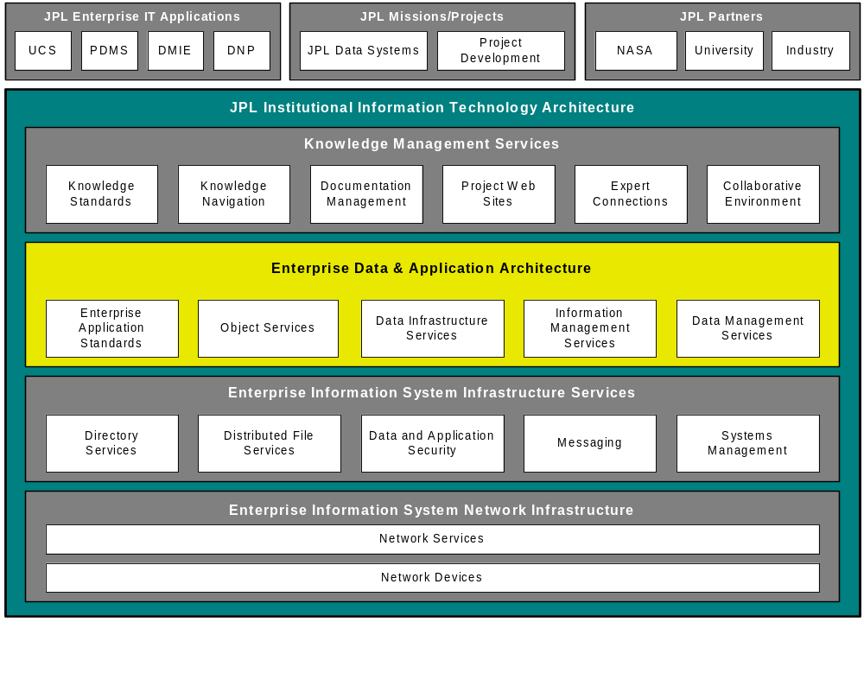
JPL Enterprise Architecture
(Logical View)

Slide 35
Why XML for OODT?
XML doesn’t provide a “silver bullet,” but it does allow us to refocus the problem on metadata
  Metadata is a key to interoperability
XML is language neutral
Allows the designer to separate the data and the transport (re: CORBA vs XML-over-CORBA)
  Transport mechanism and data are not tied together
    Could be XML/HTTP
    Simpler deployments
    Simpler interfaces
    Allows technologies to grow and change independently
Real value of XML is the content

Slide 36
CORBA vs XML
CORBA method
module jpl {
module user {
interface UserManager {
User findUser(string
name);
};
interface User {
String getName();
};
};
};
XML over CORBA/IIOP
module jpl {
module user {
interface UserManager {
string do(string xml);
};
};
};
<transaction>
<findUser>
<user>
<surname>Doe</surname>
</user>
</findUser>
</transaction>

Slide 37
Middleware Framework for OODT
OODT/Science Web Tools
Archive
Client
Navigation
Service
OBJECT ORIENTED DATA TECHNOLOGY FRAMEWORK
Archive
Service
Profile
Service
Product
Service
Query
Service
Bridge to External Services
Other Service 1
Other Service 2
Profile
XML
Data
Data System 2
Data System 2

