Slide 1

NSF SUPPORT OF THE
SOCIAL, BEHAVIORAL, AND ECONOMIC SCIENCES
Dr. Deborah Winslow
Directorate for Social, Behavioral, and Economic Sciences
National Science Foundation

Slide 2

Overview of Talk
SBE in NSF
Recent budget priorities
New programs
SBE Divisions and programs
Proposals preparation and processing
Directorate for Social, Behavioral, and Economic Sciences

Slide 3
National Science Foundation
National Science
Board
Director
Deputy Director
Inspector
General
Staff Offices
Computer &
Information
Science
& Engineering
Biological
Sciences
Mathematical
& Physical
Sciences
Engineering
Geosciences
Social, Behavioral
& Economic
Sciences
(<5% of research $s)
Budget,
Finance
& Award
Management
Information Resource
Management
Education
& Human
Resources

Slide 4
Office of the Director
Directorate for Social, Behavioral & Economic Sciences
Social and Economic Sciences
Behavioral and Cognitive Sciences
Science Resources Statistics

Slide 5
FY 2009 Budget ???
Emphases in NSF’s Request
Discovery Research
  Strengthening the Core
  Science of Science and Innovation Policy
  Complexity and Systems Thinking
    research on complexity and interacting systems; & environmental research
    Cyber-enabled Discovery and Innovation
  Adaptive Systems Technology
Research Infrastructure
Learning
Stewardship

Slide 6
Themes
New Technologies
Intertwinements with Natural and Life Sciences
Centrality of Mind/Brain
  Adaptive Systems Technology
Complexity
  Cyber-Enabled Discovery & Innovation
  Emergent phenomena
  Tipping points
  Links to policy

Slide 7
Science of
Science & Innovation Policy
First solicitation in FY 2007
FY 2009 deadline: 12/16/08
Emphasis areas
  Analytical Tools
  Model Building
  Data Development and Augmentation
Related infrastructure activities
Program Officer: Julia Lane

Slide 8
So What Does
SciSIP Science Involve?
Understanding:
develop usable knowledge and theories
Measurement:
improve and expand science metrics, datasets and analytical models and tools that are replicable and generalizable
Community development:
cultivate a community of practice focusing on SciSIP across the academy, the public sector and industry both nationally and internationally

Slide 9
Complexity & Systems Thinking
Mix of core activities and NSF-wide solicitation
Research on complexity and interacting systems (including ecology) core programs
Cyber-enabled Discovery & Innovation
New 5 year, NSF-wide program, 2008-2012
  Three themes
    complexity
    data extraction
    virtual organizations)

Slide 10
Adaptive Systems Technologies
Multi-directorate initiative
  Goal: new technologies from better understanding of biological & particularly neurological systems.
In the SBE context
  Extending findings of cognitive and learning sciences
  Relevant programs: Developmental & Learning Science; Perception, Action & Cognition; Cognitive Neuroscience; and Linguistics.

Slide 11
Science of Learning Centers
Managed by SBE with NSF-wide funding
  Multidisciplinary
  Large scale
  10 years of funding, if progress warrants
6 Centers currently funded
  Cohort 1: Boston U., Carnegie-Mellon, U. of Washington
  Cohort 2: Gallaudet, Temple, UCSD
Developing a network of centers
  Workshops
  Student activities
  International linkages
Program Officers: Soo-Siang Lim and Joan Straumanis

Slide 12
Social, Behavioral & Economic Sciences Programs
Inter-Disciplinary
Disciplinary
Cognitive Neuroscience
Developmental & Learning Sciences
Documenting Endangered Languages
Perception, Action & Cognition
HOMINID
Geography & Regional Science
Decision, Risk & Management Sciences
Science of Science & Innovation Policy
Innovation & Organizational Sciences
Methodology, Measurement & Statistics
Science, Technology, & Society
Law & Social Sciences
Cultural Anthropology
Physical Anthropology
Archaeology
Linguistics
Social Psychology
Economics
Sociology
Political Science

Slide 13
Social, Behavioral & Economic Sciences
Joint Funding
Joint-Funded Programs
Funding Partners
Cognitive Neuroscience
NIH
CISE
BIO
Ecology of Infectious Disease
Biology & Society
Dynamics of Coupled Natural
& Human Systems (CNH)
GEO
Sensors
ENG
Nanotech & Society
Cyber-enabled Discovery
  & Innovation (CDI)
MPS
Cyberinfrastructure
NSF-Wide Initiatives

Slide 14
Cross-Directorate Activities
Serves both divisions – SES and BCS
Administers and coordinates programs to increase underrepresented groups in science and engineering
  Research Experiences for Undergraduates
  Minority Postdoctoral Fellowships
Provides information on cross-Foundation/cross-cutting programs
Program Officer: Fahmida Chowdhury

Slide 15
Ecology of Infectious Diseases (EID)
Multi-disciplinary approach to modeling and preventing disease spread
Non-human agent must be involved
Ecological interactions between landscape systems and host population dynamics
Socio-economic contexts of human activity
Geography of spatial interactions (remote sensing)
Epidemiology, mass patient screening, and disease tracking & follow-up

Slide 16
Social and Behavioral Dimensions of National Security, Conflict, and Cooperation (NSCC)
NSF and the Department of Defense (DoD) program to support university-based social and behavioral science research focused on areas of strategic important to the U.S. national security policy
Goal:
  Develop the DoD’s social and human science intellectual capital in order to enhance its ability to address future challenges
  Enhance the DoD’s engagement with the social science community
  Deepen the understanding of the social and behavioral dimensions of national security issues
NSF and the DoD will bring together universities, research institutions, and individual scholars and will support disciplinary, interdisciplinary and collaborative projects

Slide 17
NSCC
Program Solicitation: 08-594
Letter of Intent (required): 9/30/08
Full Proposal Deadline: 10/20/08
Awards (10-15)
    Workshops (NSCC/W)
      Up to $50,000 to $150,00 each, 1 year (1-5)
    8-10 for Small Awards (NSCC/SA)
      Up to $500,000 each, 2-3 years (8-10)
    1-3 for Large Awards (NSCC/LA)
      Up to $2 million /year for 3-5 years for each awarded proposal (1-3)
Program officers: Amber Story & Jonathan Leland

Slide 18
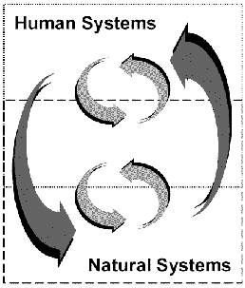
Dynamics of Coupled Natural and Human Systems (CNH)
Promotes quantitative, interdisciplinary analyses of relevant human and natural system processes and complex interactions among human and natural systems at diverse scales.
Educational Opportunity
  Undergraduate students
  Graduate students
  K-12 Educator
Program guidelines and due date
  07-598 Solicitation
  Full Proposal Deadline Date: November, 18, 2008
    Program Officer: Tom Baerwald

Slide 19
CNH Sample Award
Integration of circulation, population, habitat, and socioeconomic models to assess how biological reserves function in a coral reef ecosystem, how different stakeholder groups influence the operation of the reserves, and the efficacy of different reserve designs in promoting both local economic development and ecosystem conservation.

Slide 20
Division of Social and Economic Sciences (SES)
Supports research to develop and advance scientific knowledge focusing on economic, legal, political and social systems, organizations, and institutions
Supports research on the intellectual and social contexts that govern the development and use of science and technology
Directorate for Social, Behavioral, and Economic Sciences

Slide 21
Social and Economic Sciences
FY08 Program Allocations
Cross-Directorate Activities $3.8M
Decision, Risk, & Management Sciences $6.55
Economics $23.8M
Innovation and Organizational Sciences $2.3M
Law and Social Science $4.5M
Methodology, Measurement & Statistics $3.6M
Political Science $8.2M
Science and Society $7.6M
Sociology $8.1M
Directorate for Social, Behavioral, and Economic Sciences

Slide 22

Decision, Risk, and Management Sciences
Supports research that explores fundamental issues in judgment and decision making, risk analysis, management science, and organizational behavior
Research must be relevant to an operational or applied context, grounded in theory, and based on empirical observation or subject to empirical validation
Program Officers: Robert O’Connor,
Jacqueline Meszaros & Jon Leland

Slide 23

Economics
Supports:
  Empirical and theoretical economic analysis, and work on methods for rigorous research
  Research to improve understanding of the processes and institutions of the U.S. economy and of the world system of which it is a part
  Most economics subfields: econometrics, economic history, finance, industrial organization, international economics, labor economics, public finance, macroeconomics, and mathematical economics
Program Officers: Dan Newlon,
Nancy Lutz, George Von Furstenberg

Slide 24
Innovation and Organizational Sciences
Supports social science research to advance understanding of organizational phenomena & phenomena related to innovation.
Includes (but not limited to):
  All scales: individuals, groups, subunits, institutions, networks.
  All types of methods: qualitative & quantitative.
  All kinds of organizations: industrial, educational, service, gov’t., not-for profits, emergent, voluntary, inter-organizational arrangements.
Not evaluation/implementation of specific innovations or programs.
Program Officer: Jacqueline Meszaros

Slide 25
Law & Social Science
Supports social scientific studies of law and law-like systems of rules, institutions, processes, & behaviors
Includes, not limited to
  research designed to enhance the scientific understanding of the impact of law
  human behavior and interactions related to law
  dynamics of legal decision making
  the nature, sources, and consequences of variations and changes in legal institutions
Supports Doctoral Dissertation Improvement Grants.
Program Officer: Susan Haire

Slide 26

Methodology, Measurement, and Statistics
Supports research that is interdisciplinary, methodologically innovative, and theoretically grounded, such as:
  Models and methodology for social and behavioral research
  Statistical methodology/modeling directed towards the social and behavioral sciences
  Methodological aspects of procedures for data collection
Program Officer: R. Saylor Breckenridge

Slide 27

Political Science
Supports scientific research that advances knowledge and understanding of citizenship, government, and politics
Includes, but not limited to:
  Government and politics (U.S., comparative)
  International relations
  Political behavior, economy, and institutions
  political economy
  political institutions
Supports Doctoral Dissertation Research Improvement Grants
Program Officers: Brian Humes and Brian Schaffner

Slide 28
Science, Technology, and Society
Supports research to examine questions about the interactions of engineering, science, technology, & society.
4 overlapping components, with different orientations and foci:
Ethics and Values in Science, Engineering and Technology (EVS)
History and Philosophy of Science, Engineering and Technology (HPS)
Social Studies of Science, Engineering and Technology (SSS)
Studies of Policy, Science, Engineering and Technology (SPS)
Program Officers: Fred Kronz, Laurel Smith-Doerr, Steve Zehr

Slide 29
Sociology
Supports theoretically-grounded research on systematic patterns of social relationships, behavior, structure & change, at any scale.
Supports full range of methodologies
Topics include, but are not limited to:
  Stratification, labor markets, mobility, social change
  Organizations, networks, economic and workplace change
  Crime, delinquency, social organization and social control
  Race, ethnicity, social identity/interactions, culture, education
  Family, gender, population, migration, immigration
  Social movements, political processes, globalization and more
  Program Officers: Pat White & Jan Stets

Slide 30
SES Target Dates
January 15 & August 15
  Economics
  Law and Social Science
  Methodology, Measurement & Statistics
  Political Science
  Sociology
January 18 & August 18
  Decision, Risk, & Management Sciences
February 1 & August 1
  Science and Society
September 3 and February 2
Innovation and Organizational Sciences

Slide 31
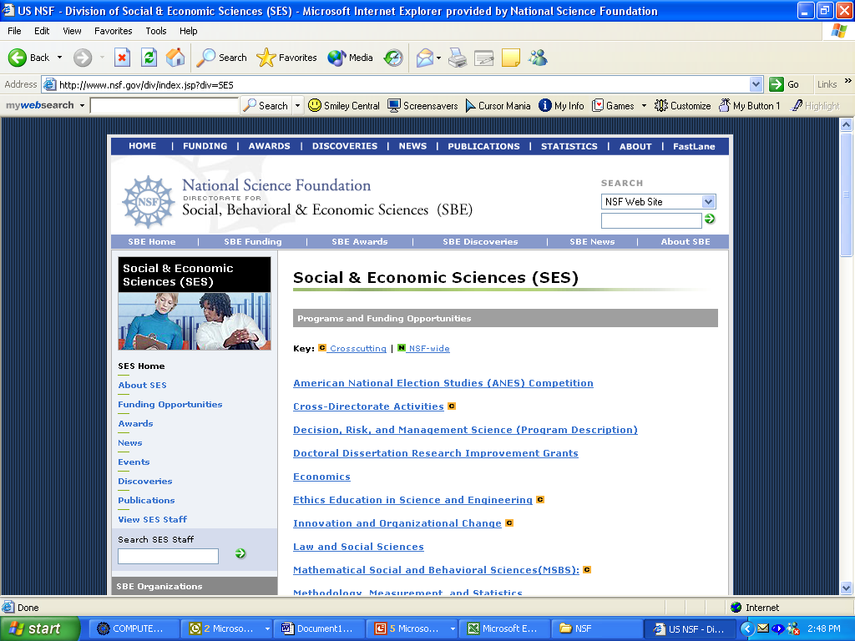

Slide 32
Division of Behavioral and Cognitive Sciences
Supports research to develop and advance scientific knowledge focusing on human cognition, language, social behavior, and culture
Supports research on the interactions between human societies and the physical environment
Directorate for Social, Behavioral, and Economic Sciences

Slide 33
Behavioral and Cognitive Sciences
FY07 Program Allocations
Archaeology & Archaeometry $6.5M
Cultural Anthropology $3.4M
Cognitive Neuroscience $6.3M
Developmental & Learning Sciences $7.0M
Geography & Regional Science $6.2M
Linguistics $7.41M
Perception, Action, & Cognition $6.3M
Physical Anthropology $3.8M
Social Psychology $5.7M
Directorate for Social, Behavioral, and Economic Sciences

Slide 34
Archaeology
Supports
Archaeological research that contributes to an anthropological understanding of the past
Anthropologically significant archaeometric research
Supports Doctoral Dissertation Research
Program Officer: John Yellen

Slide 35

Cognitive Neuroscience
Program supports innovative and inter-disciplinary research that advances rigorous understanding of how the human brain supports:
    thought
    perception
    affect
    action
    social processes
    and other aspects of cognition and behavior, including how such processes develop and change in the brain and through evolutionary time.
Program Officer: Ping Li and Stacia Friedman-Hill

Slide 36
Cultural Anthropology
Promotes basic scientific research on the causes and consequences of human social and cultural variation.
Supports social scientific research of theoretical importance in all theoretical and empirical subfields of cultural anthropology.
Supports Doctoral Dissertation Improvement Grants.
Program Officer: Deborah Winslow and Susan Penfield

Slide 37

Developmental and
Learning Sciences
Supports studies of child and adolescent learning in formal and informal settings
Supports research on learning and development that:
  Incorporates multidisciplinary, multi-method, microgenetic, and longitudinal approaches
  Is methodologically and theoretically innovative
  Assesses social relations (peer, family, societal) & motivations
  Examines the impact of family, school, and community resources, cultures, and demographics
  Assesses adolescents’ preparation for entry into the workforce
Program Officer: Amy Sussman

Slide 38
Documenting Endangered Languages
NSF (National Science Foundation) and NEH (National Endowment for the Humanities) partnership to supports projects to advance knowledge of endangered human languages.
Field research and other activities relevant to recording, documenting, and archiving endangered languages, including the preparations of lexicons, grammars, test samples and databases.
Program guidelines and due date
  06-577 Solicitation
  Full Proposal Deadline Date: September 15, 2008
Program Officer: Susan Penfield

Slide 39

Geography and Regional Science
Supports research on human, physical, and biotic systems on the Earth’s surface, & related subfields.
Encourages research on nature, causes, and consequences of human activity within particular "places and spaces.”
Funds international, domestic, and inter- disciplinary projects.
Program Officers: Tom Baerwald,
Scott Freundschuh & Kenneth Young

Slide 40
Linguistics
Supports scientific research that focuses on human language as an object of investigation, including:
  Syntactic, semantic, phonetic, and phonological pro-perties of individual languages and language in general
  Psychological processes involved in the use of language
  Development of linguistic capacities in children
  social and cultural factors in language use, variation, and change
  Speech acoustics and the physiological and psychological processes involved speech production and perception.
  The biological bases of language in the brain
Program Officer: Joan Maling and Eric Potsdam

Slide 41
Perception Action and Cognition
Supports basic research on human cognitive and perceptual functions
Topics include, but are not limited to:
  Attention
  Memory
  Spatial Cognition
  Language Processing
  Perceptual and Conceptual Development
  Visual, Auditory, and Tactile Perception
  Reasoning
Research supported by the program encompasses a broad range of theoretical perspectives such as Symbolic Computation, Connectionism, and Dynamical Systems
Program Officer: Betty Tuller and Vincent Brown

Slide 42
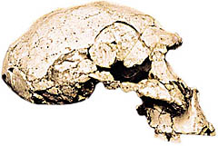
Physical Anthropology
Supports basic research in areas related to:
  Human Evolution
  Anthropological Genetics
  Human Adaptation
  Skeletal Biology
  Primate Biology
  Ecology and Behavior
Grants are often characterized by:
  An underlying evolutionary framework
  A consideration of adaptation as a central theoretical theme
  Generalizable Results
Serves as a bridge between the social and behavioral sciences and the natural and physical sciences
Program Officer: Jean Turnquist

Slide 43
Social Psychology
Supports research on human social behavior, including cultural differences and development over the life span.
Among the many research topics supported are:
  attitude formation and change
  social cognition
  personality processes
  interpersonal relations and group processes
  the self, emotion, social comparison and social influence
  the psychophysiological correlates
  of social behavior
Program Officers: Amber Story,
Kellina Craig–Henderson and Gil Clary

Slide 44
BCS Target Dates
December 1 & July 1
Archaeology & Archaeometry
Physical Anthropology
January 15 & July 15
Cognitive Neuroscience
Developmental & Learning Sciences
Human Cognition & Perception
Linguistics
Social Psychology
January 15 & August 15
Cultural Anthropology
Geography & Regional Science

Slide 45
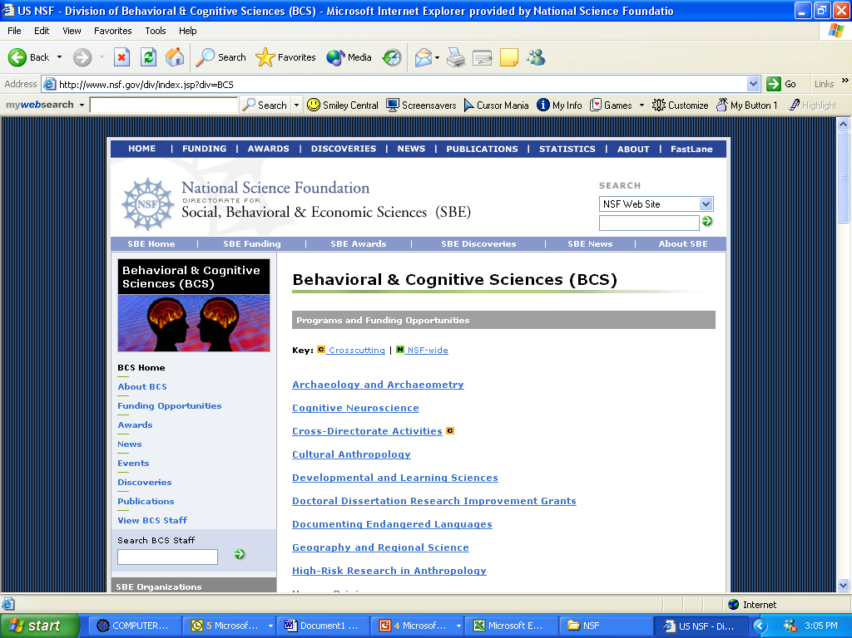

Slide 46
Doctoral Dissertation Improvement Awards
Small grants to provide funds for items not normally provided through the student’s institution
Archaeology
Cultural Anthropology
Decision, Risk, & Management Science
Economics
Geography & Regional Science
Law and Social Science
Linguistics
Physical Anthropology
Political Science
Science and Society
Sociology
Directorate for Social, Behavioral, and Economic Sciences

Slide 47
SBE Minority Post-Docs
Fellowships for minority SBE scientists within four years of receipt of doctoral degree
Travel grants ($4,000) available to help find a host institution
$50,000 research start-up grant available at conclusion of post-doc
Deadline: first Monday in December, annually
SBE spends about $1M (10 Fellowships) on this program each year
2 year fellowships for $100,000

Slide 48
GK-12: NSF Graduate Teaching Fellows in K-12 Education
Supports fellowships and training to place STEM (including social and behavioral science) graduate students as resources in K-12 schools
Collaboration between university and local school system
Up to $600,000 per year for 5 years
Letters of Intent deadline – May
Full proposal deadline – ca. July

Slide 49
Research in Undergraduate Institutions (RUI)
  Institution self certifies as predominantly undergraduate (20 or fewer sci. and eng. Ph.Ds in 2 years)
  Supports high quality research with active involvement of undergraduates
  PI can submit additional 5-page impact statement
  Review process is the same as for a “regular” proposal
  Regular research, multi-user instrumentation or
  Research Opportunity Awards (ROA) provide supplements to RUI researchers to collaborate with an NSF PI

Slide 50
Research Experiences for Undergraduates (REU)
Emphasis is on providing a meaningful, pedagogical research experience with significant student-faculty interaction
REU Sites are typically:
  10-12 week summer programs
  8-12 students
  Total project costs expected to be around $600-$650 per student per week
  Next deadline is August 17, 2004
REU Supplements
  Support research activities for 1-2 undergraduates as a supplement to a new or renewal NSF grant
  Supported by the various disciplinary and education research programs throughout the Foundation

Slide 51
Major Research Instrumentation (MRI)
Acquisition or development of major equipment by U.S. institutions
Proposals may be for a single instrument, a large system, or multiple instruments that share a common research focus
Institutions limited to 2 equipment proposals and 1 instrument development proposal
$100K - $2M awards (can be as low as $25,000 for SBE sciences)
Deadline in late January, annually

Slide 52
Human Subjects
No award for a project involving human subjects can be made without prior Institutional Review Board (IRB) approval of the research activity.
The PI may request Human Subjects evaluation from the IRB of a nearby institution.

Slide 53
Human Subjects
A tribal community may establish its own Institutional Review Board (IRB) following Federal Policy for the Protection of Human Subjects, Subpart A: The Common Rule for the Protection of Human Subjects (45 CFR 690) http://www.nsf.gov/bfa/dias/policy/docs/45cfr690.pdf

Slide 54
Proposals

Slide 55
Proposal Preparation
You write it.
Your institution submits it.
NSF reviews it.
  Compliance review
  In house reviews (sometimes)
  Ad hoc reviews (usually)
  Advisory panels
  Program officer recommendation
  Divisional Director review and recommendation

Slide 56
How to Develop a Proposal
Determine your long-term research and education goals
Develop your bright idea
  Survey the literature
  Contact Investigators working on topic
  Prepare a brief concept paper
  Discuss with colleagues/mentors
Prepare to do the project
  Determine available resources
  Realistically assess needs
  Develop preliminary data
  Present to colleagues/mentors/students

Slide 57
How to Develop a Proposal
Determine possible funding sources
Understand the ground rules
  Read carefully announcements and instructions
  Determine whether your project fits program scope
  Look over prior award abstracts
  Ascertain evaluation procedures and criteria
  Talk with NSF Program Officer
Coordinate with your institution and sponsored research office
Ask PIs for copies of proposals

Slide 58
Budget Tips
Amounts
  Reasonable for work -- Realistic
  Well Justified -- Need established
  In-line with program guidelines
Eligible costs
  Personnel
  Equipment
  Travel
  Other Direct Costs, Subawards
  Facilities & Administrative Costs

Slide 59
Types of Support
Standard Research Grants
Postdoctoral Fellowships
Conference and Workshop Awards
CAREER Grants
Small Grants for Exploratory Research
Doctoral Dissertation Improvement Grants

Slide 60
Standard Review Criteria
What is the intellectual merit of the proposed activity?
    Importance
    Qualifications
    Creativity and originality
    Conception and organization
    Access to resources
NEW in NSF Review Criteria:
  To what extent does the proposed activity suggest and explore creative, original, or potentially transformative concepts?
What are the broader impacts of the proposed activity?
    Training
    Diversity
    Infrastructure
    Dissemination/Public Awareness
    Societal Benefits

Slide 61
Merit Review Facts
1. NSF Program Officers recommend funding or declining a proposal (not panels).
2. Most proposals that are awarded do not receive all "Excellents."
3. Program Officers are encouraged to recommend "risky" science for funding.
4. Principal Investigators submit on average 2.1 proposals for every award they receive.
5. NSF promotes broadening participation in science and engineering.
6. NSF annually has active awards at over 2000 awardee organizations.

Slide 62

Proposal Process & Timeline
NSF
Proposal
Generating
Document
Returned as Inappropriate/Withdrawn
Award via DGA
Organization
submits
via
FastLane
Program
Officer
Analysis
&
Recom-
mendation
Minimum
of 3
Reviews
Required
Proposal
Processing
Unit
Division
Director
Concur
Ad hoc
NSF Program Officer
Panel
Decline
Both
Research &
Education
Communities
Organization
Proposal received by NSF
Div. Dir. Concur
Award
90 Days
6 months
30 days
DGA Review &
Processing of Award
Proposal Preparation Time
Review of Proposal P.O. Recommend

Slide 63

National Science Foundation

