Slide 1
PROHIBITED PERSONNEL PRACTICES
WHISTLEBLOWER PROTECTION
RIGHTS AND REMEDIES
OF FAA EMPLOYEES
UNDER 5 U.S.C., CHAPTERS 12 & 23
and
FAA PERSONNEL MANAGEMENT SYSTEM
As Presented by: AHR
Federal Aviation Administration

Slide 2
TOPICS
5 U.S.C. CHPTRS. 12, 23, 73 and FAA PMS
U.S. Office of Special Counsel (OSC)
●
Prohibited Personnel Practices
●
Whistleblower Protection
Notes:
NOTES:

Slide 3
OFFICE OF SPECIAL COUNSEL (OSC)
5 U.S.C. §§ 1211-19; 5 C.F.R. PART 1800
Authorized to —
  Investigate Prohibited Personnel Practices and other activities prohibited by civil service law, rule, or regulation
  Seek corrective action on behalf of individuals who are the victims of prohibited personnel practices
  Seek disciplinary action against agency officials who commit prohibited personnel practices
Notes:
NOTES:

Slide 4
OFFICE OF SPECIAL COUNSEL (OSC)
5 U.S.C. §§ 1211-19; 5 C.F.R. PART 1800
Authorized to —
  Provide a safe channel for whistleblower disclosures by current and former federal employees, and applicants for federal employment
  Advise on and enforce Hatch Act provisions on political activity applicable to federal, state, and local government employees
  Protect the reemployment rights of federal employee military veterans and reservists under USERRA
Notes:
NOTES:

Slide 5
RESPONSIBILITIES OF AGENCY OFFICIALS
5 U.S.C. § 2302(c) and FAA PMS VIII (b) (i)
The head of each Line of Business or Staff Organization, and officials with delegated personnel management authority, are responsible for —
  Preventing prohibited personnel practices
  Complying with and enforcing civil service laws, rules, and regulations
  Ensuring that employees are informed of their rights and remedies (in consultation with OSC)

Slide 6
KEY CONCEPTS
MERIT SYSTEM PRINCIPLES
The framework and foundation for making all personnel decisions in the civil service
PROHIBITED PERSONNEL PRACTICES
Admonitions against specific practices that conflict with Merit Systems Principles
WHISTLEBLOWER DISCLOSURES
OSC provides a safe channel for disclosures by current and former federal employees and applicants for federal employment

Slide 7
PROHIBITED PERSONNEL PRACTICES:
OVERVIEW
12 PROHIBITED PERSONNEL PRACTICES — fall under one of five general categories:
  Discrimination
  Coerced political activity
  Hiring practices that offend merit system
  The catch-all: violation of laws, rules, or regulations that implement merit system principles (including violations of Constitutional rights)
  Retaliation for engaging in protected activity (including whistleblowing)

Slide 8
DISCRIMINATION
Prohibited personnel practice to discriminate against an employee:
  Based on race, color, national origin, religion, gender, handicapping condition, age, marital status, sexual orientation, or political affiliation
  Based on “conduct which does not adversely affect the performance of the employee or applicant or the performance of others”
5 U.S.C. §§ 2302(b)(1) and (b)(10) and
FAA PMS VIII (a) (i) and (viii)

Slide 9
POLITICAL ACTIVITY
Prohibited personnel practice to:
  Coerce the political activity of any person (including providing of any political contribution or service)
  Take any action against an employee or applicant for employment as a reprisal for the refusal of any person to engage in such political activity
5 U.S.C. § 2302(b)(3) and
FAA PMS VIII (a) (ii)

Slide 10
HIRING OFFENSES
  Obstructing the right to compete
  Influencing withdrawal from competition
  Unauthorized preferences
  Nepotism
  Considering improper job references
  Knowingly violating Veterans’ Preference
5 U.S.C. §§ 2302(b)(2); (b)(4); (b)(5); (b)(6);(b)(7); (b)(11) and
FAA PMS VIII (a) (iii); (iv); (v)

Slide 11
HIRING OFFENSES
Most Common Violations:
  Deceiving or willfully obstructing right to compete for employment — FAA PMS VIII (a) (iii) and
  5 U.S.C. § 2302(b)(4)
  Influencing withdrawal from competition in order to improve or injure employment prospects of another — FAA PMS VIII (a) (iv) and 5 U.S.C. § 2302(b)(5)
  Giving an unauthorized preference or advantage to improve or injure the prospects of any particular person for employment — FAA PMS VIII (a) (v) and
  5 U.S.C. § 2302(b)(6)

Slide 12
HIRING OFFENSES
    It is not a prohibited personnel practice to act upon one’s existing expectation that one person may be the best selectee for a particular position (“preselection”).
      To violate the law there must be —
        the grant of some illegal advantage
        an intentional and purposeful manipulation of the system to insure that one person is favored and another person is disadvantaged
Notes:
NOTES:

Slide 13
HIRING OFFENSES
Caveats:
  While hiring offenses usually require intent to deceive or manipulate the system, if a law, rule, or regulation implementing a merit system principle is violated in the process, that would also be a prohibited personnel practice.
  Negligence or impudent actions can create the appearance of a hiring offense and result in complaints and investigations — e.g., broadcasting one’s choice before competition is held.

Slide 14
EXAMPLES OF HIRING OFFENSES
Manager deliberately fails to have vacancy announcement posted, to prevent a particular candidate from applying for a vacancy
Application received is deliberately misplaced or destroyed
Supervisor gives an employee a dishonest recommendation or appraisal to keep valuable employee or to help another candidate
Closed vacancy announcement is re-opened to permit a favored candidate to apply

Slide 15
EXAMPLES OF HIRING OFFENSES
Supervisor encourages a subordinate not to compete, or to withdraw his or her application, by making promises of future benefits that supervisor does not intend to keep
Job qualifications are manipulated to favor a particular applicant
A supervisor advises a qualified employee not to apply for a job in order to improve another employee’s chances to be selected

Slide 16
CATCH ALL PROHIBITED PERSONNEL PRACTICE
Taking or failing to take personnel action, in violation of a law, rule or regulation that implements or directly concerns a merit system principle
FAA PMS VIII (a) (ix) and
5 U.S.C. § 2302(b)(12)
Notes:
NOTES:

Slide 17
MERIT SYSTEM PRINCIPLES
FAA PMS VII and 5 U.S.C. § 2301(b)
Recruit, select, and advance on the basis of merit after fair and open competition
Treat employees and applicants fairly and equitably
Provide equal pay for equal work and reward excellent performance
Maintain high standards of integrity, conduct, and concern for the public interest

Slide 18
MERIT SYSTEM PRINCIPLES
FAA PMS VII and 5 U.S.C. § 2301(b)
Manage employees effectively and efficiently
Retain or separate employees on the basis of their performance
Provide employees with effective training and education
Protect employees from improper political influence
Protect employees from reprisal for lawful disclosures

Slide 19
RETALIATION
FAA PMS VIII (a) (vi); (vii) and 5 U.S.C. §§ 2302(b)(8); (b)(9)
Taking, failure to take, or threatening to take or fail to take personnel action for ―
  Protected whistleblowing
  Exercise of appeal, complaint, or grievance rights
  Testimony or other assistance to person exercising such rights
  Cooperation with or disclosures to the special counsel or an inspector general
  Refusal to obey an order that would require violation of law
Notes:
NOTES:

Slide 20
ELEMENTS OF PROOF:
REPRISAL FOR WHISTLEBLOWING
5 U.S.C. §§ 1214(b)(4)(A)-(B), 1221(e)
Must Show —
  Protected Disclosure of information under
  5 U.S.C. § 2302(b)(8)
  Personnel Action taken, not taken, or threatened
  Actual or constructive knowledge of the protected disclosure
  Protected disclosure was a contributing factor in the personnel action
Notes:
NOTES:

Slide 21
PROTECTED WHISTLEBLOWER DISCLOSURES
5 U.S.C. §§ 2302(b)(8), 1213
Categories of Disclosures
  A violation of any law, rule, or regulation
  Gross mismanagement (more than De Minimis)
  Gross waste of funds
  (more than a debatable expenditure)
  Abuse of authority
  Substantial and specific danger to public health and/or safety
Notes:
NOTES:

Slide 22
PROTECTED WHISTLEBLOWER DISCLOSURES (cont’d)
5 U.S.C. §§ 2302(b)(8), 1213
    Generally protected when made to any person (except the wrongdoer)
    Need not be accurate to be protected
    Protected if employee has a reasonable belief that it is true- test is both objective and subjective.
    No requirement that employee go through chain of command
    Whistleblower’s personal motivation does not affect reasonableness of a disclosure
Notes:
NOTES:

Slide 23
PROTECTED WHISTLEBLOWER DISCLOSURES (cont’d)
5 U.S.C. §§ 2302(b)(8), 1213
    Employee or applicant is protected if employer mistakenly believes he or she is a whistleblower
    Disclosure not protected (unless made to the Special Counsel or Inspector General), where disclosure is –
      Prohibited by law, or
      Required by Executive Order to be Secret for national security or foreign affairs reasons
Notes:
NOTES:

Slide 24
CONTRIBUTING FACTOR
Any factor which alone or in connection with others tends to affect in any way the outcome of the personnel action at issue
  Can be established by knowledge/timing alone
  Often established by circumstantial evidence
Notes:
NOTE

Slide 25
DISCIPLINARY ACTION
5 U.S.C. § 1215
May be sought by OSC for -
  Prohibited personnel practices
  Hatch Act violations
  Other violations of civil service law, rule, or regulation
Notes:
NOTES:

Slide 26
DISCIPLINARY ACTION (cont’d)
5 U.S.C. § 1215
May be sought by OSC from -
  The Merit Systems Protection Board
  Agency Heads
    (For uniformed service members and contractors)
  The President
    (For most Presidential Appointees)
Notes:
NOTES:

Slide 27
DISCIPLINARY ACTION (cont’d)
5 U.S.C. § 1215
Possible penalties -
  Removal, reduction in grade, suspension, or reprimand
  Debarment from federal employment
  (up to five years)
  Civil penalty
  (up to $1,100)
Notes:
NOTES:

Slide 28
DISCIPLINARY ACTION (cont’d)
5 U.S.C. § 1215
Rights of the charged employee include -
  Opportunity to respond
  Legal or other representation
  Hearing before a Merit Systems Protection Board Administrative Law Judge
  Written decision
Notes:
NOTES:

Slide 29
OSC’S MANAGEMENT ADVICE
Be measured in your speech and actions
Keep the merit systems concepts on your radar screen
Seek expert advice when you are unsure
Deal with problems as they occur to avoid the appearance of bad motive
Be consistent in your management of your employees
Do your best not to be someone about whom the whistle is blown

Slide 30
WHISTLEBLOWER DISCLOSURES
5 U.S.C. § 1213
  The Office of Special Counsel provides a safe channel for whistleblower disclosures by federal employees, former federal employees, and applicants for federal employment.
Notes:
NOTES:

Slide 31
WHISTLEBLOWER DISCLOSURES
  If the Special Counsel makes a positive determination that there is a substantial likelihood that the information discloses one or more of the noted categories of wrongdoing, the Special Counsel must transmit the information to the agency head.
    The agency head is required to conduct an investigation and submit a written report on the findings of the investigation to the Special Counsel within 60 days - 5 U.S.C. § 1213 (c)(1)
Notes:
NOTES:

Slide 32
WHISTLEBLOWER DISCLOSURES (cont’d)
    The Special Counsel reviews the agency report and determines whether it contains the information required by statute and whether the findings appear reasonable - 5 U.S.C. § 1213 (d) and (e)(2)
    The whistleblower has 15 days to comment on the agency report – 5 U.S.C. § 1213 (e)(1)
    The agency’s report and any comments provided by the whistleblower are transmitted to the President and the Congressional Oversight Committees with jurisdiction over the agency that the disclosure involves - 5 U.S.C. § 1213 (e)(3)
Notes:
NOTES:

Slide 33
WHISTLEBLOWER DISCLOSURES
  If the Special Counsel does not make a positive determination that there is a substantial likelihood that the information discloses one or more of the categories of wrongdoing, the Special Counsel informs the whistleblower -
    The reasons why the disclosure may not be further acted on, and
    Directs the whistleblower to other offices available for receiving disclosures - 5 U.S.C. § 1213 (g)(3)
Notes:
NOTES:

Slide 34
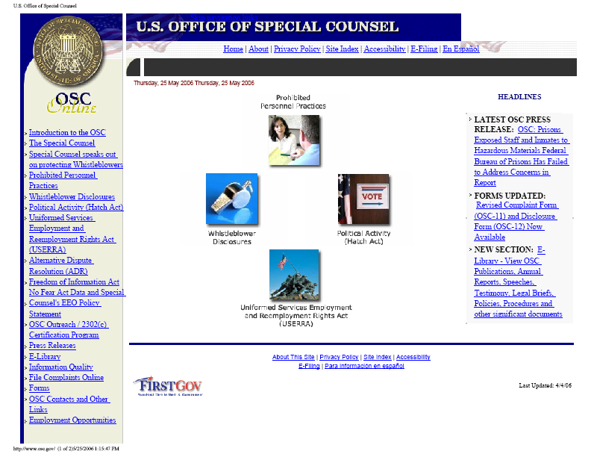
OSC WEB SITE
(http://www.osc.gov)

Slide 35
OSC PHONE / E-MAIL CONTACTS
Complaints Examining Unit: (202) 254-3670
(800) 872-9855
Disclosure Hotline: (202) 254-3640
(800) 572-2249
Hatch Act Unit: (800) 85-HATCH
(202) 254-3650
hatchact@osc.gov
USERRA Unit: (202) 254-3620
userra@osc.gov
OSC Speakers/
Outreach Requests: (202) 254-3600
Notes:
NOTES:

Slide 36
OSC MAIL CONTACTS
U.S. Office of Special Counsel
1730 M Street, N.W. (Suite 218)
Washington, DC 20036-4505
Notes:
NOTES:

