Slide 1


The Sun Grant Initiative
A Concept From Sen. Tom Daschle to Revitalize Rural Communities and Solve Our Energy Needs

Slide 2
Problems and Challenges for the Nation
Second major energy crisis in 30 years.
Shortages of electrical power.
Retail prices of gasoline and natural gas recently hit record levels.
Farmers are experiencing economic hardships.
Exodus from rural areas to urban centers.

Slide 3
Problems and Challenges for the Nation
Viable alternatives and diversity are needed in agriculture.
We can help solve these problems.
Feedstocks for production of fuels, electrical power, lubricants, plastics, solvents, pharmaceuticals, cosmetics, building materials, and numerous other biobased products.

Slide 4

The Sun Grant Initiative
A national network of DOE laboratories and land grant universities to implement a biobased economy.

Slide 5
The Sun Grant Initiative
Mission
  Enhance national energy security through development, distribution and implementation of biobased energy technologies.
  Promote biobased diversification and environmental sustainability of America’s agriculture.
  Promote opportunities for biobased economic diversification in rural communities.

Slide 6
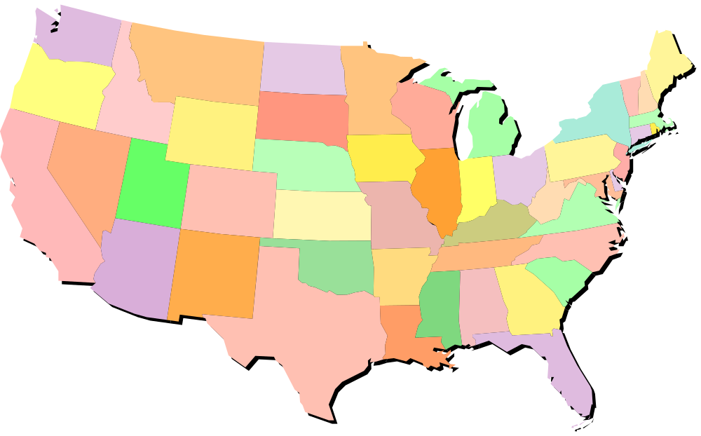
The Sun Grant Initiative
South Dakota State Univ.
Cornell Univ.
Oregon State Univ.
DOE-ORNL
USDA-CSREES
Univ. of Tennessee
DOE - NREL
Oklahoma State Univ.

Slide 7
Centers and Regions
Five national centers.
Each to receive federal funding to establish their expertise and solidify their programs.
Each center will also administer competitive grants for their respective regions.

Slide 8
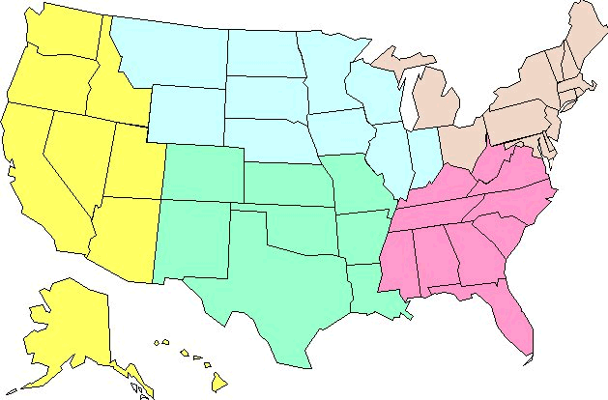
Five Sun Grant Regions

Slide 9
The Land Grant System
Research, Academic, and Extension programs.
Broader than the ag colleges;
  SDSU Colleges of Family & Consumer Sciences, Engineering, and Pharmacy

Slide 10

Research
Agricultural Experiment Stations
Federal support – Hatch Act of 1887
State Matching support
A state – Federal partnership through SDSU and USDA-CSREES
Mandated multi-state, multi-disciplinary research
Integrated with Extension

Slide 11
Sun Grant Research
Development of adapted plant varieties and delivery of certified seed
Transportation and delivery
Conversion of biobased resources into products and energy
Responsible implementation of biotechnology
Sustainability and environmental benefits

Slide 12
Extension
Cooperative Extension Service
Smith-Lever Act of 1914
State match
A three-way partnership: Federal (USDA-CSREES), State (SDSU), Counties
Mandated multi-state, multi-disciplinary programs
Integrated with the experiment stations

Slide 13

Sun Grant and Extension
“an Enterprising Extension Service”
Linking new technology and rural-based businesses.
Linking sources of capital and rural businesses.
Public education, demonstration, pilot programs

Slide 14
Higher Education
Land grant universities founded by the Morrill Act of 1862.
Currently, all support is through state, tuition, and private funds.
The Sun Grant institutions would receive federal funds to establish education programs for a biobased economy.

Slide 15
Higher Education
New academic programs, new majors, new curricula.
Link disciplines, such as agriculture, food science, biology, engineering, pharmacy
Bio-based chemical engineering.
Connect students with new opportunities to strengthen rural communities.

Slide 16
Partnerships
There will be opportunities for all the land grants
  1862s
  1890s
  1994s
Integrated, multi-state, multi-disciplinary programs
Public, industry, small/medium sized enterprises

