Slide 1
PROHIBITED PERSONNEL PRACTICES
WHISTLEBLOWER PROTECTION
USERRA
RIGHTS AND REMEDIES
OF FEDERAL EMPLOYEES
UNDER 5 U.S.C., CHAPTERS 12 & 23
(Name)
(Title)
(Division and/or Unit)
U.S. OFFICE OF SPECIAL COUNSEL

Slide 2
TOPICS
5 U.S.C. CHPTRS. 12, 23, 73
U.S. OFFICE OF SPECIAL COUNSEL (OSC)
PROHIBITED PERSONNEL PRACTICES
WHISTLEBLOWER PROTECTION
Notes:
NOTES:

Slide 3
OFFICE OF SPECIAL COUNSEL (OSC)
5 U.S.C. §§ 1211-19; 5 C.F.R. PART 1800
AUTHORIZED TO —
  INVESTIGATE PROHIBITED PERSONNEL PRACTICES AND OTHER ACTIVITIES PROHIBITED BY CIVIL SERVICE LAW, RULE, OR REGULATION
  SEEK CORRECTIVE ACTION ON BEHALF OF INDIVIDUALS WHO ARE THE VICTIMS OF PROHIBITED PERSONNEL PRACTICES
  SEEK DISCIPLINARY ACTION AGAINST AGENCY OFFICIALS WHO COMMIT PROHIBITED PERSONNEL PRACTICES
Notes:
NOTES:

Slide 4
OFFICE OF SPECIAL COUNSEL (OSC)
5 U.S.C. §§ 1211-19; 5 C.F.R. PART 1800
AUTHORIZED TO —
  PROVIDE A SAFE CHANNEL FOR WHISTLEBLOWER DISCLOSURES BY FEDERAL EMPLOYEES, FORMER EMPLOYEES, AND APPLICANTS FOR EMPLOYMENT
  ADVISE ON AND ENFORCE HATCH ACT PROVISIONS ON POLITICAL ACTIVITY APPLICABLE TO FEDERAL, STATE, AND LOCAL GOVERNMENT EMPLOYEES
  OTHER AREAS ENFORCED: USERRA, ARBITRARY AND CAPRICIOUS WITHHOLDING UNDER FREEDOM OF INFORMATION ACT
Notes:
NOTES:

Slide 5
RESPONSIBILITIES OF AGENCY OFFICIALS
5 U.S.C. § 2302(c)
AGENCY HEADS, AND OFFICIALS WITH DELEGATED PERSONNEL MANAGEMENT AUTHORITY, ARE RESPONSIBLE FOR —
  PREVENTING PROHIBITED PERSONNEL PRACTICES
  COMPLYING WITH AND ENFORCING CIVIL SERVICE LAWS, RULES, AND REGULATIONS
  ENSURING THAT EMPLOYEES ARE INFORMED OF THEIR RIGHTS AND REMEDIES (IN CONSULTATION WITH OSC)

Slide 6
KEY CONCEPTS
MERIT SYSTEMS PRINCIPLES
THE FRAMEWORK AND FOUNDATION FOR MAKING ALL PERSONNEL DECISIONS IN THE CIVIL SERVICE
PROHIBITED PERSONNEL PRACTICES
ADMONITIONS AGAINST SPECIFIC PRACTICES THAT CONFLICT WITH MERIT SYSTEMS PRINCIPLES
USERRA
REEMPLOYMENT WITH BENEFITS OF ACTIVATED MILITARY RESERVISTS

Slide 7
MERIT SYSTEM PRINCIPLES
5 U.S.C. § 2301(b)
RECRUIT, SELECT, AND ADVANCE ON THE BASIS OF MERIT AFTER FAIR AND OPEN COMPETITION
TREAT EMPLOYEES AND APPLICANTS FAIRLY AND EQUITABLY
PROVIDE EQUAL PAY FOR EQUAL WORK; REWARD EXCELLENT PERFORMANCE
MAINTAIN HIGH STANDARDS OF INTEGRITY, CONDUCT, AND CONCERN FOR THE PUBLIC INTEREST

Slide 8
MERIT SYSTEM PRINCIPLES
5 U.S.C. § 2301(b)
USE HUMAN RESOURCES EFFECTIVELY AND EFFICIENTLY
RETAIN OR SEPARATE EMPLOYEES ON THE BASIS OF THEIR PERFORMANCE
PROVIDE EMPLOYEES WITH EFFECTIVE TRAINING AND EDUCATION
PROTECT EMPLOYEES FROM IMPROPER POLITICAL INFLUENCE
PROTECT EMPLOYEES FROM REPRISAL FOR LAWFUL DISCLOSURES

Slide 9
PROHIBITED PERSONNEL PRACTICES:
OVERVIEW
12 PROHIBITED PERSONNEL PRACTICES — FALL UNDER ONE OF FOUR GENERAL CATEGORIES:
  DISCRIMINATION
  HIRING PRACTICES THAT OFFEND MERIT SYSTEM
  RETALIATION FOR ENGAGING IN PROTECTED ACTIVITY (INCLUDING WHISTLEBLOWING)
  THE CATCH-ALL: VIOLATION OF LAWS, RULES OR REGULATIONS THAT IMPLEMENT MERIT SYSTEMS PRINCIPLES (INCLUDING VIOLATIONS OF CONSTITUTIONAL RIGHTS)

Slide 10
DISCRIMINATION
PROHIBITED PERSONNEL PRACTICE TO DISCRIMINATE AGAINST AN EMPLOYEE:
  BASED ON RACE, COLOR, NATIONALITY, RELIGION, GENDER, HANDICAPPING CONDITION, AGE, MARITAL STATUS, OR POLITICAL AFFILIATION
  BASED ON “CONDUCT WHICH DOES NOT ADVERSELY AFFECT THE PERFORMANCE OF THE EMPLOYEE OR APPLICANT, OR THE PERFORMANCE OF OTHERS”
5 U.S.C. § 2302(b)(1) and (b)(10)

Slide 11
HIRING OFFENSES
OBSTRUCTING THE RIGHT TO COMPETE, INFLUENCING WITHDRAWAL FROM COMPETITION, UNAUTHORIZED PREFERENCES, NEPOTISM, CONSIDERING IMPROPER JOB REFERENCES, VIOLATING VETERANS’ PREFERENCE
5 U.S.C. § 2302(b)(2); (b)(4); (b)(5); (b)(6);
(b)(7); (b)(11)

Slide 12
HIRING OFFENSES
MOST COMMON VIOLATIONS:
  DECEIVING OR WILFULLY OBSTRUCTING RIGHT TO COMPETE FOR EMPLOYMENT — 5 U.S.C. § 2302(b)(4)
  INFLUENCING WITHDRAWAL FROM COMPETITION IN ORDER TO IMPROVE OR INJURE EMPLOYMENT PROSPECTS OF ANOTHER — 5 U.S.C. § 2302(b)(5)
  GIVING AN UNAUTHORIZED PREFERENCE OR ADVANTAGE TO IMPROVE OR INJURE THE PROSPECTS OF ANY PARTICULAR PERSON FOR EMPLOYMENT — 5 U.S.C. § 2302(b)(6)

Slide 13
HIRING OFFENSES
    COMMON MISCONCEPTION:
      IT IS NOT A PROHIBITED PERSONNEL PRACTICE TO ACT UPON ONE’S EXISTING EXPECTATION THAT ONE PERSON MAY BE THE BEST SELECTEE FOR A PARTICULAR POSITION (“PRESELECTION”).
      TO VIOLATE THE LAW THERE MUST BE —
        THE GRANT OF SOME ILLEGAL ADVANTAGE
        AN INTENTIONAL AND PURPOSEFUL MANIPULATION OF THE SYSTEM TO INSURE THAT ONE PERSON IS FAVORED AND ANOTHER PERSON IS DISADVANTAGED
Notes:
NOTES:

Slide 14
HIRING OFFENSES
CAVEATS:
  WHILE HIRING OFFENSES USUALLY REQUIRE INTENT TO DECEIVE OR MANIPULATE THE SYSTEM, IF A LAW, RULE, OR REGULATION IMPLEMENTING A MERIT SYSTEM PRINCIPLE IS VIOLATED IN THE PROCESS, THAT WOULD ALSO BE A PROHIBITED PERSONNEL PRACTICE.
  NEGLIGENCE OR IMPRUDENT ACTIONS CAN CREATE THE APPEARANCE OF A HIRING OFFENSE AND RESULT IN COMPLAINTS AND INVESTIGATIONS — E.G., BROADCASTING ONE’S CHOICE BEFORE COMPETITION IS HELD.

Slide 15
EXAMPLES OF HIRING OFFENSES
MANAGER DELIBERATELY FAILS TO HAVE VACANCY ANNOUNCEMENT POSTED, TO PREVENT A PARTICULAR CANDIDATE FROM APPLYING FOR A VACANCY
APPLICATION RECEIVED IS DELIBERATELY MISPLACED OR DESTROYED
SUPERVISOR GIVES AN EMPLOYEE A DISHONEST RECOMMENDATION OR APPRAISAL TO KEEP VALUABLE EMPLOYEE OR TO HELP ANOTHER CANDIDATE

Slide 16
EXAMPLES OF HIRING OFFENSES
SUPERVISOR ENCOURAGES A SUBORDINATE NOT TO COMPETE, OR TO WITHDRAW HIS OR HER APPLICATION, BY MAKING PROMISES OF FUTURE BENEFITS THAT SUPERVISOR DOES NOT INTEND TO KEEP
CLOSED VACANCY ANNOUNCEMENT IS RE-OPENED TO PERMIT A FAVORED CANDIDATE TO APPLY

Slide 17
EXAMPLES OF HIRING OFFENSES
JOB QUALIFICATIONS ARE MANIPULATED TO FAVOR A PARTICULAR APPLICANT
A SUPERVISOR ADVISES A QUALIFIED EMPLOYEE NOT TO APPLY FOR A JOB IN ORDER TO IMPROVE ANOTHER EMPLOYEE’S CHANCES TO BE SELECTED

Slide 18
RETALIATION
5 U.S.C. § 2302(b)(8); (b)(9)
TAKING, FAILING TO TAKE, OR THREATENING TO TAKE OR FAIL TO TAKE PERSONNEL ACTION FOR
  PROTECTED WHISTLEBLOWING
  EXERCISE OF APPEAL, COMPLAINT, OR GRIEVANCE RIGHTS
  TESTIMONY OR OTHER ASSISTANCE TO PERSON EXERCISING SUCH RIGHTS
  COOPERATION WITH OR DISCLOSURES TO THE SPECIAL COUNSEL OR AN INSPECTOR GENERAL
  REFUSAL TO OBEY AN ORDER THAT WOULD REQUIRE VIOLATION OF LAW
Notes:
NOTES:

Slide 19
WHISTLEBLOWER PROTECTION
5 U.S.C. § 2302(b)(8)
AN EMPLOYEE WITH PERSONNEL AUTHORITY MAY
NOT —
  TAKE, FAIL TO TAKE, OR THREATEN TO TAKE OR FAIL TO TAKE
  A PERSONNEL ACTION AGAINST AN EMPLOYEE OR APPLICANT
  BECAUSE OF ANY DISCLOSURE OF INFORMATION TO ANY PERSON
  WHICH THE EMPLOYEE OR APPLICANT REASONABLY BELIEVES
  EVIDENCES A VIOLATION OF ANY LAW, RULE OR REGULATION; GROSS MISMANAGEMENT; A GROSS WASTE OF FUNDS; AN ABUSE OF AUTHORITY; OR A SUBSTANTIAL AND SPECIFIC DANGER TO PUBLIC HEALTH AND SAFETY
Notes:
NOTES:

Slide 20
ELEMENTS OF PROOF:
REPRISAL FOR WHISTLEBLOWING
5 U.S.C. §§ 1214(b)(4)(A)-(B), 1221(e)
MUST SHOW —
  PROTECTED DISCLOSURE OF INFORMATION UNDER
  5 U.S.C. § 2302(b)(8)
  PERSONNEL ACTION TAKEN NOT TAKEN, OR THREATENED
  ACTUAL OR CONSTRUCTIVE KNOWLEDGE OF THE PROTECTED DISCLOSURE
  PROTECTED DISCLOSURE WAS A CONTRIBUTING FACTOR IN THE PERSONNEL ACTION
Notes:
NOTES:

Slide 21
PROTECTED WHISTLEBLOWER DISCLOSURES
5 U.S.C. § 2302(b)(8)
VIOLATION OF LAW, RULE OR REGULATION
SUBSTANTIAL AND SPECIFIC DANGER TO PUBLIC HEALTH OR SAFETY
GROSS WASTE OF FUNDS
MORE THAN A DEBATABLE EXPENDITURE
Notes:
NOTES:

Slide 22
PROTECTED WHISTLEBLOWER DISCLOSURES (cont’d)
5 U.S.C. § 2302(b)(8)
GROSS MISMANAGEMENT
MORE THAN DE MINIMIS WRONGDOING OR NEGLIGENCE — AN ACTION THAT CREATES A RISK OF SIGNIFICANT ADVERSE IMPACT ON THE ACCOMPLISHMENT OF AN AGENCY’S MISSION
ABUSE OF AUTHORITY
AN ARBITRARY OR CAPRICIOUS EXERCISE OF POWER THAT INJURES ANOTHER, OR BENEFITS THE ABUSER OR OTHERS
Notes:
NOTES:

Slide 23
PROTECTED WHISTLEBLOWER DISCLOSURES (cont’d)
5 U.S.C. § 2302(b)(8)
    GENERALLY PROTECTED WHEN MADE TO ANY PERSON (EXCEPT THE WRONGDOER)
    NEED NOT BE ACCURATE TO BE PROTECTED
    PROTECTED IF EMPLOYEE HAS A REASONABLE BELIEF THAT IT IS TRUE — TEST IS BOTH OBJECTIVE AND SUBJECTIVE
Notes:
NOTES:

Slide 24
PROTECTED WHISTLEBLOWER DISCLOSURES (cont’d)
5 U.S.C. § 2302(b)(8)
    NO REQUIREMENT THAT EMPLOYEE GO THROUGH CHAIN OF COMMAND
    WHISTLEBLOWER’S PERSONAL MOTIVATION DOES NOT AFFECT REASONABLENESS OF A DISCLOSURE
    EMPLOYEE OR APPLICANT IS PROTECTED IF EMPLOYER MISTAKENLY BELIEVES HE OR SHE IS A WHISTLEBLOWER
Notes:
NOTES:

Slide 25
PROTECTED WHISTLEBLOWER DISCLOSURES (cont’d)
5 U.S.C. § 2302(b)(8)
DISCLOSURE NOT PROTECTED (UNLESS MADE TO THE SPECIAL COUNSEL OR INSPECTORS GENERAL), WHERE DISCLOSURE IS —
    PROHIBITED BY LAW, OR
    REQUIRED BY EXECUTIVE ORDER TO BE SECRET FOR NATIONAL SECURITY OR FOREIGN AFFAIRS REASONS
Notes:
NOTES:

Slide 26
CORRECTIVE ACTION:
WHISTLEBLOWER REPRISAL MATTERS
5 U.S.C. §§ 1214(b)(4)(B), 1221(e)(1)
CAN BE OBTAINED IF —
  DISCLOSURE OF INFORMATION WAS A CONTRIBUTING FACTOR IN A PERSONNEL ACTION
UNLESS
  AGENCY SHOWS BY CLEAR AND CONVINCING EVIDENCE THAT IT WOULD HAVE TAKEN THE SAME PERSONNEL ACTION IN THE ABSENCE OF THE DISCLOSURE
Notes:
NOTES:

Slide 27
CONTRIBUTING FACTOR
ANY FACTOR WHICH ALONE OR IN CONNECTION WITH OTHERS TENDS TO AFFECT IN ANY WAY THE OUTCOME OF THE PERSONNEL ACTION AT ISSUE
  CAN BE ESTABLISHED BY KNOWLEDGE / TIMING ALONE
  OFTEN ESTABLISHED BY CIRCUMSTANTIAL EVIDENCE
Notes:
NOTE

Slide 28
CLEAR AND CONVINCING EVIDENCE
(AGENCY DEFENSE)
AGENCY DEFENDS PERSONNEL ACTION BY SHOWING — BY CLEAR AND CONVINCING EVIDENCE — THAT IT WOULD HAVE TAKEN THE SAME ACTION WITHOUT THE DISCLOSURE.
FACTORS:
  STRENGTH OF THE EVIDENCE IN SUPPORT OF THE PERSONNEL ACTION
  EXISTENCE AND STRENGTH OF MOTIVE TO RETALIATE
  TREATMENT OF SIMILAR EMPLOYEES WHO ARE NOT WHISTLEBLOWERS
Notes:
NOTES:

Slide 29
OSC’S MANAGEMENT ADVICE
BE MEASURED IN YOUR SPEECH AND ACTIONS
KEEP THE MERIT SYSTEMS CONCEPTS ON YOUR RADAR SCREEN
SEEK EXPERT ADVICE WHEN YOU ARE UNSURE
DEAL WITH PROBLEMS AS THEY OCCUR TO AVOID THE APPEARANCE OF BAD MOTIVE
BE CONSISTENT IN YOUR MANAGEMENT OF YOUR EMPLOYEES
DO YOUR BEST NOT TO BE SOMEONE ABOUT WHOM THE WHISTLE IS BLOWN

Slide 30
DISCIPLINARY ACTION
5 U.S.C. § 1215
MAY BE SOUGHT BY OSC FOR —
  PROHIBITED PERSONNEL PRACTICES
  HATCH ACT VIOLATIONS
  OTHER VIOLATIONS OF CIVIL SERVICE LAW, RULE, OR REGULATION
Notes:
NOTES:

Slide 31
DISCIPLINARY ACTION
5 U.S.C. § 1215
MAY BE SOUGHT BY OSC FROM —
  THE MERIT SYSTEMS PROTECTION BOARD
  AGENCY HEADS (FOR UNIFORMED SERVICE MEMBERS AND CONTRACTORS)
  THE PRESIDENT (FOR MOST PRESIDENTIAL APPOINTEES)
Notes:
NOTES:

Slide 32
DISCIPLINARY ACTION
5 U.S.C. § 1215
POSSIBLE PENALTIES —
  REMOVAL, REDUCTION IN GRADE, SUSPENSION, OR REPRIMAND
  DEBARMENT FROM FEDERAL EMPLOYMENT (UP TO FIVE YEARS)
  CIVIL PENALTY (UP TO $1,100)
Notes:
NOTES:

Slide 33
DISCIPLINARY ACTION
5 U.S.C. § 1215
RIGHTS OF CHARGED EMPLOYEE INCLUDE —
  OPPORTUNITY TO RESPOND
  LEGAL OR OTHER REPRESENTATION
  HEARING BEFORE A MERIT SYSTEMS PROTECTION BOARD ADMINISTRATIVE LAW JUDGE
  WRITTEN DECISION
Notes:
NOTES:

Slide 34
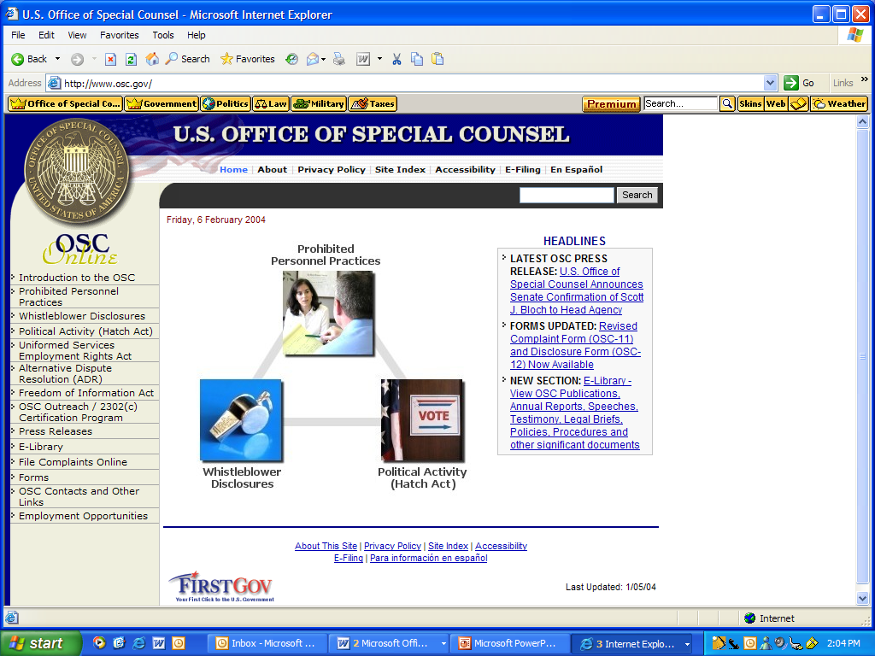
OSC WEB SITE
(HTTP://WWW.OSC.GOV)

Slide 35
OSC PHONE / E-MAIL CONTACTS
COMPLAINTS: (202) 653-7188
(PROHIBITED PERSONNEL (800) 872-9855
PRACTICE, HATCH ACT,
OTHERS)
DISCLOSURE HOTLINE: (202) 653-9125
(800) 572-2249
HATCH ACT UNIT: (800) 85-HATCH
(202) 254-3650
hatchact@osc.gov
PUBLIC INFORMATION /
OSC SPEAKERS /
OUTREACH:
CATHY DEEDS
JAMES McVAY (202) 254-3600
Notes:
NOTES:

Slide 36
OSC MAIL CONTACTS
U.S. OFFICE OF SPECIAL COUNSEL
1730 M STREET, N.W. (SUITE 218)
WASHINGTON, DC 20036-4505
Notes:
NOTES:

