Slide 1
SOFTWARE INTEGRATION
USING STEP AP210
Prof. Jan Helge Bøhn
Virginia Tech, Mechanical Engineering
Blacksburg, Virginia 24061, USA
Tel: +1-540-231-3276, Fax: +1-540-231-9100
E-mail: bohn@vt.edu, Mobile: +1-540-819-0326
NASA's STEP for Aerospace Workshop • January 16-19, 2001 • JPL, Pasadena, CA

Slide 2
Presentation Outline
CPES overview
Why software integration?
Sample demonstration case
  A first generation implementation
Current activities
  STEP AP210 mini-consortium

Slide 3
CPES Overview
National Science Foundation (NSF) Engineering Research Center (ERC)
Five universities
  Virginia Tech, Univ. Wisconsin (Madison),
  RPI, NC A&T, Univ. Puerto Rico (Mayagüez)
85+ corporate members
$120M budget over 10 years (year 3)

Slide 4
CPES Vision
Improve the competitiveness of US power electronics industry by developing an integrated systems approach via Integrated Power Electronics Modules (IPEMs)
10 x improvement in quality, reliability, and cost effectiveness of power electronics systems

Slide 5
Why Software Integration?
To achieve these goals, we must
push existing technologies to their limits and develop new ones as needed
  use a multi-disciplinary set of software tools for design, modeling, and analysis, to optimize performance
    integrate our software tools

Slide 6
The Multi-Disciplinary Analysis
and Design Process
Prototype
Geometric
Modeling
3D
Solid-Body
Modeling
FE Stress
& Strain
Analysis
FE Stress
& Strain
Analysis
Cost
Modeling
Cost
Modeling
Lumped
Mechanical
Parameter
Extractor
Mechanical
Layout
Geometry
data
Prototype
Prototype
FE
Thermal
Analysis
FE
Thermal
Analysis
Lumped
Thermal
Parameter
Extractor
Engineer
Engineer
Geometry
data
Lumped
Electrical
Parameter
Extractor
Multi-
Disciplinary
Lumped Parameter
Simulator
Circuit
Diagram
FE
EM Field
Analysis
FE
EM Field
Analysis
Electrical
Circuit
Simulation
Electro-
Dynamic
Analysis
Notes:
If we look at today’s design process, it typically begins with an engineer…that gets an idea on how to solve a problem.
…He then begins to develop a circuit diagram…using an electric circuit simulation tool…which provides feedback to the engineer.
…He then begins to look at the mechanical layout…using a geometric modeling system.
…Taken together, the engineer now begins to have a prototype design
…on which he can do thermal analysis…electromagnetic field analysis…stress and strain analysis…and, at some point, costs analysis.
Today this process is completed on an ad hoc basis, and it is not uncommon that data is re-entered seven or eight times during the design process, with all the inefficiencies and problems this generates.
We want to streamline this process. We want to make the the prototype data model the core of our process so the engineer can concentrate on the flow of design and analysis activities
…while the applications interact with the model to extract the necessary data

Slide 7
The CPES Solution
Ever since CPES was first proposed in 1993:
Software integration should rely on open international standards
— and in particular
STEP AP210

Slide 8
CPES Solution: Target Platforms
3D
Solid Modeling
I-DEAS
Mechanical
ABAQUS
Cost
Model and Analysis Data Flow
AP 210
STEP
Product
Database
Thermal
FLOTHERM
Program
Flow Control
iSIGHT
Electro-
Magnetic
MAXWELL
Reliability
(CALCE)
Electro-
Dynamic
SABER

Slide 9
Sample Demonstration Case
OBJECTIVE: Sample demonstration case to illustrate usefulness of integration of software tools for design, modeling, and analysis of an IPEM:
3D solid modeling
Electrical modeling and analysis
Thermal modeling and analysis
Automated optimization
Experimental verification

Slide 10
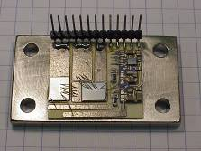
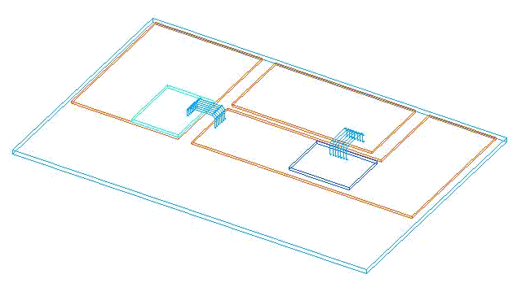
Sample Demonstration Case
P
L₁
IPEM
On-board
Converter
Power
Pre-
regulator
High Volt VRM
V_{in}
S₁
Factor
Correction
V
L
₃
L_{o}
On-board
_{o}
Converter
O
IPEM
Low Volt
VRM
S₂
C_{o}
L
₂
PCB
N
DPS
IPEM Design
APEP
Mechanical CAD
IPEM: Two MOSFETs in a half-bridge structure as part of a front-end converter in a distributed power system (DPS).

Slide 11
Sample Demonstration Case
Aluminum Oxide (Al₂O₃)
MOSFET Power Devices
Thermal Grease
Solder
Copper
(Top & Bottom)
Heat Sink
The two MOSFETs are soldered on one side of a Al₂O₃ Direct Bonded Copper (DBC) board.
The copper substrate of the DBC is etched to give it the desired pattern.
Wire-bonding is used to connect the MOSFETs to the copper substrate.
The copper substrate on the other side of the DBC is attached directly to the heat sink.

Slide 12
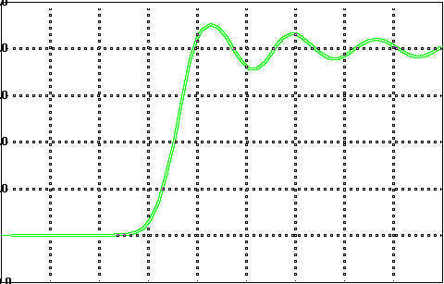
Parasitic Inductance
Ideal Case
V_{in}
S₁
V
L_{o}
_{o}
S₂
C_{o}
Voltage waveform of the
bottom switch at turn off
Non-ideal Case
V_{in}
S₁
V
L_{o}
_{o}
S₂
C_{o}
Voltage waveform of the
bottom switch at turn off
To minimize the parasitic inductance, we want to place these two MOSFETs as close together as possible...

Slide 13


Thermal Considerations
But if we place these two MOSFETs too close together, then the thermal interaction between them may cause the junction temperature to become too high
We therefore
Need electrical and thermal models that are based on 3D solid geometry to address these issues
Need to integrate the electrical and thermal analysis tools to quantify these effects

Slide 14
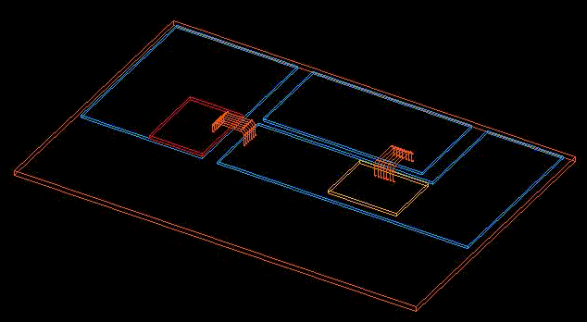
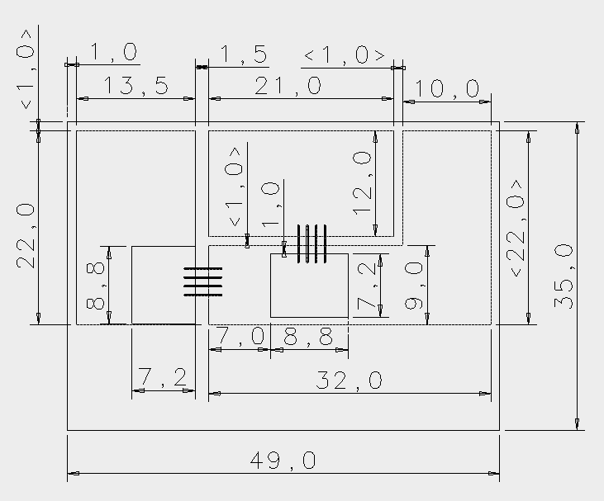
I-DEAS 3D Solid Model
Step 1
P
MOSFET
N
O
Wirebond
35mm
49mm
I-DEAS 3D Solid Model of the IPEM
With I-DEAS we can describe all the necessary geometry and material information

Slide 15
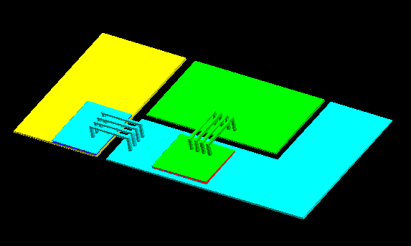
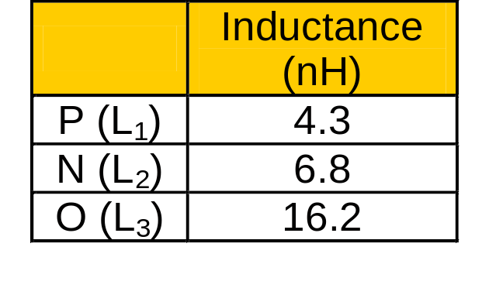
Step 2
Maxwell Q3D Model
(Parasitic Parameter Extraction)
P
M₁₃
N
L₁
M₁₂
O
L₂
M₂₃
L₃
Parasitic Inductance
Maxwell Q3D Model of the IPEM
With Maxwell Q3D Extractor we can calculate the inductance from the geometry
{ using the partial element equivalent circuit (PEEC) method }

Slide 16
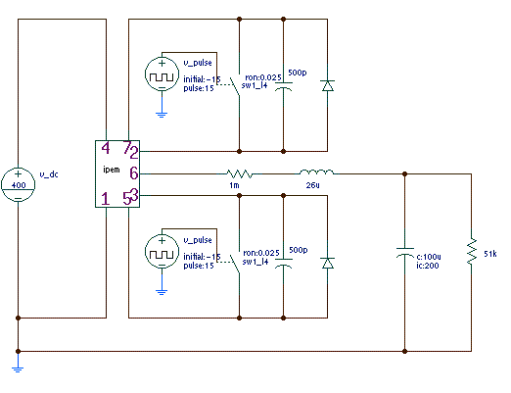
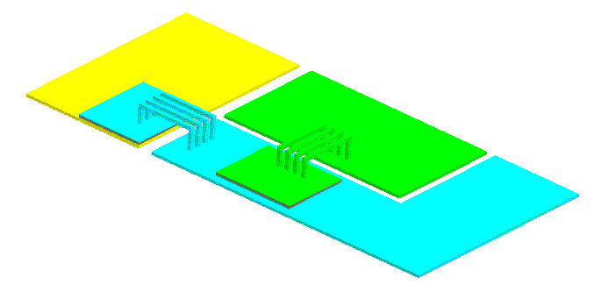
Saber Model (losses, EMI)
Step 3
P
P
S1
N
O
S1
O
N
S2
S2
Maxwell Q3D Extractor
Saber Model of the IPEM
With Saber we can determine losses and EMI
{ using the equivalent inductance matrix obtained from Maxwell }

Slide 17
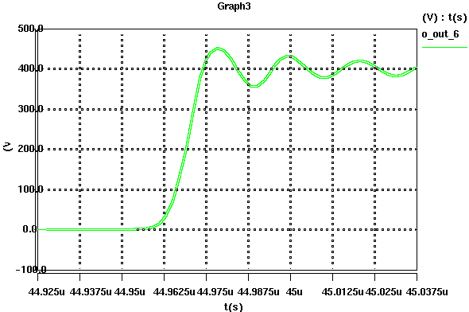
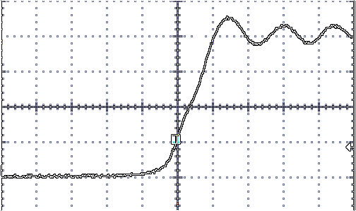
Experimental Verification
L₁
IPEM
P
Maxwell Q3D Parameter Extractor
S₁
P
V_{in}
L
L_{o}
N
V
_{o}
₃
O
O
S₂
C_{o}
L
₂
N
Saber Simulation Result
Waveform Measurement Result
Voltage waveform of the
bottom switch at turn off

Slide 18
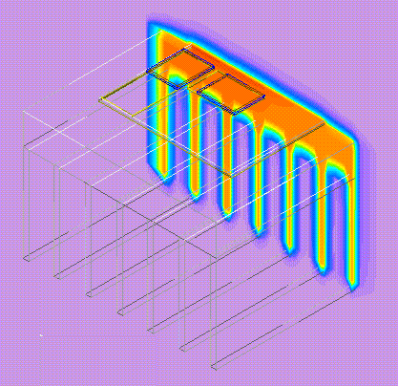
Thermal Modeling
Step 4
FLOTHERM uses computational fluid dynamics (CFD) to predict air flow and heat transfer in and around the electronic systems
Air flow
FLOTHERM Model of the IPEM
The thermal analysis is based on:
Device power loss provided by Saber
Geometry provided by I-DEAS
Boundary condition, such as air flow rate and ambient temperature

Slide 19
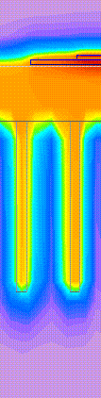
Results: Thermal Modeling
Power Devices
Aluminum Oxide
Copper (top & bottom)
Solder
Thermal Grease
DBC
Heat Sink
R_{j-hs}
OBSERVATIONS:
The thermal resistance of the heat sink is much larger than that of any other package component
The heat sink size is determined by the device loss
<<
R_{hs-a}

Slide 20
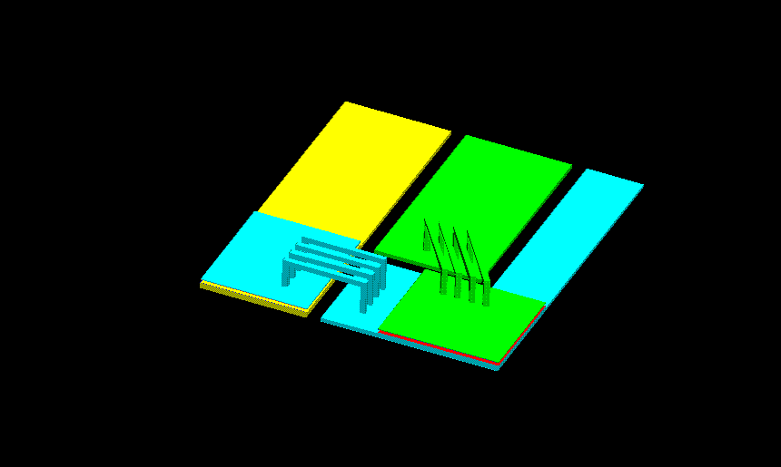
Results: IPEM Geometry
Large-Sized IPEM
Small-Sized IPEM
L: 4~16nH
L: 6~12nH
CASE STUDY: Reduce the size of the IPEM
Does not affect the parasitic inductance since both the length and width of the trace are reduced

Slide 21
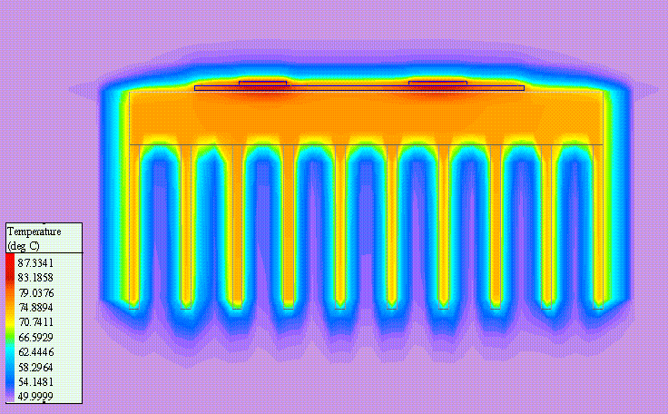
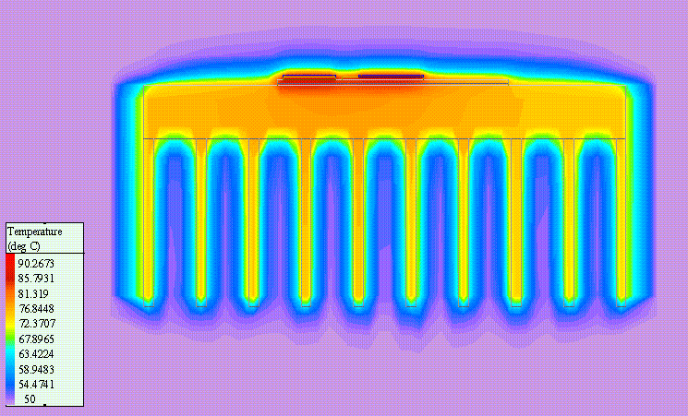
Results: IPEM Geometry
Large-Sized IPEM
Small-Sized IPEM
ΔT: 37°C
ΔT: 40°C
CASE STUDY: Reduce the size of the IPEM
Does not affect the power density since the size of heat sink is mainly determined by the power loss

Slide 22
Sample Conclusions
To minimize the parasitic inductance of the layout, we should keep the width of the copper trace as large as possible, but minimize the length of the trace.
Scaling down the size of the IPEM may not increase the high power density, because the heat sink size is mainly determined by the power loss.

Slide 23
A First Generation Implementation of
IPEM Design, Modeling, and Analysis
Software Tools Integration

Slide 24
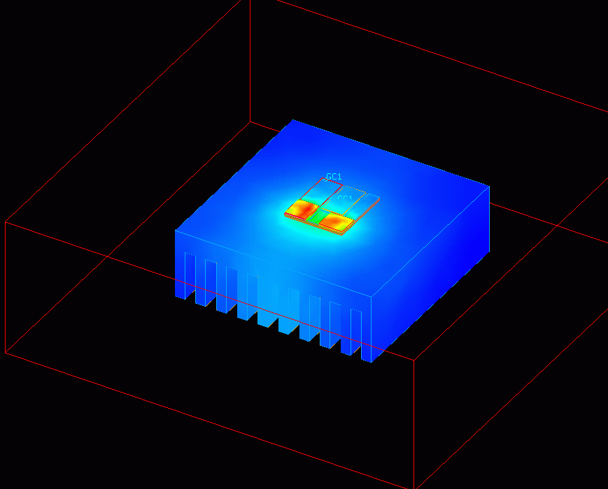
Flow Controlled by iSIGHT
I-DEAS
Geometry
IPEM geometry
in Maxwell:
Change Heat Sink Size
Geometry
data and
program
flow control
Maxwell Q3D
iSIGHT
Change Thickness
L, C
EMI
Temperature Distribution
in IPEM and Heat Sink:
Saber
Device
Temperature
Device
Temperature
loss
I-DEAS
Thermal

Slide 25
Data Flow and Storage
Software Tools
iSIGHT
flow control
iSIGHT data storage
I-DEAS
(geometry)
Geometry
Design Variables
Heat sink size
External I-DEAS
Maxwell Q3D
Heat sink thickness
see notes below
Parasitics: L, C
Saber
Temperatures
Losses
I-DEAS
(thermal)
“Chicken & egg” iteration
EMI
NOTES: Currently the heat sink thickness is provided as an explicit variable to Maxwell in addition to the geometry (which currently is transmitted only once in the form of an .STL file). Because Maxwell ignores the relative positioning of parts within an .STL file, these parts must be manually repositioned within Maxwell; hence, the geometry is only transferred once and the variable thickness is provided explicitly as it changes from one iteration to another. In the future, when using AP203/AP210, the entire geometry will, for each iteration, be transmitted to Maxwell without the need for manual repositioning of parts or the explicit information of heat sink thickness.

Slide 26
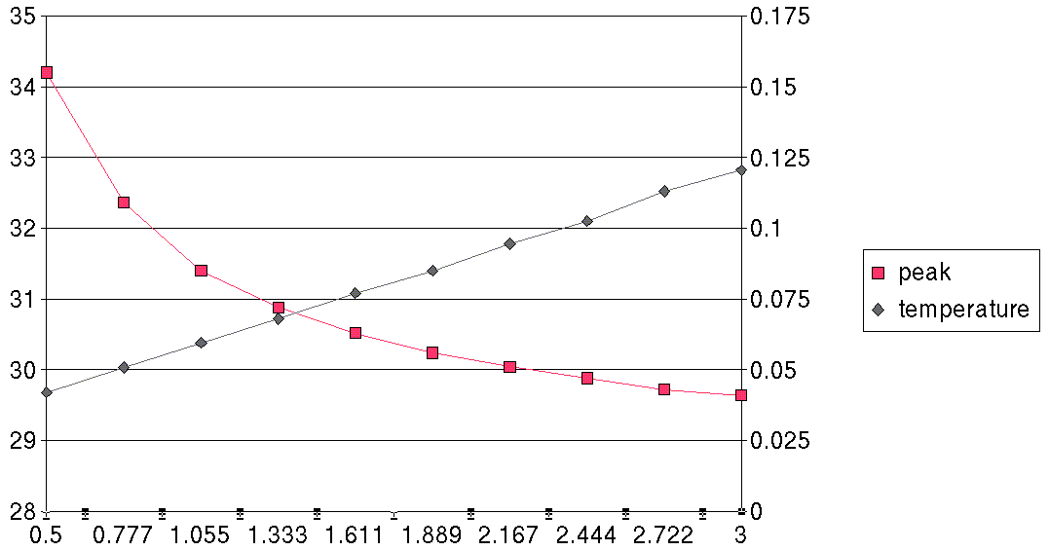
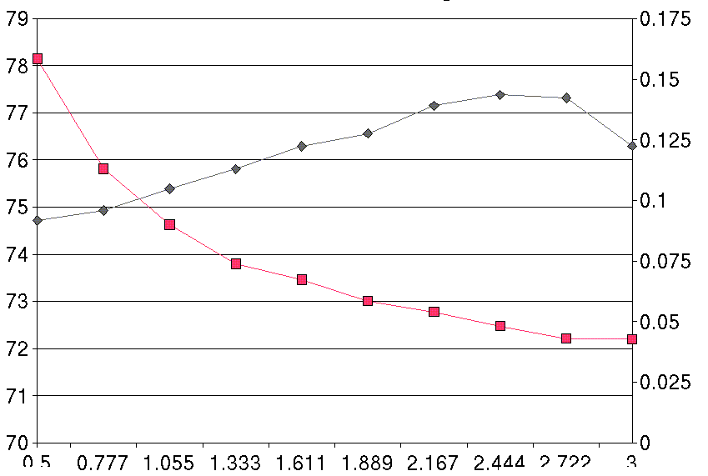
Vary the Heat Sink Thickness
Heat Sink length
76 mm
Heat Sink length
30 mm
Temp (°C)
Current (A)
Temp (°C)
Current (A)
Thickness (mm)
After several iterations driven by iSIGHT, we can examine
the tradeoff between EMI and device temperature.

Slide 27
Conclusions
MOTIVATION: Once a model is defined, it is practical to optimize via an automatically driven sequence of analysis-redesign iterations.
NEED: We need to optimize our IPEMs in order to reach our 10x improvement targets.
PROBLEM: Lack of implemented standards for data exchange between our software tools makes it impractical to set up such a model...
☺
✓


Slide 28
Current Activities
Examine how STEP AP210 can represent IPEM models
  What are the limitations?
  How can we work around them?
  What must be changed?
Establish a STEP AP210 mini-consortium within CPES to drive the deployment of AP210 among MCAD and ECAD vendors
  Test case: 1kW DC/DC power conversion module for server and low-end telecommunication systems.

Slide 29
Acknowledgements
CPES STEP AP210 Team:
Yingxiang Wu, MS ME / MS CPE
Jonah Z. Chen, Ph.D. EE
Li Ma, Ph.D. EE
Christelle Gence, visiting scholar
Prof. Jan Helge Bøhn, ME
Prof. Dushan Boroyevich, EE
Prof. Elaine Scott, ME

Slide 30

Acknowledgements
This work was supported primary by the ERC Program of the National Science Foundation under Award Number EEC-9731677

