Slide 1
High Energy and Nuclear Physics SciDAC Program
Vicky White, DOE/HENP
SciDAC PI Meeting, January 15, 2002

Slide 2
High Energy and Nuclear Physics SciDAC Program Objective
To make a step-function leap in our ability to use computation for scientific discovery in the exploration of the fundamental processes of nature.
  Theory
  Experiment
  Simulation and Computational Science
  3-pronged integrated approach to scientific discovery

Slide 3
High Energy and Nuclear Physics SciDAC Program
The HENP SciDAC program consists of 5 projects
  Science and Simulation of Particle Accelerators
    complex and expensive tools used throughout DOE for scientific discovery
  Supernova Science (2 projects)
    to discover the fundamental mechanisms of these complex natural systems
  Lattice Gauge Theory calculations
    to test and explore the Standard Model (QCD) and to interpret NP and HEP experiment results
  Particle Physics Data Grid (joint with ASCR)
    Collaborative tools for large geographical dispersed researchers needing access to data and computing resources

Slide 4
Challenges for HENP SciDAC
Extend our traditions of huge international collaborations for experimental science into Theory and Computational Science
  work in multi-disciplinary teams, build community codes to deal with the size and complexity of the problems
  apply innovative math and computing techniques and algorithms to problems
  work effectively together (Collaborative Tools/Grid)
Strive for science deliverables soon and harness all the human and computing resources to meet the science goals

Slide 5
Challenges for HENP SciDAC
Evolve the scientific codes to run on the multi-Teraflop computers of tomorrow
  Portable, scalable codes that can use today’s resources for scientific discovery and be prepared for the next generation of computing resources
  Well layered, structured and supported community-wide codes
  Instrumented codes to optimize performance and understand the type of computers that will meet the needs in the most cost effective manner

Slide 6
Presentations from 2 of the HENP SciDAC projects
Both have gone a long way in forming true multi-disciplinary collaborations with strong ties to applied mathematicians and computer scientists
Both have scientific goals with some short-term results expected, that they will tell you about
  Shedding New Light on Exploding Stars: Terascale Simulations of Neutrino-Driven Supernovae and their Nucleosynthesis (Mezzacappa – PI)
  Advanced Computing for 21st Century Accelerator Science and Technology (Ryne, Ko – PIs)

Slide 7
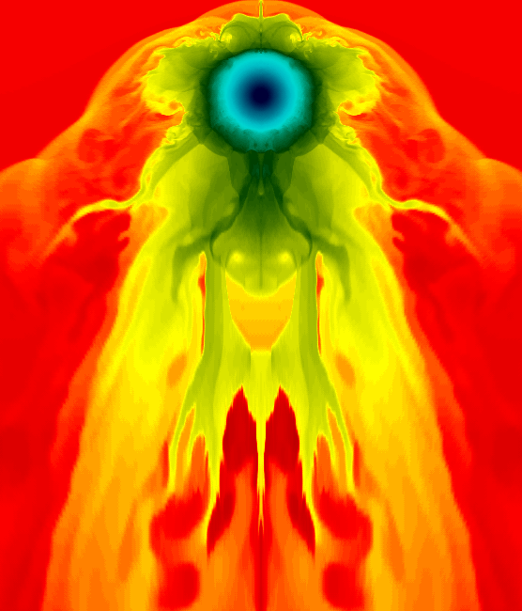
SciDAC center for Supernova Research (Woosley – PI)
Funding for 2 labs and 2 universities
Good start on multi-disciplinary team
  Many applied math and computing challenges
  Synergy with other projects?
Impact of a supernova on an adjacent star

Slide 8
National Computational Infrastructure for Lattice Gauge Theory (Sugar- PI)
Representing ~60 Theorists in the US. Funding to 3 labs and 6 universities
National effort to regain US competitiveness
  put in place the software and hardware needed for accurate lattice QCD calculations

Slide 9
National Computational Infrastructure for Lattice Gauge Theory (Sugar- PI)
Huge strides made in collaborative approach
  + starting to work with computer scientists on performance metrics and optimization of code
Accurate computations of important scientific constants requires tens of Tflop years
  Need highly cost-effective Topical Computing Centers for Lattice QCD – aiming at below $1/Mflop and targeting two different machine architectures – (1) Custom built for QCD and (2) Commodity PC Clusters with low latency networking

