Slide 1

CIRES-CDC Institutional Partnership
Western Water Assessment Review
Randall M. Dole, Director
Climate Diagnostics Center
September 2001

Slide 2
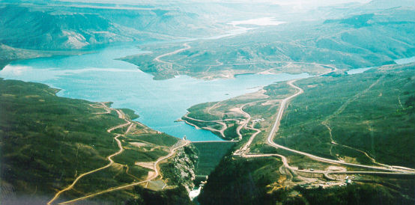
Outline
Context: what are key NOAA issues and drivers?
What is CDC’s role?
The CIRES-CDC partnership.
Future directions.
Blue Mesa
Reservoir,
Colorado
Notes:
Main point: CIRES-CDC (University-Federal) direct partnership is a unique aspect of this RISA. The close links between CDC and other parts of NOAA (NWS/CPC and NESDIS) help to greatly accelerate the transfer of knowledge into new operational products. The results of research can be very quickly tested at CDC, and help to suggest directions for new climate science research and applications.

Slide 3
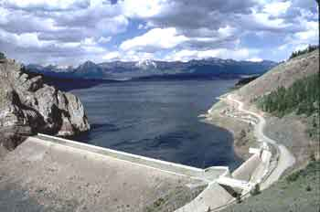
What are Key NOAA Issues and Drivers?
Emphasis on two principal issues:
  New NOAA Climate Services.
  Global Environmental change.
Taylor Park Reservoir, Colorado
Notes:
Climate services - focus now on relatively short-range (seasonal-interannual) forecast products; however, a key aspect of both issues is making climate information more useful and, in particular, bringing it down to the regional-to-local scales which are of primary interest to most decision-makers.

Slide 4
NOAA’s Mission
NOAA’s fundamental mission is to provide environmental assessments and predictions, and stewardship of marine resources.
NOAA has specific agency responsibility for the issuance of routine, operational weather and climate forecasts and warnings for the Nation.

Slide 5
1: New NOAA Climate Services
As a result of sustained basic research, there is now demonstrable skill in seasonal climate forecasts, particularly related to El Niño.
There has been growing public recognition of the impacts of climate variability, and the potential value and uses of climate information and forecasts.
Demand has increased enormously for more climate information and services.
NOAA commits to provide new climate services, but there are many unresolved questions, e.g. : What services? Organization? Delivery?
Multidisciplinary research, in many cases beyond NOAA core capabilities, is required to address such questions.
Notes:
Multidisciplinary research needed, because these are not just physical sciences problems, but also depend critically on the needs of the public and decisionmakers. This situation also differs from routine weather forecasting, which has had roughly 100 years to mature and where applications and needed products are generally well known.

Slide 6
2: Global Environmental Change
Public grows increasingly concerned on global change and its impacts; enormous science and policy challenges are raised.
IPCC 2001 report:
Broad science consensus: Greenhouse gases are accumulating; global temperatures are rising; due at least in part to human activity.
Projections indicate greenhouse gases will continue to increase, and global average temperatures are likely to continue to warm.
But: impacts will depend on many factors, including magnitudes, rates of change, regional manifestations, societal and ecosystem vulnerability and adaptability.
Can useful information on potential changes be provided on scales that meet decision-maker needs?

Slide 7
National Science Recommendations
NRC reports and others, e.g., “The Science of Regional and Global Change: Putting Knowledge to Work“ recommend:
Ensure an “intimate connection” between research, operational activities, and the support of decision-making.
Participate in and support interdisciplinary research relating physical, biological, and human systems.
Define and carry out programs of regional and sectoral multiple-stress research and demonstration projects.
Fundamental Point: Major societal issues - such as considered in WWA - are not just “climate” problems. They involve multiple stressors, including physical systems-society-ecosystem interactions. Hence, to address these problems multi-disciplinary partnerships are required, in most cases beyond the capabilities of any individual agency or organization.
Notes:
There is a compelling federal interest in such issues, and hence federal research lab. involvement is natural. Yet the diverse disciplinary expertise required to address such problems does not generally exist in a federal entity, and hence partnerships with universities become virtually essential.

Slide 8
NOAA: Bottom Line
NOAA has compelling reasons to support research on assessments and toward the development of new climate services. Both of these elements are contained in WWA research.
Diverse disciplinary expertise required to address such problems does not generally exist in a single federal agency, and hence partnerships (other agencies, universities, private sector) become virtually essential.
Notes:
The WWA is interested in both assessments and climate services.

Slide 9
What is CDC’s Role?
CDC is a hybrid research organization. It is:
a Research Laboratory in NOAA.
a University Center in CIRES.
an Applied Research Center (ARC) in the OGP-supported “Climate Dynamics and Experimental Prediction” Program. Links basic research to improvements in operational climate forecasts.
CDC has strong, direct connections with the NWS/Climate Prediction Center (CPC), and the International Research Institute for Climate Prediction IRI).
CDC’s core strength is in climate diagnostics , a discipline which provides fundamental links between research and applications.
Notes:
The links to operational forecast centers means that CDC can quickly transform research into new operational products.

Slide 10
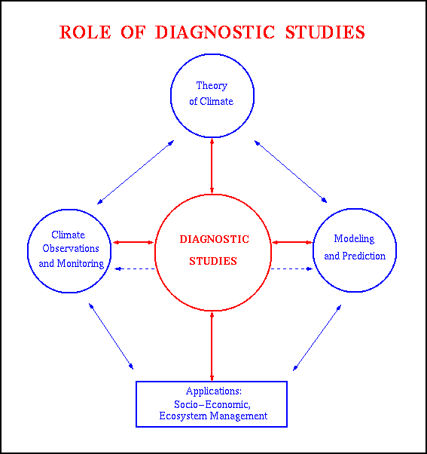
Role of Diagnostic Studies

Slide 11
The CIRES-CDC Partnership
  A very strong partnership, across multiple areas of climate science. WWA is just one area.
  Majority of CDC staff are CU/CIRES, not federal.
  CDC acts as a bridge to facilitate interactions and collaborations between Federal and University scientists on a variety of problems in climate science and related applications, and to transfer this knowledge into NOAA to improve NOAA models and services.

Slide 12
Partnership: Direct Benefits
  CDC as University Center within CIRES substantially enhances the potential for multi-disciplinary collaborations and research coordination with related academic programs.
  CDC as a federal lab ensures an ongoing NOAA mission orientation and provides strong, direct links to operational climate services.

Slide 13
The WWA Partnership
  Mutual leadership and management since its inception.
  Recognizes - and takes advantage of - diverse expertise between federal lab and University.
  As an indication of organization commitment, both CIRES and CDC have provided substantial resources beyond RISA funding to support WWA efforts.
  To be effective on such complex issues, it is essential that partnerships be sustained over the long haul.

Slide 14
WWA - a two-way learning process
  Sustained interactions have enabled users to learn what is, or may become, available in climate information and forecasts, and how to best interpret current NOAA products.
  Interactions have also helped scientists identify decision-maker needs, and possible entry points for the use of climate information, now and in the future. This has helped to focus priorities for future NOAA research, including observational and modeling needs.

Slide 15
Relationships between predictable and needed info.
Relationships among current products, potentially predictable and needed climate information
What is potentially predictable
Spectrum of User Needs
Current Forecast Products

Slide 16
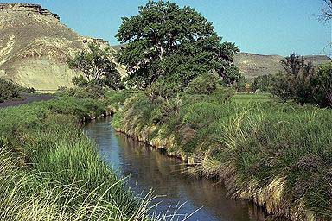
Future Directions
Irrigation ditch in western Colorado, with natural
arid landscape
in the background
CDC will continue its very strong partnership with CIRES,
in WWA and other research areas of climate research.
Critical need now is to address NOAA mega-issue: how to
organize regional climate services?

Slide 17
Challenge to RISA’s and NOAA
Need to plan for transition to operational products, communicate through information brokers (whether NOAA or another distributor of climate information). This step is essential, but not well established.
Transition to routine, operational distribution allows researchers to move on to new studies and partnerships.
Notes:
The transition from research into operations is a weak link right now.

Slide 18
One Approach: Create a Testbed for Regional Climate Services
Develop a regional climate services core activity for the western United States (WESTCOR), where most RISAs are located.
Establish formal partnerships and interactions between the western RISA’s - now at U.Washington, Scripps, U. Arizona and CU - and NOAA CDC and the Western Region Climate Center in Reno.
Goals:
Accelerate improvements in climate products available for local, state, and regional interests in the West, and identify emerging or future needs for climate information.
Provide a basis to facilitate interactions among RISA’s in this region, as well as to coordinate with NOAA research and operational arms.
Notes:
In a sense, what is being proposed here is a generalization of the interaction between CU and CDC through the WWA.

Slide 19
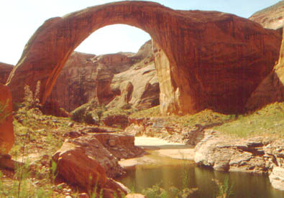
Summary
CIRES-CDC (University-Federal) direct
partnership is a unique aspect of this RISA.
The close links between CU, CDC and
other parts of NOAA (NWS/CPC and
NESDIS) help accelerate the transfer of
knowledge into new operational products.
WWA research also helps identify directions
for new climate science research and applications.
Need to plan for transition to regional climate services. Can this process be
accelerated through a regional testbed that links RISA’s and NOAA centers?
Rainbow Bridge

