Slide 1




Cancer Disparities Research Partnership (CDRP): Linking University & Community Radiation Oncology to Improve Cancer Outcomes
Patrick D. Maguire, M.D.
New Hanover Radiation Oncology
Wilmington, NC

Slide 2
CDRP: Partnerships in Radiation Oncology
The Problem
  Clinical Trial Enrollment
  University vs. Community
The CDRP Solution
  Long-lasting Relationships
  TELESYNERGY®

Slide 3
Clinical Trial Enrollment: Failing our patients, both current & future?
Pediatric vs. Adult
  ~50% vs. <5% (DHHS, 2003)
Majority vs. Underserved
  Low minority enrollment (0.05 x 0.1)
  Are trial endpoints representative?

Slide 4
University vs. Community Radiation Oncology:
Ivory Tower vs.
The Dark Side!

Slide 5
“Make Love, Not War”
UNIVERSITY:
Research, lab & clinic
Focused expertise
New technologies
Clinical trials
COMMUNITY:
Large n (patients)
Convenience
Cultural bonds
Clinical trials less common

Slide 6
Essentials of A Successful Relationship
Mutual contribution & care
Mutual benefit
Marriage: love & effort!

Slide 7
The CDRP Solution to The Clinical Trials Problem:
Marriages Between University &
Community Radiation Oncology Centers

Slide 8
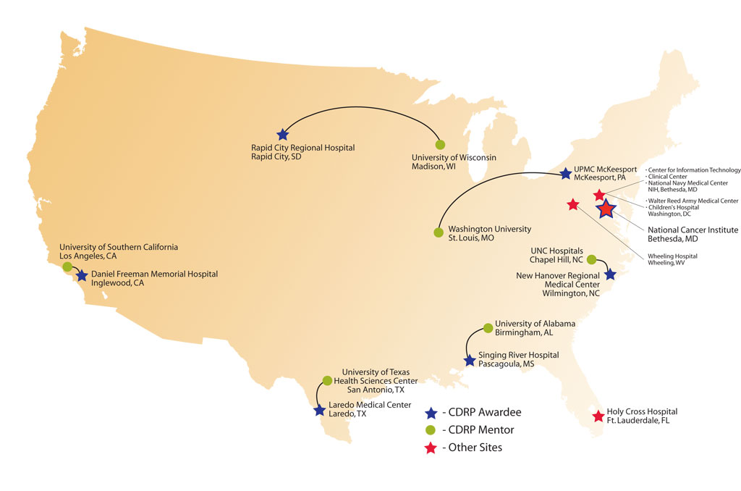
U.S. Map

Slide 9
CDRP in North Carolina
University of North Carolina
Chapel Hill
160 Miles
New Hanover Regional Medical Center
Wilmington

Slide 10

The UNC – NHRMC Bond
We started with:
Strong foundation
Patient referrals (two-way street)
Occasional visits
CDRP grant added:
TELESYNERGY®
New multi-disciplinary & enhanced rad onc relationships
Regular tumor boards
IMRT shared planning
Phase II H&N trial
Quarterly visits

Slide 11
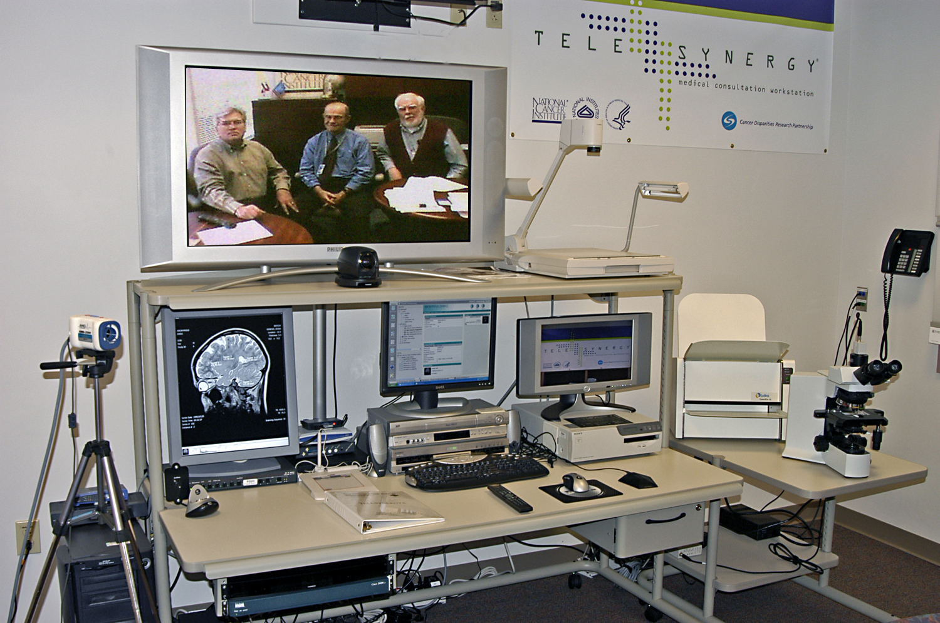

Slide 12
A Year of TELESYNERGY® in NC
August 2004 – August 2005
Multi-disciplinary tumor boards 79
Treatment planning 7
Other 9
Total 95

Slide 13
“Improving Cancer Outcomes for African Americans in Southeastern North Carolina”

Slide 14
Rad Onc Clinical Trial Enrollment at NHRMC (2004 – 2006)
Disease Site African American/Total
H&N 4 22
Lung 0 6
Breast 5 8
Prostate 2 2
Cervix 0 2
Anal 1 2
Total 12 42

Slide 15
Phase II Trial of Hyperfractionated IMRT with Concurrent Weekly Cisplatin for Stage III & IVa Head & Neck Cancer
Designed & opened in community with IMRT planning advice from university
Later opened at university
A model of cooperation & teamwork!

Slide 16
CDRP Summary
Enrollment in adult clinical oncology trials is poor, especially for underserved
Relationships b/w university & community cancer centers can be enhanced
These bonds may improve patient care, including clinical trial enrollment

