Slide 1
Weed Risk Assessment-
A Tool for Selecting Non-Invasive Species for Forestry, Gardening and Landscaping in Hawaii
Curt Daehler, UH Department of Botany
Duane Nelson, Forest Health Coordinator
Julie Denslow, Ecologist and Team Leader
USDA- Forest Service, Institute of Pacific Island Forestry
Notes:
Invasive alien plants pose one of the major threats to biodiversity on Pacific Islands. Unfortunately some of these species were established as intentional introductions for reforestation, windbreaks, landscaping or watershed protection. Some unfortunate introductions include melochia, silk oak, Faya tree, black wattle, blackwood acacia, Mexican weeping pine, ironwood and Miconia. Though these species may have provided some benefits, they have unarguably become weeds that impose huge costs to landowners, and society.
The intent is not to denigrate decisions made by our forbearers, but to help avoid bad decisions now and in the future.
Exotic tree species have become the foundation for forestry on Pacific islands. Despite growing interest in native species, ease of establishment, rapid growth, high stumpage value, disease resistance, novelty and suitability for plantation forestry continue to entice foresters to plant exotic species for many purposes.

Slide 2
Needs: Decision tools for making responsible planting choices
Goal:
Develop and test a weed risk assessment (WRA) system that identifies plants likely to become invasive pests
in Hawai‘i.
Characteristics of an ideal WRA system
objective
transparent
science-based
repeatable
reliable

Slide 3
Uses of the WRA system in Hawai‘i
Species not yet in Hawai‘i
assist with import decisions
Species already in Hawai‘i
allow informed planting decisions
nursery growers, architects, landscapers
foresters, land managers, ranchers
public
assist in prioritizing proactive control efforts

Slide 4
Developing the WRA system for Hawai‘i
Several systems were examined for use in Hawai‘i
The Australian AQIS system was most promising after simple modifications¹
History of the Australian WRA system
1994 Developed and tested in Australia
1995 Modified and tested in New Zealand
(currently used in both countries)
1998 Modified and tested for use in Hawai‘i
2001-2002 Further testing for use in Hawai‘i and other Pacific Islands
¹Daehler and Carino 2000

Slide 5
Australia/New Zealand
Weed Risk Assessment System
49 questions
climate/distribution
domestication
weed elsewhere
undesirable traits
plant type
reproduction
dispersal
persistence attributes
Prediction
< 1 not a pest
1-6 evaluate
> 6 pest
Score

Slide 6
Australia/New Zealand
Weed Risk Assessment System
Designed to identify all types of pest plants
-- invaders of natural areas
-- weeds of agriculture and forestry
-- nuisance species
Don’t need to answer all 49 questions
Assessment can be done quickly (within a day)

Slide 7
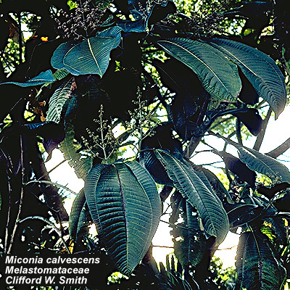
Example: WRA for Miconia calvescens
Score: 14
Decision: PEST
Risk factors
Environmental weed of Tahiti
Broad range (0-6000 ft elevation)
Shade-tolerance
Re-growth after mutilation

Slide 8
Example: WRA for Miconia calvescens
Score: 14
Decision: PEST
Risk factors
Self-compatible
> 1000 seeds per m²
Bird-dispersed
Easy accidental dispersal by humans

Slide 9
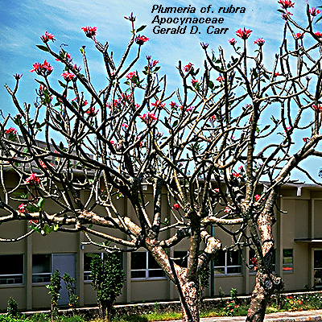
Example WRA for Plumeria rubra (frangipani)
WRA Score: -5
Decision: NOT A PEST
Risk factors
toxic/allergenic sap
tolerates a wide range of soil conditions
Risk reducing factors
not a recognized pest elsewhere

Slide 10
Example WRA for Plumeria rubra (frangipani)
WRA Score: -5
Decision: NOT A PEST
Risk-reducing factors
not a recognized pest elsewhere
poor shade tolerance
does not form dense thickets
specialist pollinator
lacking natural vegetative spread

Slide 11
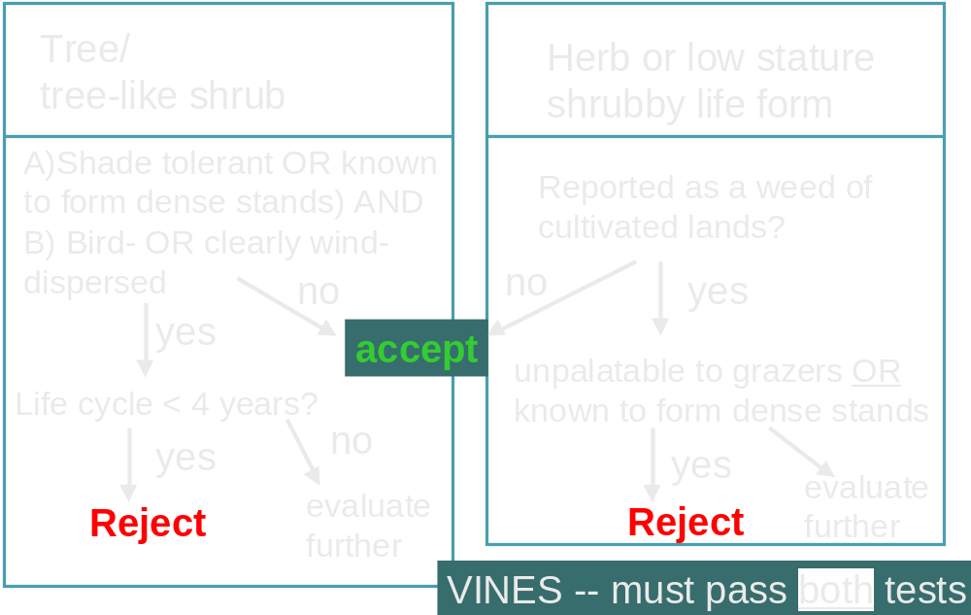
Further assessment of the EVALUATE category
(species scoring between 1 and 6)
About 25% of species scored between 1 and 6
Based on scientific literature, we applied simple decision rules

Slide 12
Evaluating the WRA system decisions in Hawai‘i
December 2001 - June 2002
∼ 200 plants were evaluated using the WRA system
most species were found on planting lists in Hawai‘i
each WRA question was answered in a consistent manner
information from around the world, including Hawai‘I
  scientific literature, horticultural literature, Internet databases
sources for all information were documented
Species were classified as:
Not a pest (WRA score <1)
Pest (WRA score >6)
Evaluate (WRA score 1-6)
Not a pest
second
screen
Pest

Slide 13
Evaluating the WRA system decisions in Hawai‘i
Compared WRA decisions with 18 expert opinions
The expert evaluators:
botanists/weed scientists
first hand, detailed knowledge of weeds in Hawai‘i
native ecosystems
managed ecosystems

Slide 14
Questions to Evaluators
1. Is it present in the region?
2. Is it naturalized in disturbed habitats?
For native/managed ecosystems:
3. Is it currently naturalized?
4. What is its current status ?
not a pest
minor pest
major pest
5. What is the estimated future status?
not likely to become a pest
minor pest
major pest

Slide 15
Evaluating the WRA system decisions in Hawai‘i
All species were classified based on the expert surveys
individual opinions varied (differences in personal experience)
Classification criteria
Major pest -- at least 3 experts agreed
Minor pest -- at least 3 experts agreed
Not a pest -- all other species

Slide 16
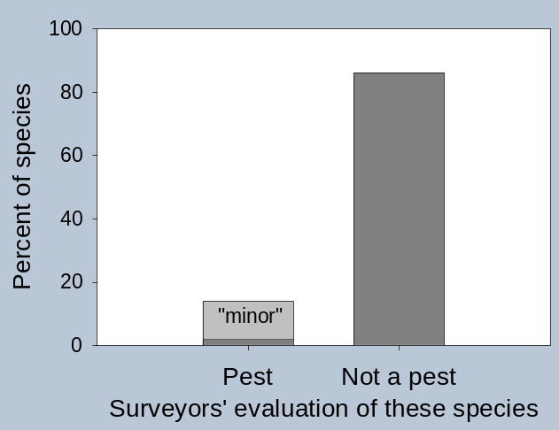
Results: species with an NON-PEST WRA rating
(108 of 178 species assessed)
NON-PEST rating
86% Agreement between WRA and experts
‘major’

Slide 17
Examples
Non-pests according to WRA (experts agreed)
Score
Bougainvillea glabra paperflower -1
Breynia disticha snow bush -5
Cassia xnealiae rainbow shower -8
Citrus limon lemon -3
Cordia sebestena geiger tree -1
Erythrina variegata coral tree -2
Fagraea berteroana pua keni keni -1
Galphimia gracilis slender goldshower -2
Graptophyllum pictum caricature-plant -5
Guaiacum officinale lignum vitae -6
Heliconia caribaea lobster claw -1
Lagerstroemia speciosa queen's crape myrtle-4
Petrea volubilis sandpaper vine -1

Slide 18
Examples - - “mistakes”
Non-pests according to WRA BUT:
Experts rated as MAJOR pests (only 2 “mistakes”)
Score
Fraxinus uhdei tropical ash 0
Tournefortia argentea tree heliotrope -1
Non-pests according to WRA BUT:
Experts rated as MINOR pests (13 “mistakes” total)
Cryptomeria japonica Japanese cedar -3
Filicium decipiens fern tree -3
Senna surattensis kolomona 0
Zingiber zerumbet shampoo ginger -1
Zoysia tenifolia templegrass -2

Slide 19

Results: species with a PEST rating
(56 of 178 species assessed)
PEST rating
80% Agreement between WRA and experts
11 reject “mistakes”
(among 178 total evaluations)

Slide 20
Examples
High WRA score and major pests according to experts
Score
Ardisia elliptica shoebutton ardisia 11
Brachiaria mutica para grass 12
Citharexylum spinosum fiddlewood 7
Coccinia grandis ivy gourd 21
Psidium cattleianum strawberry guava 18
Pyracantha angustifolia narrowleaf firethorn 13
“Mistakes”
High WRA score but not pests according to experts
Acacia auriculaformis Darwin black wattle 13
Bischofia javanica bishopwood 7
Elaeagnus umbellata autumn olive 13
Pittosporum undulatum Aust. cheesewood 9
Tamarix aphylla Athel tamarisk 13

Slide 21
Results summary
The WRA ratings were 80-86% consistent with assessments made by a large group of plant experts
The WRA ratings screened out 95% of the major pests
The WRA accepted 84% of non-pests
If the WRA system were used for import and planting decisions, Hawai‘i’s invasive plant problems could be greatly reduced

Slide 22
Things to remember
WRA’s can be easily revised if new information becomes available
Any risk assessment system can make occasional mistakes (the same is true of “experts”)
But, compared to individual expert opinions, WRA ratings are less variable and less subjective¹
¹also demonstrated in Australia and New Zealand

Slide 23
Things to remember
If used for planting decisions, WRA ratings can greatly reduce invasive plant problems
WRA ratings currently have no legal standing; industry has an opportunity to take the lead

Slide 24
Future directions:
Screen more species
proposed imports
requests from industry, public?
commonly used planting lists
develop a long list of low risk/ non-invasive plants
expert review of WRA’s to minimize errors?

Slide 25
Future directions:
Outreach
increase awareness of invasive plant problems
publicize assessment results
identify and promote lower risk alternatives to “rejected” species
“Green certification”?

