Slide 1
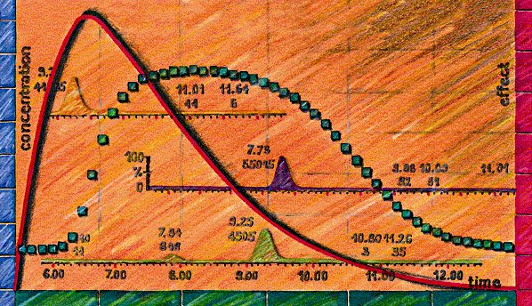
BI Experience/Opinion: Transporter Based Drug Interactions
Clinical Pharmacology Subcommittee of Advisory Committee Meeting for Pharmaceutical Science (ACPS)
October 18, 2006
Mitchell E. Taub,
Boehringer Ingelheim, DMPK

Slide 2
Outline
Drug Transporters: Background
Drug-Transporter Interactions
P-gp and CYP3A4
In Vitro Techniques and Data
Reports: Clinical Transporter-Based DDIs

Slide 3


Drug Transporters: Overview
Intestinal efflux:
P-gp, MRP2, BCRP
Intestinal uptake:
ASBT, OCT1, OATP-B,
OATP-A
Biliary excretion:
P-gp, BCRP, MRP2, BSEP, MDR3
Hepatic uptake:
OATP-A, -B, -C, -8, NTCP, OAT1, OCT1
PO dosing
Intestine
Fecal excretion
IV administration
Vascular space
Liver
Renal secretion:
OAT1-3, OCT2, MRP2, MRP4, P-gp
Brain
Kidney
Urinary excretion
Brain transport:
P-gp, BCRP, MRP2 OAT3 (OATP-A, MCT)
Interstitial space
Renal reuptake:
OATP-A, PepT2
Transporters contribute to the absorption, distribution and elimination of
drugs, metabolites, various endogenous molecules, vitamins, and nutrients
Tissue entry of drugs can be either facilitated or hindered by transporters

Slide 4
The Importance of Transporters
  In addition to AD/E; transporters can also facilitate the access of certain drugs to metabolizing enzymes (e.g. liver)
  Understanding PK, PD of certain drugs requires knowledge of drug transporter interactions
  As with CYP450s, interactions with transporters differ between species (consideration: prediction of clinical outcome)
  DDI: variable exposure, potential toxicity, and therapeutic failures can originate from drug transporter interactions
  What do we need to predict whether (and to what extent) the biological fate of a drug is influenced by drug transporters?
  Challenge: It is likely that a compound will interact with multiple transporters; likelihood increases for newer drugs structurally related to those already known to interact with transporters

Slide 5
The Most Relevant Transporters for Consideration in R&D Programs
How many transporters exist?
  Identified to date: 48 ABC genes, 300 solute carriers
Which transporters should be evaluated?
  General consensus: similar to CYP450s, not all transporters are relevant
Drug Transporters (alternative names) CYP450 Enzymes
P-gp (MDR1, ABCB1) CYP3A4 /3A5
OATP-C (LST-1, OATP-2, SLC21A6, OATP1B1) CYP2C9
BCRP (MXR, ABCG2) CYP2D6
MRP2 (cMOAT, ABCC2) CYP1A2
OATP-B (SLC21A9, OATP2B1) CYP2C19
OATP-8 (SLC21A8, OATP1B3) [CYP2C8, CYP2B6]

Slide 6
P-gp and CYP3A4: Similarities
Expressed in intestinal epithelium;
frontline defense against xenobiotics
Highly variable expression
Broad substrate selectivity
“promiscuous” enzyme/transporter
Atypical (sigmoidal) kinetics
ex: cooperativity/activation
Effects and consequences on pharmacokinetics by CYP3A4 or P-gp can only be fully understood with the help of investigations covering the enzyme and the transporter
Inducible via PXR
Cooperative action
for drug elimination
Mutations detected; impact
on PK notable, but minor
Overlapping substrates

Slide 7
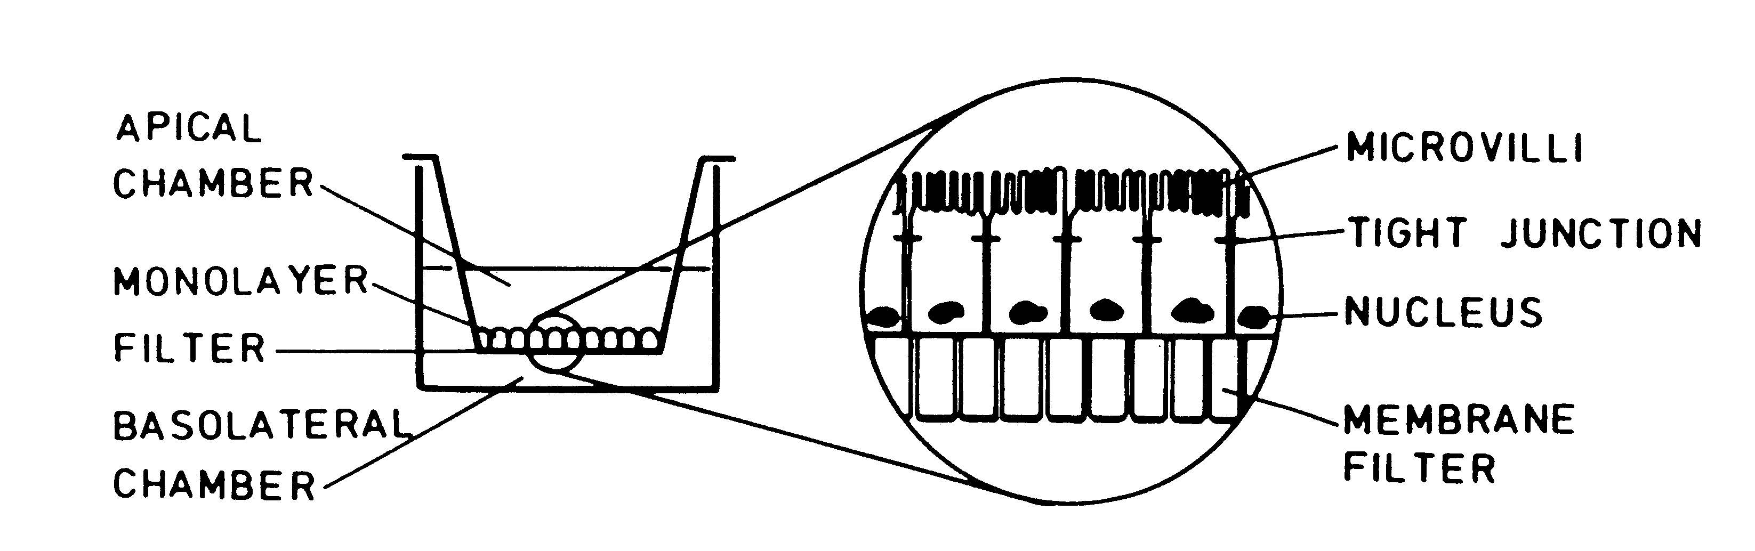
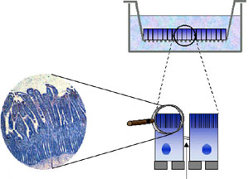
Permeability Experiments: Transwells with Monolayers of MDCK-MDR1, Caco-2, L-MDR1
BL to AP P_{app}
Secretory Transport
BL-AP / AP-BL ~1
Not an Efflux Pump Substrate
BL-AP / AP-BL > 1-2
Efflux Pump Substrate
AP to BL P_{app}
Absorptive Transport

Slide 8
P-gp Considerations/Complexities:
Selecting Probe Substrates and Inhibitors
Multiple binding sites (4+) on P-gp: selective probes for each P-gp binding site not yet identified
Taub et al., DMD (November, 2005) Vol. 33, No. 11
  In MDCK-MDR1 cells, ketoconazole activates P-gp at low concentrations and inhibits P-gp at high concentrations
  Would a compound with similar properties as KETO have a differential effect on P-gp in the intestine (high conc.) compared to the effect on P-gp at the BBB (lower conc.)?
  Substrate cooperativity and allosteric binding can complicate determination of secretory transport of P-gp substrates in P-gp expressing cell lines such as MDCK-MDR1 and Caco-2
Inhibition of P-gp can potentially alter the PK and possibly the PD profile of a drug – what about activation?
Possibly due to expression of other transporters, need to be cautious comparing data between cell lines that express P-gp

Slide 9
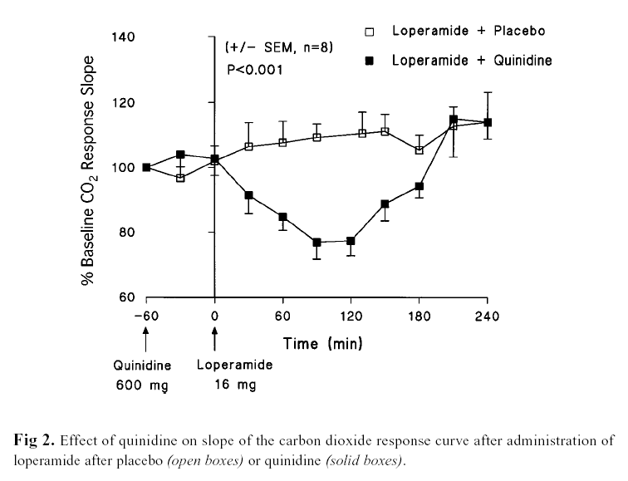
Clinical Study: P-gp Mediated DDI Involving
Loperamide and Quinidine
LOP: potent opiate/anti-diarrheal; no CNS effects at normal doses
When LOP (16 mg) given with QND (600 mg) AUC increased ~2.5 fold
Respiratory depression produced by LOP only when co-administered with QND
Authors conclude: QND inhibited the P-gp mediated efflux of LOP at the BBB
Example of transporter mediated DDI with potential for toxic effect in humans
Sadeque, Wandel, He, Shah, and Wood, CPT (2000) 68:231-237

Slide 10
Expression of OATPs in HeLa Cells Using Vaccinia-Based Transfection System
Utilizes the highly efficient bacteriophage T7 RNA polymerase
“Modular” system for evaluating uptake transporters; only one cell line to passage
No need to establish range of stably transfected cells for each transporter
Lipofectin
(positively charged)
Plasmid containing OATP-X cDNA and viral promoter successfully carried into the cell by lipofectin
Expression of OATP-X within 16-20 hrs post-infection by vaccinia virus
Plasmid with OATP-X cDNA
(negatively charged)
pTM1
T7
OATP-X
-
OATP-X expressing
HeLa cell
T7 Polymerase
HeLa Cell Membrane (net negative charge)

Slide 11
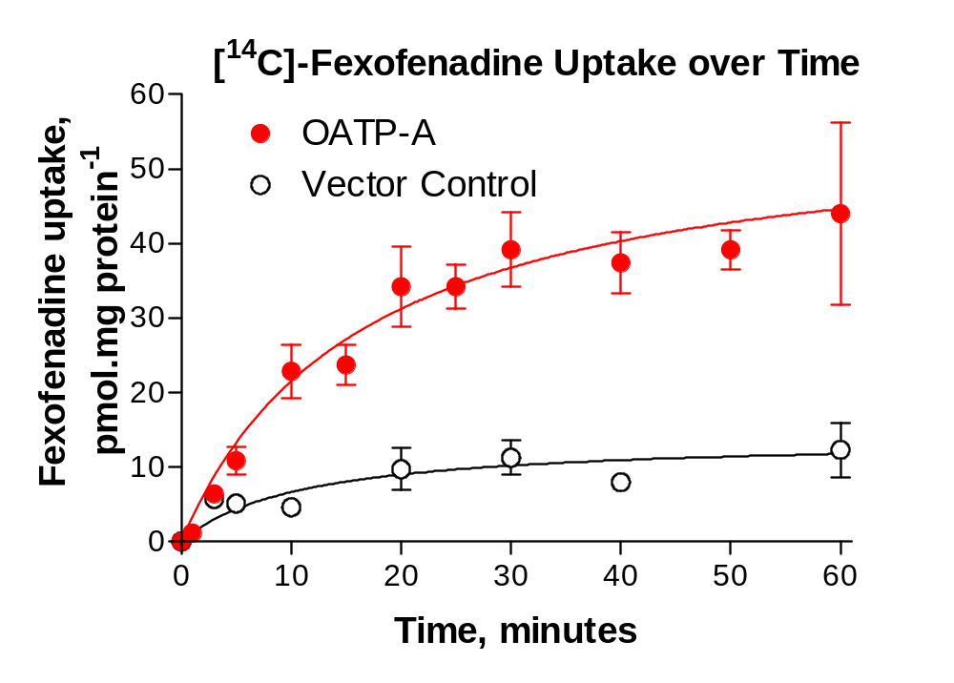
Expression of OATP-A in HeLa Cells Using Vaccinia-Based Transfection System
Figure courtesy of Richard B. Kim

Slide 12
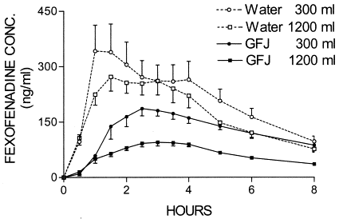
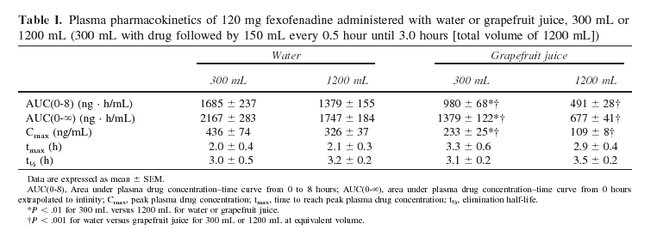
OATP-A Mediated DDI:
Fexofenadine and Grapefruit Juice
Dresser, Kim, and Bailey
CPT (2005) 77:170-177
Fig 1. Mean plasma drug concentration–time curves of 120 mg fexofenadine for individuals (N = 12) administered water or grapefruit juice (GFJ), 300 mL or 1200 mL (300 mL with drug followed by 150 mL every 0.5 hour until 3.0 hours). Bars represent SEM.

Slide 13
ABC Transporters in Hepatocytes
Basolateral
membrane
MRP1
MRP5
MRP6
MRP3
PC
(flippase)
TJ
Hydrophobic
waste-products,
drugs
MDR3
GS-conjugates,
GSH, GSSG etc.
?
MDR1
BCRP
various
drugs
Bile
canaliculus
Nucleus
Nucleus
BSEP
MRP2
Taurocholate,
bile acids
Canalicular
membrane
Glucuronate-, sulfate-,
GS-conjugates, anionic drugs etc.
High expression level: | MRP2, MDR1, MDR3
Lower expression level: | MRP1, MRP3 (inducible)
Illustration courtesy of SOLVO Biotechnologies
Notes:
-Most important ones: Mrp2/cMOAT and BSEP
-MRP3 has similar substrate specificity as MRP2, MRP3 exp goes up is MRP2 function is compromised - importance in removing toxic substrates, metabolites from hepatocyte,
Millenium Boehringer: BSEP is important, liver package:
Human: MRP2, MRP3 and BSEP
Rat: ratMrp2, ratBsep

Slide 14
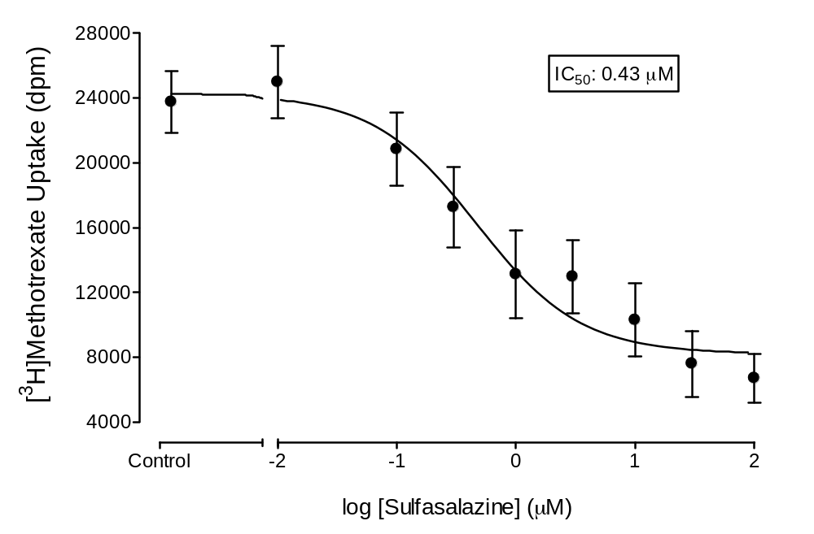
BCRP-Expressing Sf9 Vesicles: Inhibition of [³H]Methotrexate Uptake in by Sulfasalazine

Slide 15
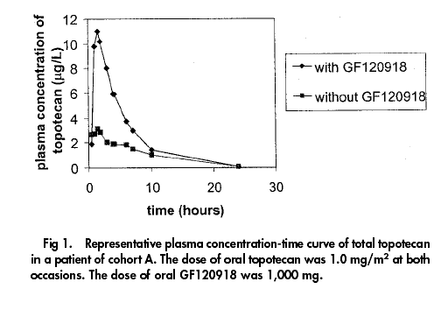
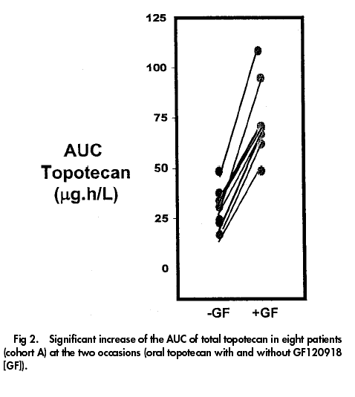
BCRP Mediated DDI:
Topotecan and GF120918
When co-administered with 1000 mg GF120918, the AUC of oral topotecan increased >2-fold
F_{po} of topotecan increased from 40% to >97% when co-administered with GF120918
GF120918 had a slight effect on IV administered topotecan AUC and CL, but no effect on t_{1/2}
Kruijzer et al., J. Clinical Oncology
(2002) 20:2943-2950

Slide 16
Clinical Relevance of Transporter Mediated Effects: P-gp, Other Transporters
Survey of University of Washington DDI database:
# of studies
# showing no
# with effect eliciting
Transporter
reported
no effect
> 20% change of PK
P-gp
181
47
134
OATP
17
4
13
MRP2
8
3
5
OAT
6
2
4
OAT1
2
1
1
OATP2
2
0
2
OCT
2
0
2
BCRP
1
0
1
Results of a recent literature survey, including the UW DDI Database:
P-gp inhibition: ~120 studies published; max. effect ~18-fold increase of AUC
P-gp induction: ~40 studies published; max. effect ~ 80% reduction of AUC
Some results due to combined effects of P-gp and CYP3A4 induction or inhibition
P-gp effects often exceed the 2-fold increase/decrease of exposure that may be considered as acceptable PK variability
What is the current regulatory perspective on the design and implementation of clinical studies to investigate potential transporter-based DDI?

Slide 17
Concluding Remarks
CYP3A4 and P-gp demonstrate many similarities and are both integrally important to consider in most R&D programs
  Examples: CNS, cancer, liver-targeted indications
To what extent/frequency do clinical DDIs or toxic effects involving transporters occur? Careful consideration in R&D programs is necessary
The selection of appropriate transporter probe substrates and inhibitors is a critical issue; this area is still not well-defined for many transporters
In vitro methods for ascertaining drug-transporter interactions vary considerably from one laboratory to another….. → standardization?
Legal barriers exist (patents) restricting FTO for the mechanistic evaluation of certain transporters

Slide 18
Are the criteria for determining whether an investigational drug is an inhibitor of P-gp and whether an in vivo drug interaction study is needed (Fig. 1) appropriate?
How relevant is the [I]/Ki relationship, originally established for CYP450 inhibition, to transporter interactions?
  This area is not as well defined for transporters (even P-gp) as it is for the CYP450s.
  Should [I] be the plasma C_{max} or an estimated GI concentration of drug?
  [I] for CYPs → microsomes, [I] for P-gp → cells……comparable?
In a previous version of this document, there was a cutoff IC₅₀ value of <10 µM for classification of a compound as an inhibitor of P-gp. While it could be argued that this is an arbitrary value, is an [I]/IC₅₀ (or Ki) > 0.1 any less arbitrary? (consider statement above)
Some of the most potent inhibitors of P-gp are compounds that are not commercially available and may not be suitable for evaluation in humans.
  Examples: LY335979, Valspodar (PSC833), Elacridar (GF 120918)
Concerning ritonavir and cyclosporine and proposed inhibitors, these compounds have been shown to inhibit many transporters. At this point it is not clear how this lack of specificity would affect results of a clinical DDI study.

Slide 19
Are the criteria for determining whether an investigational drug is a substrate of P-gp and whether an in vivo drug interaction study is needed (Fig. 2) appropriate?
A reasonable concern may be that flux ratios ≥ 2 could represent a value that is too liberal and will lead to too may positive results.
  Need to present a consensus opinion representing PhRMA members
  Would it be expected that any Development compound with a flux ratio ≥ 2 be evaluated clinically with P-gp inhibitors to determine potential DDI?
  Consideration of the transcellular passive permeability of a compound in relation to the efflux ratio may be the most important issue.
General concern: Many open questions still exist regarding the complexity of the transporter field and how to appropriately link in vitro data to the potential for clinical outcome.
  Even for the CYP450 area, for which the IVIVC for DDIs is better characterized, we are not always able to correctly predict DDI.
  Current knowledge base does not yet support the recommendation of drug interaction studies involving other transporters such as OATP1B1, MRP2, BCRP, OCTs, and OATs.

Slide 20
Acknowledgements
Laboratory Work – Transporter Group:
  Lalitha Podila
  Diane Ely
  Rucha Sane
  Susan Lazos
  Iliana Almeida
Helpful Advice and Consultation:
  Donald Tweedie
  Richard Kim
  Naoki Ishiguro

