Slide 1
Modeling Your Application, Data or Service
Creating Your UML Model for caBIG®

Slide 2
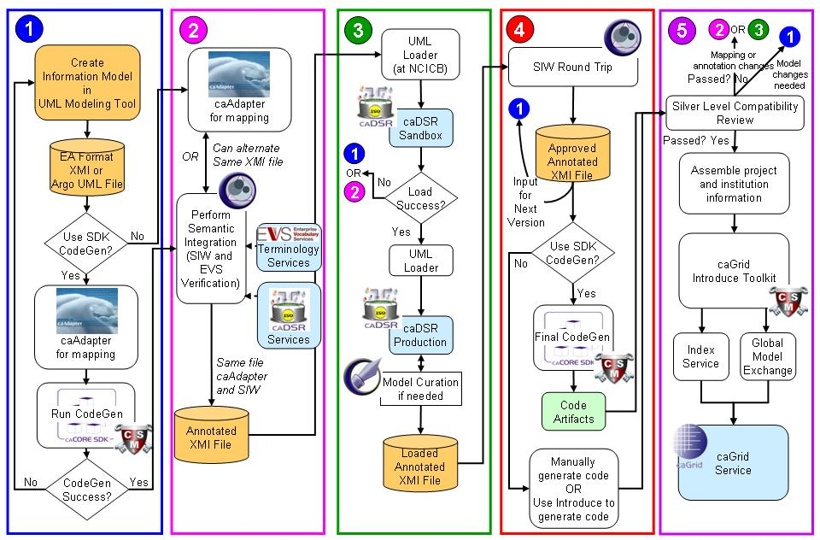
Modeling Your Application, Data or Service
Create UML Model
Metadata Reuse
Semantic Annotation
Transform UML Model into Metadata
SDK Code Generation
Compatibility Review
Create a Node on the Grid

Slide 3
Sessions 0-4: Creating Your UML Model
Session Overview
Outline
  caCORE SDK Process and Workflow
  UML Model Basics (Optional Review)
  caDSR Introduction
  Model Naming Conventions
  UML Modeling for SDK, example gridPIR data service
  Adding Classes and Attributes in EA
  Exercise
Objectives
  Discuss the SDK Process and caBIG workflow
  Identify the packages to create different portions of your model
  Discuss the naming conventions appropriate for a UML Model that will be run through the caCORE SDK process
  Add a new Class to your UML Model
  Add Attributes to your UML Model
Notes:
The first step in Semantic Integration is to draw your system/project domain in UML. *
There are three parts to the system model: the logical model, data model, and data mapping model. The logical model describes the target domain and should be created in the logical package.* The Data Model describes the database schema* and the Object relational mapping maps classes to object. All of these are drawn in UML. Throughout this presentation, the terms “logical model”, “domain model” and “object model” are used interchangeably.*
caCORE SDK tools impose modeling guidelines* such as
Java naming conventions*
Package rules*
Element constraints*
For Example, *
*Only UML class diagram elements may be used
*Cannot use interface, object, etc.
Detailed instructions on creating diagrams in UML can be found in the SDK Programmer’s Guide.

Slide 4
Session 0: UML Basics
Why Model?
Modeling achieves four aims:
  Helps you visualize a system
  Permits you to specify the structure or behavior of a system
  Guides you in constructing a system
  Documents the decisions you have made
Build models of complex systems because they are difficult to comprehend in their entirety
Build models to better understand the system you are developing.
The caBIG™ process and architecture is model driven, it is required for interoperability and silver level compliance.
Notes:
Why model?
Short answer is it is absolutely required and the first step in the caCORE process is to draw your system/project domain in UML. * The model, when semantically annotated and combined with service metadata becomes the foundation that allows the grid and grid services to programmatically discover and combine relevant information from different data services. This has to be done early and well and updated as you update your data service
Remember the model is not just for your application but for interoperability with others.
In addition is helps by
Helps you visualize a system
Permits you to specify the structure or behavior of a system
Guides you in constructing a system
Documents the decisions you have made
Additional reasons are:
Build models of complex systems because they are difficult to comprehend in their entirety
Build models to better understand the system you are developing.
The caBIG process and architecture is model driven, it is required for interoperability and silver level compliance
There are three parts to the system model: the logical model, data model, and data mapping model. The logical model describes the target domain and should be created in the logical package.* The Data Model describes the database schema* and the Object relational mapping maps classes to object. All of these are drawn in UML. Throughout this presentation, the terms “logical model”, “domain model” and “object model” are used interchangeably.*
caCORE SDK tools impose modeling guidelines* such as
Java naming conventions*
Package rules*
Element constraints*
For Example, *
*Only UML class diagram elements may be used
*Cannot use interface, object, etc.
Detailed instructions on creating diagrams in UML can be found in the SDK Programmer’s Guide.

Slide 5

Session 0: UML Basics
What is UML?
UML is a language for
  Visualizing
  Specifying
  Constructing
  Documenting
  The artifacts of a software system.
UML allows you to build models that are precise, unambiguous and complete
There are many UML diagram types
  caCORE SDK utilizes one type, the UML Class Diagram
Notes:
Visualizing: Communicating conceptual models to others is prone to error unless everyone involved speaks the same language. There are things about a software system you can’t understand unless you build models. An explicit model facilitates communication.
Specifying: UML allows you to build models that are precise, unambiguous and complete. There are many UML diagram types. caCORE utilizes one diagram type: UML Class Diagram
Constructing: UML models can be directly connected to a variety of programming languages. Maps to Java, C++, Visual Basic, etc. Tables in a RDBMS or persistent store in an OODBMS Permits forward engineering Permits reverse engineering
Documenting: The UML addresses documentation of system architecture, requirements, tests, project planning, and release management.
There are many UML diagram types, however caCORE utilizes one diagram type – the UML Class Diagram
Throughout this presentation we only talk about the logical model the most critical one to get right for caBIG , the terms “logical model”, “domain model” and “object model” are used interchangeably.*

Slide 6
Session 0: UML Basics
UML Documenting
UML can be used to document of system architecture, requirements, tests, project planning, and release management.
CaBIG requires only class diagrams for a logical model.
Use Case Diagram
Deployment Diagram
- À©µµ¿ì 95 : Å¬¶óÀÌ¾ðÆ®
ºÐ»ê È¯°æÀÇ ÇÏµå¿þ¾î¹× ³×Æ®¿÷À¸·ÎÀÇ Á¤º¸ ½Ã½ºÅÛ ¿¬°á ¸ðµ¨
- À©µµ¿ì NT: ÀÀ¿ë¼­¹ö
- À¯´Ð½º ¸Ó½Å: ÀÀ¿ë ¼­¹ö ¹× µ¥ÀÌÅ¸ ¼­¹ö, Åë½Å ¼­¹ö
- IBM ¸ÞÀÎÇÁ·¹ÀÓ: µ¥ÀÌÅ¸ ¼­¹ö, Åë½Å ¼­¹ö
Use Case 1
Window95
Windows95
Windows95
¹®¼­°ü¸®
Å¬¶óÀÌ¾ðÆ®.EXE
Windows
¹®¼­°ü¸® ¾ÖÇÃ¸´
Actor A
Use Case 2
Actor B
NT
Solaris
¹®¼­°ü¸® ¿£Áø.EXE
Alpha
Windows
ÀÀ¿ë¼­¹ö.EXE
UNIX
Use Case 3
NT
IBM
Mainframe
µ¥ÀÌÅ¸º£ÀÌ½º¼­¹ö
mainWnd
fileMgr :
document :
gFile
repository
FileMgr
DocumentList
Document
user
FileMgr
Document
add( )
name : int
fetchDoc( )
delete( )
docid : int
Æ¯Á¤¹®¼­¿¡ ´ëÇÑ º¸±â¸¦
1: Doc view request ( )
sortByName( )
get( )
numField : int
read() fill the
»ç¿ëÀÚ°¡ ¿äÃ»ÇÑ´Ù.
open( )
code..
2: fetchDoc( )
close( )
FileList
fList
read( )
sortFileList( )
3: create ( )
add( )
create( )
fillDocument( )
delete( )
1
4: create ( )
5: readDoc ( )
1
È­ÀÏ°ü¸®ÀÚ´Â ÀÐ¾î¿Â
6: fillDocument ( )
¹®¼­ÀÇ Á¤º¸¸¦ ÇØ´ç ¹®¼­
°´Ã¼¿¡ ¼³Á¤À» ¿äÃ»ÇÑ´Ù.
7: readFile ( )
Repository
rep
File
8: fillFile ( )
(from Persistence)
read( )
GrpFile
È­¸é °´Ã¼´Â ÀÐ¾îµéÀÎ
9: sortByName ( )
name : char * = 0
°´Ã¼µé¿¡ ´ëÇØ ÀÌ¸§º°·Î
º¸¿©ÁØ´Ù.
Á¤·ÄÀ» ½ÃÄÑ È­¸é¿¡
readDoc( )
read( )
readFile( )
open( )
create( )
fillFile( )
Sequence Diagram
Class Diagram
Notes:
UML addresses documentation of system architecture, requirements, tests, project planning, and release management.
Example UML diagrams include:
Use Case Diagrams
Deployment Diagrams
Sequence Diagrams
Class Diagrams
As stated before, caCORE utilizes only the class diagrams which will be the focus of our training today.

Slide 7
Session 0: UML Basics
How are caBIG™ models different?
caBIG™ services are expected to have a domain information model:
  A Domain Information Model is a representation of our understanding of an area of knowledge
  A Domain Information Model consists of ‘Classes’ that represent ‘things’ in the real world
  In a Domain Information Model, classes contain ‘attributes’ that are characteristics of different instances of things in the real world

Slide 8
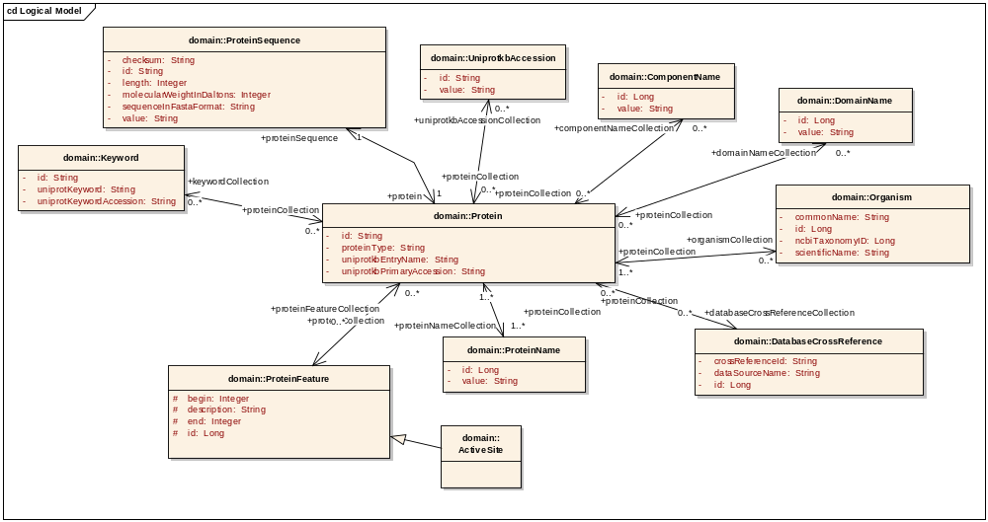
Session 0: UML Basics
Components of a Class Diagram
ClassName
attributeName
Datatype
associationName
Multiplicity
Bi-directional Association
Generalization
Notes:
Here is a logical model. It contains
The UML diagram contains
- classes (see Protein)
- attributes (see Organism.commonName) with datatype
- associations with end point names, directionalities and multiplicities
-operations (not shown)

Slide 9
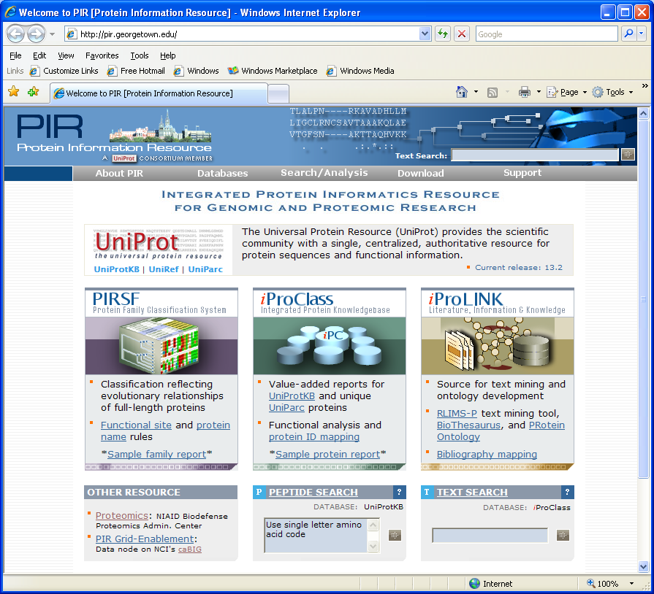
Modeling a Real Life Data Service (gridPIR): gridPIR - The Protein Information Resource
The Protein Information Resource
PIR is an integrated resource for proteomic research.
gridPIR is a caBIG™ silver level compliant data service exposing information from one of the PIR databases, the UniProt Knowledgebase (UniProtKB)
gridPIR’s goal is to provide comprehensive and fully annotated protein sequence and functional information for basic cancer research
Notes:
Here and for the rest of these lessons we will us as an example work done with gridPIR
PIR is an integrated resource for proteomic research at Georgetown University.
gridPIR is currently a caBIG silver level compliant data service exposing information from on of the PIR databases, the UniProt Knowledgebase (UniProtKB)
Contains information for basic cancer research.
Its goal is to provide comprehensive and fully annotated protein sequence and functional information for basic cancer research.
How can we model this service?

Slide 10
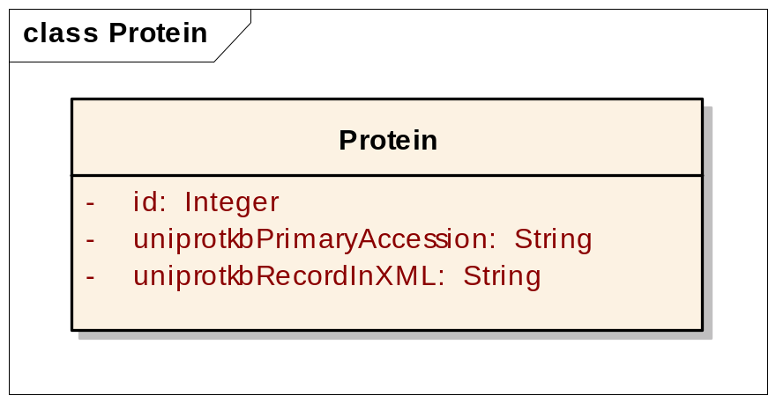
Modeling a Real Life Data Service (gridPIR):
A not-so-recommended approach
Modeling Approaches: One object approach => Modeling the record using existing XML schema.
Is this valid? Yes
Is this a domain information model? No
Is this a good model? Not for us
<uniprot xmlns="http://uniprot.org/uniprot" xmlns:xsi="http://www.w3.org/2001/XMLSchema-instance" xsi:schemaLocation="http://uniprot.org/uniprot http://www.uniprot.org/support/docs/uniprot.xsd"> <entry dataset="Swiss-Prot" created="1986-07-21" modified="2007-01-23" version="44"> <accession>P99999</accession> <accession>P00001</accession> <accession>Q6NUR2</accession> <accession>Q6NX69</accession> <accession>Q96BV4</accession> <name>CYC_HUMAN</name> <protein> <name>Cytochrome c</name> </protein> <gene> <name type="primary">CYCS</name> <name type="synonym">CYC</name> </gene> <organism key="1"> <name type="scientific">Homo sapiens</name> <name type="common">Human</name> <dbReference type="NCBI Taxonomy" id="9606" key="2"/> <lineage> <taxon>Eukaryota</taxon> <taxon>Metazoa</taxon> <taxon>Chordata</taxon> <taxon>Craniata</taxon> <taxon>Vertebrata</taxon> <taxon>Euteleostomi</taxon> <taxon>Mammalia</taxon> <taxon>Eutheria</taxon> <taxon>Euarchontoglires</taxon> <taxon>Primates</taxon> <taxon>Haplorrhini</taxon> <taxon>Catarrhini</taxon> <taxon>Hominidae</taxon> <taxon>Homo</taxon> </lineage> </organism>
……
P99999
The valuable information is not exposed (e.g. protein annotation)
It needs to be exposed to be advertised and discovered on caGrid
Notes:
One very simple and not recommended approach is to model the entire record as one object.
Obviously this is an extreme example and not be used for your service. However a record object has been proposed in some cases were there is an already established and excepted community standard for xml transfer of information, is this case it would be one object in a larger information model and the objects use would be to transmit the record for a tool that needed that format for input.
Less extreme and the first approach we took and many others have tried with poor success is to reverse engineer the xml we already had.
This reverse engineering though tempting seldom works well as the xml formats are often designed for data or record transfer and may be great for that purpose but not the best for information modelling or attaching meaningful metadata or semantics
This can be true for applications existing UML models also.

Slide 11
Modeling a Real Life Data Service (gridPIR):
A reverse engineering approach
Should You Reverse Engineer an Existing XML Model?
You can but it will not guarantee caBIG™ compatibility.
In practice reverse engineering existing models has seldom worked well in the context of caBIG™.
Reverse engineering an existing model can help in understanding the domain but in practice it has not always provide a good information model for caBIG™’s goals of interoperability. It is often been better to create a new or extensively modified version.
Notes:
Less extreme and the first approach we took and many others have tried with poor success is to reverse engineer the xml we already had.
This reverse engineering though tempting seldom works well as the xml formats are often designed for data or record transfer and may be great for that purpose but not the best for information modelling or attaching meaningful metadata or semantics
This can be true for applications existing UML models also.
So what do we need to consider in modeling?

Slide 12
Modeling a Real Life Data Service (gridPIR):
Modeling Considerations
  Scientific meaning – Design a re-usable domain information model, not application-specific record model
  Use cases – Consider search criteria objects e.g. Protein, Gene, Database Cross references
  Data related constraints – Include only associations or objects based on your data. e.g. Gene to Protein, but not Protein to DNA Sequence as UniProt does not have DNA sequence only Xrefs to other data sources for DNA.
  Semantics – Express semantics and avoid using non-informative “type” attributes. For example: name the ProteinFeature subclasses, don’t assign a feature “type”.
  Reuse – Try to reuse existing models. Same “Things” can exist in other caBIG™ compatible models.
  caCORE SDK constraints – Consider naming conventions or other SDK constraints
Notes:
What do you want in a ‘good’ model.
Example of SDKconstraint, SDK versions 1-3 required an “id” attribute version 4 does notnot.

Slide 13
Modeling a Real Life Data Service (gridPIR):
Use cases
Retrieving protein information using:
  Simple search using only one criteria
  Advanced search criteria constructed using Boolean operators
  Database identifier search without providing data source
Search criteria can be based on:
  Database identifiers
  Protein sequence features (annotations)
  Protein/Gene name
  Keywords/Organism
Notes:
We are actually building a data service for a real world database called UniProt that collects and annotates information for a variety of other scientific databases and the literature, here are our use cases
Note that the use cases already asks for creation of certain classes (things in real life) and how they should relate to each other (associations)

Slide 14
Modeling a Real Life Data Service (gridPIR):
Naming conventions, caCORE SDK constraints
Naming Conventions:
Adopt a case convention
  camelCase is recommended, some caBIG™ tools like the SIW support camelCase in mapping concepts.
Avoid using class identifiers in attribute names
Avoid using abbreviations, Jargon and acronyms.
Avoid plural class or attribute names unless necessary
Add “Collection” to association ends with multiplicity >1 (no longer required but a good practice)
caCORE SDK constraints:
“id” attribute in classes (only caCORE SDK 3.0)
Avoid use of complex data types like “List” and “Collection”
Notes:
These are some current best practices at least in regards to the caCore SDK which has some technical constraints, not all is absolutely required but these can help speed the review process and avoid problems or more work later

Slide 15
Modeling a Real Life Data Service (gridPIR):
Naming Exercise
UML Class
Are these the best names available?
Class name: Student - OK
Attribute name: name – OK
  Student+name
Attribute name: address – OK
  Student+address
Attribute name: studentID – ??
  Student+studentID ? redundant
  Better is “identifier”
  Student+identifier
Student
- name: string
- address: string
- studentID: long
- dateOfBirth: string
Notes:
Okay, lets review some of the names in the previous objects it the light of semantic interoperability and see if we can do better.
Class name: Student –OK the name is obvious and commonly used for the concept student, SIW will probably find the name and concept automatically.
Attribute name: name – OK the ideal situation is when the class and attribute name together define the attribute ie the concept for Student + the concept for name joined define the meaning of “Student name”
Attribute name: address – OK
Attribute name: studentID – ?? Not recommended to repeat class name in attribute name, it is redundant information. the SIW will take care of that association, a better attribute name would be “identifier”
The SIW would then link the known concepts of Student+identifier and the attribute is fully defined….

Slide 16
Modeling a Real Life Data Service (gridPIR):
Naming Exercise
Are these the best names for the concepts?
Professor
- name
- employeeID
Class name: Professor - OK
Attribute name: name – OK
hireDate and discipline - OK
What does status and maxLoad mean in the context of Professor??
  May need a better name, definitely needs a clear expert definition.
- hireDate
- status
- discipline
- maxLoad
Notes:
What does status and maxLoad mean in the context of Professor??
If status means something like tenure status it would be better to call it “tenure” or “tenureStatus”
If maxLoad means “maximum load of students” it would be better to call it something like “maxLoadStudents”
Good naming is not enough as many names will still have multiple meanings or special meanings in the context of the application or scientific field
All these attributes need definitions.

Slide 17
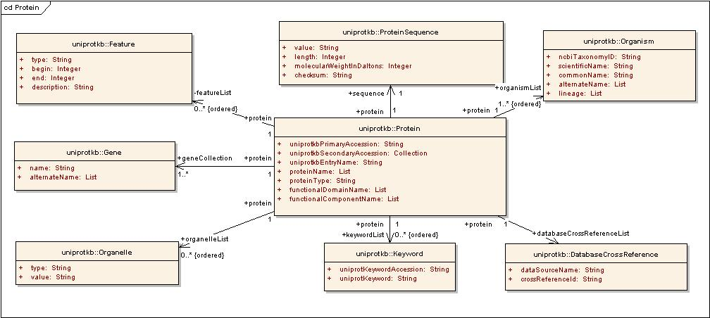
Modeling a Real Life Data Service (gridPIR):
A so-so model
Good:
A pseudo-domain information model; classes are scientific real life things
Association directionality and classes based on use cases
Re-use of classes from available models; e.g. caBIO
Bad:
Attributes with complex data types
like list and collection.
Not all use cases are met
Semantics needs improvement
Violates some naming conventions
Notes:
What does this mean here is a better model but not good enough yet.
Complex data types like collection and string are not the most informative way to model and have some technical limitations in the SDK, more on that in the next slide
The feature object uses hides useful sematics and inhibits on of our use cases to search for all proteins with a particular ‘type’ of feature, more on that in a minute
The attribute proteinName in the class protein violates one of the naming conventions should just be called name, as you will see caBIG tools and services understand the name is in the context of the class protein.
Also the recommended convention for naming associations with multiplicity greater than 1 is Collection not used everywhere
If we look closer at the right side of this model – the Organism class should be curated further as demonstrated next.

Slide 18
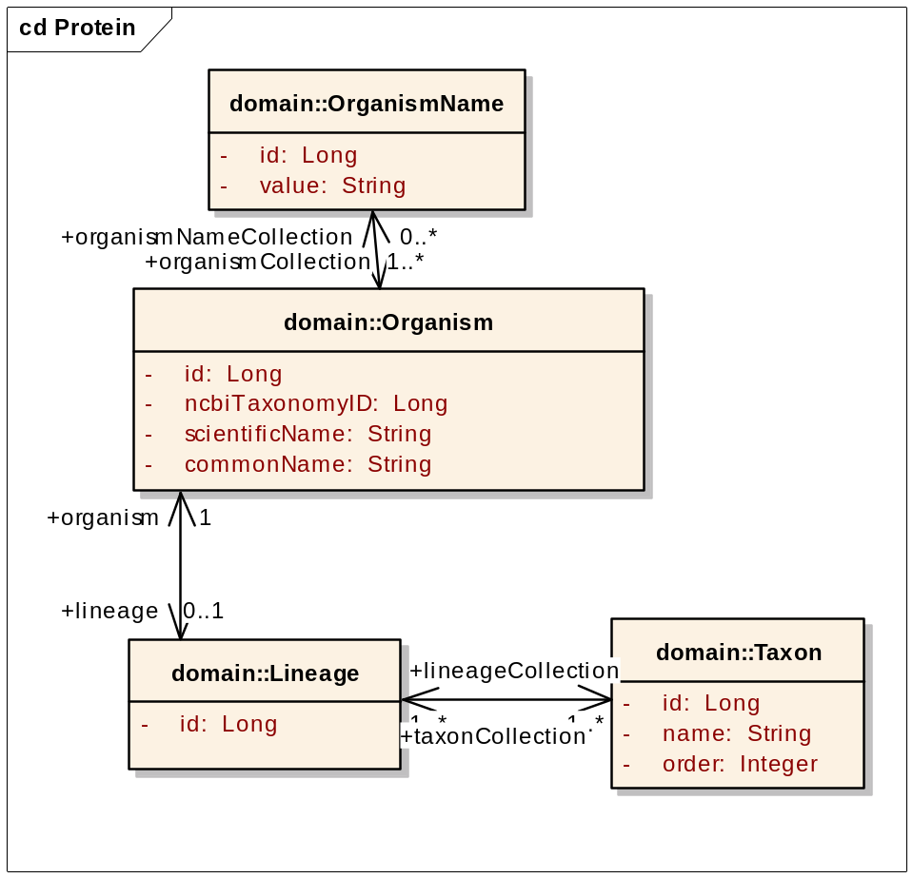
Modeling a real life data service: gridPIR
Improving Semantics Further
Break up lists into collections of separate objects so gridPIR can provide searches on:
  Lineage
  Taxon names
  Alternate names for Organism
Notes:
Complex data types like collection and string are not the most informative way to model and have some technical limitations in the SDK, they can make it difficult to search inhibiting some use cases,
they should be broken out into different objects

Slide 19
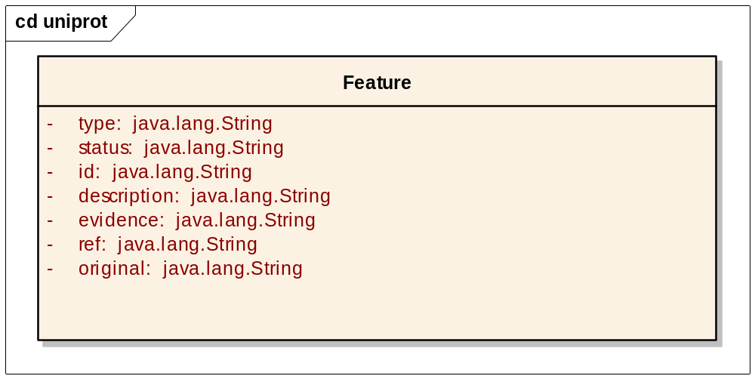
Modeling a Real Life Data Service (gridPIR):
Improving Semantics Even Further
Important annotations in the protein sequence are features, which are regions or sites of interest in the sequence, including:
Posttranslational modifications
Binding sites
Enzyme active sites
Other functional domains
Problems:
Using “type” makes it difficult to discover gridPIR as a protein annotation resource
User needs to know permissible values for “type” to discover and even use the system
Solution: Create an individual class for each feature
Notes:
The feature object uses a attribute type to contain our ‘classification type name’ for different features like “binding site”, this hides very useful biological semantics and inhibits on of our use cases to search for all proteins with a particular ‘type’ of feature.

Slide 20
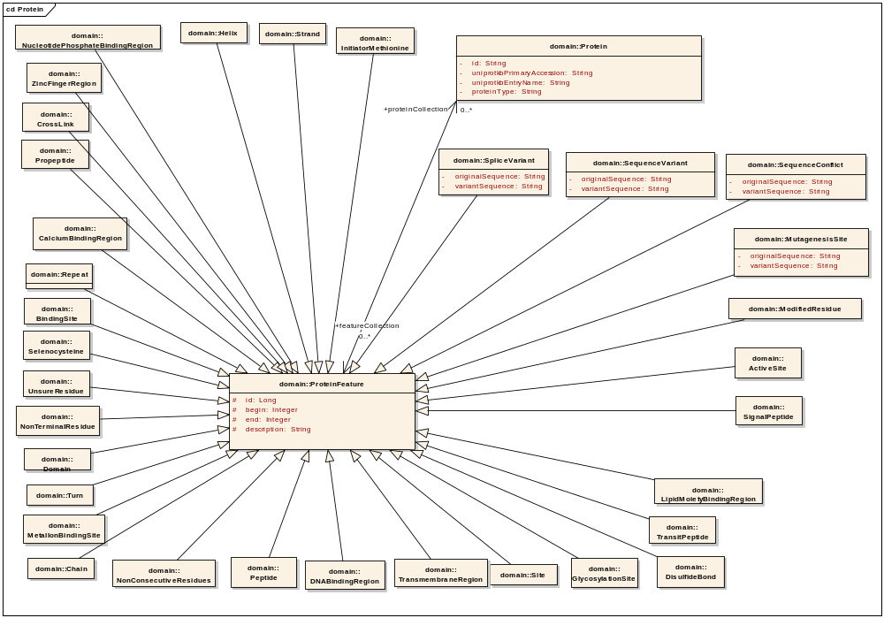
Modeling a Real Life Data Service (gridPIR):
Improving Semantics Even Further
Protein Sequence Annotation Classes
Notes:
This tells me there are ActiveSites/BindingSites exposed by the data service. Good for this case but obviously not for a case where there are thousands of features, for that might use enumerated value domain.

Slide 21
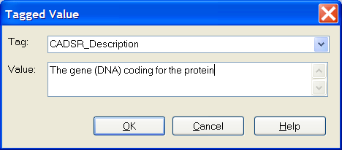
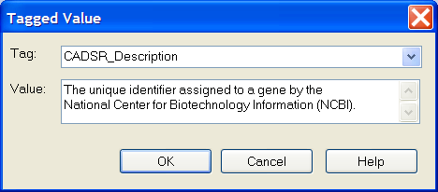
Modeling a Real Life Data Service (gridPIR):
Improving Semantics
Using tagged values of UML tool
  Enter “CADSR_Description” for classes and attributes
For a gene object
For a gene attribute, entrezGeneId
Notes:
To improve the system metadata, assist in the semantic annotation process and help anyone trying to understand and reuse your model you must also add tagged values
This information becomes part of metadata exposed as a part of caGrid Service Metadata, caDSR stored metadata.

Slide 22
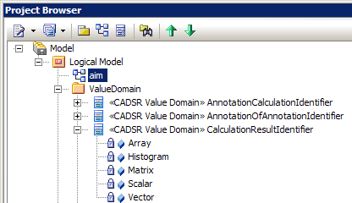
Modeling a Real Life Data Service (gridPIR):
Improving Semantics Even Further
Use enumerated value lists and model them in UML – a class with “caDSR Value Domain” stereotype:
If appropriate to your data service or application please see the developer boot camp presentation on this subject.
gforge.nci.nih.gov/docman/view.php/196/6025/02_Enumerated%20Value%20Lists%20JLB.ppt
Notes:
It limits the value set for an attribute. When filling out a form or using a web page; which one is more informative; a textbox or a pull-down/options menu that guides you in entering values?

Slide 23
Modeling a Real Life Data Service (gridPIR):
Reuse of existing Common Data Elements
Common Data Element (CDE)
The caBIG™ community has adopted select CDEs as standards and strongly encourages all to use them.
One of the best and most important steps you can take to promote interoperability is to reuse a Data Element from another caBIG™ service.
The Candidate, Proposed and Approved Standards can be found in the CDE Browser.
http://cdebrowser.nci.nih.gov/CDEBrowser/
Silver to Grid Training provides additional information and options on reuse.
Notes:
It limits the value set for an attribute. When filling out a form or using a web page; which one is more informative; a textbox or a pull-down/options menu that guides you in entering values?

Slide 24
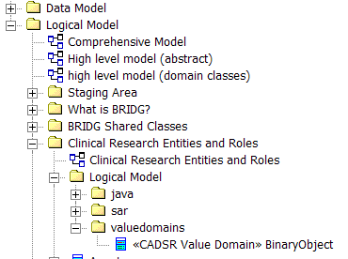
Additional Points:
Adding Packages – Value Domains Package
Value Domains, if applicable, should be located in a separate folder than the other classes, but still in the Logical Model Package.
Notes:
This slide is an example of a UML Value Domain specification in the project view of Enterprise Architect (EA). Note that the Value Domains are located in a separate folder than the other classes but are still in the Logical Model Package.

Slide 25
Additional Points:
Java Wrappers
Java Wrapper classes can be added to appropriate package
No need to add attributes

Slide 26
Additional Points:
UML notations ignored by SIW/UML Loader
Stereotypes (other than enumeration)
Attribute multiplicity (use -1 to represent many)
Options in Class and Attribute Details pages
  Scope
  Abstract class
  Cardinality (always use -1 to represent many)
Operations in classes

Slide 27
Creating Your UML Model:
Getting Started
UML Modeling Tools
caCORE SDK is compatible with:
Enterprise Architect by Sparx Systems:
http://www.sparxsystems.com/products/ea/index.html
ArgoUML (open source): http://argouml.tigris.org
System/project domain is drawn in UML
  Logical model describes target domain
  Data model describes database schema
All UML Models should be placed in the Logical View Package of the modeling tool
Notes:
The first step in Semantic Integration is to draw your system/project domain in UML. *
There are three parts to the system model: the logical model, data model, and data mapping model. The logical model describes the target domain and should be created in the logical package.* The Data Model describes the database schema* and the Object relational mapping maps classes to object. All of these are drawn in UML. Throughout this presentation, the terms “logical model”, “domain model” and “object model” are used interchangeably.*
caCORE SDK tools impose modeling guidelines* such as
Java naming conventions*
Package rules*
Element constraints*
For Example, *
*Only UML class diagram elements may be used
*Cannot use interface, object, etc.
Detailed instructions on creating diagrams in UML can be found in the SDK Programmer’s Guide.

Slide 28
Conclusion
In a model driven architecture, the model development is the most important step
caBIG™ silver-level compatible services are expected to expose domain information models
Reusing portions of existing silver-level compatible service models is helpful in achieving compatibility
Use caBIG™ best practices and knowledge of caBIG™ tool features (or limitations) to guide your modeling
Notes:
Remember real life “things” may have been modeled in other silver level compatible applications.

Slide 29
Additional Points:
Exercise
Use the step by step instructions to try it yourself with EA
  Open an existing model file in Enterprise Architect
  Add a Class and Attribute to the existing diagram
  See link below for all exercise files in 01_Exercises on gforge
https://gforge.nci.nih.gov/docman/index.php?group_id=470&selected_doc_group_id=4636&language_id=1
Some slides from the exercise follow.

Slide 30
Exercise: Creating Your UML Model
An Incomplete Information Model
ClassName
attributeName
Datatype
associationName
Multiplicity
Bi-directional Association
Generalization
Notes:
Here is a simplified version of gridPIR with some objects removed. Some names for parts of the UML model are indicated. One critical component of the model missing the gene object which connects proteins to the genetic material DNA, lets add it to this model.

Slide 31
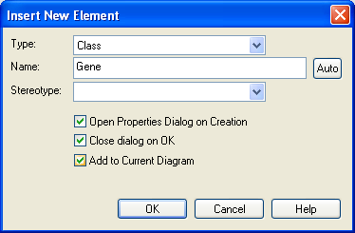
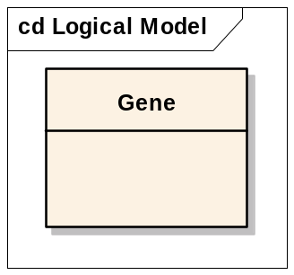
Exercise: Creating Your UML Model
Adding Classes
In the EA Project View navigate to Domain Model > Logical Model > edu > georgetown > pir > domain folder and double click on the Logical Model if the Class Diagram is not already visible.
Right click on the domain folder, select Add > Add Element
Select Type as Class
Enter the name of the class (remember the naming conventions)
Select all check boxes
Click OK
Click OK again
An new Class
will appear in the
diagram

Slide 32
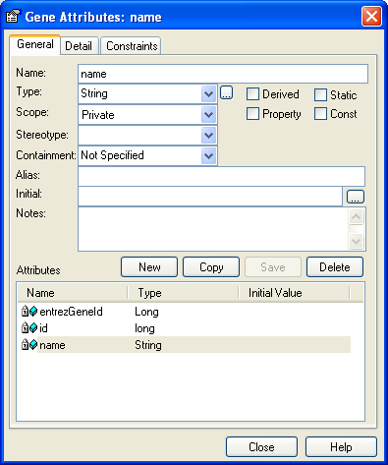
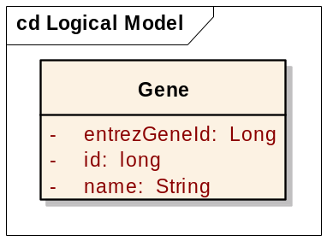
Exercise: Creating Your UML Model
Adding Attributes to Classes
Select the new gene Class in either the Class Diagram or the Project View, right click > attributes….
Enter the name of the attribute (adhere to naming convention)
Enter the datatype in the Type field
  Type in the java primitive or
  wrapper class, using the dropdown
  list can cause problems
Click Save
Click New to enter more attributes
Click Close when finished

Slide 33
Exercise: Creating Your UML Model
Adding tags for definitions for classes
Select the Gene Class in the Project View or the Class Diagram
Select Element > Tagged Values from the Main Menu
Enter “CADSR_Description”
as the tag name
Enter the class definition
as the value
Click OK
DO NOT use Notes
section for the definition

Slide 34
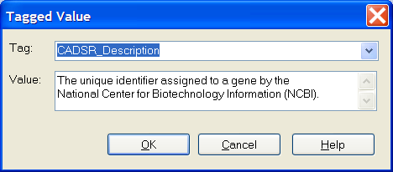
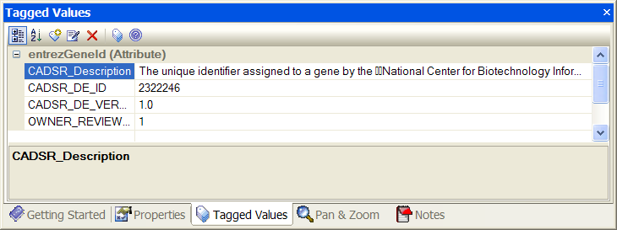
Exercise: Creating Your UML Model
Adding tags for definitions for attributes
Select the attribute entrezGeneId in the Class Gene in the Project View or Diagram
Select Element > Tagged Values from the Main Menu
Enter “CADSR_Description” for the tag name
Enter the attribute’s definition in the value field.
Click OK

Slide 35
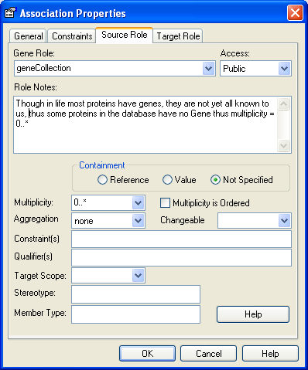
Exercise: Creating Your UML Model
Associations
From the Menu button bar, select Link > Association (or from the toolbox > Class > Associate)
Click and hold one class (source), then drag and drop to the second class (target) to create the link.
Right click on the association (or double click) and select Association Properties.
Click the Source Role tab
Enter the role name (className)
  Add “Collection” if >1
Select the Multiplicity from
the dropdown
Click OK
Do the same for the Target Role

Slide 36
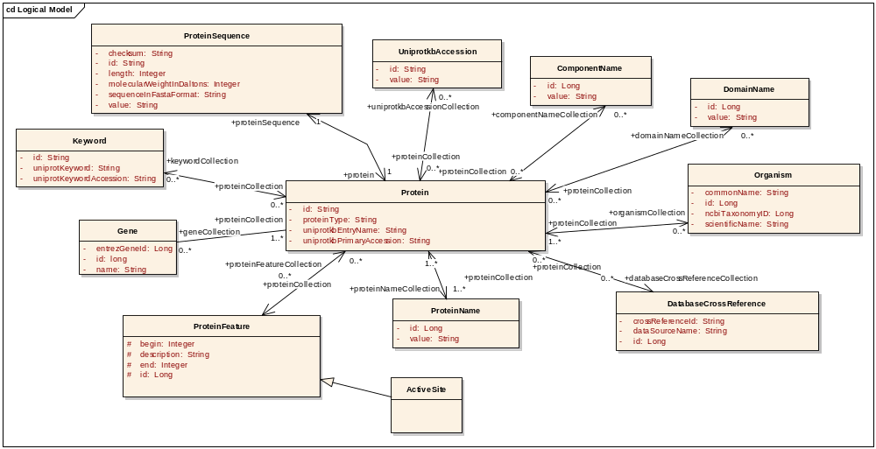
Exercise: Creating Your UML Model
A Completed Protein Model
Protein + Gene and Related Classes
Notes:
You did it

Slide 37
Acknowledgements
Peter McGarvey
Baris Suzek
Mike Keller
Dianne Reeves
George Komatsoulis
Avinash Shanbhag
Becky Angeles
Jennifer Brush
Jamie Parker
Claire Wolfe
Ken Smith
Sal Mungal
Virginia Hetrick
Shannon Hastings
Architecture/VCDE workspace participants

Slide 38


