Slide 1

Welcome to the
Johnson Space Center
Mission Operations Directorate
Facilities Development & Operations Contract (FDOC) Pre-proposal Conference
Monday, February 4, 2008
Gilruth Center, Alamo Ballroom
8:30 AM – 11:30 AM

Slide 2
Agenda
Welcome
Safety and Administration Information
Source Selection Authority and Source Evaluation Board Membership
Orientation
FDOC Scope
DD Organizational Chart
FDOC Period of Performance
FDOC Contract Structure
Draft RFP Highlights
Current Changes to Final RFP
Revised FDOC Schedule
Pre-Proposal Conference Remarks
Tour Comments
Questions
Observation Opportunity Information

Slide 3
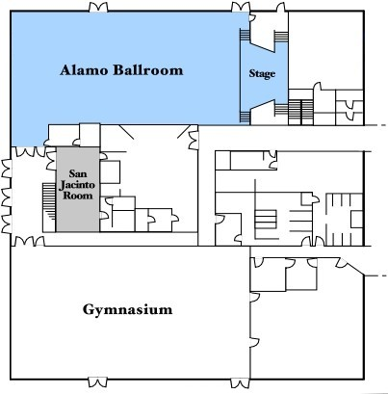
Safety and Administrative Information
Restrooms can be found in the hallway outside this ballroom
Fire exits are the front entrance and side exit doors. In the event of a fire, you must move at least 75 ft away from the building
Fire Exits
Fire Exit
Fire Exit
Restrooms

Slide 4
Disclaimer
These slides are not to be interpreted as a comprehensive description of the requirements in the Draft Request for Proposal (DRFP)
To the extent there are any inconsistencies between this briefing and the future solicitation, the solicitation will govern

Slide 5
Pre-proposal Conference
Debra L. Johnson
Director, Office of Procurement

Slide 6
FDOC SSA and SEB Membership
Source Selection Authority (SSA)
  William H. Gerstenmaier, Associate Administrator of NASA’s Space Operations Mission Directorate (SOMD)
Source Evaluation Board (SEB) Membership
  Jimmy L. Spivey, Chair
  J.R. Carpentier, Contracting Officer
  Dennis Beckman
  Mitchell Macha
  Kevin McCluney
  Paul Torrance
  Joe Williams
  Wendy Stone, Recorder
  Jannette Bolden, Price Analyst

Slide 7
Orientation
The purpose of this pre-proposal conference is to help industry understand the Government’s requirements
Questions:
  Any response to verbal questions during the conference shall not be construed as an official answer
  Submit written questions to the Contracting Officer as described in the cover letter to the Draft RFP
  Official responses to written questions received by the Contracting Officer will be posted to the Facilities Development & Operations Contract (FDOC) procurement website
    The deadline for questions regarding the Draft RFP has been extended to April 4, 2008
  Post RFP release, responses will be posted as amendments to the RFP

Slide 8
Orientation (cont.)
Points of Contact:
  Contracting Officer: J.R. Carpentier
  Contract Specialist: Wendy Stone
  FDOC web address:
    http://procurement.jsc.nasa.gov/fdoc/default.asp
    Click on the “Anonymous Questions to C.O.” link to submit a question

Slide 9
Orientation (cont.)
Ombudsman (NFS 1852.215-84): “…before consulting with an ombudsman, interested parties must first address their concerns, issues, disagreements, and/or recommendations to the Contracting Officer for resolution … If resolution cannot be made by the Contracting Officer, interested parties may contact the installation ombudsman …”
Installation Ombudsman:
Lucy Kranz, Associate Director (Management), Building 1, Room 957B, telephone 281-483-0490

Slide 10
FDOC Scope
Encompasses all work currently being done by MSOC, plus the MOD facilities and (non-flight) software work currently being done under SPOC
Composed of three contract elements (as specified in the SOW):
  Baseline (Completion Form)
  Indefinite Delivery, Indefinite Quantity (IDIQ)
  Level of Effort (LOE)
Supported programs:
  Space Shuttle
  International Space Station
  Constellation
  Future human spaceflight program support
Provide facility and system services:
  Development
  Maintenance
  Sustaining engineering
  Operations

Slide 11
MISSION OPERATIONS FACILITIES DIVISION
Management
Long Range Division Planning
Staffing and Budget
Contracts
DD111
SYSTEMS ENGINEERING & FACILITY INTEGRATION OFFICE
MISSION CONTROL CENTER & SIMULATOR OPERATIONS OFFICE
• Facility User Requirements Integration &
Management (New Requirements &
Sustaining Engineering)
Systems Engineering Processes Compliance
(NPR Implementation Guidance)
Technical Cost and Schedule Reviews (TCSR)
& Process Control
Coordination of Program Requirements
MOFD Prototyping & Development
Trade Studies & Benchmarking
Strategic Engineering
Integration of Systems
Project Plan, Load & Schedules
Risk Management
MOFD Sustaining & Development Project
Standardization
Facility Customer Advocacy
Division IT Integration
Quality System Implementation
MCC Operations
Ground Segment Integration
Space Communication Integration Office
SSTF Operations
SMS Operations
Operations Resource Management
CoFR Coordination & Integration
MSOC, SFOC Operations Evaluations
Facility Management
Facility Safety
COD Interface
Facility Control Board Co-Chair
Facility Physical Security Management
Facility IT Security
Contractor Evaluations
Projects
DD121
DD131
MISSION CONTROL CENTER SYSTEMS BRANCH
RECONFIGURATION & SIMULATION SYSTEMS BRANCH
DD221/Mission Control Systems Development Group
MCC Software Sustaining Engineering
MCC Hardware Equipment Replacement Projects
Cx MCC Development
Cx Integration Planning System Development
Cx MCC Automation System Development
Contractor Evaluations
Projects
DD231/Planning Systems
Planning Systems Development
Planning Systems Software Sustaining Engineering
Planning Systems Operations
Contractor Evaluations
Projects
DD321/Mission Operations Reconfiguration Group
Cx Reconfiguration Systems
SSP RECON (MCC, Trainers & External Customers)
ISS Avionics Data Integration
ISS Recon Data Production (MCC, Trainers & External Customers)
IMARS Tools Sustaining
ISS FSW Recon
SPF Operations Insight
DD331/Simulation Systems Development Group
Simulator Requirements
Development
Design
Prototyping
Testing
Verification/Validation
Sustaining
DD211
DD311
Original signed by:_ _
Daniel D. Lindner, Chief
Mission Operations Facilities Division

Slide 12
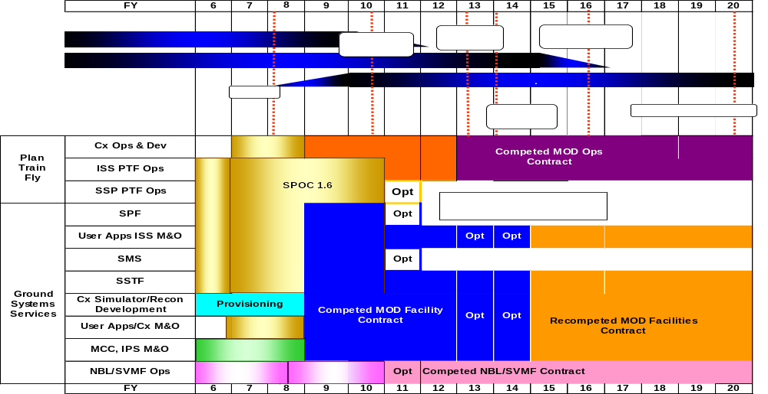
FDOC Period of Performance
Period of Performance
  3.75 year base—January 1, 2009 – September 30, 2012
  Option 1—1 year option—October 1, 2012 – September 30, 2013
  Option 2—1 year option—October 1, 2013 – September 30, 2014
IMOC
FDOC

Slide 13
FDOC Contract Structure
Basic Period
Performance-based Statement of Work (SOW)
Period of performance: January 1, 2009 through September 30, 2012
Contract type: Cost Plus Award Fee (CPAF)
  Fee payments based on numerical/adjectival performance ratings
  Areas of Emphasis will be issued to indicate specific areas of concern prior to each award fee period that will be limited in number and directly related to the desired outcome
  Award Fee Pool amounts to be based on baseline work and requirements issued to the contractor by NASA via approved IDIQ Delivery Orders & LOE Task Orders

Slide 14
DRFP Highlights—Section C (Statement of Work)
The SOW is composed of three sections:
  Section 1 is information only regarding the FDOC facilities
  Section 2 contains the contract management requirements pertaining to all FDOC facilities
  Section 3 contains the work requirements for each facility and is divided into three areas:
    3.1 Common work content for all FDOC facilities
    3.2 Facility-unique work content
    3.3 Level of Effort (LOE) work content
All work described is considered baseline unless specifically identified as IDIQ or LOE

Slide 15
DRFP Highlights—Section C (Statement of Work)
Section 1 is a high-level description of each FDOC facility
  Section 1 neither contains nor levies any requirements on the offeror
  The objectives of this contract are described: “…to consolidate efforts across these facilities in order to maximize synergy for development, modification, sustaining, maintenance, reconfiguration, and operations for the purpose of reducing cost without compromising facility functionality and performance. Furthermore, NASA plans to collaborate with the Contractor on developing technical and procedural innovations to improve quality and further reduce cost.”
  Please note the definition of “facility” as used throughout the contract: “…the systems and subsystems of integrated hardware, software, data, and displays used in the preparation for and performance of human spaceflight mission operations. The term ‘facility’ does not refer to ‘brick and mortar’ buildings or building functions, such as lighting, environmental control, and janitorial services.”

Slide 16
DRFP Highlights—Section C (Statement of Work), cont.
Section 2 describes the requirements for the management of FDOC
  Section 2 contains and levies requirements on the offeror
  Section 2 asks the offeror to recommend consolidation and synergy of processes that align with the NASA and MOD vision and cost cutting goals without negative impact to current and future facility operations
    New, efficient ways of doing business
    Consolidation and synergy across all aspects of FDOC
  In Section 2.6.3, please note the requirement that personnel working with the COMSEC (Communications Security) System must have a SECRET clearance on Day 1 of the contract

Slide 17
DRFP Highlights—Section C (Statement of Work), cont.
Section 3 describes the work content by facility
  Section 3 contains and levies requirements on the offeror
  Section 3.1 contains the common work elements which apply to all FDOC facilities described in subsequent subsections
  Section 3.2 contains the unique work requirements for each facility. These requirements are in addition to the requirements listed in Section 3.1. These requirements also describe differences of a particular facility as compared to the common work content in Section 3.1.
    For specific, detailed requirements for any FDOC facility, please consult the associated references in the Technical Library (available via FDOC website).
    In certain cases, a given facility will not have unique requirements for a particular subsection. Either the requirements for that facility in that particular area default to the common requirements in the appropriate Section 3.1 subsection or are indicated as not applicable.

Slide 18
DRFP Highlights—Section C (Statement of Work), cont.
Section 3.2 also describes the major IDIQ work
  Mission Operations Reconfiguration System (MORS)
    Previously known as Constellation Reconfiguration System (CxRS)
    Common system infrastructure for acquiring, validating, managing, producing, and distributing compatible sets of data and/or flight software
    Will serve as a single, authorized source for data, software, and documentation that are required for mission operations
  Constellation Training Facility (CxTF)
    Envisioned as multiple simulators/trainers of varying fidelity and complexity that provide training of astronauts and flight controllers on Constellation vehicle system operations and procedure development/verification
    Will allow for standalone and integrated training of astronauts and flight controllers
Section 3.3 contains the Level of Effort work content
  Facility Engineering and Support Services
    Ground Segment Control Board (GSCB)
    Program Requirements Document (PRD)
    Human Space Flight (HSF) Network Operations Integration
    Systems Engineering and Integration Support
    Architectural and Engineering Support
    Technique Development Meteorologist

Slide 19
DRFP Highlights - J Attachments
J-1 Glossary
J-2 Applicable Documents List
  Most documents available in the Technical Library
J-3 Award Fee Plan
J-4 Small Business Subcontracting Plan
J-5 Safety & Health Plan
J-6 Security Classification
  Form DD254
J-7 Personal Identification Verification (PIV) Procedures
  HSPD-12
  Badging must be complete and personnel ready on Day 1 of the contract
J-8 Government Furnished Property
J-9 Installation Accountable Property
J-10 Phase-In Plan
J-11 Wage Determination

Slide 20
DRFP Highlights - J Attachments
J-12 Statement of Equivalent Rates
J-13 Continuous Improvement Plan
J-14 Organizational Conflict of Interest (OCI) Avoidance Plan
J-15 Surveillance Plan
J-16 Data Requirements Description (DRD) List
J-17 Data Requirements Description Sheets
  62 DRDs encompassing all significant aspects of the contract
J-18 List of Facilities
J-19 Acronyms
J-20 Labor Rates Tables
J-21 Work Breakdown Structure (WBS)
J-22 Floor Space Management

Slide 21
DRFP Highlights B through M
B.2 ESTIMATED COST AND AWARD FEE—Contract Line Item Number (CLIN) Structure–Propose cost and fee per CLIN
  Propose fixed price amount for phase-in
B.4 OPTION TO EXTEND COMPLETION DATE—Offeror needs to fill-in dollar amount for each 1-year option
E.2 HIGHER-LEVEL CONTRACT QUALITY REQUIREMENT—compliance with ISO-9000-2000
Contract Section F—IDIQ and LOE descriptions
G.16 and J-7 PIV—new badge requirements; understand that the process may be more lengthy than anticipated
H.9 ASSOCIATE CONTRACTOR AGREEMENT FOR FDOC ACTIVITIES—lists the various contracts related to FDOC performance
Contract Section K—fill out all certifications
L.2 COMMUNICATION REGARDING THIS SOLICITATION—point of contact is J.R. Carpentier; all communications shall be in writing via e-mail only; cutoff date for questions regarding the DRFP is April 4, 2008

Slide 22
DRFP Highlights B through M
L.3 DUE DATE FOR RECEIPT OF PROPOSALS—Observe proposal due dates; Past Performance is to be delivered by June 9, 2008
L.11 PROPOSAL PAGE LIMITATIONS—review all instructions and page count limitations; the SEB will not evaluate pages that exceed page limitations; understand what counts for page limitations
L.18 PROPOSAL MARKING AND DELIVERY—Understand proposal marking and delivery to ensure timely delivery of proposals; a call to the C.O. that the proposal is in transit would be appreciated
L.20 LIST OF ATTACHMENTS
Proposal Acceptance Period—Please state in your cover letter the number of days for which your proposal is valid

Slide 23
DRFP Highlights—Section L.19
Instructions to Offerors
The proposals are submitted in three volumes:
Volume I is Mission Suitability factors (225 pages; appendices - no page limit)
  Part I: Technical Approach
    TA5 asks the offeror to describe the approach taken to fulfill the requirements of a sample task order
      Narrative and BOE information is part of 225 page limit
      No task order cost information to appear in Volume III Price/Cost
  Part II: Management Approach
  Part III: Safety and Health Approach
  Part IV: Small Business Utilization
  Appendix A: Basis of Estimate and Technical Resources (templates provided)
    BOE template: one page only per WBS element
    Technical resources shall agree with the BOEs and reconcile to the COST volume
  Appendix B: DRDs due with proposal
    20 DRDs are due with proposal
  Appendix C: Key Personnel information (template provided)
    Signed letters of commitment required for each key person identified
  Appendix D: Total Compensation plan (templates provided)
Volume II is Past Performance (50 pages)
Volume III is Price/Cost (no page limit)

Slide 24
DRFP Highlights B through M
M.2 NASA may award without discussions
  Options will be evaluated as part of overall cost and price
M.3 Evaluation factors
  Mission suitability – scored on 1000 point system, with the following proposed allocation
    Technical Approach – 450 points
    Management Approach – 300 points
    Safety and Health – 150 points
    Small Business (SB) Utilization – 100 points
  Past Performance – adjective scale
  Cost/Price – evaluated on cost realism
  Factor comparison
    Mission Suitability and Past Performance when combined are significantly more important than Cost/Price
    Mission Suitability is more important than Past Performance
    Mission Suitability and Cost are approximately equal in importance

Slide 25
Current Changes for Final RFP
SOW Section 2.16 Facility Floor Space Management: Additional words to be provided regarding the amount of on-site space available for FDOC employees, as well as the floor space to be managed by the FDOC contractor. This information may be found in Section J-22
SOW Section 2.2.4 Associate Contractor Agreements (ACAs): Additional words requiring ACAs to describe the contractor roles, responsibilities and expectations, and that copies of all ACAs be given to the COTR
SOW Section 3.2.1 MCC-H Facilities Support: Adding information regarding support of the Meteorological Interactive Data Display System (MIDDS) hardware and software at MSFC
SOW Section 3.2.1.7 Interface Support: Under Subcontractor agreements, NASA to provide clarification for utilizing excess capacity for agreements with the Canadian Space Agency (CSA) and revenue sharing with the Government
Section L.3 Due Date for Receipt of Proposals: See dates on following slide

Slide 26
Revised FDOC Schedule
✓ Draft RFP released December 17, 2008
Draft RFP questions due April 4, 2008
Final RFP release May 9, 2008
Past Performance due June 9, 2008
Proposals due July 8, 2008
Award FDOC November 7, 2008
FDOC start January 1, 2009

Slide 27
Pre-Proposal Conference Remarks
Topics covered today are not inclusive and potential Offerors should not place any added emphasis based on the content of this briefing
Information provided today is to assist in the development of proposals; however the Final RFP will take precedence
The Pricing conference is this afternoon at 1 pm in this room
Continue to monitor the NAIS and FDOC websites for updates
Official responses to written (e-mailed) questions are being posted to the FDOC website and NAIS
Final RFP release is planned for May 9, 2008 at which time the technical library will be frozen
As a result of the FDOC schedule increasing by 90 days, the time between today’s pre-proposal conference and release of the Final RFP is significantly greater. This was done to permit early tours of the FDOC facilities

Slide 28
Tour Comments
Please limit questions during tours to facility operations only. Employees providing tours have not participated in any of the FDOC preparation and are not knowledgeable in the contract details and content
  All questions regarding FDOC should be addressed to J.R. Carpentier, Contracting Officer
During the tours, there will be no “private” questions. All questions and answers will be heard by the entire group
Tours are scheduled for this afternoon and evening, plus tomorrow morning and afternoon
  Please remain with the group to which you are assigned
Notes:
Authorize use of government property for commercial purposes on a “as available” and “as is” basis
Obtain adequate consideration for non-government use

Slide 29
Questions?
Are there any questions regarding the information
provided today or regarding the tours of the facilities?

Slide 30
Observation Opportunities
NASA is planning opportunities for interested offerors to observe daily operations of areas of particular interest
Since the observation activities must be scheduled around the STS-122 and STS-123 missions, as well as the schedules of the guides, the dates, times, and content of the observations determined by NASA are non-negotiable
  Every effort will be made to allow observation of each request, however, Shuttle missions, secure content, and time may prevent some areas from being observed
All rules regarding the observations as well as the dates and times of each observation will be posted to the FDOC website
  OBSERVATIONS WILL NOT BE RESCHEDULED IF MISSED

Slide 31
Observation Strategy
To request participation in the Observations:
  Please use http://procurement.jsc.nasa.gov/fdoc/default.asp and click on the Observation Period link to submit areas of interest
    Prioritize your list of requested areas of interest from highest to lowest priority
      Please be very specific about the area, function or activity requested (for example, don’t request “MCC”, but rather components such as “Front End Processors”, or “Control Board X”)
      Information regarding future CxP work will be provided via project status briefings
Only 2 people per single company or team are allowed at any observation; however, different people are permitted to sign up for each observation
  Assign the names of the 2 people to attend each requested observation with your prioritized list of areas of interest
During the observations, all questions will be addressed to the NASA guide. No contact with the current contractor personnel is permitted, unless permission is otherwise given by the NASA guide
  Questions constrained to daily operations only

Slide 32
Observation Schedule Relative to RFP Milestones
Observation inputs due February 15, 2008
Planned Observations March-April 2008
Draft RFP questions due April 4, 2008
Final RFP release May 9, 2008
Blackout period begins May 9, 2008
Are there any questions regarding the observation opportunities or schedule?

Slide 33
Contract Website
http://procurement.jsc.nasa.gov/fdoc/default.asp

