Slide 1

Global Grid Forum (GGF)
Jennifer M. Schopf
Steering Group Member, Global Grid Forum
Argonne National Laboratory
jms@mcs.anl.gov
July 2003
A GGF primer

Slide 2
GGF Objectives
An Open Process for Development of Standards
  Grid “Recommendations” process modeled after Internet Standards Process (IETF)
  Persistent, Reviewed Document Series (similar to RFC)
A Forum for Information Exchange
  Experiences, patterns, structures
  Useful even if every application & Grid were completely separate and not interoperable…but ideally will result in interoperability!
A Regular Gathering to Encourage Shared Effort
  In code development: libraries, tools…
  Via resource sharing: shared Grids
  In infrastructure: consensus standards

Slide 3
GGF Mission
Working Groups
Specifications or Best Practices
Research Groups and Workshops
Partnerships
Education
Conferences, Tutorials & Partnerships
Identify where / what specs are critical
Frameworks / Architectures
(how specs fit together)
Research and Technology Directions
Application Requirements

Slide 4
GGF Groups
Working Groups
  Tightly focused on development of a specification or set of related specifications
    Protocol, API, etc.
  Finite set of objectives and schedule of milestones
Research Groups
  More exploratory than Working Groups
  Focused on understanding requirements, taxonomies, models, methods for solving a particular set of related problems
  May be open-ended but with a definite set of objectives and milestones to drive progress
  Renewed every 2 years
Groups are approved and evaluated by a GGF Steering Group (GFSG) based on written charters. Among the criteria for group formation:
Is this work better done (or already being done) elsewhere, e.g. IETF, W3C?
Are the leaders involved and/or in touch with relevant efforts elsewhere?

Slide 5
GGF Areas
Areas are primarily management constructs
  Not the “chapters” of a Grid text book - formed from original research areas of interest, expanded as needed
  Within an area are Research Groups and Working Groups
Current Areas:
  Applications, Programming Models and User Environments
  Architecture
  Data
  Peer-to-Peer
  Performance and Information Services
  Scheduling and Resource Management
  Security

Slide 6
42 Current GGF Groups
Applications and Programming Environments
Grid Checkpoint/Recovery (GridCPR-WG)
Grid Remote Procedure Call (GridRPC-WG) Advanced Collaborative Environments (ACE-RG)
User Program Development Tools For The Grid (UPDT-RG) Applications and Test Beds (APPS-RG)
Grid Computing Environments (GCE-RG) Grid User Services (GUS-RG)
Life Sciences Grid (LSG-RG) Production Grid Management (PGM-RG)
Architecture
Open Grid Services Infrastructure (OGSI-WG) Semantic Grid (SEM-RG)
New Productivity Initiative (NPI-WG) Open Grid Services Architecture (OGSA-WG)
Open Grid Service Common Mngt. Model (CMM-WG) Grid Protocol Architecture (GPA-RG)
Service Management Frameworks (SMF-RG)
Data
GridFTP-WG Data Access and Integration Services (DAIS-WG)
· OGSA Data Replication Services (OREP-WG) Persistent Archives (PA-RG)
Grid High-Performance Networking (GHPN-RG) Data Transport (DT-WG)
Data Format Description Language (DFDL-WG)
Information Systems and Performance
Discovery and Monitoring Event Description (DAMED-WG) Network Measurement (NM-WG)
Grid Information Retrieval (GIR-WG) CIM based Grid Schema (CGS-WG)
Relational Grid Information Services (RGIS-RG) Grid Benchmarking (GB-RG)
Peer-to-Peer
Appliance Aggregation OGSA-P2P-Security
Scheduling and Resource Management
Distributed Resource Mgmt. Application API (DRMAA-WG) Grid Resource Allocation Agreement Protocol (GRAAP-WG)
OGSA Resource Usage Service (RUS-WG) Grid Economic Services Architecture (GESA-WG)
Usage Record (UR-WG)
Security
Grid Security Infrastructure (GSI-WG) Grid Certificate Policy (GCP-WG)
Open Grid Service Architecture Security (OGSA-SEC-RG) CA Ops (CAO-WG)
Authorization Frameworks and Mech. (AuthZ-WG) Site Auth., Authorization, and Accounting Req (SAAA-RG)

Slide 7
Proposed GGF Groups-FIX
AREA | Working Groups | Research Groups
Scheduling and Resource Management | Scheduling Command Line API Distributed Rsc Mgmt Application API | Scheduling Optimization
Performance | Sensor Management Grid Event Service
Architectures | Open Grid Services Architecture | Grid Economies
Data | Archiving Command Line API Persistent Archives | DataGrid Schema Application Metadata Network Storage
Area TBD… | Open Source Software Licensing Cluster Standardization | High-Performance Networks for Grids
Group Formation process is 3-steps:
Develop a Charter,
Hold a BOF at a GGF meeting for community input
Steering Group approval (review of proposed charter, BOF results)

Slide 8
Grid Standards
GGF Document Series Modeled after IETF RFC Series
  Informational or Experimental
    Objective: To inform of relevant/interesting work
    Example: “Ten Actions when SuperScheduling”
  Community Practice
    Objective: To document commonly agreed-upon approaches, methods, etc. (often non-technical)
    Example: “GGF Document Process”
  Recommendations Track
    Objective: To document a technical standard
    Example: “Open Grid Services Infrastructure (OGSI) Version 1”
      Technical specification, allows for building interoperable systems
      Does not declare an “exclusive” solution- may be multiple standards, just as FTP (an Internet standard) is not the exclusive data transfer protocol for the Internet.

Slide 9
Current Documents
GFD-C.1 | GGF Document Series | C.Catlett
GFD-C.2 | GGF Structure | C. Catlett, I. Foster, W. Johnston
GFD-C.3 | GGF Management | C. Catlett, I. Foster, W. Johnston
GFD-I.4 | Ten Actions When Superscheduling | J. Schopf
GFD-E.5 | Advanced Reservation API | V. Sander, A. Roy
GFD-I.6 | Attributes for Communication between Scheduling Instances | U. Schwiegelshohn, R. Yahyapour
GFD-I.7 | A Grid Monitoring Architecture | B. Tierney, R. Aydt, D. Gunter, W. Smith, M. Swany, V. Taylor, R. Wolski
GFD-I.8 | A Simple Case Study of a Grid Performance System | R. Aydt, D. Gunter, W. Smith, M. Swany, B. Tierney, V. Taylor
GFD-I.9 | Overview of Grid Computing Environments | G. Fox, M. Pierce, D. Gannon, M. Thomas
GFD-I.10 | Grid User Services Common Practices | J. Towns, J. Ferguson, D. Frederick, G. Myers
GFD-I.11 | Grid Scheduling Dictionary of Terms and Keywords | M. Roehrig, W. Ziegler, P. Wieder
GFD-I.12 | Security Implications of Typical Grid Computing Usage Scenarios | M. Humphrey, M. Thompson
GFD-I.13 | Grid Database Access and Integration: Requirements and Functionalities | M. P. Atkinson, V. Dialani, L. Guy, I. Narang, N.W. Paton, D. Pearson, T. Storey, P. Watson
GFD-I.14 | Services for Data Access and Data Processing on Grids | V. Raman, I. Narang, C. Crone, L. Haas, S. Malaika, T. Mukai, D. Wolfson, C. Baru

Slide 10
Drafts in Editorial Pipeline
Type | GFSG Review | Public Comment (end date) | Final Draft Editor Review | Title | Author(s)
INFO | n/a | √ 5/20/03 |  | An Analysis of the UNICORE Security Model | T. Goss-Walter, R. Letz, T. Kentemich, H.-C. Hoppe, P. Wieder
CP | √ | √ 5/29/03 |  | Global Grid Forum Certificate Policy Model | R. Butler, T. Genovese
INFO | n/a | √ 5/29/03 |  | CA-based Trust Issues for Grid Authentication and Identity Delegation | M. Thompson, D. Olson, R. Cowles, S. Mullen, M. Helm
REC | √ | √ 5/29/03 |  | Distributed Resource Management Application API Specification 1.0 | H. Rajic, R. Brobst, W. Chan, F. Ferstl, J. Gardiner, J. P. Robarts A. Haas, B. Nitzberg, J. Tollefsrud
REC | √ | √ 6/5/03 |  | Open Grid Services Infrastructure (OGSI) Version 1 | S. Tuecke, K. Czajkowski, I. Foster, J. Frey, S. Graham, C. Kesselman, T. Maquire, T. Sandholm, D. Snelling, P. Vanderbilt
CP | √ | 7/15/03 |  | Job Descriptions for GGF Steering Group Members | J. Schopf, B. Nitzberg, P. Clarke, C. Catlett
REC |  |  |  | GridFTP: Protocol Extensions to FTP for the Grid | W. Allcock, ed.

Slide 11
GGF Governance
Initial Establishment of GGF
  GGF Chair, initial GFSG appointed by plenary vote
    October 1999
  GFAC members appointed by GFSG
  Expansions of GFSG and GFAC in 2000, 2001, and 2002
    New members selected by general consensus of existing GFAC, GFSG
  Working Group and Research Group Chairs
    Appointed by GFSG in conjunction with proposed group charter
Current Proposed GGF Governance Process
  GGF Chair
    Three year term, renewable, nominated by GFSG
  GFSG: ADs and Executive Committee
    Three year term, renewable, nominated by (RFC2727) Nominating Committee
  GFAC and GROC members
    Nominated by GFSG, GFAC and invited by Board of Directors, GGF, Inc.
  STATUS
    Nominating committee to be formed in March 2003 to select “Class of 2003” GFSG members. Chair Brian Tierney (LBNL)

Slide 12
GGF Chair and GGF Editor
GGF Chair
  Overall Structure and effectiveness of GGF
    Governance Role: GFSG evaluation
      Regular evaluation of effectiveness of GFSG
    Governance Role: Area Formation and Operation
      Work with GFSG to evaluate need for changes in area structure (create, merge, etc.)
    Chairs GFSG, serves as liaison between GFSG and GFAC
  Represents GGF to external entities
  Ensures that GGF meeting schedule, structure, logistics support the GGF mission
GGF Editor
  Manages document process flow for all GGF Documents
  Facilitates GFSG review of documents (CP and REC)

Slide 13
GFSG
  Domenico LaForenza (CNUCE)
  Satoshi Matsuoka (Tokyo Inst. Tech)
  Jeff Nick (IBM)
  Bill Nitzberg (Veridian)
  Jennifer Schopf (ANL)
  Satoshi Sekiguchi (ETL)
  Steve Tuecke (ANL)
  (members up for re-nomination 3/03)
GFSG Structure
  Two area directors per area
  Oversee liaisons with Other Groups
GFSG Participation
  Individuals, not representatives
  Selected by Nomcom
GGF Steering Group
  Ian Baird (Platform Computing)
  Charlie Catlett (ANL) [Chair]
  Andrew Chien (Entropia)
  Peter Clarke (UCL/UK)
  Cees DeLaat (UVA/NL)
  Ian Foster (ANL/UC)
  Andrew Grimshaw (Avaki)
  Marty Humphrey (UVa)
  Bill Johnston (LBL)
  Ken Klingenstein (Internet2)
GFSG Role
  Operational Management and policy
  Document series review
  Chartering of new groups
  Group oversight and review

Slide 14
GGF External Advisory Committee (GFAC)
GFAC Members
  Kyriakos Baxevanidis (EU/CEC)
  Frederica Darema (US NSF)
  Bill Feiereisen (LANL)
  Fabrizio Gagliardi (CERN)
  Tony Hey (UK)
  John Hurley (CAU)
  Sangsan Lee (KISTI)
  Paul Messina (Caltech) [chair]
  Yoichi Muraoka (Waseda Univ)
  Simon Nicholson (Sun)
  Alexander Reinefeld (ZIB)
  Mary Anne Scott (US DOE)
  Rick Stevens (ANL)
  Martin Walker (HP)
  Irving Wladawsky-Berger (IBM)
GFAC Role
  External long-range advice
  Strategies for partnerships, governance, liaisons
  Global perspective
    Representatives from multiple regions
GFAC Status
  Expect to add 4-6 new members in 2003
  Emphasis on increasing industry participation in GFAC
GFAC Participants
  Invited as individuals to give wise advice.
  Not “representatives”

Slide 15
Grid Research Oversight Council (GROC)
Currently in Formation
  Interim co-chairs Satoshi Matsuoka (Tokyo Inst. of Technology) and Dennis Gannon (Indiana University)
  Members to be invited based on nominations from GFSG, GFAC
Charter
  Create and manage a high-quality workshop series in conjunction with GGF tri-annual meetings.
    Proposals accepted exclusively from GGF working and research groups
      Solicited topics (from GROC, GFSG, GFAC, GGF Chair)
      Unsolicited topics (from group chairs)
    Arrange for publication of workshop proceedings as appropriate.
  Provide input to GFSG on approval of new Research Groups
  Provide peer-review on selected GGF documents

Slide 16
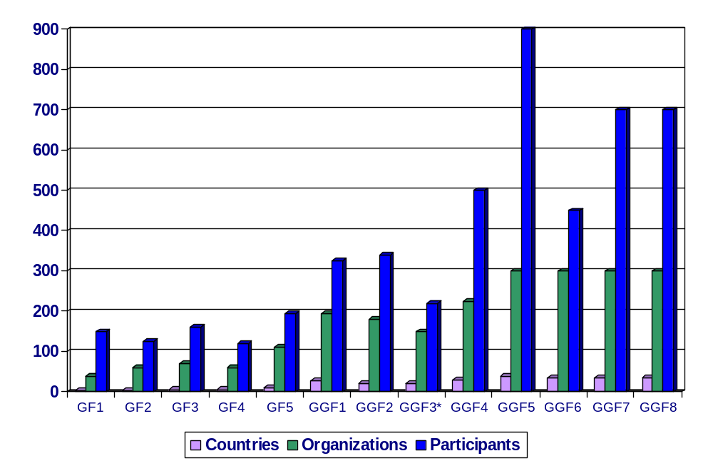
GGF Participation

Slide 17
Getting Involved
Participate in a GGF Meeting
  3x/year
  Join a working group or research group
  Electronic participation via mailing lists (see www.gridforum.org)
Contact a Steering Group member
    Ian Baird, Charlie Catlett, Andrew Chien, Peter Clarke, Cees DeLaat, Ian Foster, Andrew Grimshaw, Marty Humphrey, Bill Johnston, Ken Klingenstein, Domenico LaForenza, Satoshi Matsuoka, Jeff Nick, Bill Nitzberg, Jennifer Schopf, Satoshi Sekiguchi, Steve Tuecke

Slide 18
Upcoming GGF Meetings
5-8 October 2003: Chicago
  GGF-9 will be work sessions only
March 2004: Frankfurt
  GGF-10 will be work sessions only
June 2004: Hawaii
  GGF-11 will be joint with HPDC-12
    HPDC: 2.5 day Grid academic/research symposium
  Plenary, Tutorials, Workshops, Work sessions
September 2004: Chicago or Brussels
  GGF-12 will be work sessions only

Slide 20
GGF Copyright
This document and translations of it may be
  copied and furnished to others, and
  derivative works that comment on or otherwise explain it or assist in its implementation may be prepared, copied, published and distributed, in whole or in part,
without restriction of any kind, provided that the above copyright notice and this paragraph are included on all such copies and derivative works.
However, this document itself may not be modified in any way,
  such as by removing the copyright notice or references to the GGF or other organizations,
except as needed for the purpose of developing Grid Recommendations
  in which case the procedures for copyrights defined in the GGF Document process must be followed,
or as required to translate it into languages other than English.

Slide 21
GGF Intellectual Property Policy: Note Well
Contributions
  All statements related to the activities of the GGF and addressed to the GGF are subject to all provisions of Section 17 of GFD-C.1 which grants to the GGF and its participants certain licenses and rights in such statements. Such statements include verbal statements in GGF meetings, as well as written and electronic communications made at any time or place, which are addressed to:
    the GGF plenary session,
    any GGF working group, research group, or portion thereof,
    the GFSG, or any member thereof on behalf of the GFSG,
    the GFAC, or any member thereof on behalf of the GFAC,
    any GGF mailing list, including any working group or research group list, or any other list functioning under GGF auspices,
    the GFD Editor or the GWD process
  Statements made outside of a GGF meeting, mailing list or other function, that are clearly not intended to be input to an GGF activity, group or function, are not subject to these provisions.

Slide 22
GGF Intellectual Property Policy: Notices
Where the GFSG knows of rights, or claimed rights,
  the GGF secretariat shall attempt to obtain from the claimant of such rights, a written assurance that
    upon approval by the GFSG of the relevant GGF document(s),
    any party will be able to obtain the right to implement, use and distribute the technology or works when implementing, using or distributing technology based upon the specific specification(s)
    under openly specified, reasonable, non-discriminatory terms.
  The working group or research group proposing the use of the technology with respect to which the proprietary rights are claimed may assist the GGF secretariat in this effort.
  The results of this procedure shall not affect advancement of document, except that the GFSG may defer approval where a delay may facilitate the obtaining of such assurances.
  The results will, however, be recorded by the GGF Secretariat, and made available.
  The GFSG may also direct that a summary of the results be included in any GFD published containing the specification.

