Slide 1

NASA
Software Safety Standard
Cynthia Calhoun
NASA Glenn Research Center
Cleveland, Ohio
Fourth Annual Southeastern
Software Engineering Conference
March 29, 2005

Slide 2
Software and System Safety
When a device or system can lead to injury, death, the destruction or loss of vital equipment, or damage to the environment, system safety is paramount.
System safety discipline focuses on “hazards” and the prevention of hazardous situations.
Hardware or software that can lead to a hazard, or is used to control or mitigate a hazard, comes under the “hazard” category.
Software safety discipline expands beyond the immediate software used in hazard control or avoidance to include all software that can impact hazardous software or hardware.
Software must be safe.
“Software does not fail – it just does not perform as intended.”
Dr. Nancy Leveson, MIT

Slide 3
Hazardous Software
A hazard is the presence of a potential risk situation that can result in or contribute to a mishap. Every hazard has at least one cause, which in turn can lead to a number of effects.
A hazard cause may be a defect in hardware or software, a human operator error, or an unexpected input or event which results in a hazard.
A hazard control is a method for preventing the hazard, reducing the likelihood of the hazard occurring, or the reduction of the impact of that hazard.
Software can be used to detect and control hazards, but software failures can also contribute to the occurrence of hazards.

Slide 4
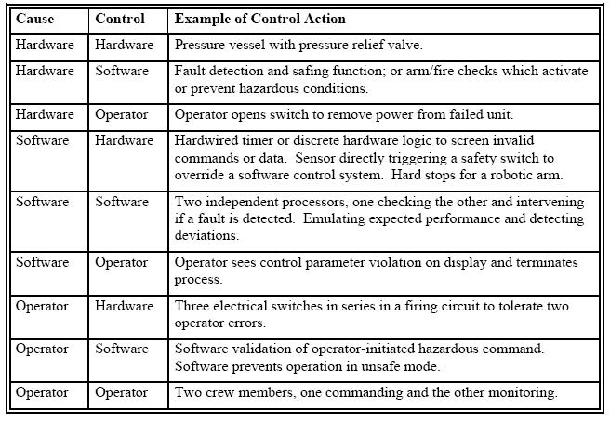
Hazard Causes and Controls

Slide 5
Software Safety Discipline
The aspects of software engineering and software assurance that provide a systematic approach to identifying, analyzing, and tracking software mitigation and control of hazards and hazardous functions (e.g., data and commands) to ensure safer software operation within a system.
NASA-STD-8719.13B Software Safety Standard provides requirements that will ensure the safety-critical software receives the required levels of attention throughout the project life cycle.

Slide 6

Software Safety and Project Development
System Safety
Project Development
Concept
Hardware Design, Build, Test
Software Design, Code, Test
Software Safety
Operations
K. Berens – “Enhancing Safety in Software-Intensive Systems”

Slide 7
The
NASA-STD-8719.13B
Software Safety Standard

Slide 8
Overview
Developed by the NASA Office of Safety and Mission Assurance to provide the requirements for software safety across all NASA Centers, programs and facilities.
Provides requirements to implement a systematic approach to software safety as an integral part of the project’s overall system safety program, software development, and software assurance processes.
Available for Project Managers, Software Engineers, Software Assurance Engineers, System Engineers, and safety practitioners to utilize as requirements for assessing software’s contribution to safety and quality.

Slide 9
Purpose
Describes the activities necessary to ensure that safety is designed into the software that is acquired or developed by NASA and that safety is maintained throughout the software and system life cycle.
Specifies the software safety activities, data, and documentation necessary for the acquisition or development of software in a safety-critical system.
Contains two types of safety requirements:
  Process Oriented Requirements - what needs to be done to ensure software safety.
  Technical Requirements - what the system must include or implement (e.g., two-fault tolerance).
  Both need to be addressed and properly documented within a program, project, or facility.

Slide 10
Applicability
Applicable to all safety-critical software acquired or developed by NASA.
  Flight, Ground Support, and Facilities software.
  Software that resides in hardware (i.e., firmware).
  Government furnished software.
  Purchased software (including commercial-off-the-shelf (COTS) software).
  Reused software when included in a safety-critical NASA system.
  Software in a system already in development or is a part of a legacy system.

Slide 11
Tailoring
While the requirements of the NASA Software Safety Standard can not be tailored, the activities performed to meet the requirements in the Standard can and should be tailored.
  Although the requirements must be met, the implementation and approach to meeting these requirements may and should vary to reflect the system to which they are applied.
  The level of risk posed by the safety-critical software will be a function of the hazard criticality and the degree of control the software has over the safety functions of the system.

Slide 12
Safety-Critical Software [1]
1. Resides in a safety-critical system (as determined by a hazard analysis) AND at least one of the following:
  a. Causes or contributes to a hazard.
  b. Provides control or mitigation for hazards.
  c. Controls safety-critical functions.
  d. Processes safety-critical commands or data.
  e. Detects and reports, or takes corrective action, if the system reaches a specific hazardous state.
  f. Mitigates damage if a hazard occurs.
  g. Resides on the same system (processor) as safety-critical software.

Slide 13
Safety-Critical Software [2]
2. Processes data or analyzes trends that lead directly to safety decisions (e.g., determining when to turn power off to a wind tunnel to prevent system destruction).
3. Provides full or partial verification or validation of safety-critical systems, including hardware or software subsystems.
Assume the software is safety-critical.
  Prove that it is not.

Slide 14
Software Safety Management
Organization and Responsibilities
Software Safety Planning
Personnel Qualifications and Training
Resources
Software Life Cycles
Documentation Requirements
Traceability
Discrepancy and Problem Reporting and Tracking
Software Configuration Management Activities
Software Assurance Activities
Tool Support and Approval
Off-the-shelf Software (COTS/GOTS/OTS)
Contract Management
Certification Process
Waivers/Deviations
Security

Slide 15
Software Development & Safety Analyses
Describes which software safety tasks to perform for each software development life cycle phase, using the waterfall life cycle as the primary life cycle methodology.
  Software Safety Requirements and Analysis
  Software Design and Safety Analysis
  Software Implementation and Safety Analysis
  Software Test and Safety Analysis
Tracing system should be used to:
  Trace the flow down of the software safety requirements to design, implementation, and test.
  Map the relationships between software safety requirements and system hazard reports.

Slide 16
Software Safety Requirements & Analysis
Performed in conjunction with or immediately following the system hazard analysis.
Software safety requirements carry a unique identification in the software requirements specification for traceability purposes.
Software safety requirements should do more than prohibit unsafe behavior.
  Proactively to monitor the system.
  Analyze critical data.
  Look for trends.
  Signal when events occur that may be precursors to a hazardous state.

Slide 17
Software Design and Safety Analysis
Identifies software safety design features and methods.
Software design ensures that software safety features and requirements can be thoroughly tested.
Safety requirements are traced to the design elements that implement the requirement, and each design element is traced back to the requirements which implements it.
Analysis methodology is documented and any improperly designed safety features is documented and reported.

Slide 18
Software Implementation & Safety Analysis
All software safety design features and methods are implemented in the software code.
Software safety personnel are responsible for analyzing the method of implementation, documenting the analysis methodology used, and documenting and reporting any improperly implemented safety features.
Verification of each safety-critical code unit and data is completed prior to the unit’s incorporation in a higher-level code package.

Slide 19
Software Test and Safety Analysis
Software testing includes safety testing at the unit level and component level, as well as system and acceptance testing.
All artifacts used to conduct the tests are placed under configuration management.
All functional software safety requirements and safety-critical software elements are verified by testing.
Requirements that cannot be verified by test are verified by evaluation, inspection, or demonstration.
Results from the software and system test process, or the requirements verification evaluation, inspection, or demonstration process, are analyzed.

Slide 20
Operational Use of the Software
Requirements of this Standard continue to be applicable after the safety-critical software has been released for operations.
Software safety requirements to specify, develop, analyze, and test safety-critical software, applies to all changes made to the software or routine operational updates.
Operational documentation, including user manuals and procedures, describes all safety related commands, data, input sequences, options, and other items necessary for the safe operation of the system.
Requirements of this Standard expire for a particular facility or system only upon the retirement of that facility or system.

Slide 21
Requirements Compliance Matrix

Slide 22
Conclusions
Requirements specified in this Standard:
  Ensure that software is considered within the context of system safety, and that appropriate measures are taken to create safe software.
  Ensure that software safety is addressed in project planning, management, and control activities.
  Ensure that software safety is considered throughout the system life cycle, including generation of requirements, design, coding, test, and operation of the software.
  Ensure that software acquisitions, whether off-the-shelf or contracted, have evaluated, assessed, and addressed the software for its safety contributions and limitations.

Slide 23
Location of the Standard
NASA-STD-8719.13B
NASA Software Safety Standard
http://www.hq.nasa.gov/office/codeq/doctree/871913.htm

