Slide 1
This presentation is for illustrative and general educational purposes only and is not intended to substitute for the official MSHA Investigation Report analysis nor is it intended to provide the sole foundation, if any, for any related enforcement actions.

Slide 2
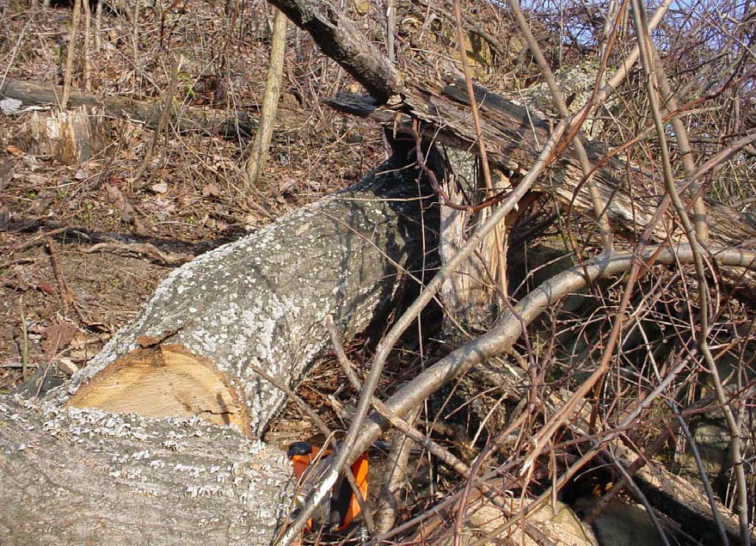
Coal Mine Fatal Accident 2004-27
GENERAL INFORMATION
Contractor: Mountaintop Clearing LLC
Operator: Catenary Coal Company
Mine: Samples Mine
Accident Date: December 2, 2004
Classification: Machinery
Location: District 4, Kanawha County, WV
Mine Type: Surface

Slide 3
ACCIDENT DESCRIPTION
A 44-year old contract employee with 4 years of mining experience was fatally injured while clearing trees and brush in advance of the surface mining operations. The victim was using a chain saw to cut a standing danger tree which contained a hanger tree (a fallen tree that has become lodged or wedged into a standing tree). As the victim cut the standing danger tree, the hanger tree fell and struck the victim.

Slide 4
ROOT CAUSE ANALYSIS
Causal Factor: During the examination of the work area, a danger tree was observed by the foreman, however; the foreman did not mark the danger tree to assure that other cutters would not cut the tree. Established work procedures were not followed. Work procedures described in the annual refresher training material requires that danger trees, which have not been corrected by mechanical means, be marked to eliminate exposure to the hazard.
Corrective Actions: The contractor revised the safety training guidelines portion of the annual refresher training and all workers had the new safety training. A list of the new safety procedures, which includes the marking of danger trees, was distributed, reviewed and signed by each employee.

Slide 5
ROOT CAUSE ANALYSIS
Causal Factor: The examination of the working area by the certified person designated to conduct the examination did not correct or report the hazardous condition to the operator.
Corrective Actions: Persons conducting workplace examinations were reinstructed in their responsibilities to identify, correct and report hazardous conditions to the operator. All tree cutter foreman received training in the identification, correction and reporting of tree cutting hazards.
Causal Factor: The communication of the presence of the hanger tree between the foreman and the victim was misunderstood.
Corrective Actions: The presence of hazardous conditions should be communicated effectively to all persons who may be exposed to the hazard. Hand communication, if used, should be standardized to eliminate the potential for misunderstanding. Verbal communication of hazards should be confirmed before allowing persons to work in a hazardous location.

Slide 6
CONCLUSION
The accident occurred because the danger tree, which was observed by the foreman, was neither marked nor taken down to assure that the other tree cutters would not expose themselves to the hazardous condition. Neither was the hazardous condition reported to the operator nor corrected. The failure to confirm communication concerning the danger tree between the foreman and the victim was also a factor in the accident.

Slide 7
ENFORCEMENT ACTIONS
104(a) Citation was issued to the Contractor for a violation of 30 CFR 77.1713(a) The operator conducted an inadequate daily examination of Area Q of this mine site. A hazardous condition was not reported and corrected by the operator. The foreman of the tree cutters found a hanger tree (a fallen tree that had become lodged/wedged into a standing tree), but failed to mark it as a danger tree or to remove it. Another tree cutter felled the danger tree and was killed.

Slide 8
BEST PRACTICES
Conduct thorough examinations. Identify and clearly designate any tree deemed unsafe to cut as a "danger tree" so all cutters will know that they are not to be cut (e.g. lodged trees or snags).
Prior to cutting a tree, conduct a visual examination for possible hazards and clear away any potential obstacles that could interfere with cutting the tree.
Select the best position from which to cut the tree and determine an escape route to use in case of an emergency.
Fell or remove each "danger tree" using mechanical or other techniques that minimize miner exposure.
Fell or remove each "danger tree" before work is commenced in the area.

