Slide 1
Section 4
LEISA Atmospheric Corrector

Slide 2
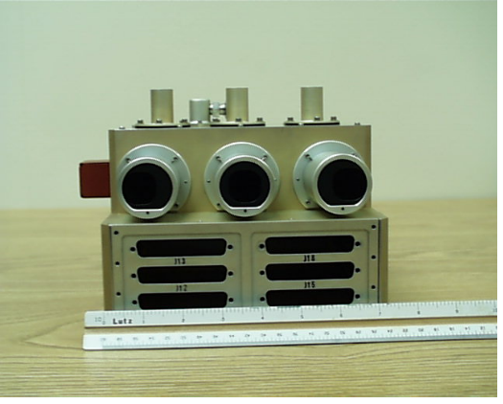
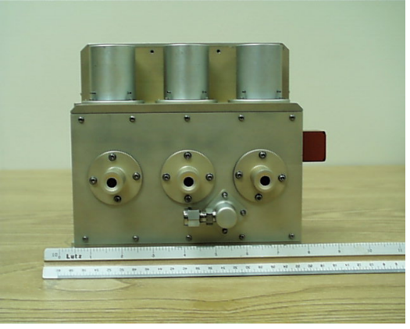
LEISA Atmospheric Corrector
Correction of multispectral surface imagery for atmospheric variability (water and aerosols)
High spectral, moderate spatial resolution (250m), large swath (180km) hyperspectral imager using wedge filter technology
Spectral coverage of 0.89 - 1.6µm, bands selected for optimal correction of high spatial resolution images

Slide 3
LAC Performance
High Spectral - Moderate Spatial Resolution Hyperspectral Imager Using Wedged Filter Technology (LVE)
Spectral Coverage: ~0.9 - 1.6 μm; 256 Bands Selected for Optimal Correction of High Spatial Resolution Images
Spectral Resolution: 35 cm⁻¹ (Δλ: 3 nm @ 0.9 μm, 9 nm @ 1.6 μm)
Swath Width: ~185 km; Matches Landsat
Spatial Resolution (pixel): 356 μradian (250 meter @ 705 Km)
Three 256 x 256 Element InGaAs Arrays; TEC Stabilized (<285 K)
Three 15 Degree FOV 3 Element Lenses
Two Modules: “Bolt-on”Optics Module and Electronics Module
Mass: 10.5 kg (EM, 4.4 kg; OM 3.9 kg; Cable 2.2 kg)
Power: 48 W (Peak); <15 W (Orbital Average)

Slide 4
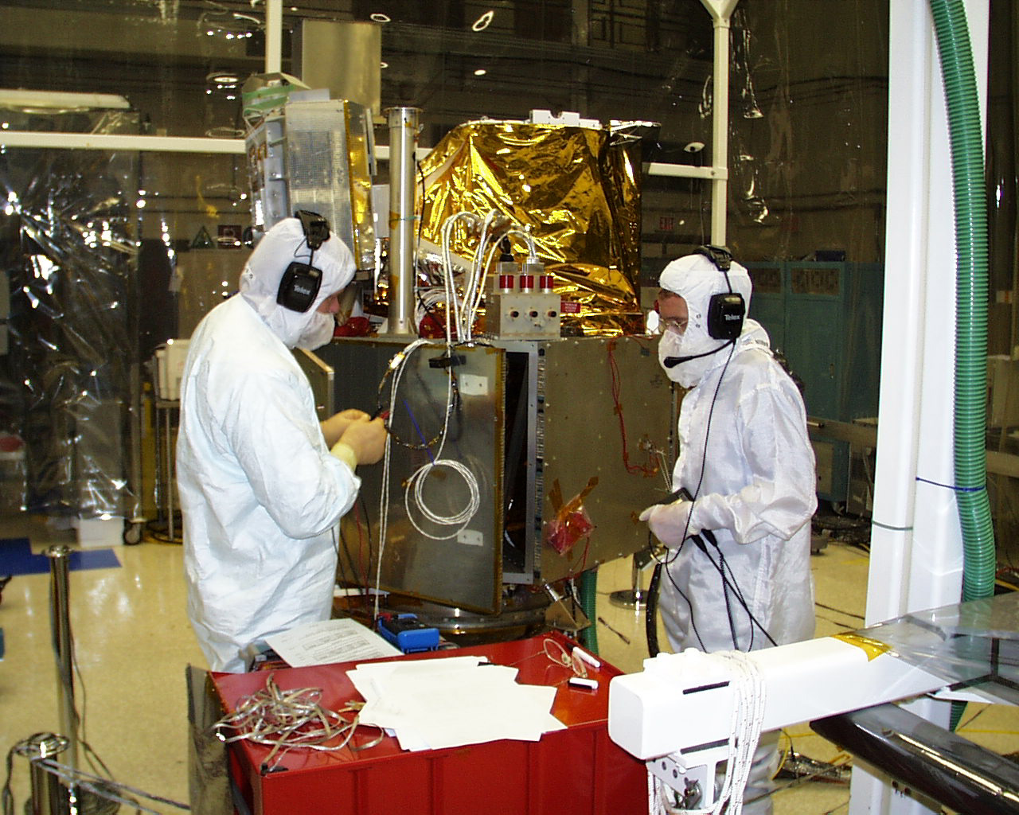
Comparative Size

Slide 5
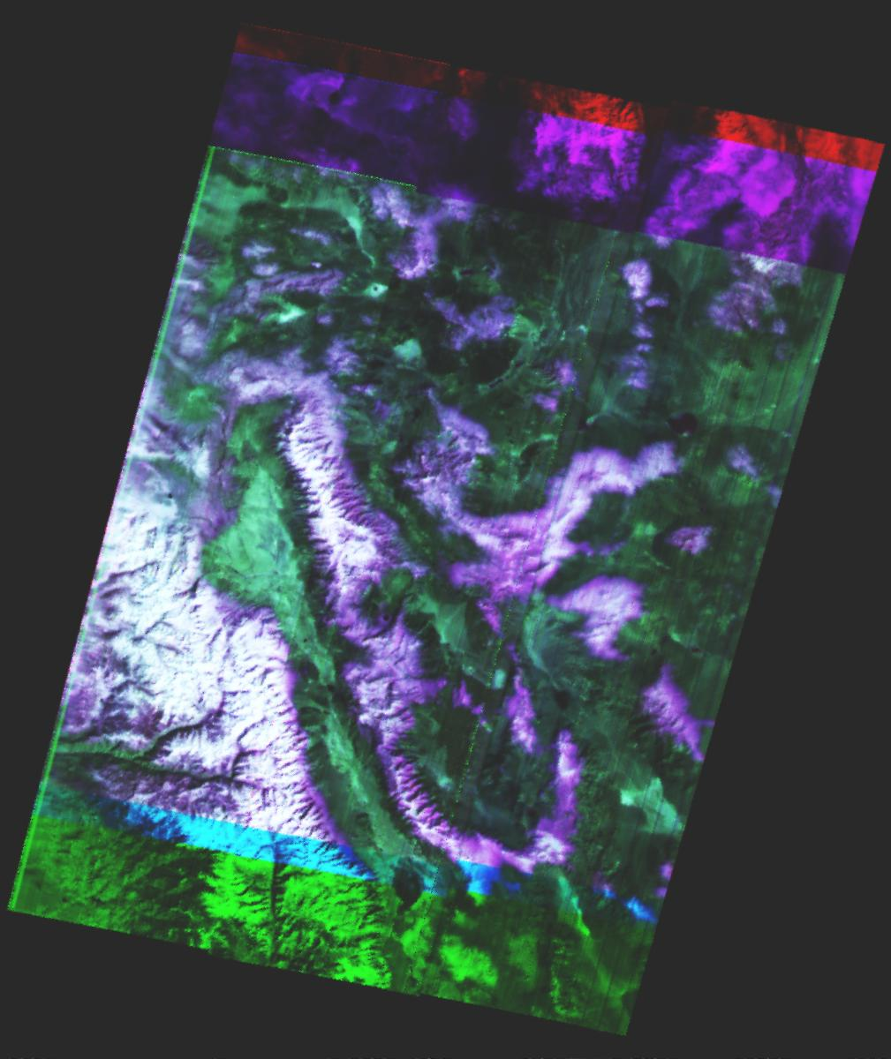
Color Composite Images
Cuprite, NV March 1, 2001
red=1.32, green=1.03, blue=0.98 (μm)

Slide 6
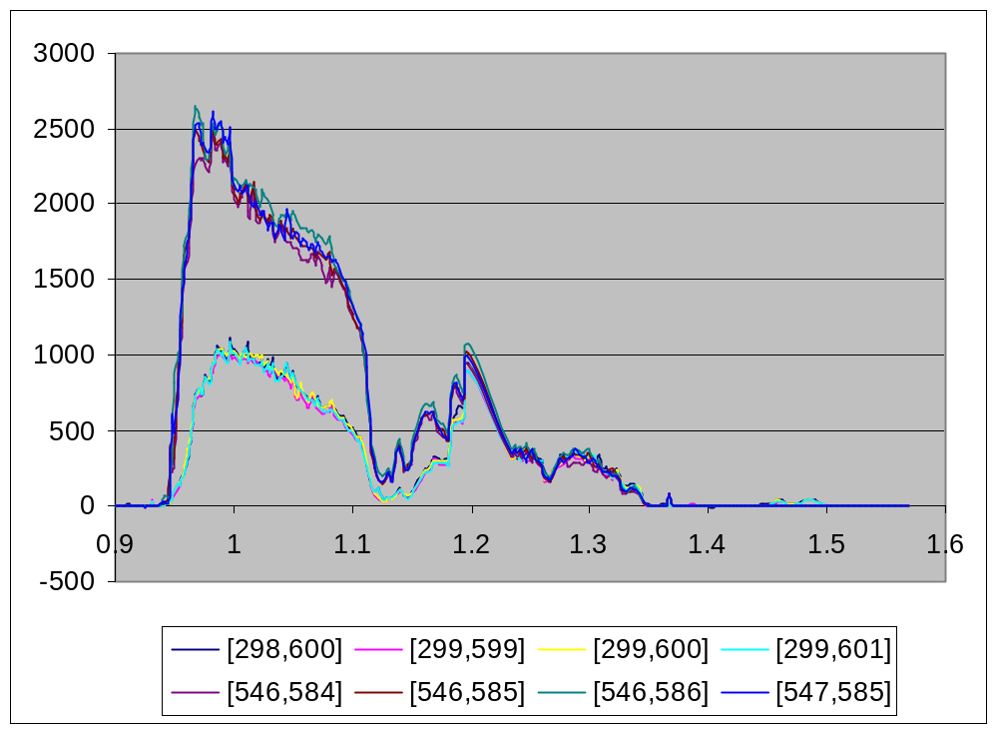
Spectra
Cuprite, NV March 1, 2001

Slide 7
Status
Operational: Complete
L1R Processing Software: Complete
Radiometric Calibration: Complete
  Non-linear correction being implemented
Geo-rectification Algorithms: Complete

