Slide 1

MNM Fatal 2007-30
Handtools Accident
October 24, 2007 (Indiana)
Limestone Operation
Assistant Superintendent
36 years old
17 years experience

Slide 2
Overview
The victim was injured on October 24, 2007,
while removing a loader bucket tooth lodged
in a crusher. He was struck by material that
had been placed on top of jacks in an
attempt to free the tooth. The victim was
hospitalized and died of his injuries on
October 29, 2007.

Slide 3
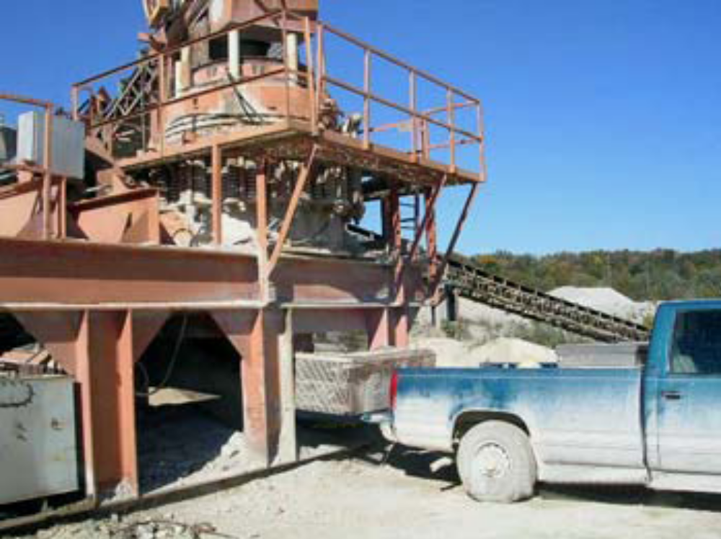

Slide 4
Causal Factors
Management policies procedures and controls were inadequate. Management had not developed safe work procedures to remove objects lodged in the crusher. The crew working to free the blocked crusher used jacks to raise the upper section of the crusher while it was under pressure from the compression springs.
Management did not have a system in place to prevent metal from entering the crusher.

Slide 5
Best Practices
Contact the manufacturer to discuss their recommendations before attempting to free wedged material.
Train persons in safe work procedures and ensure they are provided with the appropriate tools or equipment to safely perform the task.
Review maintenance procedures to ensure all possible hazards have been identified and appropriate controls are in place to protect persons.
Remember and use SLAM: Stop, Look, Analyze, and Manage.

