Slide 1



NIST Single Photon Workshop 2003
Uncertainty analysis of radiometric calibrations using correlated photons
Jessica Cheung and Chris Chunnilall
Optical Radiation Measurement Group
31 March 2003 © 2003 British Crown Copyright

Slide 2
Overview
Optical Radiation Measurement Group, NPL
Radiometric calibrations
Correlated photon technique
  Detector calibration
  Source radiance calibration
Current accuracies
Key uncertainty factors
Ultimate goal - Reducing these uncertainties
Current and Future plans

Slide 3
Optical Radiation Metrology at NPL
Responsibility for calibration requirements concerning:
Optical detectors and sources (200 nm – 14 μm)
Materials – reflectance, transmittance, fluorescence etc, appearance (200 nm – 56 μm)
Primary standard – cryogenic radiometer
Transfer standards

Slide 4
Radiometric calibrations
Current techniques – cryogenic radiometer
  Traceable to SI units of electricity
  Realised in few mW regime
Correlated photon techniques
  Direct realisation of scales (no calibration chain)
  Realised in photon-counting regime
  Responsivity & radiance scales realised independently
Ultimate goal
  New calibration facilities – absolute measurements in photon counting regime
  Reduce primary uncertainties to same/better level as current techniques – new primary scales

Slide 5
Spontaneous parametric downconversion
k₁, ω₁
ω_{p} = ω₁ + ω₂
k_{p} = k₁ + k₂
t₁ ≅ t₂
k_{p}, ω_{p}
k₂, ω₂
Non linear crystal
Simultaneous and Random process
Conversion efficiency ~ 10⁻⁷

Slide 6
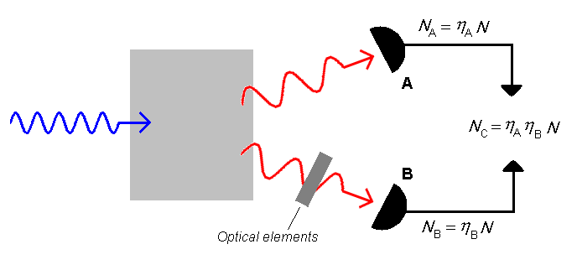
Detector calibration
N: number of photon pairs
N_{C}: number of coincidences
η_{A} = N_{C} / N_{B}
A is DUT channel,B is trigger channel
  Key sources of uncertainty
  Measurement of N_{C} – wide temporal window – jitter, others?
  Accidental coincidences A_{C}
  Losses in channel A: t_{A}
  Measurement of N_{B}
  False triggers due to shot noise, background: D_{B}
  Limiting optical elements can be placed in the trigger path B
  Alignment – optimisation, stability, reproducibility
  η_{A} = (N_{C} – A_{C}) / [t_{A} (N_{B} – D_{B})]

Slide 7
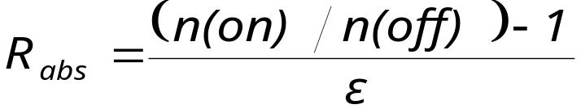
Source radiance
  Stimulated down-conversion
  Absolute measurement relative to one-photon/mode vacuum fluctuation
R _{vac} = h c ² / λ ⁵
k₁, ω₁
visible
(counts, n, are of visible photons)
k_{p}, ω_{p}
IR measured with visible detector
k₂, ω₂
Key sources of uncertainty
Loss in path from source to down-conversion region
Overlap of pump and injected source
Alignment – optimisation, stability, reproducibility
Infrared

Slide 8
Current accuracies:
 | Cryogenic Radiometer (%) | Correlated Photons (%)
Responsivity | 0.01 → 0.001 | 0.5
Radiance | 0.3 → 0.01 | 1
Required improvement:
<1 order of magnitude for direct calibration in photon-counting regime
1 to 2 orders of magnitude for realisation of primary scales

Slide 9
Schematic of NPL set up for detector calibration
delay on DUT arm
TTL
NIM
994
DUT
NIM
dual counter
TTL
λ/2 plate
9308
TRIGGER
filter
PBS
BBO
picosecond time analyser
laser
351.1 nm

Slide 10
Summary of key uncertainty factors
Characterisation of optical path loss
Measurement of coincidence counts (η)
Alignment issues:
How well can we align system ?
How stable is this alignment ?
How reproducibly can this be carried out ?

Slide 11
Characterisation of Optical path loss
Want to drive to 0.01% or better:
Losses between crystal and detector
most challenging will be losses in crystal
Current techniques
Classical (grating spectrometer based) spectrometry (0.03%)
Laser-based techniques (0.01%)
Developing improved techniques
Laser-based Gonioreflectometer (aim 0.01%)
Mode locked laser technique (0.03%)

Slide 12
Laser based techniques: Coherence effects
Coherence of laser radiation leads to errors in spectrophotometry of the order of several percent,
  e.g. in specular transmittance due to interference in reflected beams:
Solution:
Wedged sample
Or
Mode locked laser
Parallel sided
sample

Slide 13
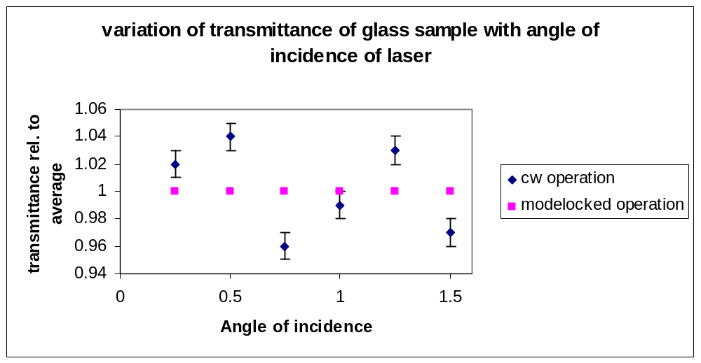
Mode locked laser techniques
Mode-locked laser has pulses of width approx. 0.3 mm.
  No interference for sample thicker than 0.15 mm ??
transmittance of glass plate at 800 nm with cw and with modelocked laser

Slide 14
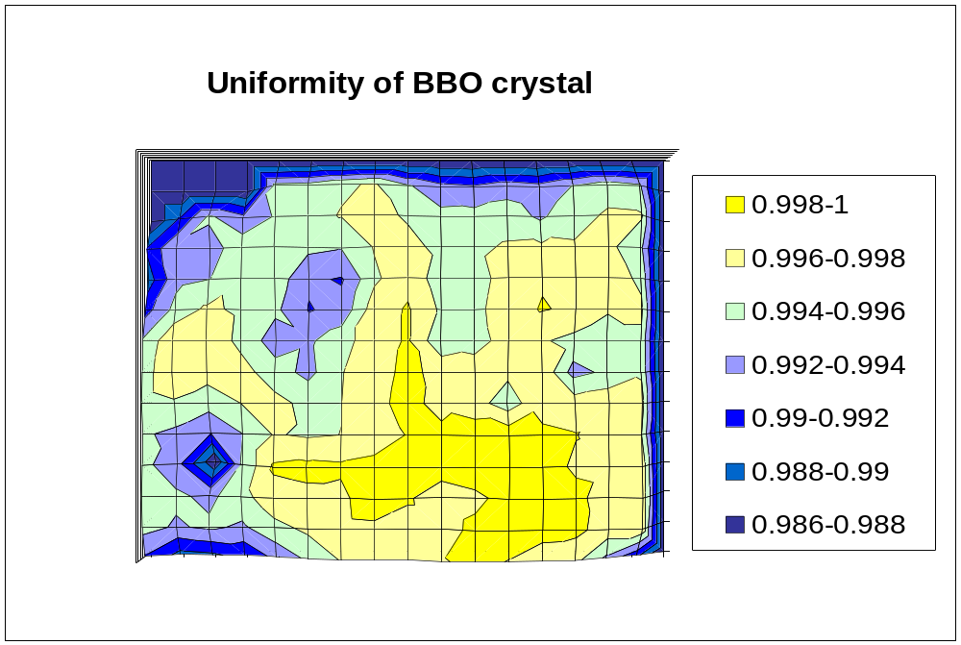
Limited by quality of crystal
Map scan of 3mm thick BBO crystal (with AR coatings – 632nm)

Slide 15
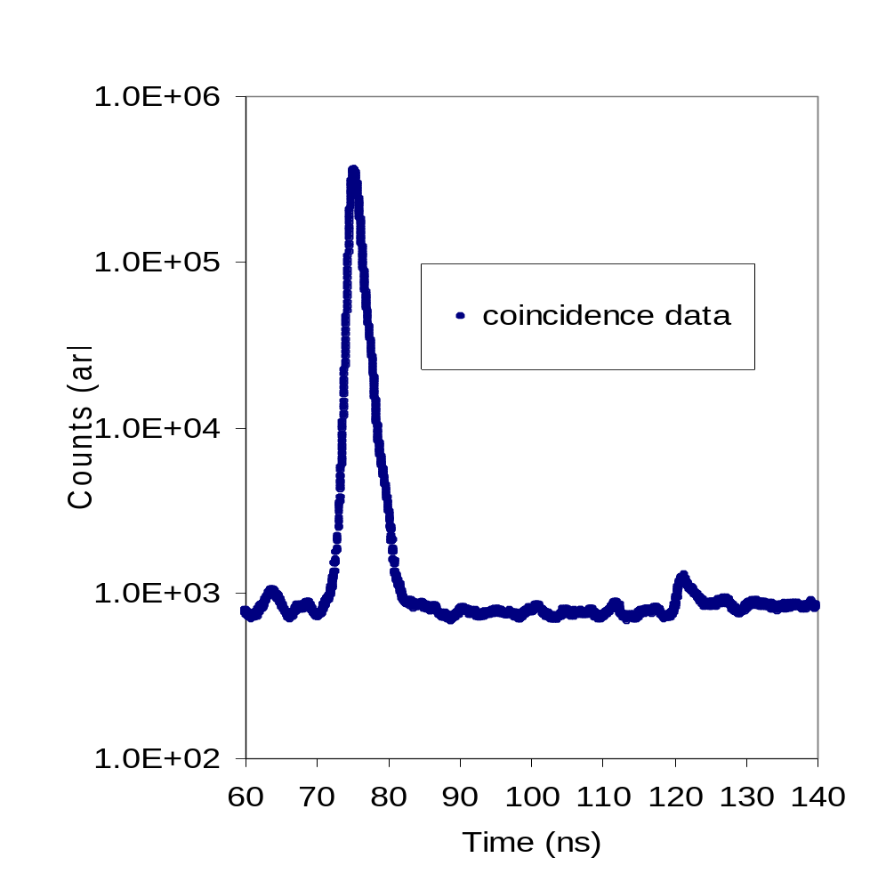
Measurement of coincidence counts
Pre-existing photons hit DUT before twin
DUT does not see twin but sees a subsequent ‘twin’ or background photon
Electronic features ?
Background -
half wave plate
Detection of false twins - careful choice of coincidence window

Slide 16
Alignment issues
Improvement to experimental facility:
Computer-control of detector positioning to optimise and maintain alignment
Map spatial uniformity of detectors
Intensity stabilisation of pump power during alignment process
Try to improve/quantify effects of beam pointing instability
Minimise effects due to temperature variation

Slide 17
Current and future plans at NPL
Optical losses – high accuracy measurements of transmittance losses
Alignment and reproducibility issues addressed via the use of automated stages and control software
Validate technique via
  In-house comparisons (cryogenic radiometer)
  Inter-comparisons with other NMIs (e.g. NIST, IEN)
Develop calibration facility in photon counting regime
Meet future requirements of technology for detector calibration
Primary scales

Slide 18
Acknowledgements
Chris Chunnilall (NPL)
Nigel Fox (NPL)
NIST
IEN
UK National Measurement Directorate
Principal contact: jessica.cheung@npl.co.uk

