Slide 1
Finite-Volume Formulation

Slide 2
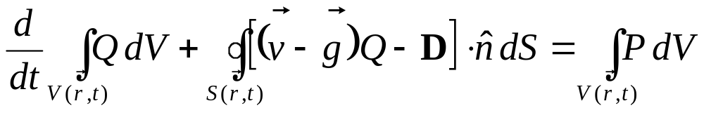
Review of the Integral Equation
The integral equation for the conservation statement is:
Equation applies for a control volume.
Control surface bounds the control volume.
Q is conserved quantity representing the flow.
Flow can be through the control surface.
Control volume and control surface can vary shape in time and space.
Flow can be time-varying (unsteady).
Time variation of Q in volume V
Flux of Q through surface S
Production of Q in volume V
V(r,t)
S(r,t)

Slide 3
Objective of the F-V Formulation
Represent the integral equation as an ordinary differential equation (then eventually an algebraic equation) amenable to a solution using computational (numerical) methods.
Thus, we need to approximate the volume integrals and the surface integrals to form algebraic expressions.
Prior to discussing these approximations, lets examine the control volumes on which the integrals will be approximated…

Slide 4
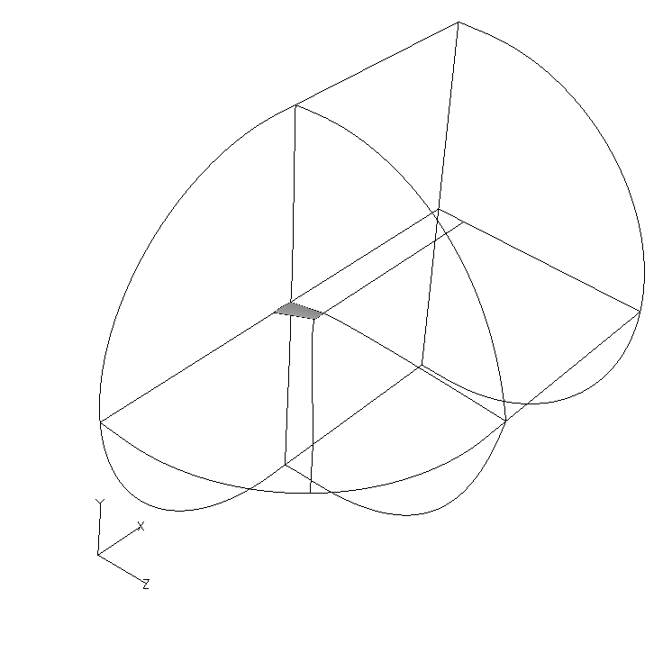
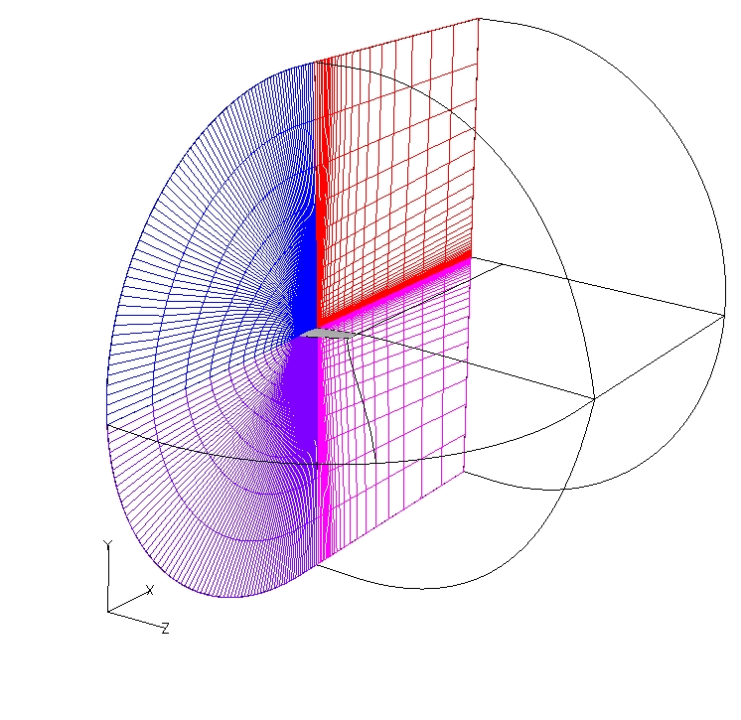
Domain, Zone, Grid, and Cell
The control volumes exists at several levels:
Flow Domain, Extent of CFD analysis
Zone, Divide domain for convenience, if needed
Grid, Divides the zone into cells
Cell, Smallest control volume, but “finite”
1 Domain
4 Zones
Let’s Examine a hexahedral cell
Each control volume is “air-tight”
Grid in each zone with 1000s of cells

Slide 5
General Classification of Grids
Grids can be classified as Structured or Unstructured:
A Structured Grid uses a topology in which the cells are arranged in an array structure. Location of neighboring cells is implicit in the array indices (i,j,k). This allows efficient storage and book-keeping of cell information.
An Unstructured Grid has no inherent ordering of the cells, and so, the arrangement of cells must be specified explicitly. Unstructured grids allow greater flexibility in generating and adapting grids at the expense of greater storage of cell information.
A Hybrid Grid contains both structured and unstructured grids, usually in separate zones.
WIND currently only uses structured grids; however, the unstructured capability has
been used at Boeing and is being tested at AEDC and GRC. This class will focus on
structured grids, but much of the material also applies to unstructured grids.

Slide 6
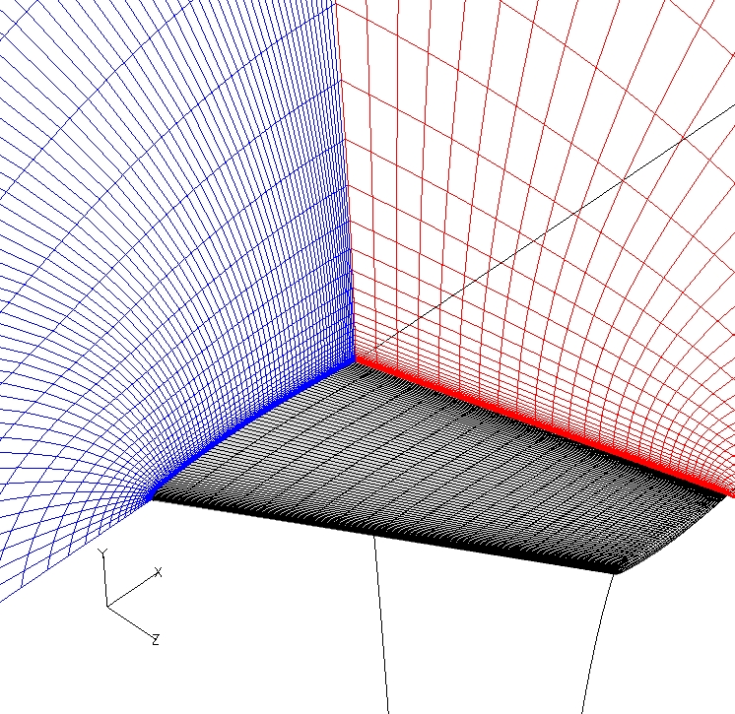
Structured Grid Example
Grid is “body-fitted” to the follow
the shape of the body (wing).
Grid points (vertices) are arranged
in an array structure with indices
(i,j,k).
Transformation between physical
space (x,y,z) and a Cartesian
computational space with
coordinates directions (ξ, η, ζ).
Grid points are clustered to the
wing to provide resolution of the
boundary layer.
Cells are hexahedral (6 quadrilateral
sides).
η, j
ξ, i
ζ, k

Slide 7
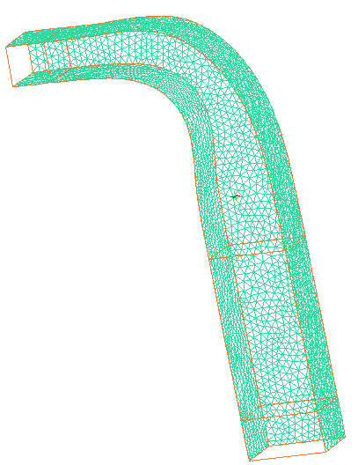
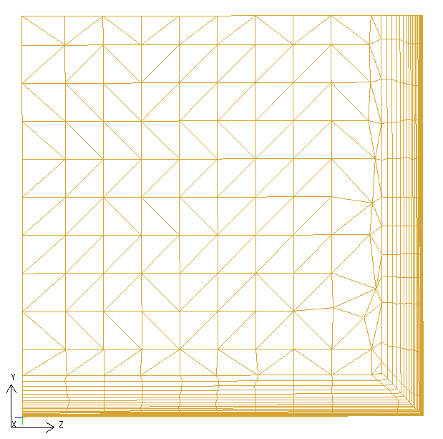
Unstructured Grid Example
Grid is “body-fitted” to the follow
the shape of the body (duct).
Grid points (vertices) are do not
have any set structure.
No transformation from physical
space (x,y,z) and a computational
Space. Specify and store geometric
and connectivity information.
Grid points are clustered to the
duct surfaces to provide resolution
of the boundary layer.
Cells are tetrahedral (4 triangular
sides).

Slide 8
Anatomy of a Finite-Volume Cell
Finite-Volume Cell:
Cell can take on a generalized shape.
Cell contains a finite (positive) volume.
Integral equation will be approximated on the cell to form an algebraic relation.
Size of cell indicates the level of computational resolution of the CFD analysis.
Control surface is faceted into a finite number of faces.
Faces can take on a variety of shapes.
Face is bounded by edges.
Edges are usually straight lines.
Edge
Cell
Face
Hexahedral Cell
6 Quadrilateral Faces
12 Linear Edges
(4 per face, edges shared)
As the cells become smaller and the number of cells in a grid increases, the computational effort increases.

Slide 9
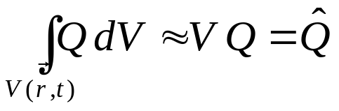
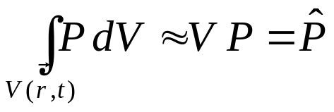
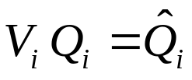
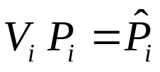
Volume Integral Approximation
Approximation: Q is uniform within the finite-volume:
The position of the solution point in the cell is not yet defined.
Cell i
(i is an index for the cell)

Slide 10
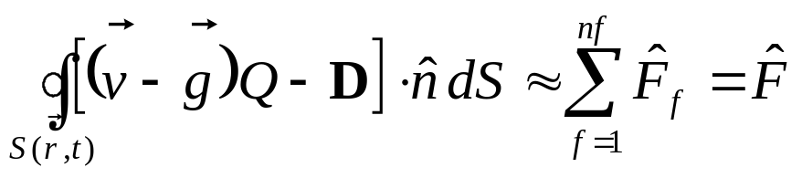


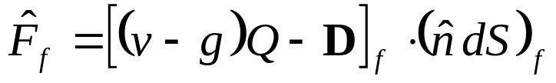
Surface Integral Approximation
Approximation: The flux is uniform over the surface of each face of the cell:
Area normal vector for face f
where the flux on the face is define as
Face f
( f is an index for the face )
Computing the flux on the face is one of the most difficult and computationally intensive operations of a CFD code.

Slide 11
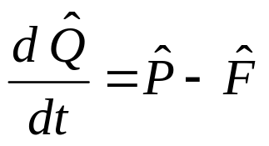
Resulting Equation
Start with the integral equation,
and substitute in the volume and surface integral approximations
to yield:
This equation is a first-order, non-linear, ordinary differential
equation for which various numerical methods exist for its
solution.

Slide 12

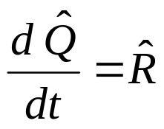
A Further Simplified Form
Further define
which will result in the form
This form will be used to simplify the discussion of the
time-marching methods.

Slide 13
Other Cell Shapes
A structured grid can only contain finite-volume cells with a
hexahedral shape. Unstructured grids allow greater freedom
for cell shapes. Possibilities include:
Generalized Cell (X quadrilateral faces, Y triangular faces)
Prismatic Cell (3 quadrilateral faces, 2 triangular faces)
Pyramidal Cell (1 quadrilateral face, 4 triangular faces)
Tetrahedral Cell (4 triangular faces)
To keep cell geometry simple, quadrilateral or triangular faces with straight-line
edges are generally used. The geometry and the normal area vector of a triangle
is uniquely known, and so, quadrilaterals are usually divided into triangles to
compute their geometric properties.

Slide 14
Location of the Solution in the Cell
The location of the flow solution and geometry of the finite
volume cell with respect to the grid can be of two types:
Cell-Vertex (Node-Centered) Cell. The flow solution is located at the
vertices of the grid. The finite-volume cell is formed about the vertex.
Cell-Centered Cell. The flow solution is located at the centroid of the cell
volume defined by the grid lines (primary grid).
Each approach has its advantages and disadvantages, but if things are
done right, both approaches do well.

Slide 15
Cell-Vertex Cell
· Solution located at vertices.
· Cell formed about vertex.
· Half-cell at the boundary.
· Solution point at boundary.
Vertex / Solution
Grid lines
Boundary
Cell edges
WIND uses a cell-vertex finite-volume cell.

Slide 16
Cell-Centered Cell
· Solution located at centroid.
· Grid forms the cell.
· Full cell at the boundary.
· Flux at boundary.
Vertex
Solution
Grid / Edge
Boundary

Slide 17
Simplified Cell Shapes
Often assumptions can be applied to simplify the geometry of the
flow domain, grid, and cells from a three-dimensional geometry:
Quasi-three dimensional cell. Grid is planar (x,y) with the z-coordinate varying to indicate variable depth of the cell.
Planar axisymmetric cell. Grid is planar (x,y) with y indicating the distance from an axis-of-symmetry. Angle of axisymmetric wedge indicates depth.
Planar two-dimensional cell. Grid is planar (x,y) with the z-coordinate indicating the fixed depth of the cell.
Quasi-one-dimensional cell. Grid is one-dimensional (x) with the cross-sectional area variable and specified along x.
One-dimensional cell. Grid is one-dimensional (x) with the cross-sectional area constant along x.
WIND needs at least a 2D grid (x,y).

Slide 18
Degenerate Cell Shapes
Degenerate cell shapes are sometimes used to build in flexibility:
Wedged-shaped cell. The hexahedral has one face on the boundary that has
collapsed to a line that is a singular axis. Since face as zero area, the flux is
zero, so all is fine with the numerical methods. Special boundary condition
is usually applied to handle these.
Sharp Nose Cell. The hexahedral has
one edge that has collapsed to a point.
This type of cell is used at a
sharp nose (i.e. nose
of a cone).
Singular axis
Nose
Next ⇒

