Slide 1
Introduction to BMT
What every pediatric heme/onc fellow should know
Allen R. Chen

Slide 2
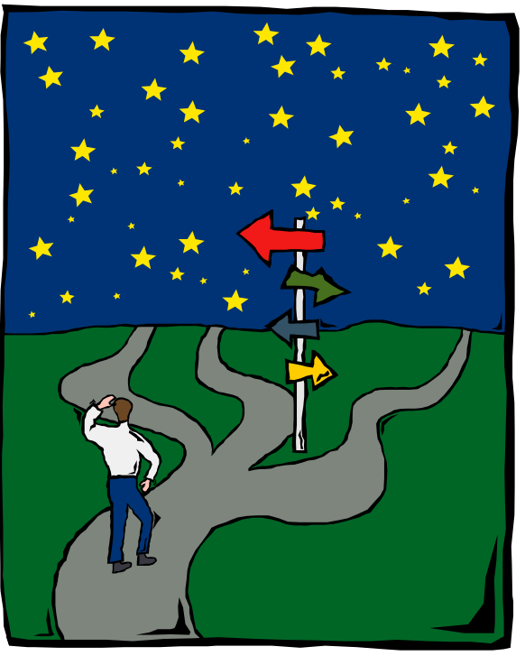
Introduction
Decisions
  Indications, donors, stem cell sources, preparative regimens, immunologic manipulations
Management of complications
  Regimen-related toxicities, opportunistic infections, graft failure, graft-vs.-host disease, relapse
Notes:
Translational research
Active evolution
High intensity therapy
Relatively little experience with decision-making during residency, lots in fellowship

Slide 3
Overview
Dx
HLA
Evaluation
Transplant
Outcome
Organ fn
Prep
Graft
GVH prophyl.
RRT
GVH
Engraft
Dx ctrl

Slide 4
Decisions
Indications
Donors
Graft
Preparative regimen
Immunologic regimen

Slide 5
Indications
Severe marrow dysfunction
  Immune deficiency
  Hematologic disease
  Metabolic disease
Facilitate giving a lethal dose of chemoradiotherapy
  Diseases incurable by conventional therapy
  Poor prognosis malignancies
  Relapsed/refractory disease
Immunotherapy of malignancy
  Break tolerance
  Allogeneic effect
Immunotherapy of severe auto-immune disease

Slide 6
Why BMT works for malignancies
Alkylator dose-response
0
Frei & Canellos, 1980
1
EMT6 (carcinoma)
2
PC5
3
B16 (melanoma)
4
KHT
Osteo
5
L1210
AKR
LL (lung ca)
6
0
100
200
300
Cyclophosphamide, mg/kg

Slide 7
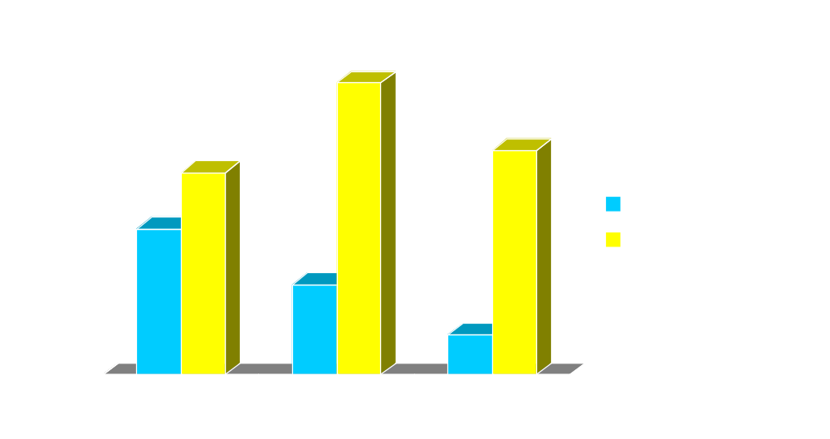
Why BMT works for malignancies
Allogeneic effect
Gale, 1994

Slide 8
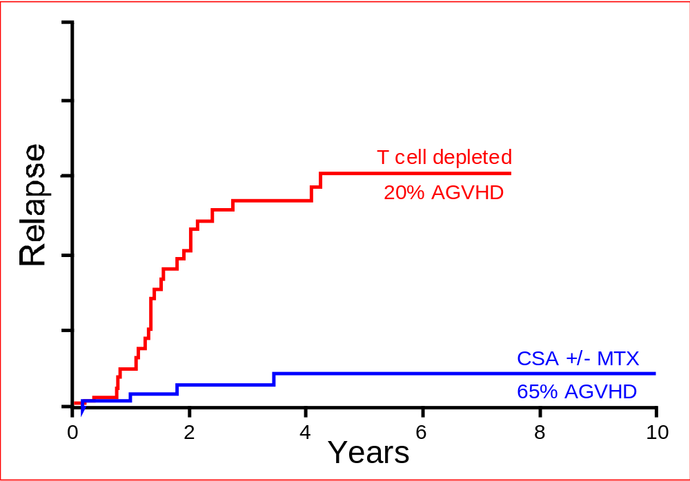
Why BMT works for malignancies
Graft-vs.-leukemia
Marks, 1992

Slide 9
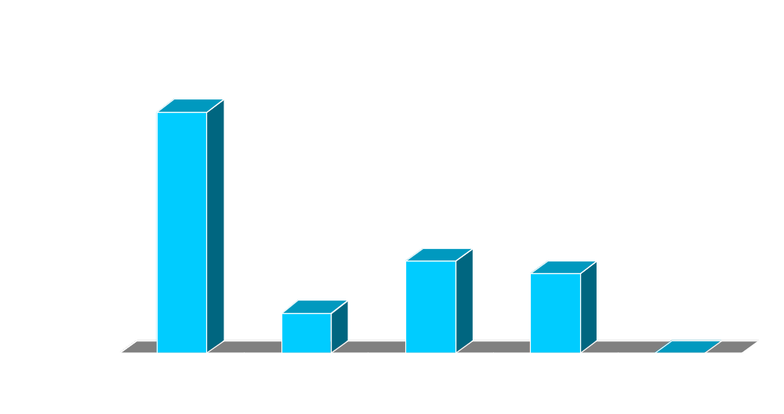
Why BMT works for malignancies
Efficacy of donor lymphocytes after relapse
Kolb, 1995

Slide 10
Decisions
Indications
Donors
Graft
Preparative regimen
Immunologic regimen

Slide 11
Donor selection
Autologous = Patient’s stored cells
Syngeneic = Identical twin
Allogeneic = Another person
  Genotypically HLA identical
  Phenotypically HLA matched
  Haploidentical +/- phenotypic matching

Slide 12
Histocompatibility
Why are HLA antigens the major histocompatibility antigens?
Function
Processing
Density on APCs
Context
CTLp frequency
Serologic responses
Antigen presentation
Not required
High
Heterogeneous
10⁻² to 10⁻³ vs 10⁻⁵
Positive

Slide 13
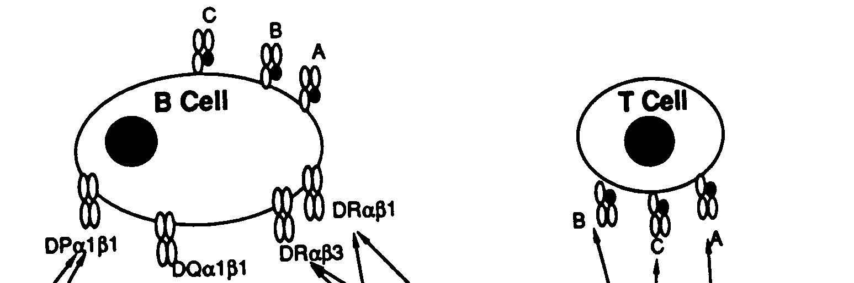
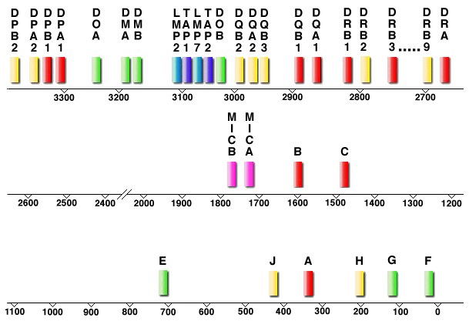
Histocompatibility: HLA
Function
Structure
Genetics
Sequence 1999 224 loci, 128 expressed
479 HLA-A, 805 B, 257 C, 460 DRB1, 34 DQA1, 73 DQB1, 23 DPA1, 125 DPB1 alleles (as of 7/06)
Notes:
Polymorphism
Linkage
MIC-A and MIC-B: ligands for activating NK and CD8 immunoreceptor, NK G2D, expressed on epithelial cells, class I homolog but independent of beta2microglobulin
TAP-1 and TAP-2: transporter for antigen presentation
LMP 2/7: large multifunctional proteasome

Slide 14


Importance of type of donor match

Slide 15
What’s the best typing for
A patient with no siblings?
A patient with all siblings and both parents available?
DNA
Serologic – but when is DNA typing necessary?
When parents appear to share antigens or appear homozygous

Slide 16
Decisions
Indications
Donors
Graft
Preparative regimen
Immunologic regimen

Slide 17
Choice of allogeneic graft
Vs. BM | Pro | Con
TCD BM | Less GVHD, mismatch more feasible | More relapse, infection, graft failure
PBSC | Faster engraftment, less infection, less relapse | More CGVHD, G-CSF for normal donor
Cord | Less GVHD, mismatch more feasible, fast searches | Slower engraftment, more early mortality

Slide 18
Decisions
Indications
Donors
Graft
Preparative regimen
Immunologic regimen

Slide 19
Preparative regimen goals
Overcome immunologic barrier to engraftment
Destroy malignant cells
Provide competitive advantage for normal cells

Slide 20
Preparative regimen:
Immunologic considerations
How mismatched is the graft?
Is the patient immune deficient?
Has the patient been alloimmunized?
Will the graft contain immune cells?

Slide 21
Preparative regimen:
Immunologic considerations
Cy
TBI
Bu
ATG, alemtuzumab
Fludarabine, cladribine, pentostatin

Slide 22
Preparative regimen:
Malignancy desiderata
Steep dose response
DLT is marrow suppression
Major increase in dose before the next DLT
No cross-resistance with prior therapy

Slide 23
Preparative regimen:
Malignancy considerations
TBI
Targeted radiation
  ¹³¹I-MIBG, ¹⁵³Samarium EDTMP, mAb anti-CD33
Alkylating agents
  Cyclophosphamide, busulfan, melphalan, thioTEPA, nitrosureas
Carboplatin
Topoisomerase inhibitors?
  Etoposide, topotecan

Slide 24
Non-myeloablative BMT
Improve post-transplant immune suppression, reduce preparative regimen intensity
Use graft immune cells to eliminate residual host immunity

Slide 25
When to use a non-myeloablative preparative regimen
High risk of RRT
Low benefit of ablative rx
Uncontrolled infection
Debilitated host
GVL > dose-response
Non-malignant disorder
  Loss of function
  Normal cells have survival advantage

Slide 26
Decisions
Indications
Donors
Graft
Preparative regimen
Immunologic regimen

Slide 27
Immunologic regimen
GVHD prophylaxis
  T cell depletion
  Immune suppression
  Specific tolerance
Immunotherapy for malignancy
  Alloreactive CTL
  NK
  Vaccine

Slide 28
18 y/o, AML, CR1
Good response to intensively timed DCTER
H/O presumed fungal pneumonia, BOOP
Matched sibling…
Bu-Cy
T cell replete BM, CSA/MTX
Alternative: Bu-Cy/Cy

Slide 29
12 y/o AML, CR2
Relapsed 11 mo after matched sibling BMT in first remission, Bu-Cy prep, CSA/MTX GVHD prophylaxis, no GVHD
H/O cardiomyopathy, resolved…
Cy-TBI, T cell replete PBSC, no GVHD prophylaxis
Alternatives: chemo/DLI, phase I, palliative care

Slide 30
10 y/o, ALL, CR2
BM relapse 6 months off therapy
Matched sibling…
Cy-TBI, BM +/- TCD

Slide 31
9 y/o, ALL, CR2
Relapse 3 years off therapy
Matched unrelated donor…
No transplant, salvage chemotherapy

Slide 32
6 y/o, ALL, CR2
CNS relapse 17 months from diagnosis
Matched sibling cord blood…
Modified craniospinal XRT, Cy-TBI, ATG, CSA

Slide 33
16 y/o with AA
Previously healthy
Matched sibling…
High Cy, T cell replete BM, CSA/MTX

Slide 34
9 y/o with AA
Severe AA, never treated before
No matched sibling, 4 potential URD…
High-dose Cy without BMT
Standard: Cy/TBI; URD BMT; CSA/MTX
Alternative: Flu/mel/campath; URD BMT; CSA/MMF

Slide 35
1 y/o, neuroblastoma 2nd relapse
Initially stage I, gross total resection, favorable biology
2nd metastatic relapse, responding to salvage chemotherapy…
ThioTEPA/topotecan/carboplatin auto PBSCT; mAb study; cis-retinoic acid

Slide 36
18 y/o, beta thalassemia
Chronic hepatitis C, poor chelation, hepatic fibrosis
HLA-identical sibling, ABO match…
Non-myeloablative fludarabine/cy/TBI, T cell replete BM, Cy/tacro/MMF

Slide 37
Infant with immune deficiency
Absent CD8, reduced CD4, intact B cells
Multiple bacterial sepsis, candidiasis, disseminated mycobacterial infection
Matched sibling…
Non-myeloablative fludarabine/TBI, T cell replete BM, tacrolimus/MMF

Slide 38
Complications
Regimen-related toxicities
Opportunistic infections
Graft failure
Graft-vs.-host disease
Relapse

Slide 39
Regimen-related toxicities
Immediate
Busulfan - seizures, N+V, D, rash
Cyclophosphamide - cardiomyopathy, hemorrhagic cystitis, N+V
TBI - fatigue, sialitis, burn, N+V, D, scrotal inflammation
Carboplatin - N+V, tubular & glomerular nephropathy, tinnitus, transaminase elevation
Etoposide - N+V, extremity pain, allergic reactions

Slide 40
Regimen-related toxicities
Delayed
Mucositis (day 0, peaks day 7 - 15)
Diarrhea (non-infectious before day 15)
Veno-occlusive disease of the liver (onset day 0 to 21)
Alopecia (onset day 7-14)
Pneumonitis (non-infectious before day 30)
Hemolytic-Uremic Syndrome (day 100+)

Slide 41
Regimen-related toxicities
Delayed
Mucositis (day 0, peaks day 7 - 15)
Diarrhea (non-infectious before day 15)
Veno-occlusive disease of the liver (onset day 0 to 21)
Alopecia (onset day 7-14)
Pneumonitis (non-infectious before day 30)
Hemolytic-Uremic Syndrome (day 100+)

Slide 42

VOD: Diagnostic criteria
Seattle: At least 2
  Hyperbilirubinemia > 2.5 mg/dl
  Hepatomegaly or RUQ pain
  Unexplained weight gain > 2% or ascites
Baltimore: Jaundice & at least 2
  Painful hepatomegaly
  Ascites
  Weight gain > 5%
Notes:
The features of the clinical syndrome are the same, with more stringent criteria in the East, so some cases will be missed, and less stringent criteria in the West, so some other entities will be included. There is a trade-off between sensitivity and specificity, and the optimal cutoff point depends on the prevalence of the condition in the population one is treating and the relative costs of a false positive and a false negative.

Slide 43
Differential diagnosis
Sepsis with cholangitis lenta
CHF / tamponade / constrictive pericarditis plus hemolysis
GVHD
Hepatic infiltration (fungus, tumor)
Pancreatitis, peritonitis, cholecystitis
Other patterns of hepatotoxicity

Slide 44
Confirmatory tests
Direct hyperbilirubinemia; ↑ALT/AST later
Lipase; paracentesis if febrile
CBC, coags: platelet consumption
FE_{Na} < 1% without volume contraction
Elevated PAI-1

Slide 45
Ultrasonography
Doppler
High hepatic artery resistive index
Monophasic hepatic venous flow
Slowing / reversal of portal flow
Gray-scale
Hepatomegaly
Splenomegaly
Gall bladder wall thickening > 6 mm
Ascites
Specific Sensitive
Notes:
Much is made of the ultrasound criteria, but these are certainly insensitive, with reversal of portal flow not universally present, particularly early in the course. Nevertheless, useful for showing what is not present, e.g. pancreatitis, cholecystitis, tumor mass, fungal abscesses, and reversal of portal flow has prognostic importance.

Slide 46

Transvenous manometry & biopsy
Hepatic venous pressure gradient:
Wedge pressure - free pressure ≥ 10 mm Hg
PPV 80%
< 10 mm Hg: NPV 80%

Slide 47
Etiology
Herbal tea: pyrrolizidine alkaloids
  Crotalaria, heliotropium, comfrey
Transplant prep regimens: Bu, Cy, TBI
Immune suppression
  Azathioprine
Standard-dose chemotherapy
  Actinomycin D, gemtuzumab ozogamycin (Mylotarg), cytosine arabinoside, dacarbazine, 6-thioguanine
Notes:
Cy metabolism: variable acrolein (toxic) and phophoramide mustard (desired alkylator)
Bu depletes glutathione. Strong relationship between PK and toxicity. Particularly high risk of VOD with prior liver irradiation, 2nd transplant.
Clear relationship between TBI dose, dose rate, & VOD.

Slide 48
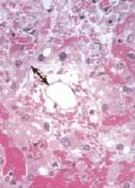
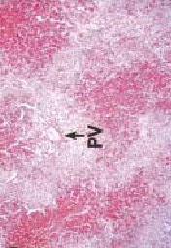
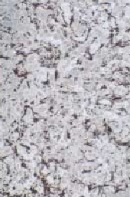
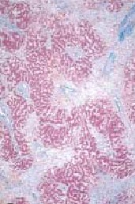
Histology
Early: edematous subendothelial zone; hepatocyte necrosis around central vein
Late: Stellate cell proliferation; fibrous matrix deposition in sinusoids
DeLeve, Shulman, & McDonald, Seminars in Liver Disease 2002
Notes:
Early: Venule is narrowed by subendothelial widening with edema, RBC fragments & debris. The area around portal triads (zone 1) is richly oxygenated and relatively spared. Hemorrhagic necrosis of hepatocytes begins in zone 3 (around central veins that become hepatic veins, hence “centrizonal necrosis”).
Late: Immunostain against smooth muscle shows proliferation of stellate cells in the sinusoids, and deposition of collagen in the sinusoids and venules.

Slide 49
Pathogenesis
Plasma abnormalities
Clotting cascade
  ↑PAI-1; ↓protein C, AT-III, platelets
Inflammatory cascade
  ↑TNF-α, TGF-β, IL-1, -2, -6, -8, sIL-2R
Notes:
Portal hypertension before parenchymal damage because disruption of microcirculation is the cause of parenchymal disease.
Sinusoidal obstruction precedes hepatic venular obstrucion, which correlates with ascites
Clotting cascade activated (plasma factors) but no clot histologically.

Slide 50
Histology
Early: edematous subendothelial zone; hepatocyte necrosis around central vein
Late: Stellate cell proliferation; fibrous matrix deposition in sinusoids
DeLeve, Shulman, & McDonald, Seminars in Liver Disease 2002

Slide 51
Pathogenesis
Animal model
Glutathione depletion from endothelial cells
Vasoconstriction
  ↑Endothelin-1, ↓NO
Endothelial cells round up
  ↑MMP-9 activity required
Sinusoidal lining dissects / embolizes
  ↑Hyaluronic acid, VWF, PAI-1, tPA
What the etiologic agents have in common:
Glutathione depletion
Greater toxicity against sinus endothelial cells than hepatocytes
Notes:
Portal hypertension before parenchymal damage because disruption of microcirculation is the cause of parenchymal disease.
Sinusoidal obstruction precedes hepatic venular obstrucion, which correlates with ascites
Clotting cascade activated (plasma factors) but no clot histologically.

Slide 52
How do you treat VOD?

Slide 53
Clinical course
Variable severity
Mild: self-limited
Moderate: symptomatic therapy
Severe: multiple organ failure, death from renal / cardiopulmonary failure

Slide 54
Supportive care
Maintain renal perfusion with minimum fluid retention
  Limit Na intake
  Support intravascular volume with cells & colloid
  Use diuretics with extreme caution
  Monitor weight, postural BP, BUN / creatinine, FE_{Na}
  Consider hemofiltration

Slide 55
Specific therapy: fibrinolytic
Rationale: Hypercoagulable plasma
t-PA response rate < 1/3
Effective only before day 15
Thrombocytopenic, 20% severe hemorrhage

Slide 56
Markers of severity
Bearman criteria
  Rapid ↑bilirubin & weight in first 2 weeks
MOF
  Creatinine 2 x baseline; O₂ requirement
PAI-1, IL-8, collagen peptide levels
High wedged pressure gradient, ALT

Slide 57
New agent: Defibrotide
ssDNA, specific binding sites on endothelium
Anti-thrombotic, anti-ischemic, fibrinolytic
Emergency use: 35 – 55% complete resolution
  Younger age, autologous SCT, reversal of portal flow favorable for survival
Flushing, low BP; exacerbation of bleeding
Phase II trial showed lower dose preferable
Pivotal trial starting up
Notes:
Specific binding sites on vascular endothelium
Increases PGI2, PGE2, TM, tPA in vitro and in vivo
Decreases thrombin generation, TF expression, PAI-1 release, endothelin activity.
Fibrinolytic activity is selective for small vessels, with no effects on systemic coagulation

Slide 58
Prevention
Dose reduction
Heparin (2+, 4-)
Ursodiol (2+, 1-)
Glutathione?
N-acetyl cysteine?
Defibrotide??
Notes:
AT-III infusions don’t prevent VOD.
Pentoxifylline (TNF-a release) doesn’t work
Ursodiol: 2 small RCTs showed benefit with very high control rates of VOD; larger RCT showed no benefit for VOD, but less GVHD (reduced inflammatory cytokine release from blood monocytes)

Slide 59
Regimen-related toxicities
Late
Leukoencephalopathy
Endocrinopathy
Growth impairment
Cataracts
Infertility
2nd malignancy

Slide 60
Regimen-related toxicities
Immune suppression
ATG
  Anaphylaxis, fever, chills, serum sickness
Cyclosporine, tacrolimus
  Nephropathy, peripheral neuropathy, CNS, hepatic, HTN
Methotrexate
  Delayed engraftment, mucositis, VOD
Mycophenolate mofetil
  BM, HA/tremor/insomnia, GI
Rapamycin
  TG, chl, BM, HTN, edema, GI, arthralgia

Slide 61
BM infusion reactions
Volume - especially in renal insufficiency
Emboli - inspect for clumps
Hemolysis - ABO incompatibility, RBC contamination of cryopreserved BM
DMSO
  N+V, odor, cardiac, nephrotoxicity, CNS
Foreign proteins
  Antibodies, complement, enzymes used in processing
Cytokines from platelets and WBC

Slide 62
Complications
Regimen-related toxicities
Opportunistic infections
Graft failure
Graft-vs.-host disease
Relapse

Slide 63
Infections - Bacterial
During pancytopenia
  Pseudomonas, other GNR
  S. epidermidis, S. aureus
  Enterococcus sp.
Subacute
  Atypical mycobacteria, e.g. fortuitum
CGVHD: functional asplenia

Slide 64
Infections - mycotic
Yeast
  Prolonged WBC << 100
  C. albicans
  Other
Aspergillus
  Aplastic anemia, GVHD
  A. fumigatus from airways
  A. flavus nosocomial outbreaks
Zygomycetes, Fusarium, Scedosporium

Slide 65
Infections - viral
HSV day 0-28 - stomatitis
BK day 0-100 - hemorrhagic cystitis
Adenovirus - hemorrhagic cystitis, hepatitis, nephritis
CMV day 30-60, CGVHD
  Pneumonitis, encephalitis, enteritis, hepatitis, retinitis
  Mortality 50% despite ganciclovir & CMV-Ig
  Reactivation in 25% of allogeneic recipients, esp. mismatched

Slide 66
Infections - viral
HVZ day 45+ - may disseminate
RSV day 0 - 60 - pneumonitis
Parvovirus
HHV6
EBV - lymphoproliferative syndrome

Slide 67
Infections – Pneumocystis jiroveci, formerly PCP
Day 30+ if intensive prophylaxis given during preparative regimen
7% incidence without prophylaxis
Prophylaxis
  Bactrim
  Dapsone
  Pentamidine
  Atovaquone

Slide 68
Complications
Regimen-related toxicities
Opportunistic infections
Graft failure
Graft-vs.-host disease
Relapse

Slide 69
Graft failure mechanisms
Immune rejection
Non-specific stem cell consumption
Inadequate stem cell dose or function
Marrow stromal dysfunction
Competition from abnormal endogenous cells
Toxic exposures

Slide 70
Graft rejection risk
Mismatch
T-cell depletion
Non-malignant disease
Alloimmunization, e.g. transfused aplastic anemia

Slide 71
Graft rejection risk
 | HLA-Genotype Non-identical N = 269 | HLA-Genotype Identical N = 930
Primary graft failure | 23 (8.6%) | 15 (1.6%)
Late graft failure | 10 (3.7%) | 4 (0.4%)
All failures | 33 (12.3%) | 19 (2.0%)

Slide 72
Graft failure risk: T cell depletion
Small lymphocyte dose / kg IBW | 1.0E+06 | 5.0E+05
n | 40 | 45
AGVHD II - IV | 21% | 11%
CGVHD | 56% | 6%
Graft failure early | 5% | 14%
Mixed chimerism |  | 32%
WBC recovery | 18 d | 22 d
Platelet recovery | 29 d | 44 d

Slide 73
Complications
Regimen-related toxicities
Opportunistic infections
Graft failure
Graft-vs.-host disease
Relapse

Slide 74
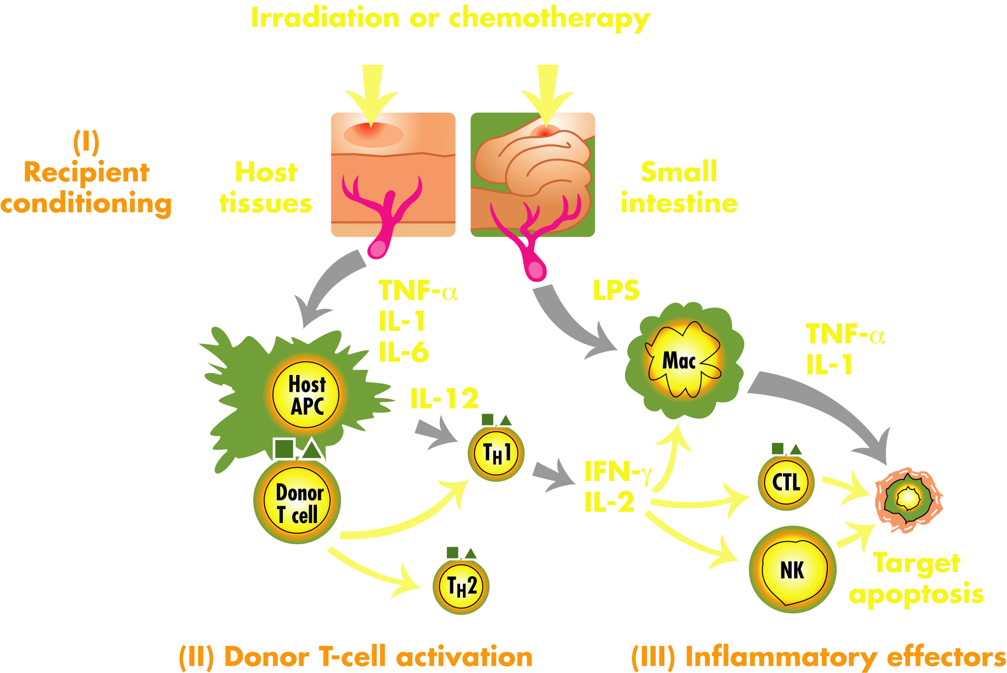
Pathophysiology of
Acute GVHD

Slide 75
Acute GVHD manifestations
Skin
  Pruritic erythematous maculopapular rash accentuated on ears, face, palms, soles, trunk
  May progress to total body erythema, blistering, like full-thickness burn, requiring grafting
GI
  Foul green slimy diarrhea
  May progress to voluminous diarrhea, cramping, tissue sloughing
Liver
  Cholestatic + hepatocellular inflammatory process
  Least likely to respond to medication

Slide 76
Staging for Acute GVHD Keystone Criteria
 | Stage 1 | Stage 2 | Stage 3 | Stage 4
Skin (Rash) | <25% of skin | 25%-50% of skin | >50% of skin | Erythroderma with bullous formation
Liver (Bilirubin) | 2-3 mg/dL | 3-6 mg/dL | 6 -15 mg/dL | >15 mg/dL
Gut (Diarrhea) | >500 mL/day | >1000 mL/day | >1500 mL/day | Abdominal pain and/or ileus
Przepiorka. Bone Marrow Transplant. 1995;15:825.
Notes:
The stage of GVHD is determined by a system that quantifies the extent of rash, serum bilirubin level, and the extent of the diarrhea.[Przepiorka 1995]

Slide 77
Grading for Acute GVHD Keystone Criteria
 | I | II | III | IV
Skin | Stage 1/2 | Stage 3 or | - | Stage 4
Liver | None | Stage 1 or | Stage 2/3 or | Stage 4
Gut | None | Stage 1 | Stage 2-4 | -
Przepiorka. Bone Marrow Transplant. 1995;15:825.

Slide 78
Survival after Allogeneic BMT by acute GVHD grade
0.8
0.6
0.4
0.2
0.0
Grade I
Proportion Surviving
Grade 0
Grade II
Grade IV
Grade III
0 20 40 60 80 100 120
Time from BMT, Months

Slide 79
Treatment of Acute GVHD
Corticosteroids are first line of therapy for acute GVHD
40%-60% of patients have a sustained response to corticosteroid therapy
Patients with steroid-resistant acute GVHD have an unfavorable prognosis
Champlin. Cancer Medicine. 2003:1019.

Slide 80

ATG for steroid-refractory acute GVHD
Arai, 2002 BBMT

Slide 81
ATG for steroid-refractory acute GVHD
100
80
60
Grade II
Survival
40
Grade III
Grade IV
20
0
0
10
20
30
Arai, 2002 BBMT
Months

Slide 82
GVHD: Chronic
Mimics scleroderma
Impedes immunologic recovery, so predisposes to opportunistic infection

Slide 83
Complications
Regimen-related toxicities
Opportunistic infections
Graft failure
Graft-vs.-host disease
Relapse

Slide 84
Management of relapse
Palliative care
Donor lymphocyte infusion
Chemotherapy
Cytokines
2nd BMT

Slide 85
Summary
Decisions
  Indications, donors, stem cell sources, preparative regimens, immunologic manipulations
Management of complications
  Regimen-related toxicities, opportunistic infections, graft failure, graft-vs.-host disease, relapse
Notes:
Apply training to management on inpt service
Evaluation during outpt rotations
BMT interest group

