Slide 1
Planning Bioenergy Options:
Climate Feedbacks and Information Needs
Robin L. Graham
Oak Ridge National Laboratory
November 15, 2006
Climate Science in Support of Decision Making
Session 4 Breakout:
Energy Management and Planning: Application of Climate Science

Slide 2
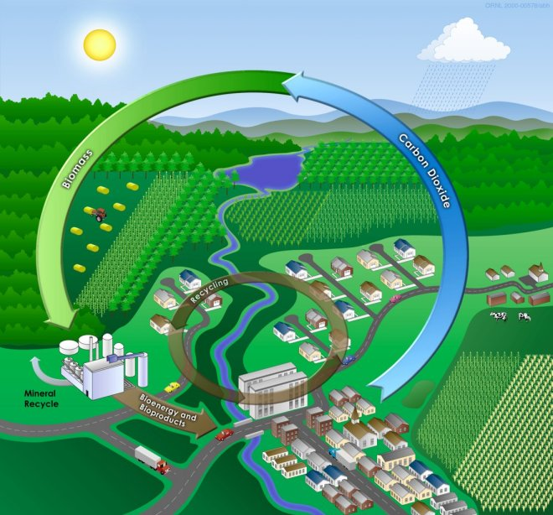
Bioenergy background
Feedstocks
Forest residue
Black liquor
Ag residues
Grains
  corn/soybeans/rapeseed
Urban wastes
  MSW, wood, cooking grease
Energy crops
  grasses
  trees
Energy forms
Heat
Power
Fuels
  ethanol
  biodiesel
  hydrogen

Slide 3
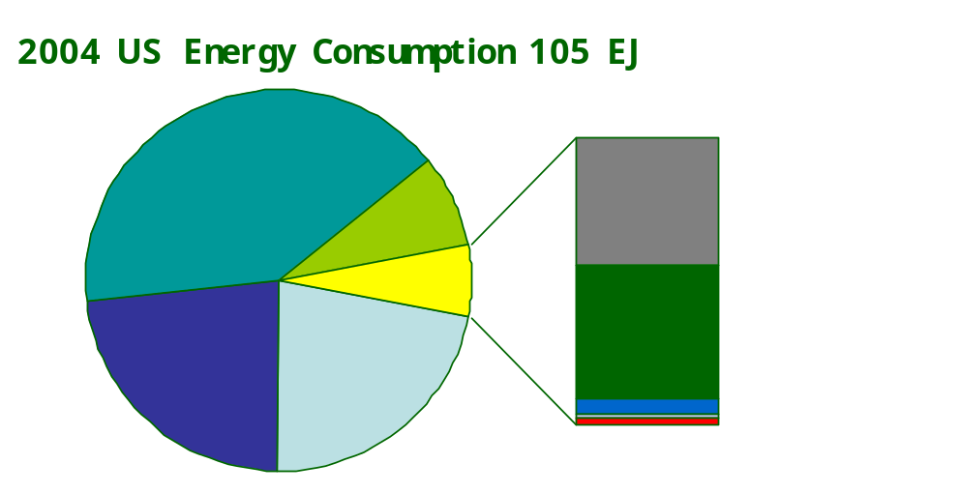
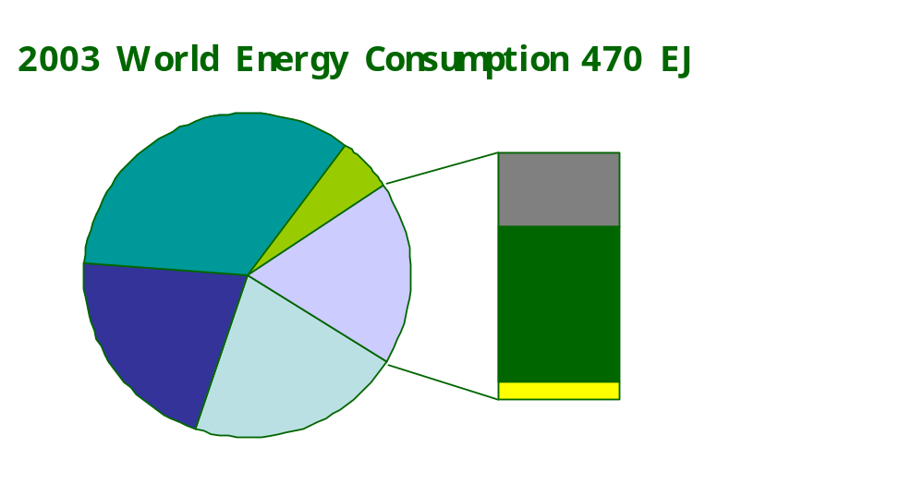
Bioenergy use
Current
Future??
2030 Goal – US Biomass R&D Act of 2000
  4 EJ power & heat
  8 EJ fuels
  28 Tg of bio-based chemicals
Oil
42.8 EJ
Hydro
2.9 EJ
Nuke.
8.7EJ
Renew
Bio
3.0 EJ
70% wood
20% wastes
10% EtOH
Nat gas
24.8 EJ
Coal
23.6 EJ
World estimates of technical bioenergy potential based on IPCC land–use scenarios (M. Hoojwijk et al. 2005)
Oil
162 EJ
Hydro
27 EJ
 | 2000 all | 2050 Biobased | 2100 biobased
Electricity (PWh/yr) | 15 | 63-132 | 98-225
Liquid Fuels (EJ/yr) | 142 | 171-361 | 217-613
Renew.
Bio
Fuelwood
55 EJ
Nat gas
99 EJ
Modern renewables
other than hydro
6 EJ
Coal
101 EJ
Notes:
Note- Most of US bio mass is wood and is used in the wood products industry for heat
Virtually all the US ethanol comes from corn – 13% of the US corn harvest goes to ethanol; we produce 3billion Gal/yr; ethanol production is rapidly rising due to subsidies, substitution for MTBE as an gasoline oxygenate. In 1995 we produced ~ 1 billion gallons so its tripled in the last 10 years. None the less US used 136 billion gallons of gasoline.
Biodiesel is usually created from Soy oil and methanol and it represents very small fraction of fuel use in the US. only ~36 million gallons in 2004. While regular diesel was 40.7 billion gallons.
World-
Fuel wood is still an very important source of energy in much of the world and estimates of fuel wood use range from 45 to 55 EJ/year. In contrast modern renewables ( electricity/biodiesel/wind/ethanol ) represent only 6 EJ

Slide 4
Bioenergy Climate
Reducing GHG emissions by displacing fossil fuels
Sequestering CO₂ in soils
Changing land surface albedo ?

Slide 5
Quantifying greenhouse gas benefits from displacing Fossil Fuels
Net bioenergy emissions- net fossil fuel emissions = Benefit
  Bioenergy GHG benefit depends on
  Energy type – transport fuel, electricity, heat
  Fossil fuel – coal, natural gas, oil
  Technologies used to create both the fossil and bio-based energy.
  Challenging because a single feedstock e.g. maize will be merchandized into many products - EtOH, protein, oil, starch, etc.
  Need to take a life cycle approach – e.g., from well to tailpipe or bare field to transmission line.
  Comparison done based on appropriate fuel unit- Net emissions/mile driven or kWh or MBtu heat or ha in production.
  Controversy over GHG benefits of bioenergy comes from how the system boundaries were drawn to do the analysis

Slide 6
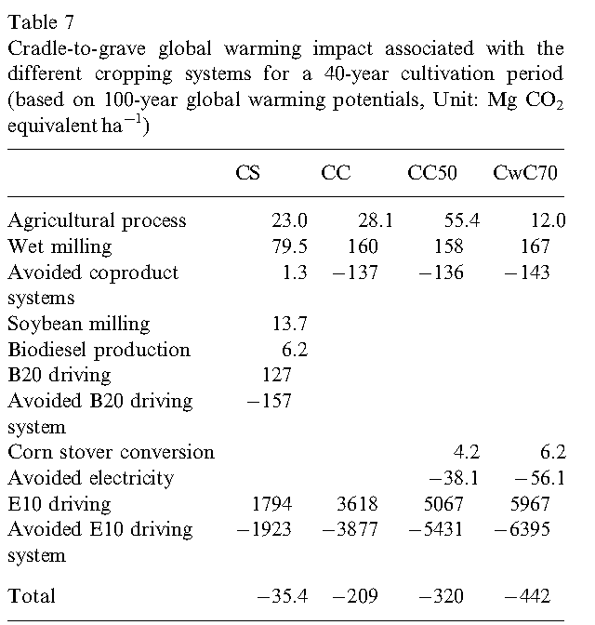
GHG benefits=f(Source of feedstock)
Life cycle analysis of GHG using a hectare of land for
No till corn grain & soybeans production to produce starch-based EtOH * biodiesel
Continuous no till corn grain production to produce starch-based EtOH
Continuous no-till corn w/50% stover removal to produce cellulosic & starch-based EtOH
Continuous no-till corn w/70% stover removal and a winter wheat cover crop to produce cellulosic & starch-based EtOH
Includes carbon sequestration
Kim & Dale 2005. Life cycle assessment of various cropping systems utilized for producing biofuels:bioethanol & biodiesel. Biomass and Bioenergy ( in press)

Slide 7
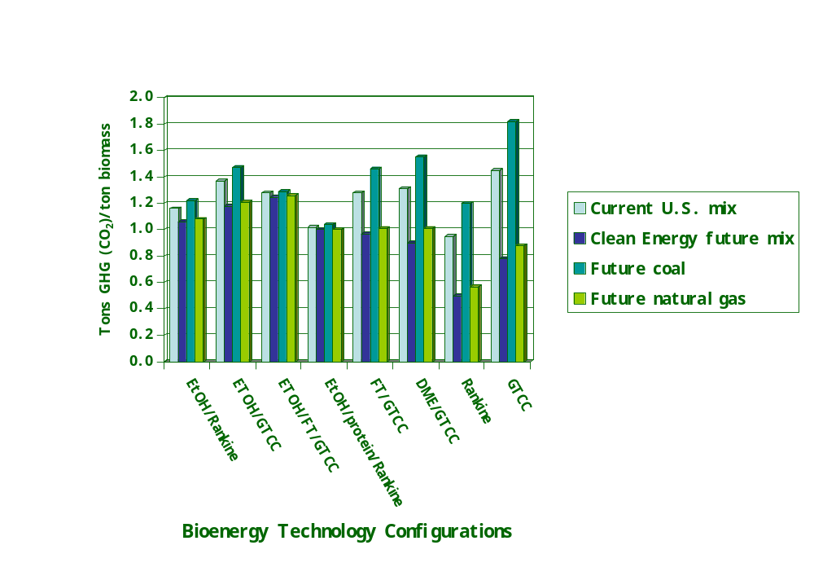
GHG benefits = f(bioenergy technology and competing fossil fuels)
Greene et al. 2004 Growing Energy: How Biofuels can help end America’s Oil Dependence. Natural Resource Defense Council

Slide 8



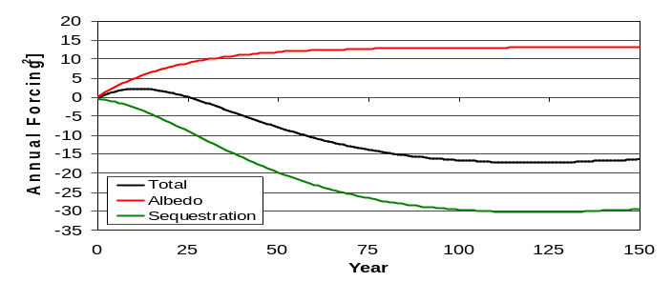
Bioenergy &
C sequestration & albedo changes
Production of biofeedstock can sequester or deplete soil carbon depending on land management
( energy crops vs. ag residue removal)
Bioenergy linked to geologic sequestration could actually reduce atmospheric CO₂ concentrations
  Power/heat production
  H₂ production
Decrease in albedo if woody energy
crop replaces herbaceous cover in a
region with snow cover.
CO
2
Conversion
to Hydrogen
H₂
CO₂
and sequester the CO₂
West & Marland 2005 personal communication

Slide 9
Climate Bioenergy?
EJ Bioenergy is function of
  Plant productivity/yield (Mg/ha/yr)
    Magnitude
    Temporal variation
  Land availability (ha)
    Demand for food & feed
    Demand for fiber
    Demand for conservation/biodiversity
  Demand for energy
  Conversion efficiency ( EJ/Tg)
Obvious Climate impacts but not so easy to quantify

Slide 10
What do we think we know about climate impacts?
Yield- Applicable to energy crops and ag residues
  Expected to go up in most of N. America due to CO₂ and technology
  Yield will go down in some places largely due to drought ( e.g. Subsaharan Africa)
  Secondary impacts on productivity (disease & pests) are largely unknown but expected to be negative
  Assume energy crop yields will increase like historic ag crop yields have increased ( 1-1.5%/yr) due to technology
  C₄ plants will respond less to CO₂ increase
  Yield variability may increase with increasing climate variability
Land area available for energy crops
  Most bioenergy potential studies don’t factor in land-use competition (Hoogwijk et al. 2003)
  Complex as it’s a function of climate change, population, food crop yields, technology assumptions
  Will increase in temperate latitudes; decrease in tropical

Slide 11
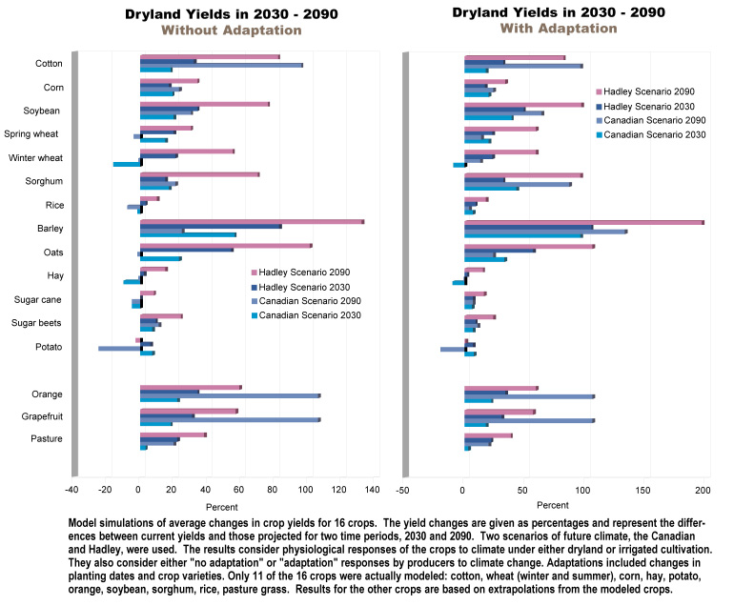
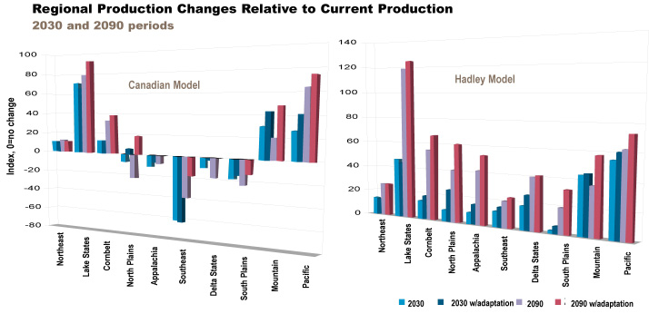
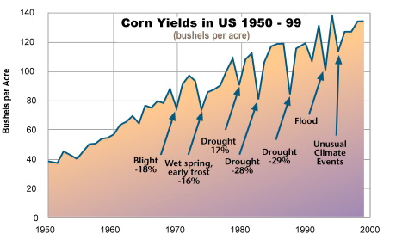
Direct Climate change effects on Ag Yield – U.S.
Bioenergy needs stable yields
Climate Change Impacts in the United States the Potential Consequences of climate Variability and Change
By the National Assessment Synthesis Team, US Global Change Research Program
Published in 2000
Notes:
Taking a global perspective, Agricultural production has winners and losers. Globally Agricultural production is expected to increase but there will be greater increases in developed countries and actual losses in many developing countries. ( Fischer 2002.. IAASA report… Lal 2005)

Slide 12
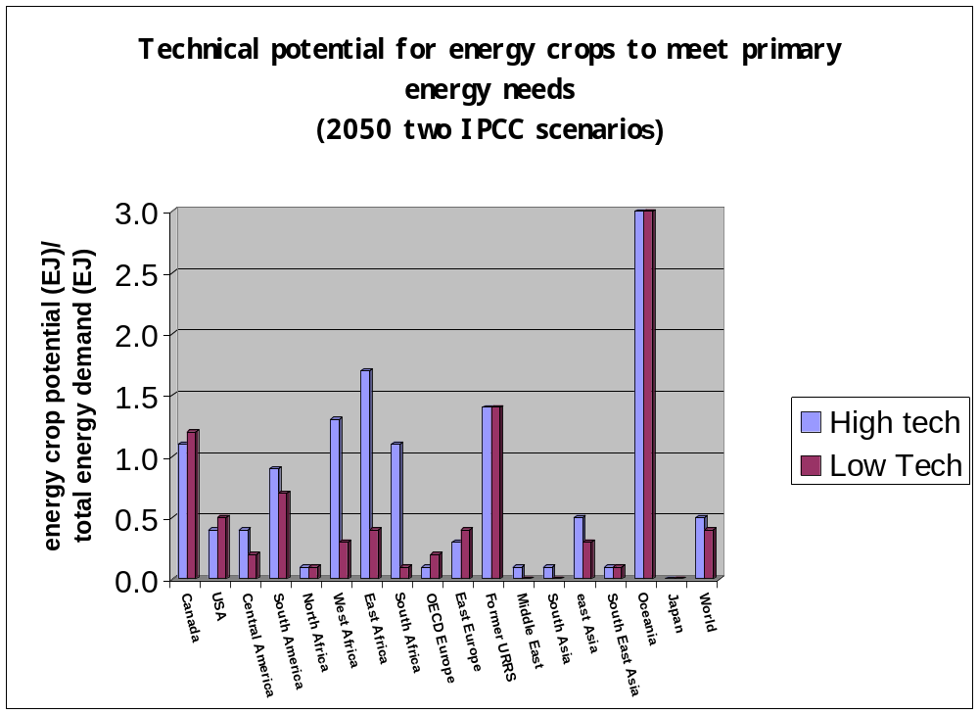
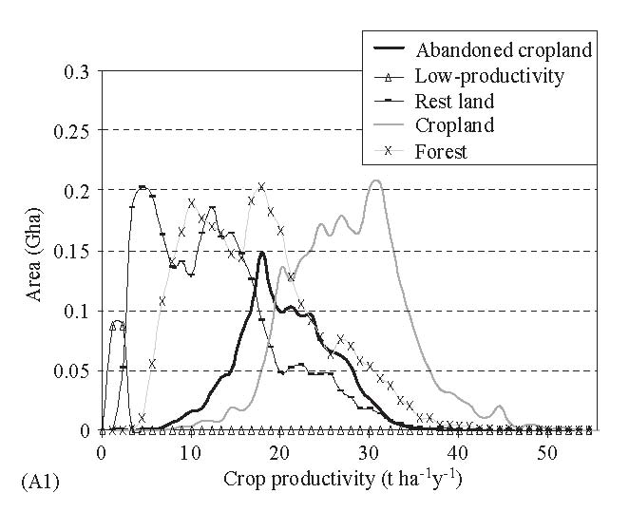
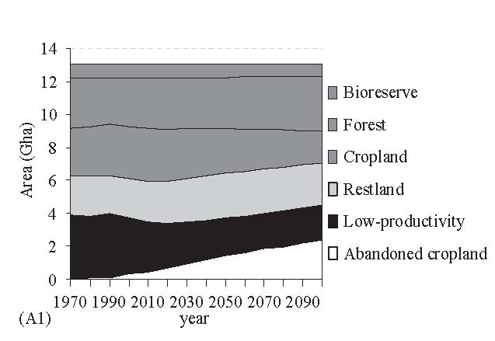
Planning Bio-energy Options-
Information needs
Hoogwijk et al. 2005 Potential of biomass energy out to 2100, for four IPCC SRES land-use scenarios. Biomass and Bioenergy, 29:225-257

Slide 13
Relevant CCSP research
Ecosystems – (Yield)
  Potential consequences of global change for ecological systems – productivity, disturbance
Land use/Land-cover Change (Land availability)
  Drivers of land-use and land-cover (LULC) change
  Future patterns of LULC
Human Contributions and Responses to Environmental change (Demand)
  Changes in energy demand
  Changes in diet and fiber demand
  Changes in population and location of population
  Technology adoption
And of course predicting climate

